Slide 1
5G-GOVSATCOM Seamless Handover NTN-TN
From mission-critical 5G continuity to 6G TN-NTN integration
Miguel Ángel Vázquez, Ph.D
Head of Space and resilient communications and systems unit head

Slide 2
Why TN/NTN handover matters?
Future resilient communications will depend on seamless operation across terrestrial and non-terrestrial domains.
Coverage extension alone is not enough; users need continuity of service.
For public safety, governmental, and critical infrastructure users, disruption during access transition can be unacceptable
TN–NTN handover is a key enabler of secure, resilient, and sovereign communications architectures
Solving this in 5G is a necessary step toward native integrated 6G TN–NTN systems

Slide 3
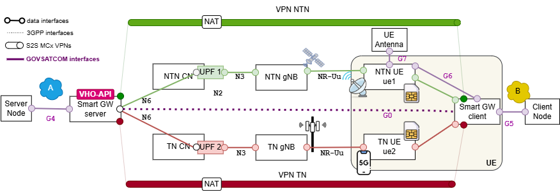
5G-GOVSATCOM: proving TN–NTN continuity for mission-critical services
A VHO is a procedure started when TN (NTN) coverage/service is not good, while NTN (TN) coverage/service can provide an alternative.
A VHO is more than a normal HO since it changes not only the access (PHY and MAC) but also the network, thus requiring IP layer mobility. This is addressed today in 5G systems using tunneling schemes (i.e., basically using VPNs).
There are some examples in the literature dealing with VHO between terrestrial systems (e.g., WiFi and 5G), but the VHO topic in the context of 5G TN and 5G NTN has not yet been addressed well.

Slide 4
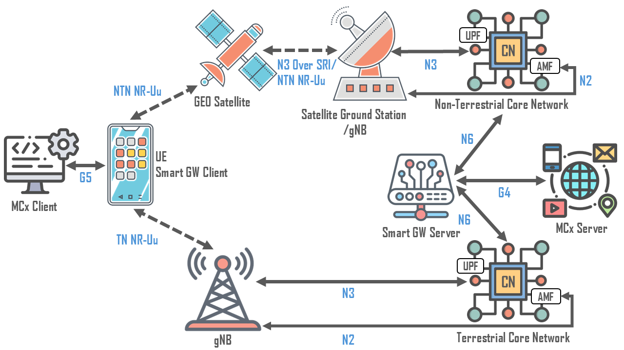
Architecture for continuity
Non-interoperable CNs of TN and NTN
Interoperable CNs of TN and NTN
Unified CN for both TN and NTN

Slide 5
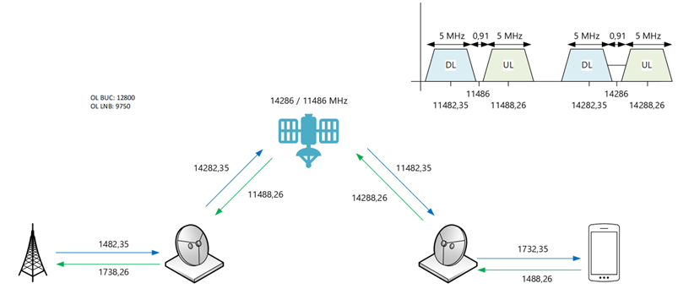
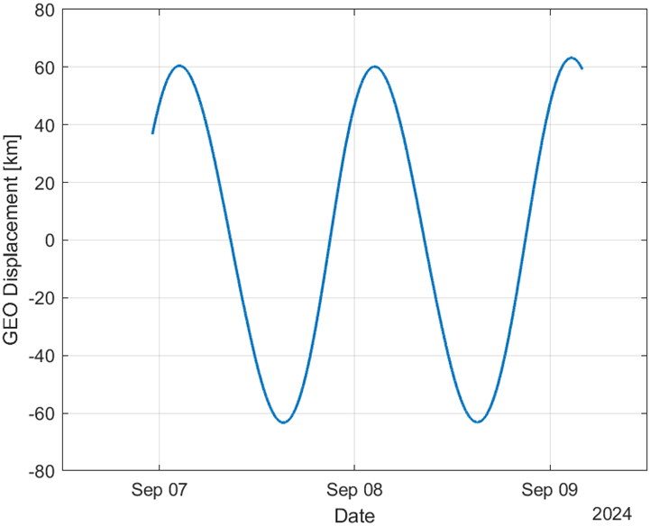
NTN UE
In other on going problems, CTTC developed the Rel. 17 adaptations in the UE and they have validated in GEO fixed services in Ku.
Important aspects:
Uncertainty of the GEO position and variation, required specific RA procedure.
The SCS and the UE architecture supported phase noise mask.

Slide 6
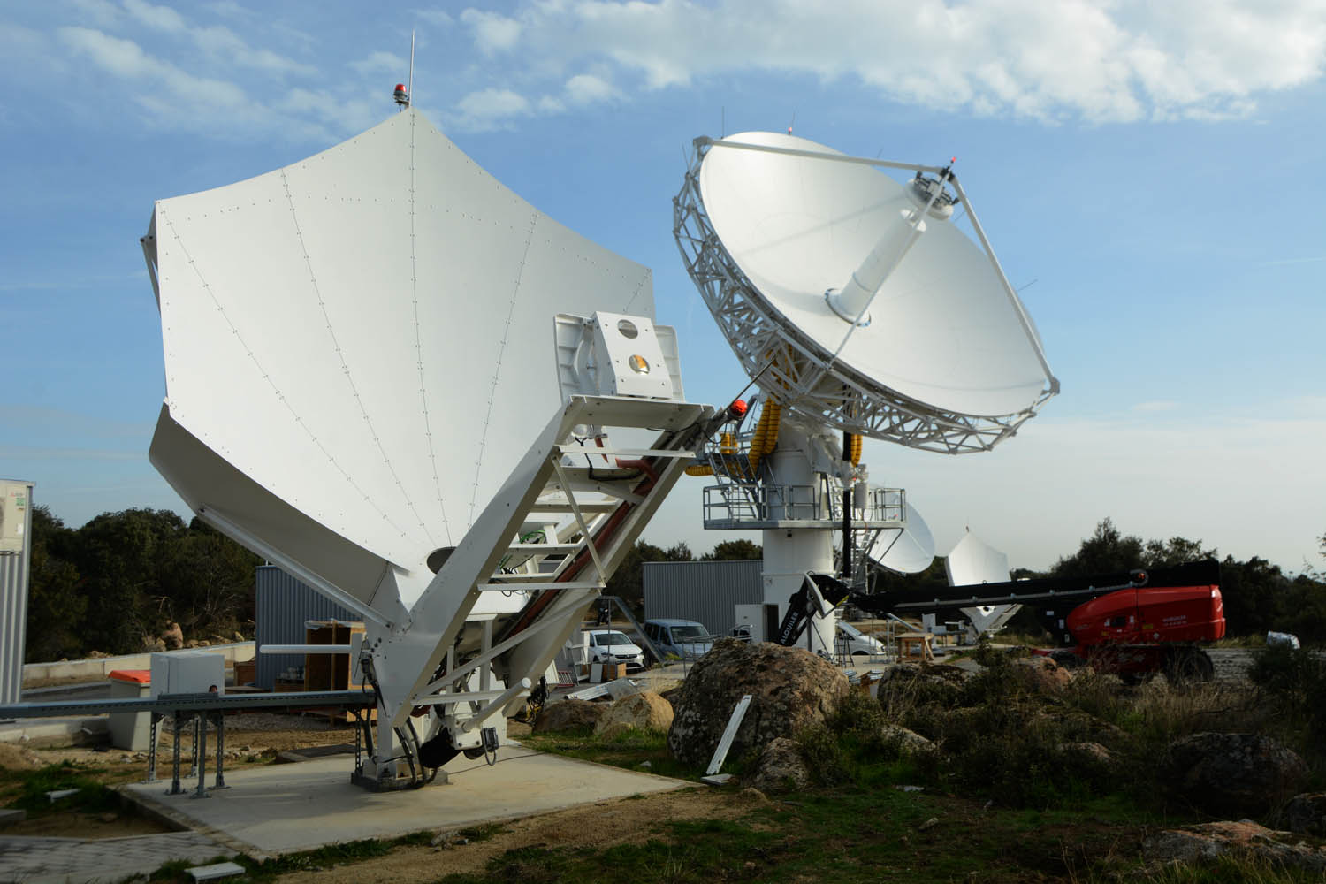
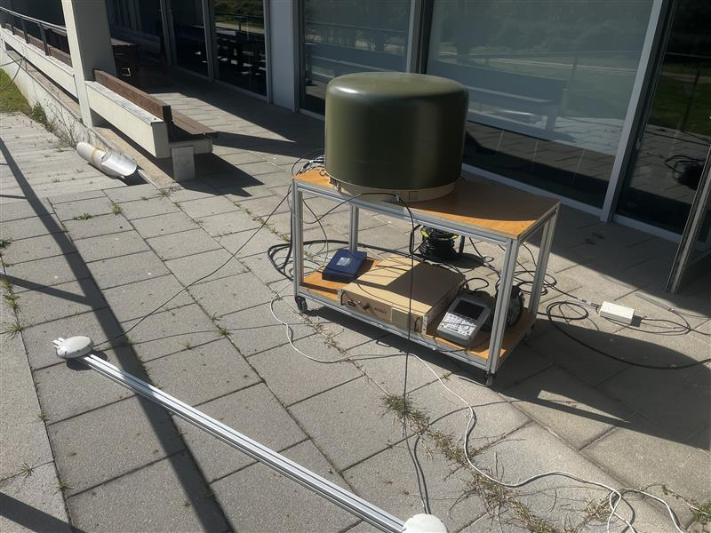
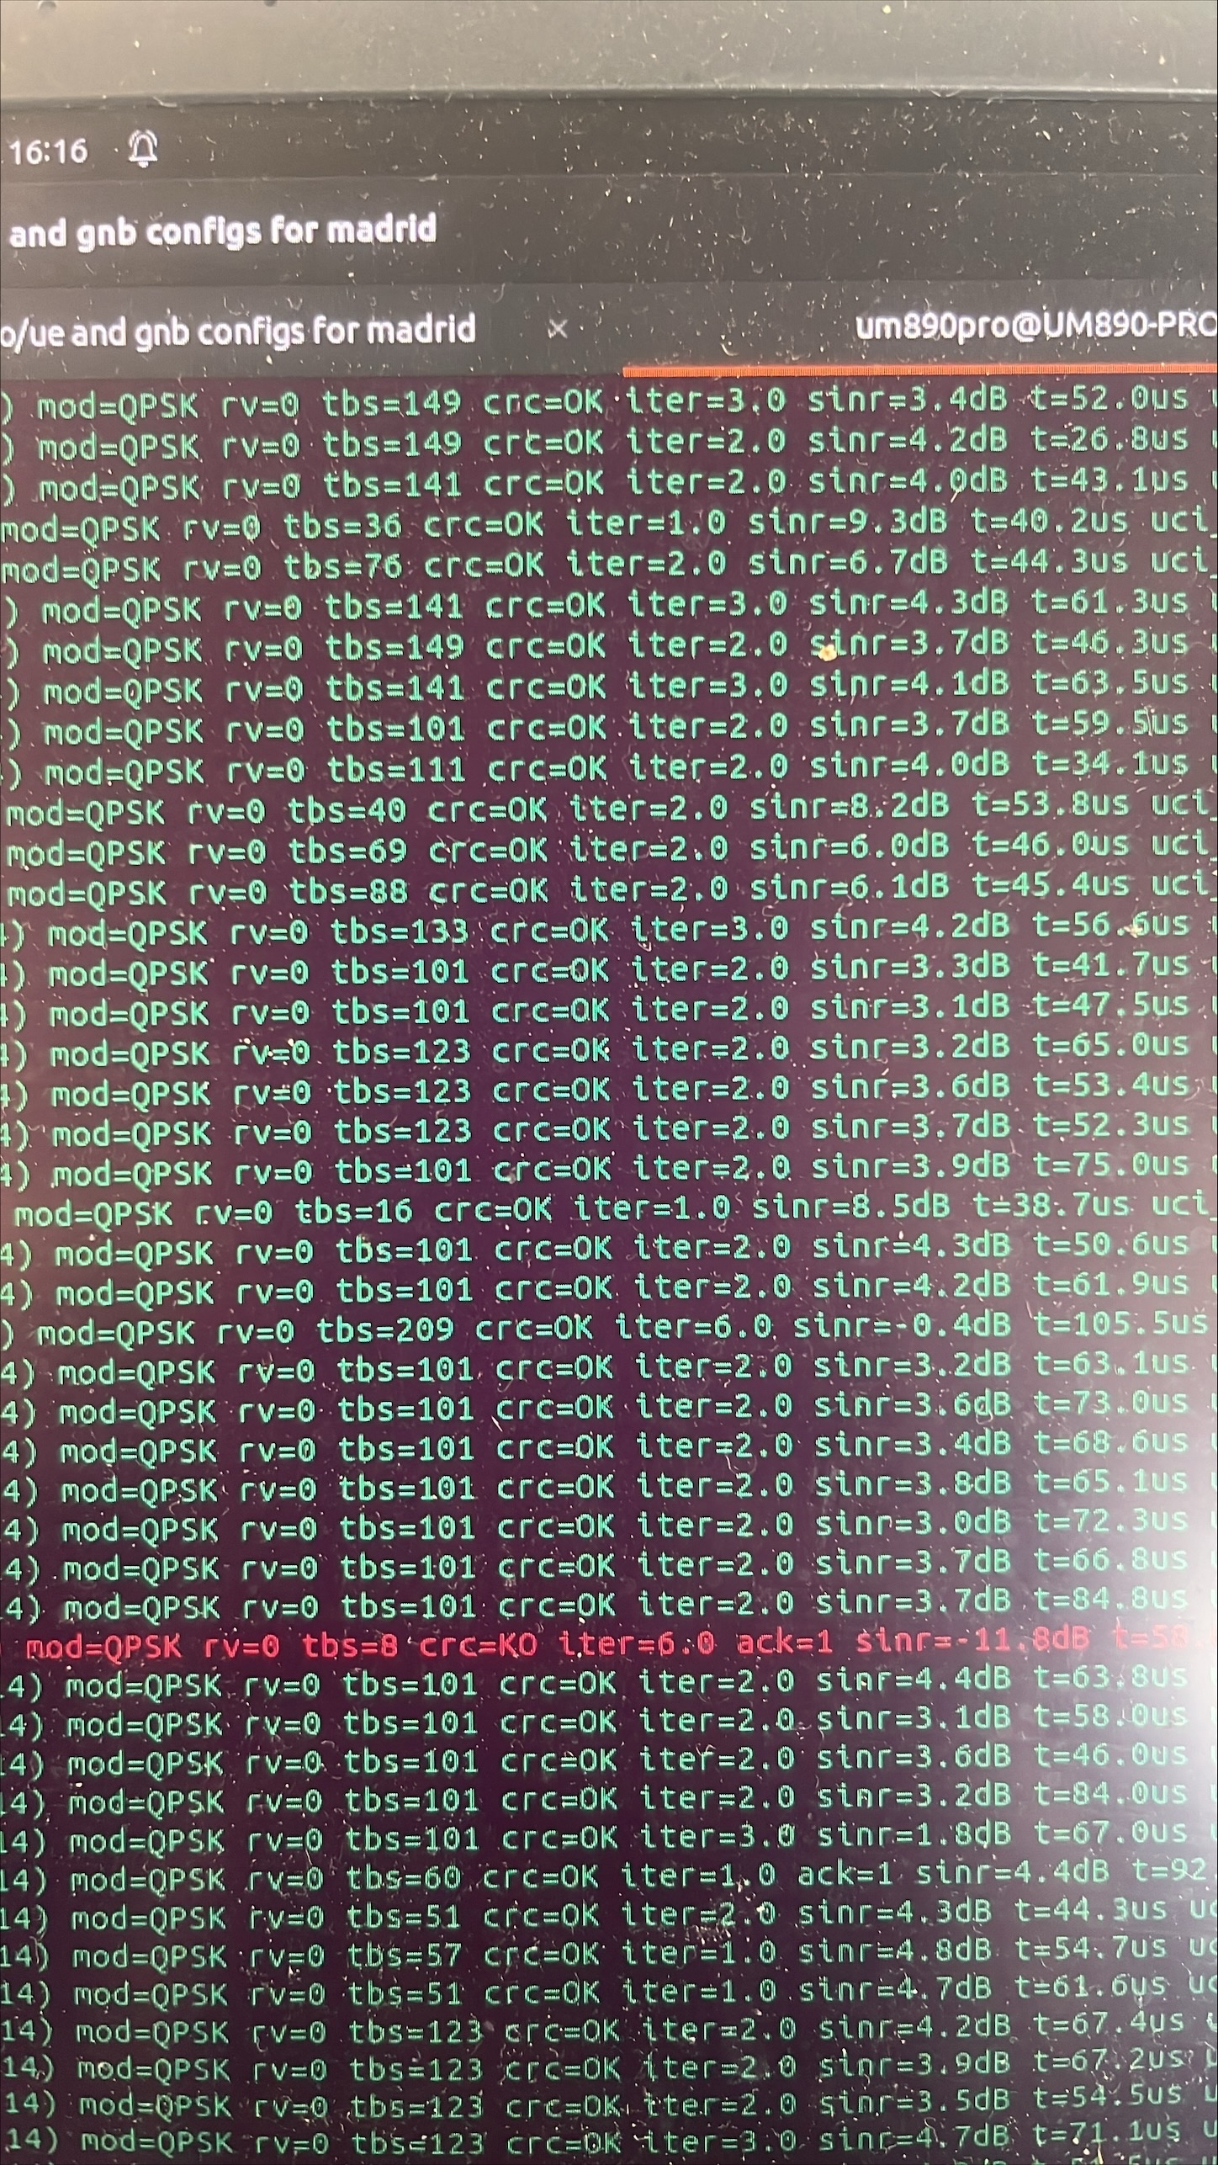




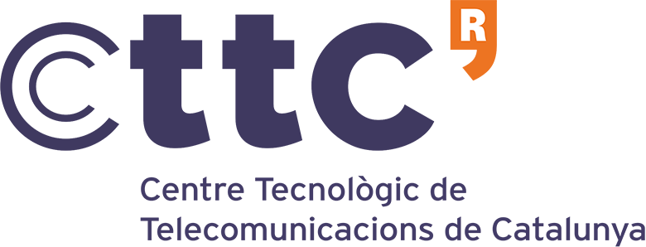
“First” 5G connection over SPAINSAT NG in X-band

Slide 7

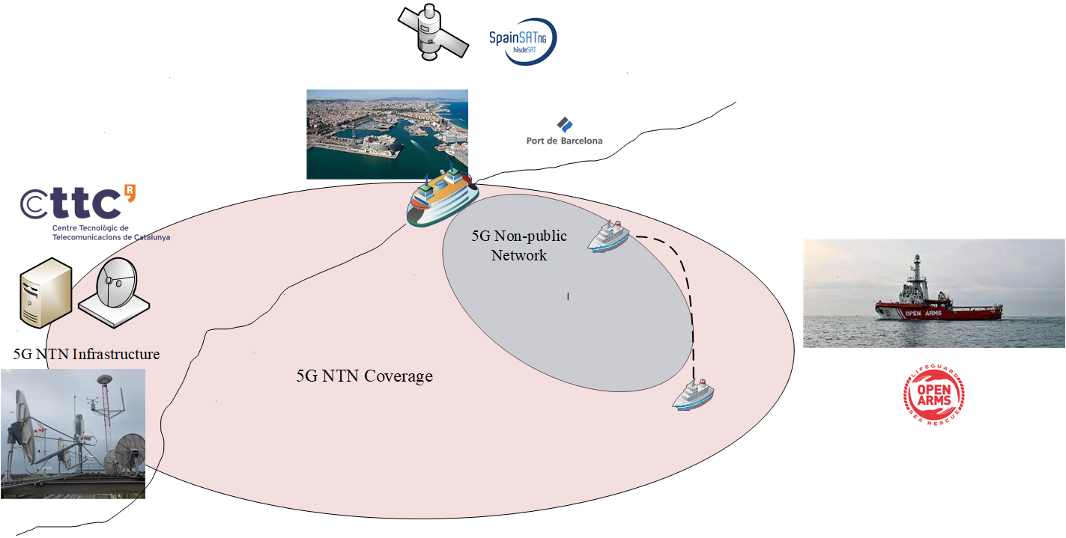
Next steps

Slide 8
Next Initiatives

Slide 9
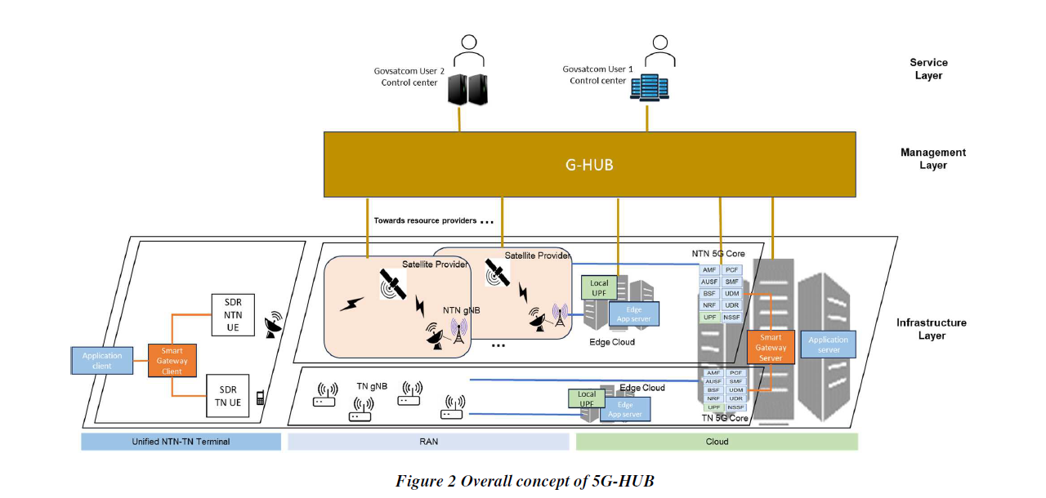

GOVSATCOM-HUB and 5G

Slide 10
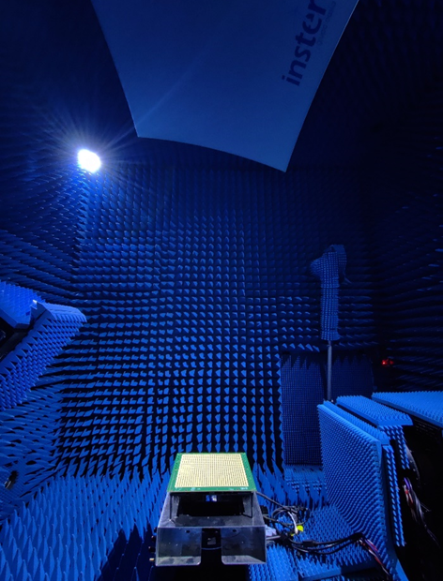



NB-NTN in Ka band
In Rel. 18, 3GPP agreed to consider FR1 and FR2 numerologies option for the operation of Ku band.
Our Proposal: extend the use of FR1 numerology in Ka band.
Pros: longer time symbols yield to simpler time tracking, reduced B adequate for small terminals, there are already baseband FR1 chipsets!
Cons: short SCS impacts CFO estimation, reduced attainable rates per reduced B.
Currently: being tested with a phase-array and GEO Ka band antenna.
Good trade-off for constrained terminals.

Slide 11
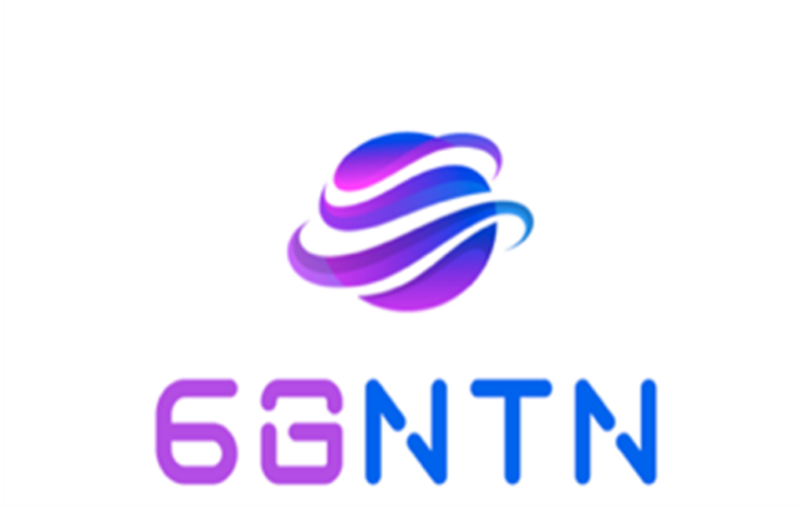

6G-NTN

Slide 12

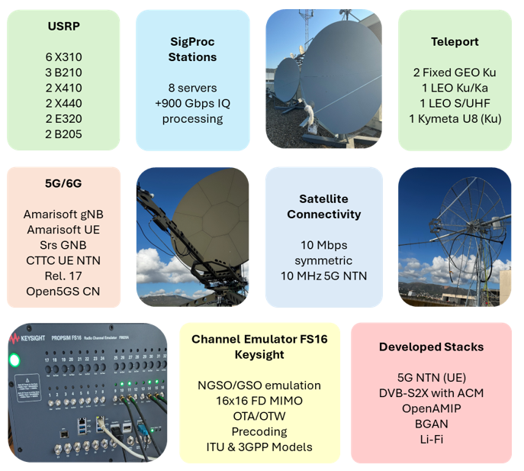
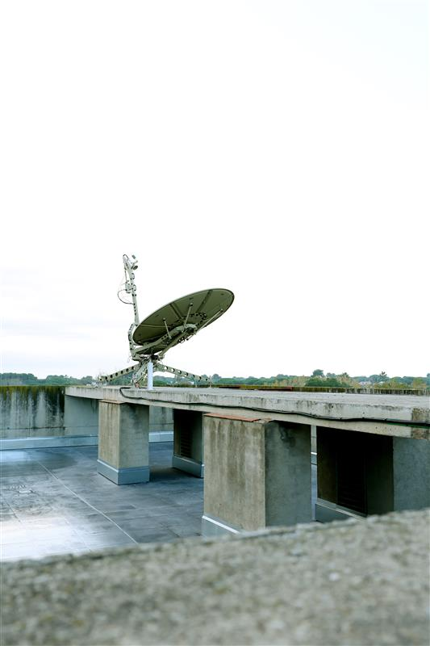
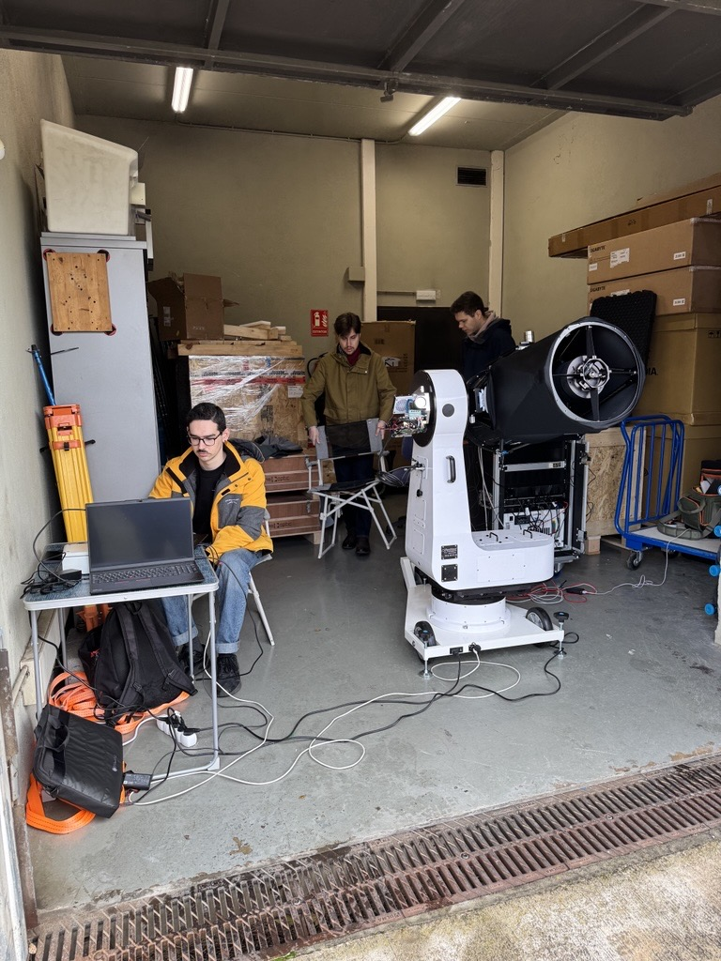
Lab by CTTC
End-to-end testing for TN/NTN OTA handover validation.
NGSO/GSO gateway antennas and Channel emulator.
Optical FSO turbulence table testing.

Slide 13
SRCOM
We build and harmonize terrestrial and non-terrestrial networks to ensure critical, resilient, and secure connectivity.
Satellite Network of Experts VI: 1.8M€ (ESA). Flagshit low-TRL ESA SatCom project. Project coordinator.
AI-GOVSATCOM: 0.6M€ (ESA). Design of AI traffic prediction model for GOVSATCOM. Project coordinator.
LEO-TEST: 0.2M€ (IRIS2). gNB in-space development. Rol: Technical support.
TRANTOR: 4M€ (Horizon Europe Space). Development of 5G/6G technologies. Project coordinator.
5G-GOVSATCOM: 2M€ (EUSPA). Field trials in E2E X band NTN/TN system. Project coordinator.
5G-HUB: 4M€ (EUSPA). Integration of 5G-NTN and GOVSATCOM-HUB. Rol: Technical coordinator.
ABACO: 0.2M€ (PTE). Development of a 5G terminal NTN a for LEO Ka. Technical support.
Personnel:
14 tenured researchers ( 11 Seniors).
1 Engineer.
3 Ph.D students.
2 Msc/Bsc.
Budget:
2025: 3.3 M€ (1.7 M€ equipments, 0.7 M€ ESA and industry contracts).
14 NTN active projects

Slide 14

