Slide 1

Machine Learning at the Edge:
Enhancing EMSO Effectiveness Through Lightweight, Continually Trained RF Models
Presented By:
Eric Mason, Ph.D., Principal Data Scientist, Special Projects
October 16, 2025
AOC Asia
FOR PUBLIC RELEASE

Slide 2
Agenda
Cognitive RF Systems for EMSO
HE360 Cognitive System
Hybrid Cloud/Edge Computing
Case Studies
Conclusions

Slide 3
Cognitive Electronic Surveillance
Cognitive RF systems sense and respond to a complex and changing electromagnetic environment

Slide 4
EMSO in a Congested Environment
Electromagnetic Spectrum Operations (EMSO) consists of observation and exploitation of the EM environment to inhibit the adversary's communication and radar utilization
The spectrum can be congested by red and blue-force emissions causing
  Increased co-channel interference
  Blue-force jamming
  Processing complexity
Operations are further challenged by complex cognitive radars possessing complex emissions and behavior
Notes:
The electromagnetic spectrum has become increasingly contested and congested.
Adversaries are using more sophisticated jamming and deceptive tactics.
Tactical operators often face decision-making in degraded or denied environments.
Traditional ground-based processing can’t keep pace—edge AI is needed.

Slide 5

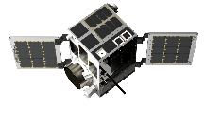
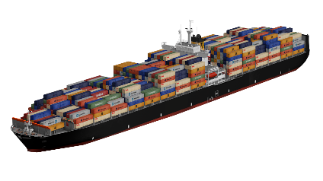
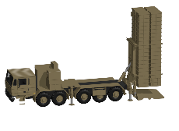
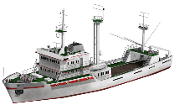
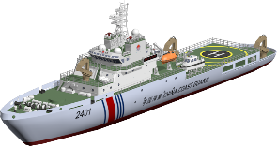

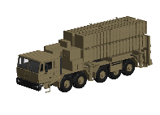
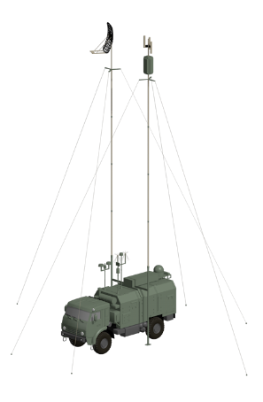

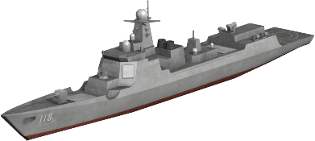
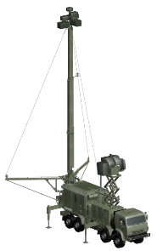
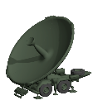
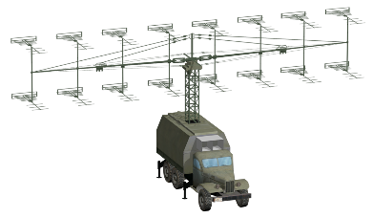
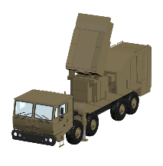

Concept of Operations
© 2025 HawkEye 360 Inc.
PROPRIETARY AND CONFIDENTIAL
5

Slide 6
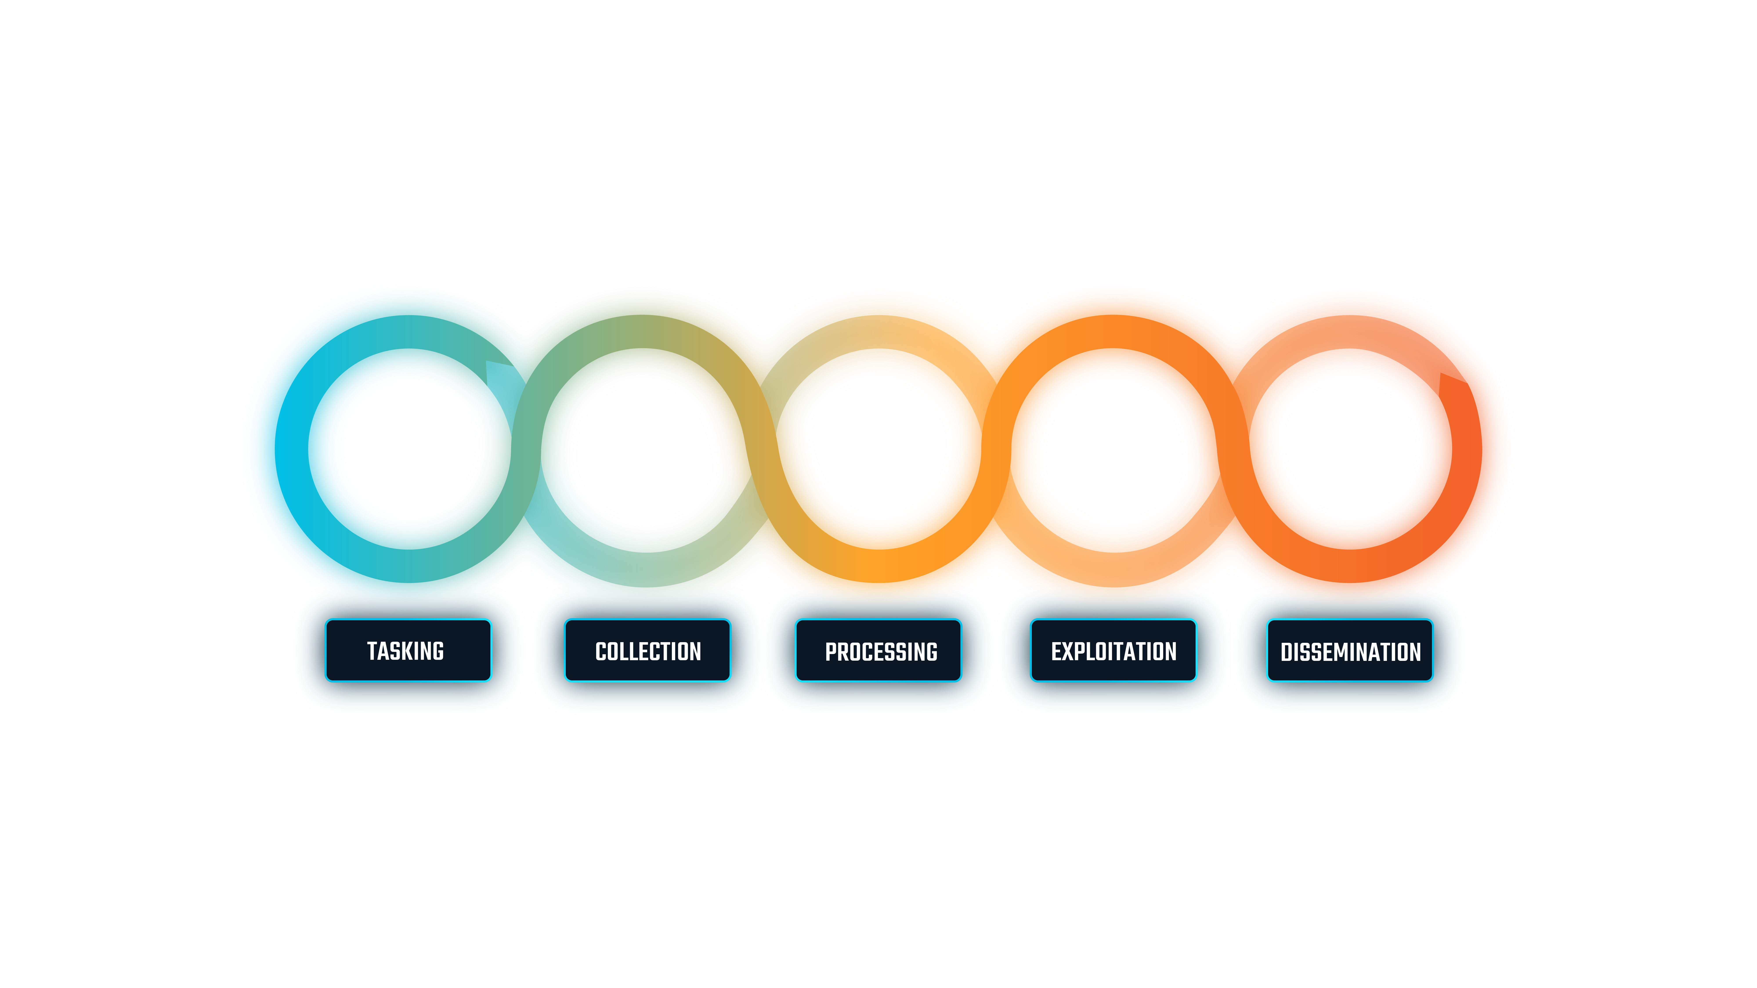
Task, Collect, Process, Exploit, Disseminate (TCPED)
The HE360 system implements the TCPED process for GEOINT
Select location, time, system and configuration
Measure data and downlink for processing
Detect, Deinterleave and geolocate
Identify and Track
Deliver emitter information
Each step in the process can leverage ML and AI to enhance operation

Slide 7
Cognitive RF Systems
"Closing the loop" in the TCPED process naturally follows the action-perception cycle making a cognitive RF system
Collect Sensor Measurements
Processing and Exploitation of measurements using signal processing and data science
Thousands of RF signals from radars, comms, and EW across 500 MHz – 18 GHz
Perception
EM Environment
Learning
Update location, time, frequencies, system configurations, and onboard processing algorithms
Action
Feedback
Disseminate Insights
Generate new configuration and Task a collection

Slide 8
Hybrid Cloud/Edge computing

Slide 9
AI & ML at the Edge: Why It Matters
Processing on the edge reduces latency from hours to minutes
  Enables real-time decision making and support measures for EW systems
Reduces data downlink for better utilization of data budget
  Smaller downlink size provides increased sensing time
Processing on the edge enables a faster perception-action cycle
  Optimize and update processing and exploitation algorithms can happen in (near) real time

Slide 10
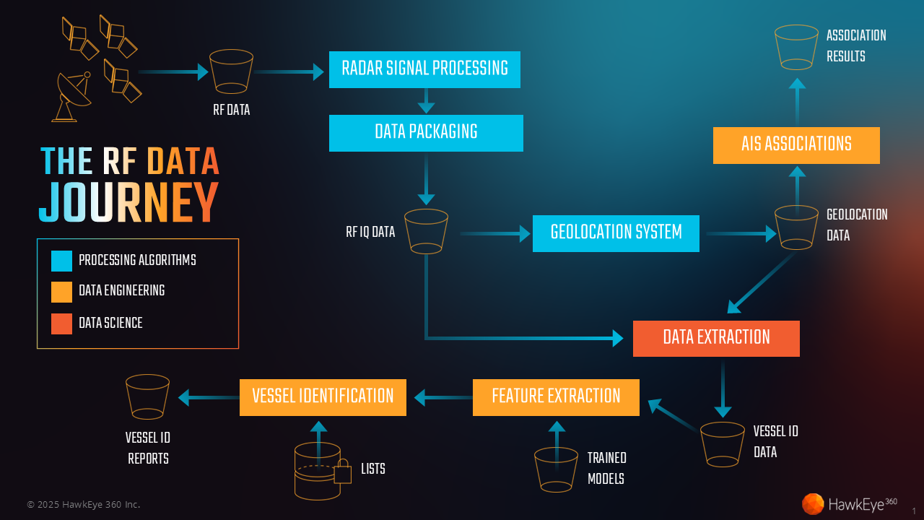
Training models and ops
Diagram showing training flow and deployment to edge hardware
Notes:
Edge deployment requires efficiency in both compute and memory.
Models are streamlined while maintaining accuracy for RF classification and geolocation.
Emphasis on pruning, quantization, and architectural simplification.
Example: shifting from large CNNs to efficient 1D convolutional or transformer-lite approaches.

Slide 11
Hybrid Cloud / Edge compute
The TCPED system is a hybrid Edge/Cloud
  Most processes running on a single receiver can be moved on edge
  Compute-intensive processes or those that fuse data from multiple receivers run in the cloud
Moving processing onboard into the payload depends on:
  Size, Weight, and Power (SWaP) of the platform
  Compute devices, such as FPGA, ARM, or NVIDIA Jetson
  Mission goal and requirements
Focus on the radar signal processing and feature extraction generation
  Detection, Deinterleaving, and modulation/mode classification are most desirable
  Enables real-time decision making for EW applications

Slide 12
Designing Lightweight ML Models
Architecture depends on the memory of the onboard compute device
  NVIDIA Jetson are popular options, optimized for ML inference, and inexpensive
      NVIDIA Jetson AGX Orin with 64GB at 60W
      NVIDIA Jetson Orin Nano with 4GB at 7-25W
  FPGAs are a more versatile option with higher price tags
Utilize edge-specific architectures with small memory requirements
  ResNet6 and EfficientNet work well for constrained RFML tasks
Perform pruning and fine-tuning to reduce network size before deployment

Slide 13
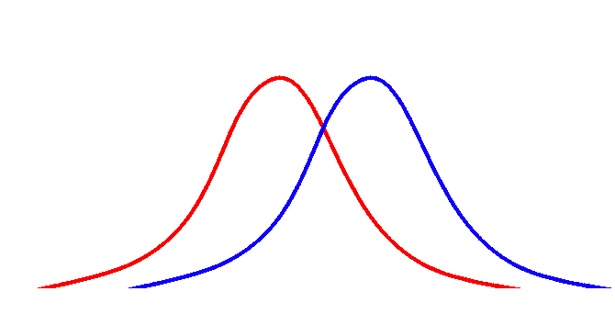
Continual Learning in Dynamic RF Environments
Changes in the RF environment data manifest as a distributional shift of the data and can result from
    Presence of new signals not in the training data
    Different RF collection systems
Solve this challenge with continual learning
    Update models on the edge with online batch gradient updates
    Use fine-tuning methods to adapt the model with data from the new environment
    Update the entire model
The best approach is application dependent
Training Data Distribution
Environment Data Distribution
Distributional Shift
Notes:
RF environments are dynamic—signals change by geography, time, and adversary tactics.
Static models degrade quickly.
Continual learning allows models to adjust with incremental updates.
Think of it as “living models” that evolve alongside mission needs.
Key challenge: ensuring updates don’t destabilize prior performance.

Slide 14
Identification and tracking
The HE360 Cognitive system supports the identification and tracking of RF emitters

Slide 15
Emitter Identification and tracking
Emitter Identification is the capability to provide an identity for a geolocated emitter
  Leverage historical data, labeling algorithms, and Deep Learning methods
Tracking refers to persistent re-identification over multiple collections
  Algorithms fuse USR, radar features, and multi-modal intelligence to predict emitter identity
  Clustering is used to label geolocations, associating groups of them with a single emitter
  When emitters are associated with vessels - using AIS, imagery, etc. - we get vessel tracking

Slide 16
Unique Signal Recognition (USR)
Uniquely identify MNR Radars using HE360 built RF Foundation models
  Leveraged state-of-the-art architectures, training methods, and ML engineering best practices
  Trained on 100+ TB of X/S-band IQ data collected over 5+ years
A Core capability that enables identification and tracking of vessels using their Maritime Navigation Radars (MNR)
The USR model predicts the identity of each geolocation
Emitter B
Emitter A
USR Model
Emitter C
Geolocations
Emitter D

Slide 17
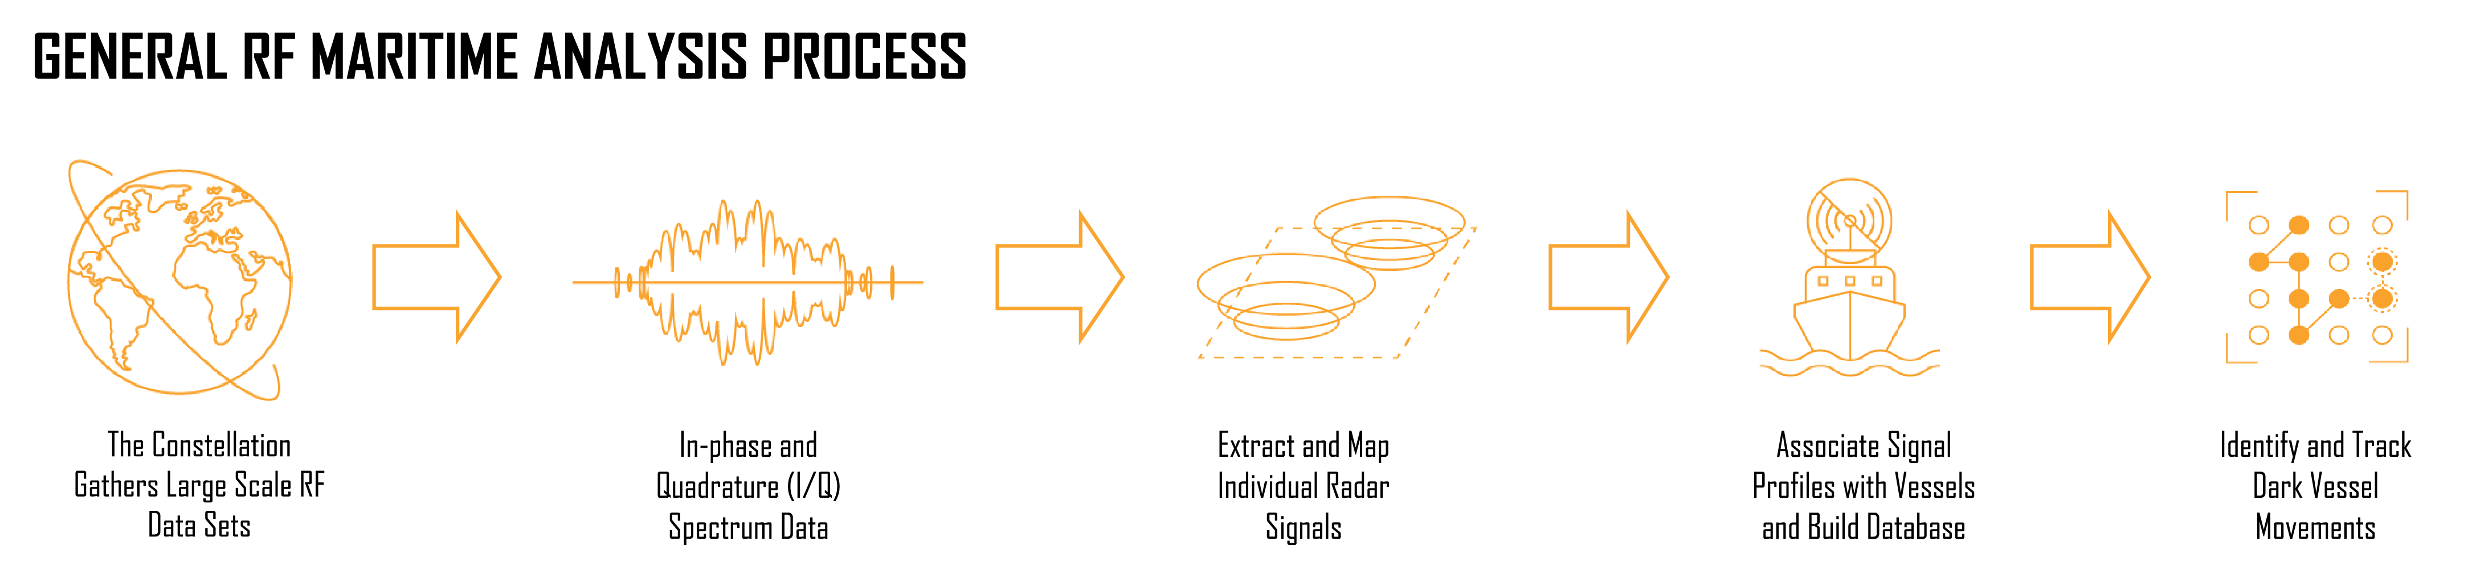
Complete rf maritime process
Application of identification and tracking to maritime domain awareness leads to the General RF Maritime analysis process

Slide 18
Case studies

Slide 19
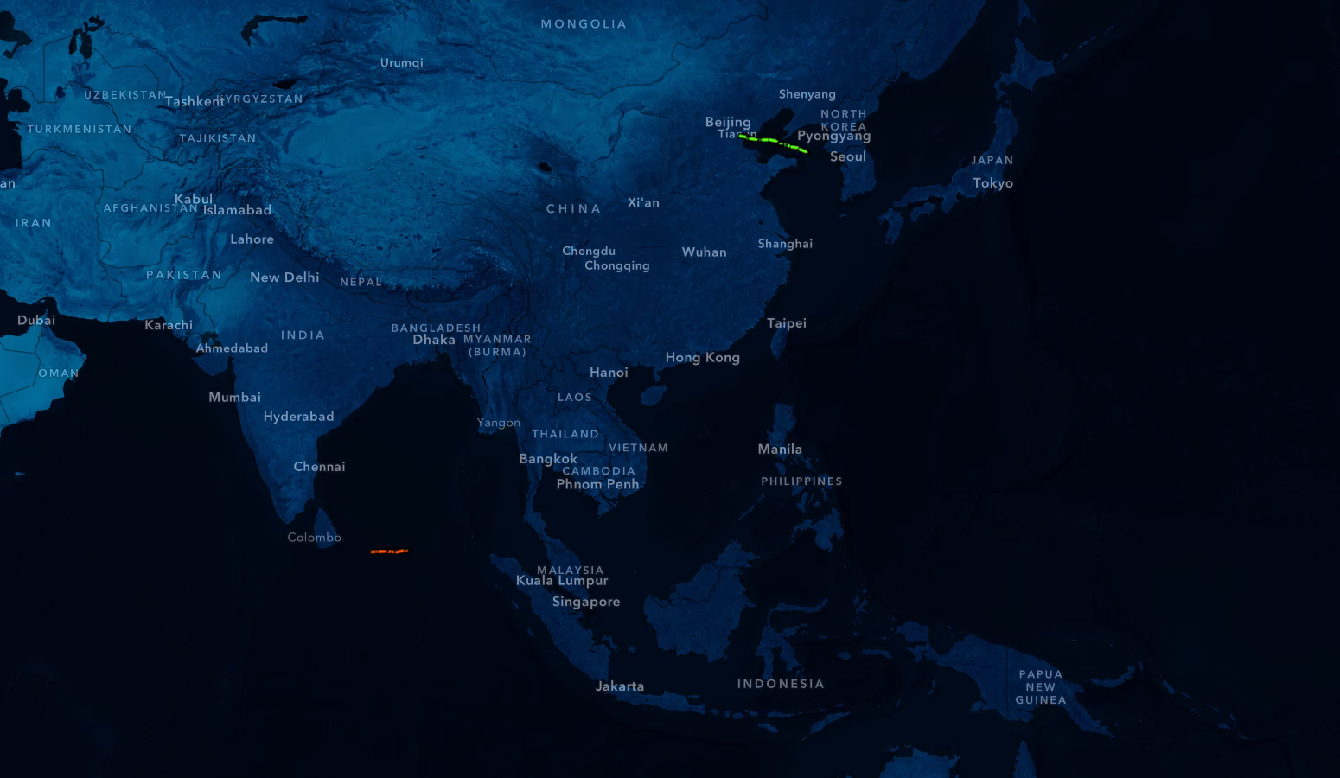

ITAGUA AND SHANAYE QUEEN MEET NE OF Johor
N
SE HEMISPHERE
On July 25, AIS records indicate Itagua began travelling through the Arabian Sea into the Bay of Bengal where HawkEye was conducting RF collection campaigns. HawkEye’s Vessel Identification analytics independently detected and identified the vessel by recognizing its radar characteristics three separate times as the vessel made its way to the strait.
On August 6, AIS records indicate Shanaye Queen left port in China and traveled southwest through the South China Sea. HawkEye 360 independently detected and identified the vessel using its radar characteristics six separate times.
HE360 RF: Itagua
HE360 RF: Shanaye Queen
AIS: Shanaye Queen
AIS: Itagua
PUBLIC RELEASE

Slide 20
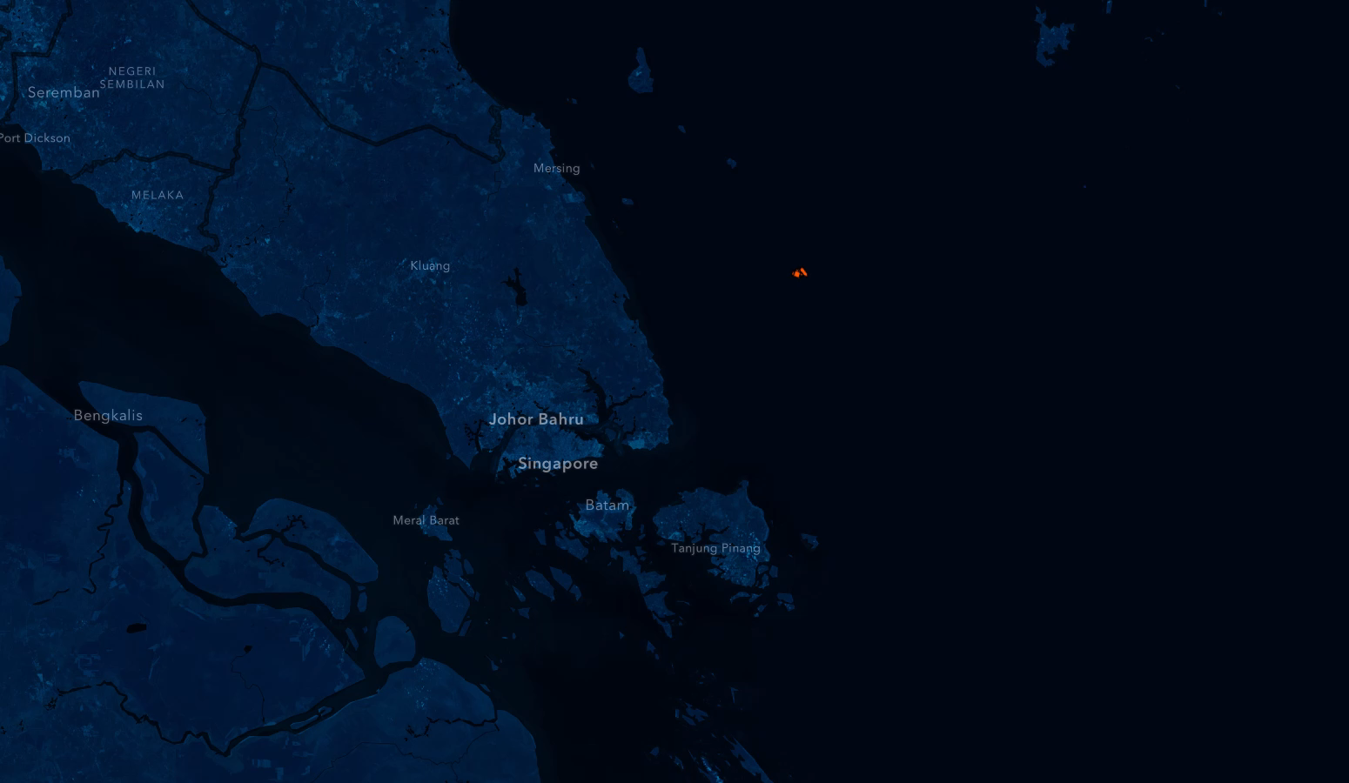
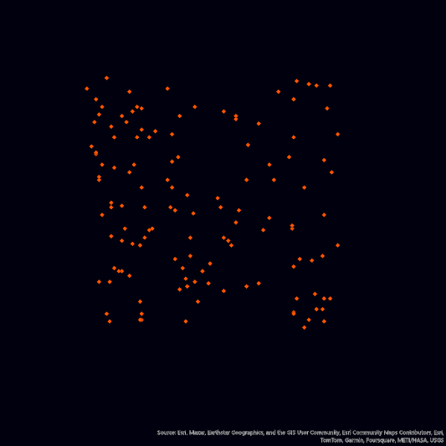
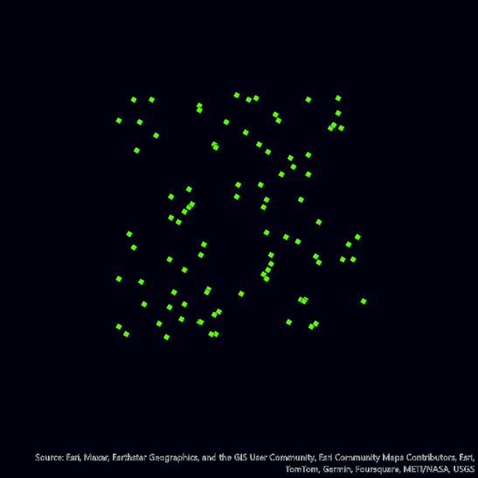
APPARENT AIS SPOOFING BEHAVIOR
N
STRAIT OF MALACCA
Itagua anchored on August 15 northeast of Johor, Malaysia. Shanaye Queen proceeded past Itagua’s location and stopped in Singapore for a port call.
As Shanaye Queen begins her return voyage from port, Itagua began transmitting strange AIS behavior, highly indicative of AIS spoofing.
On August 21, Shanaye Queen began to approach Itagua’s location. Starting the next day on August 22nd, Shanaye Queen starts to exhibit similar signs of AIS spoofing approximately 12.72 km away from Itagua.
~12.72 km
HE360 RF: Shanaye Queen
AIS: Shanaye Queen
AIS: Itagua
PUBLIC RELEASE

Slide 21


Dark Ship to ship Transfer
N
NE OF JOHOR, MALAYSIA
Around the same time frame, HawkEye 360 detected multiple marine radars just north of the two spoofed locations. Using Vessel Identification analytics, HawkEye established with high confidence that the radars match the RF characteristics of Itagua and Shanaye Queen.
Now that the precise locations of these vessels were established, HawkEye analysts were then able to reference Planet imagery to corroborate that the two vessels were conducting dark ship-to-ship operations. Furthermore, analysts also referenced imagery in the two locations of apparent AIS spoofing and confirmed no ships were present at the time they were reporting.
Following the exchange, Shanaye Queen returned to port in Beijing and Itagua returned to port near Dubai.
Probable
ITAUGUA
340m
Probable
SHANAYE QUEEN
249m
HE360 RF: Itagua
HE360 RF: Shanaye Queen
AIS: Shanaye Queen
AIS: Itagua
PUBLIC RELEASE

Slide 22
Questions?
Lightweight, continually trained ML models are reshaping EMSO effectiveness at the tactical edge
Contact Info
Eric Mason, Ph.D.
Director of Data Science, HawkEye 360
Eric.Mason@HE360.com
571-203-0360

