Slide 1


SATELLITE CONNECTIVITY:
Enabling Enterprises & The AI-Powered Network of the Future
Notes:
Steve
Good morning everyone. Thank you for being here. I’m Steve Rome, co-founder and CRO of Advantage Communications Group and I’m joined today by my Sr. Solutions Architect, Jason Pennell.
Satellite connectivity is at a very familiar stage in enterprise technology.

Slide 2



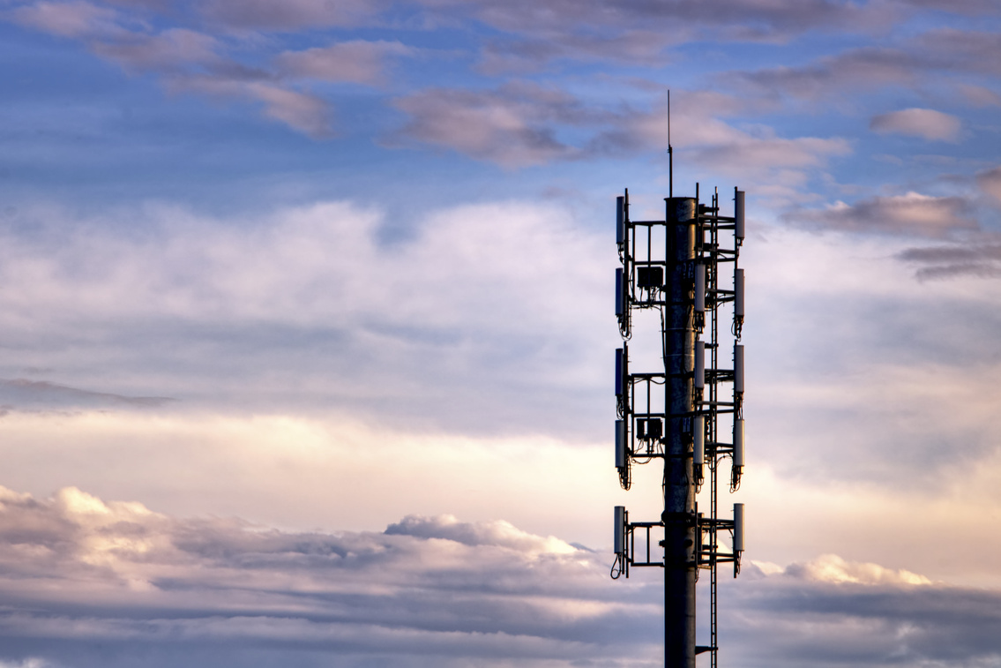
The Ever-Evolving World of Connectivity
There was a time when copper ISDN lines were the reliable backup, and broadband was the last resort. LTE was once dismissed as well, for either being too expensive or for not providing adequate performance.
Now, we’re seeing history repeat—this time with satellite connectivity. But the narrative is changing fast. Satellite is emerging not just as a viable alternative, but as a critical foundation for next-generation connectivity.
Skepticism
Adoption
Dependency
2026
Satellite
Over 10,000 constellation satellites have been launched into low Earth orbit
1988
2009
Copper ISDN
LTE
The original “Gold Standard” for dedicated, synchronous business connectivity and mission-critical failover.
The beginning of the world’s first public LTE network operations
Notes:
Steve
Every major shift in enterprise connectivity follows the same pattern.
First, it’s dismissed.
Then it’s tolerated as backup.
Eventually, it becomes essential
ISDN was once a reliable standard when broadband was considered risky
LTE was too expensive, inconsistent, and not enterprise grade
Satellite is at that exact inflection point right now.
What makes this shift different isn’t just the satellite technology but also the pressure enterprise networks are under.
Today we’re going to talk about why satellite is no longer a niche backup solution and what it means for enterprise and AI-driven networks. Jay, walk us through what actually changed.

Slide 3


New Satellite Standards: What’s Changed?
MEO
1,243 – 22,236 miles
~125 ms latency (RTT)
Moderate fleet size (12-24)
GPS navigation/High-throughput
GEO
LEO
22,236 miles
600+ ms latency (RTT)
Single-point presence
TV Broadcasting/Backup-only mindset
300 – 1,200 miles
~20-50 ms latency (RTT)
Massive network density (100-1000)
Internet/Active path
Notes:
Jay
Sure thing, Steve. When most people think satellite, they’re probably still picturing yesterday’s architecture.
Traditional GEO satellites orbit roughly 22,000 miles above Earth. That distance creates latency in the 600 ms and above range. That model absolutely limited enterprise use.
There is also a MEO satellite technology used for applications such as GPS navigation but,
What’s changed is Low Earth Orbit or LEO satellite technology. These satellites operate a few hundred miles above Earth and latency drops into the 20 to 50 ms range. That’s comparable to terrestrial broadband in many scenarios, which makes it much more usable to enterprises.
But it’s not just latency. It’s dense constellations. It’s ground station diversity. It’s redundancy by design.
This wasn’t a gradual improvement. It was a step change and this step change is colliding with a major shift in enterprise demand.
So Steve, what’s driving the shift?
GEO = Geosynchronous Orbit
MEO = Medium Earth Orbit
LEO = Low Earth Orbit

Slide 4

Why Satellite Is Becoming Enterprise-Relevant
1. The Meteoric Rise of AI
2. True Global Accessibility
3. Performance Equality
Everyone wants better, faster internet connection to support the latest AI applications.
Other connectivity technologies can’t reach remote areas the way that satellite can.
The gap between satellite and today’s leading internet technologies is rapidly closing.
Notes:
Steve
Satellite is becoming relevant again for a very simple reason: the way enterprises use networks has fundamentally changed.
Three major forces are making satellite relevant to enterprise networking again.
First is the rise of AI-driven applications. AI workloads are expanding beyond data centers into factories, logistics hubs, and field operations.
Second is the reality that infrastructure gaps still exist. Many enterprise locations operate far beyond dense fiber footprints.
And third is the technology shift itself. LEO constellations have dramatically improved latency and reliability.
Those three trends together are what’s pushing satellite from backup connectivity toward architectural relevance.
And that shift is happening because the role of the network itself has changed.
The network used to be about connecting buildings. Now it’s about connecting operations.
Downtime used to be inconvenient. Now, it’s a business interruption. It’s revenue impact. It’s production downtime and a poor customer experience.
The tolerance for ‘best effort’ connectivity is disappearing and that’s where satellite starts to become strategic.

Slide 5



AI-Aware Networking
AI Workloads
Edge AI
Satellite
Latency-sensitive
Always on
Location agnostic
Moving away from data centers
Bandwidth efficient
Real-Time action
Fills the last-mile gap AI exposes
Notes:
Jay – AI Workloads -> Edge AI Expansion -> Connectivity Demand = Satellite fills the gap
Exactly. And AI doesn’t just increase bandwidth demands, it fundamentally changes availability expectations.
AI workloads don’t care where your site is located or where your users are. It cares whether the network shows up, every time.
Historically, remote locations meant limited intelligence because everything had to flow back to centralized data centers, but that’s changing with Edge AI.
Instead of sending all data back to a central cloud for analysis, organizations are increasingly running AI models directly at remote locations.
That includes things like computer vision in logistics hubs, predictive maintenance in industrial facilities, and AI-assisted field operations. These systems don’t pause when fiber drops.
They still need connectivity to update models, synchronize data, and integrate with enterprise platforms.
Satellite helps ensure those edge environments remain connected even when traditional infrastructure isn’t available.
It closes the gap between a once disconnected edge into AI-capable edge and when you combine that with intelligent routing, satellite stops being backup connectivity and starts becoming part of the architectural strategy.

Slide 6


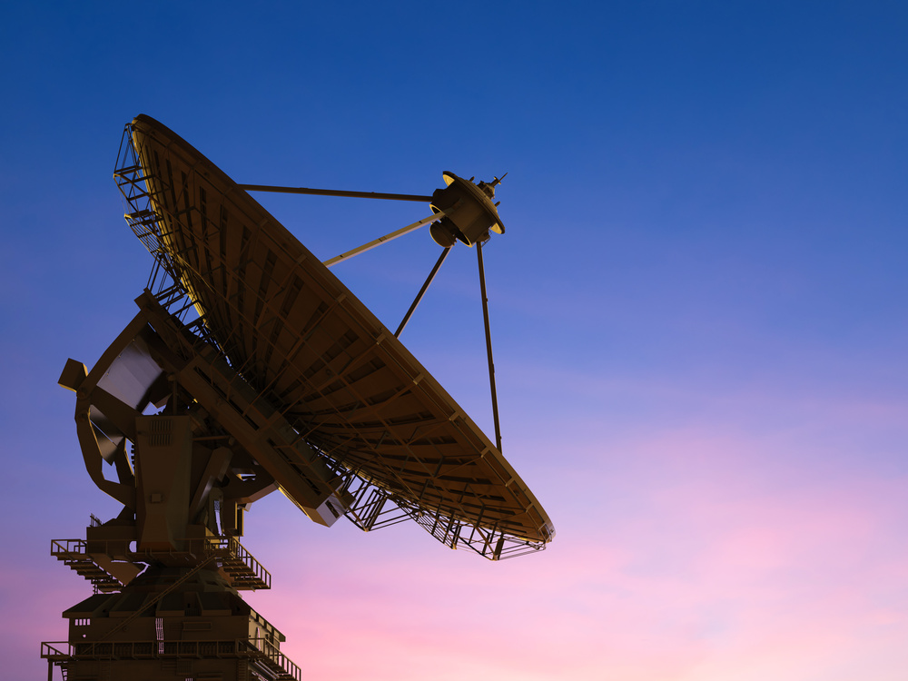

Principles of Modern Enterprise Connectivity
Diversity
Control Plane
Intelligence
Security
AI-Aware Traffic Engineering
Notes:
Jay
The shift happens when satellite stops being a last resort and becomes a policy-controlled path.
With modern SD-WAN and SASE frameworks, traffic is dynamically routed.
Latency sensitive applications can prioritize terrestrial paths.
Bulk or redundant traffic can leverage satellite with seamless failover between the multiple paths.
Satellite is more than just another connection, it’s a secure, controllable path within a broader architecture.
SD-WAN gives enterprises the ability to treat satellite like any other WAN path.
If you’re thinking about this the right way, there are four layers.
Access diversity, such as Fiber, 5G, and satellite (LEO).
Control plane intelligence. Application aware routing. Real-time path optimization.
Security. Identity-first access. Zero trust frameworks.
AI-Aware traffic engineering. Understanding which workloads require low latency, which require high throughput, and which can tolerate path variability.
So if AI changes what the network has to deliver, the real question becomes: what does the network architecture need to look like to support that?

Slide 7






Satellite in Multi-Path Enterprise Connectivity Architecture
Remote Sites
Enterprise Applications
AI – SaaS – CRM – Analytics – ERP – Voice/Collab
Intelligent Network Control
SD-WAN/SASE
Cloud and AI Platforms
Multi-Path Connectivity
Fiber/MPLS
5G/LTE
Satellite
Global Infrastructure
5G/LTE
Data Centers – Cloud – Edge Sites
Data Centers
Notes:
Jay
The most important thing to understand is that satellite isn’t replacing terrestrial connectivity.
It’s becoming part of a multi-path architecture.
Modern enterprise networks combine multiple access technologies such as fiber, cellular, and now satellite.
Above those access paths sits an intelligent control layer, typically SD-WAN or SASE, that dynamically selects the best path for each application.
In this model, satellite isn’t a backup connection.
It’s simply another controllable path in the network.
And that becomes especially powerful as AI workloads extend into locations where traditional infrastructure isn’t always available.
This is exactly where the design principles we just discussed start to come together in a real architecture.
So that’s the architecture conceptually. Now let’s look at how this shows up in a high-level network design.

Slide 8

Satellite in Modern Enterprise Network Architecture
Remote Sites
SD-WAN Edge
Cloud and AI Platforms
SD-WAN & SASE
SD-WAN Edge
SD-WAN Edge
5G/LTE
Data Centers
Fiber/MPLS
Notes:
This diagram may look a little busy but what you’re seeing here is a simplified version of what many enterprise networks are starting to look like.
On the left side you have enterprise locations such as, distribution centers, factories, energy sites, retail locations.
Those sites connect into the network through SD-WAN edge devices.
Instead of relying on a single WAN connection, those edge devices have multiple connectivity paths available like the fiber, cellular, and increasingly satellite we talked about earlier.
The SD-WAN platform continuously evaluates those paths and dynamically selects the best one for each application.
And because those paths are abstracted by the control plane, satellite becomes just another transport option within the architecture.
That’s the key shift… satellite isn’t treated as a separate network anymore. It’s integrated into the enterprise connectivity fabric.
Players like Starlink and Amazon standout but others are coming fast. It’s not about who wins the space race. At Advantage, we’ll help you figure out the right vendor at the best cost AFTER we come up with the right design. The story is how enterprises design networks that don’t care who wins.
The future network isn’t satellite-first. It’s availability-first and satellite becomes a key component of that design philosophy.
Steve, can you tell us where it’s been effective for some of our clients.

Slide 9
Where Satellite is Enabling Modern Enterprise Operations
Logistics
Industrial
Manufacturing
Lack reliable terrestrial infrastructure
Require real-time shipment visibility
Operate in remote locations
Require operational monitoring and compliance
Span regions with inconsistent connectivity
Require access to production analytics and supply chain
Notes:
Steve
Across industries, we’re seeing the same pattern. Connectivity is no longer just about access. It’s about operational continuity.
The companies adopting this approach didn’t start with satellite-first strategies. They started with connectivity and resilience problems.
Logistics companies needing uninterrupted operations.
Industrial organizations operating in infrastructure-lite environments.
Global retailers expanding into locations where fiber simply wasn’t available.
And when those organizations look for ways to extend reliable connectivity into those environments, satellite increasingly becomes part of the solution.
A good example of this is global logistics…

Slide 10

Use Case #1: Multi-National Logistics
Operational Challenge
Ports, yards, and temporary distribution hubs often lack reliable terrestrial infrastructure
Satellite Value
Maintains real-time shipment visibility and supply chain intelligence
Notes:
Steve
This massive logistics brand has a highly complex network of ports, distribution yards, and temporary logistics hubs all over the world.
In those environments, the physical movement of goods doesn’t stop when connectivity drops… but the digital visibility does.
And that visibility is critical. Tracking shipments, routing freight, and coordinating inventory, all of that depends on reliable connectivity.
Logistics networks are also constantly evolving. New hubs come online, temporary sites appear during peak demand, disaster response operations spin up quickly.
Satellite allows connectivity to move at the same speed as the supply chain.
Instead of waiting for fiber to arrive, organizations can deploy connectivity immediately and maintain real-time visibility across their operations.
Logistics is just one example. We’re seeing the same pattern in heavy industry as well…

Slide 11

Use Case #2: Global Fertilizer Manufacturer
Operational Challenge
Facilities often operate in remote locations chosen for resources rather than infrastructure
Outcomes
Enables resilient connectivity for operational monitoring and compliance
Notes:
Steve
Companies with fertilizer production and distribution facilities in locations chosen for resources… not for infrastructure.
Those environments are increasingly running connected systems such as, sensor networks, predictive maintenance models, and operational analytics. And when those systems lose connectivity, the impact is immediate.
When a production facility goes offline, it’s not a helpdesk ticket… it’s millions in operational impact.
Satellite helps bridge that infrastructure gap and ensures those remote operations remain connected to the broader enterprise network.
We are seeing the same shift in global manufacturing as well…

Slide 12

Use Case #3: International Spirits
Operational Challenge
Production sites and distribution networks span regions with inconsistent connectivity
Satellite Value
Ensures continuous access to production analytics and supply chain systems
Notes:
Steve
This client operates production facilities and distribution networks all over the world… often in locations where connectivity infrastructure isn’t always consistent.
But modern manufacturing runs on connected systems such as, ERP platforms, quality monitoring, production analytics, and supply chain coordination.
Those systems can’t simply pause when connectivity becomes unstable.
Satellite provides an additional layer of resilience that keeps those systems connected and keeps production intelligence flowing.
And the important point across all of these examples is this:
None of these organizations adopted satellite because it was novel.
They adopted it because it worked.

Slide 13
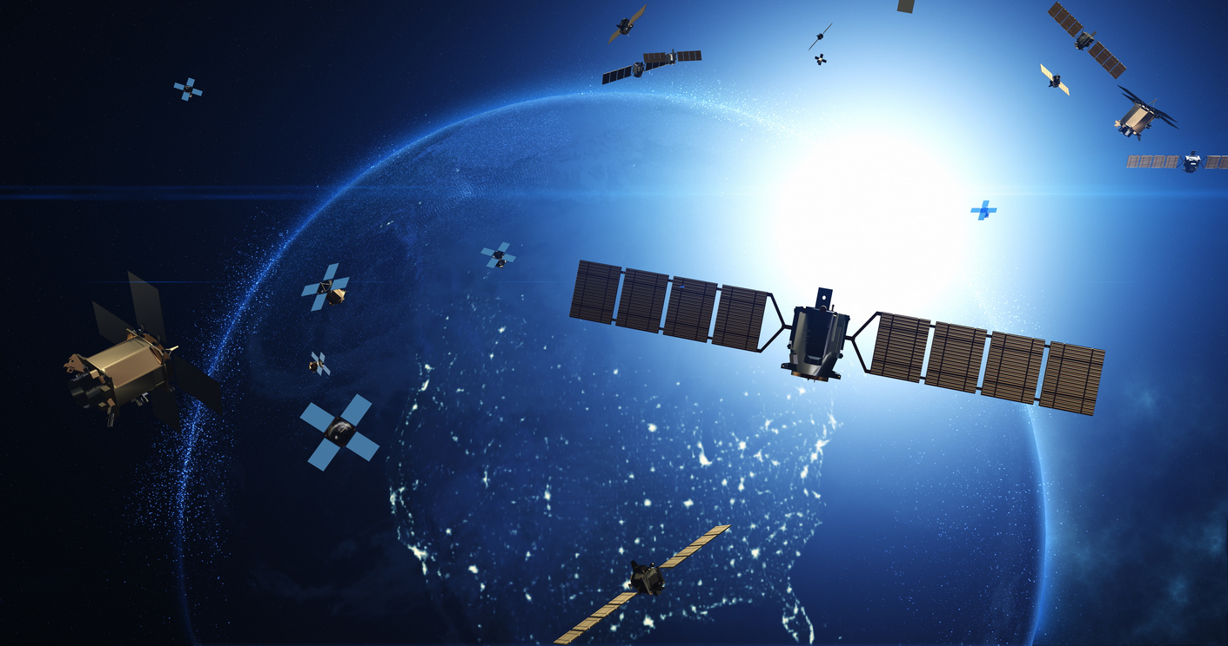
When Should You Consider Satellite a Priority Connectivity Solution?
1. Challenging Geography
2. Exorbitant Downtime Costs
3. Limited Fiber Footprint
Notes:
Steve
So the question becomes… when should satellite actually be part of your network strategy?
In most cases, we see three triggers.
First, geography. When operations extend into locations where terrestrial infrastructure simply isn’t available or reliable.
Second, operational impact. When downtime costs more than the investment required to build real network redundancy.
And third, the expansion of AI and edge computing. When workloads start moving beyond the traditional fiber footprint of the enterprise.
When those conditions exist, satellite stops being a niche technology and starts becoming part of the architecture.
Terrestrial connectivity will always be foundational… but it may not always be sufficient.

Slide 14

Satellite isn’t the future because it’s in space. It’s the future because it works, even when everything else doesn’t.
Notes:
Jay
Enterprise networks used to be designed around buildings. Then users. Then applications.
AI forces us to design networks around availability.
So I’ll leave you with this…
Satellite isn’t the future because it’s in space. It’s the future because it works, when everything else doesn’t.
Thank you.

Slide 15

Next Steps: Getting Engaged with Advantage
1. Zero-Cost Business Case
We’ll build a tailored roadmap that optimizes savings and improvement across your global network and infrastructure.
2. Quicker Time-to-Value
Our white-glove implementation yields 25% faster install times compared to industry averages.
3. Real Results
Schedule a Meeting
We’re invested in achieving your goals, such as reducing expenses, installing new satellite solutions, simplifying tedious activities, or all the above.

