Slide 1
Digital Intermediate Frequency Interoperability (DIFI / VITA 49) Test Strategies IEEE-ISTO Std 4900-2021: Digital IF Interoperability Standard
Marty Hoffmann
Keysight Systems Engineer & DIFI Business Developer
March 23, 2026

Slide 2
Legacy Ground Systems

Slide 3
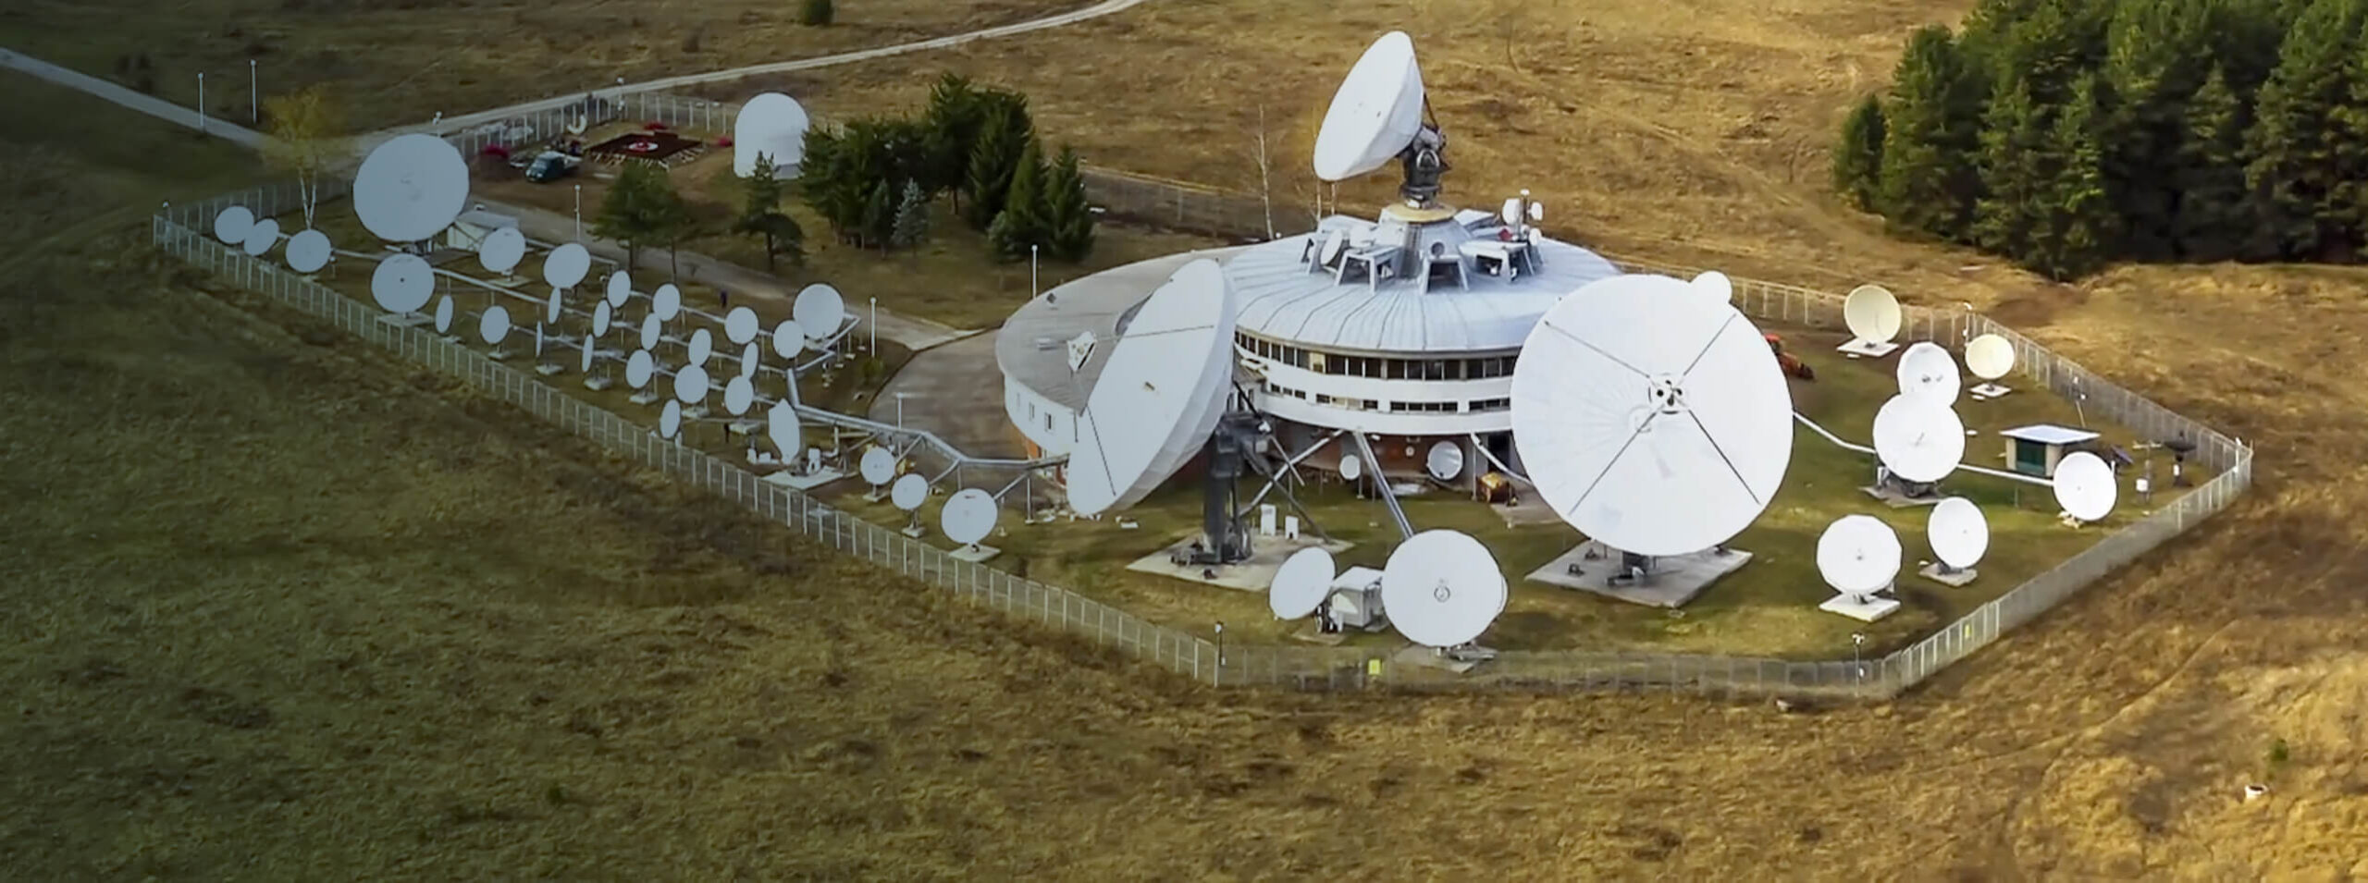
Satellite Ground Infrastructure Status Quo
Antenna System: Parabolic dishes or array antennas that focus radio frequency (RF) energy for communication with the satellite.
Antenna Pedestal & Tracking System: Mechanisms that allow the antenna to track moving satellites across the sky.
Radome: A weatherproof, dome-shaped structure that protects the antenna from environmental factors.
RF Subsystem: Includes transmitters (up-converters) and receivers (down-converters), Low-Noise Amplifiers (LNA) to amplify weak incoming signals, and Block Upconverters (BUC) for transmitting.
Modems (Modulator-Demodulator): Converts digital data into RF signals for transmission and converts received RF signals back into digital data.
Baseband System/Data Processing: Computers, servers, and software that handle network routing, data storage, and packet processing.
Control System (MOC - Mission Operations Center): Manages satellite health, sends commands (telecommand), and receives satellite status (telemetry).
Support Infrastructure : Power supplies (UPS), cooling systems, and networking equipment.
Notes:
In a traditional satcom system, the modem is often a limiting factor, serving two basic functions: IF conversion and digital signal processing. Both functions are typically integrated in a proprietary box that transmits and receives an analog intermediate frequency, like L-band.
The analog signal degrades over the length of a coaxial cable

Slide 4
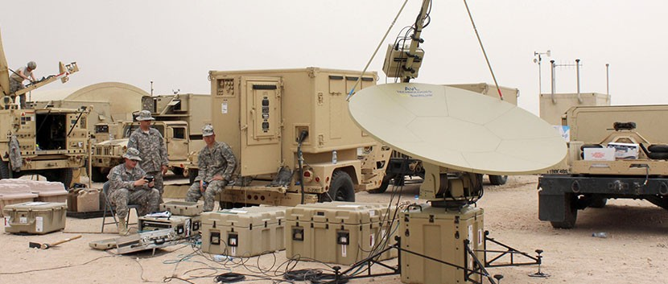
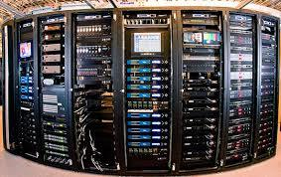
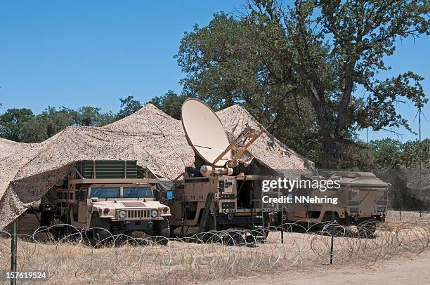
Traditional Satellite Headend Solutions
Notes:
Traditional satellite headend solutions call for housing massive satellite headend equipment in data centers located out in the field for the military. This solution calls for mobility of heavy equipment such as satellite dishes and headend equipment which would require transportation by truck.

Slide 5
What is DIFI?

Slide 6
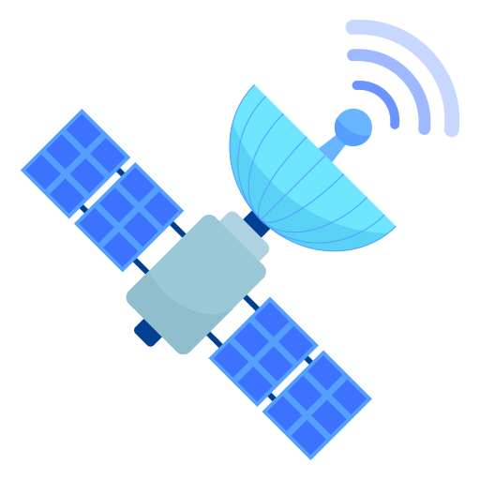




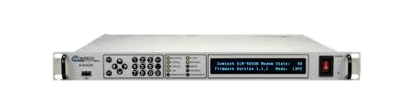

DIFI Ecosystem
0100101
1001101
DIFI: Digital Intermediate Frequency Interoperability
Packetized RF
Builds on VITA49.2
Focused on interoperabililty
Public or Private Cloud
0100101
DIFI
Public or Private Core Network
DIFI
DIFI RF/IF Converter (IFC)
1001101
0100101
Software Modem
Notes:
Digital IF decouples those two functions. An IF converter placed at or near the antenna transforms analog IF signals into digital IF streams and vice-versa. When the signal is converted to zeros and ones, it is packetized, or put in a standard format, making it compatible with any network that handles IP traffic. Rather than analog signal that degrades over the length of a coaxial cable, digital IF streams can be transported virtually anywhere accessible by an IP network, then processed by software-defined modems and other virtual machines running on local general-purpose compute or the cloud.
DIFI stands for digital intermediate frequency interoperability. Otherwise known as Packetized RF. And two of the key components are an RF/IF converter (IFC) which will take satellite signals and convert them to an intermediate frequency that can be dealt with small electronics, which are all very aware of and then packetize it. And this enables us to send actual IQ data over a public or private core network or cloud, to an EDIM modem (enterprise digital intermediate frequency multi-carrier). This is then decoded and sent to a broadcast customer or GPS data, or the military.
When we move to fully digitized RF IQ data, we no longer require a physical connection to the ground station and therefore no longer require a mobile setup for our ground station. It can instead be passed wirelessly through high-speed internet, 10 MHz microwave, and private 5G. This allows for satellite feeds to be set up in remote places and for signals to be processed in the cloud.

Slide 7
DIFI Ecosystem
In the past, if the necessary signal processing was not in the receiver, signal conditions outside of anticipated situations could not be recovered. With digital IF, all the raw signal content and meta data is available to demodulate the signal with all the flexibility and processing power available in the cloud.
0100101
1001101
Public or Private Cloud
0100101
DIFI
Public or Private Core Network
DIFI
DIFI RF/IF Converter (IFC)
1001101
0100101
Software Modem
Notes:
Digital IF decouples those two functions. An IF converter placed at or near the antenna transforms analog IF signals into digital IF streams and vice-versa. When the signal is converted to zeros and ones, it is packetized, or put in a standard format, making it compatible with any network that handles IP traffic. Rather than analog signal that degrades over the length of a coaxial cable, digital IF streams can be transported virtually anywhere accessible by an IP network, then processed by software-defined modems and other virtual machines running on local general-purpose compute or the cloud.
DIFI stands for digital intermediate frequency interoperability. Otherwise known as Packetized RF. And two of the key components are an RF/IF converter (IFC) which will take satellite signals and convert them to an intermediate frequency that can be dealt with small electronics, which are all very aware of and then packetize it. And this enables us to send actual IQ data over a public or private core network or cloud, to an EDIM modem (enterprise digital intermediate frequency multi-carrier). This is then decoded and sent to a broadcast customer or GPS data, or the military.
When we move to fully digitized RF IQ data, we no longer require a physical connection to the ground station and therefore no longer require a mobile setup for our ground station. It can instead be passed wirelessly through high-speed internet, 10 MHz microwave, and private 5G. This allows for satellite feeds to be set up in remote places and for signals to be processed in the cloud.

Slide 8
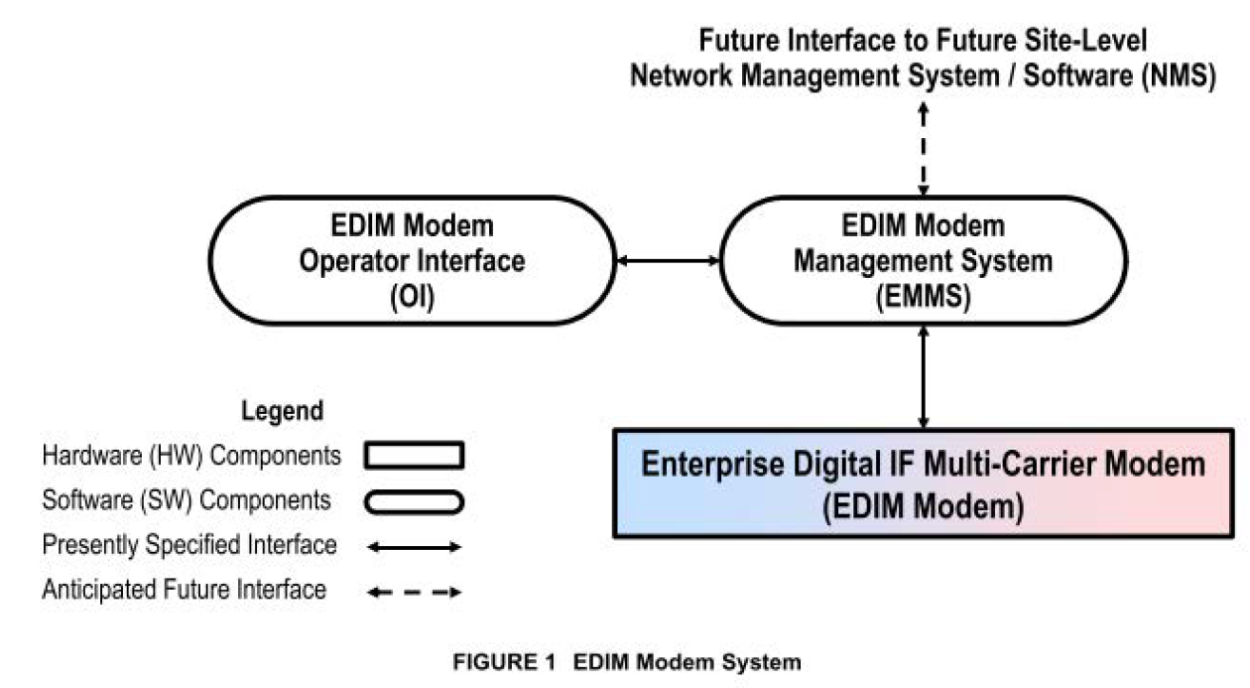
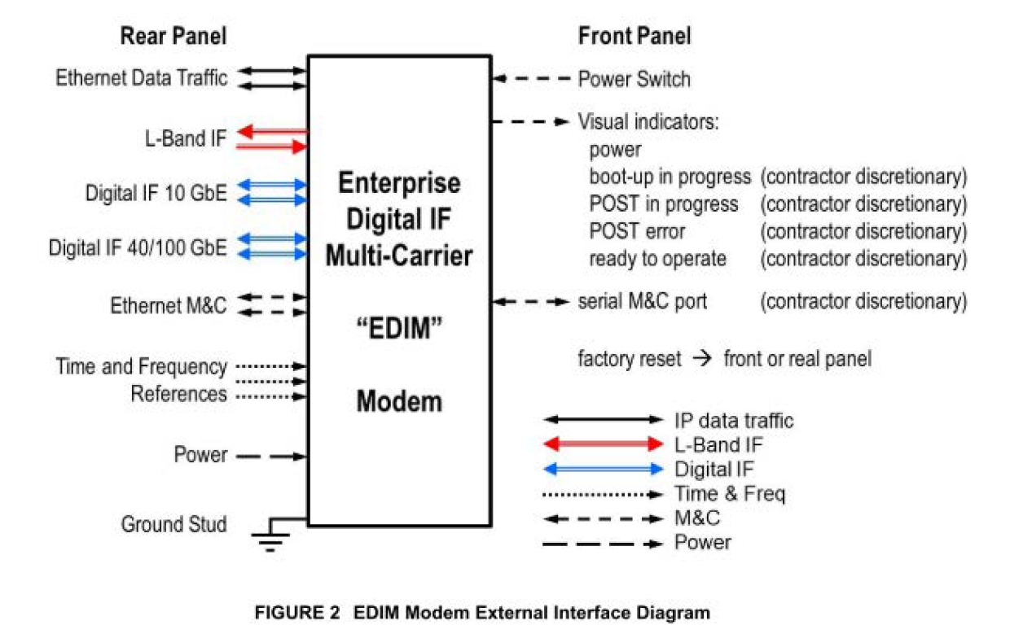
Enterprise Digital IF Multi-Carrier (EDIM) Modem System
Driving Acceleration to Satellite Digital Transformation
The EDIM Modem delivers multi-carrier capabilities, including L-Band modem and Digital IF modem, while being backwards compatible with legacy modems and interfaces.
Notes:
The EDIM Modem System is shown here in FIGURE 1. This illustration includes an interface for a future site-level Network Management System (NMS).
This future site-level NMS interface is described as a future capability
The EDIM Modem System consists of the following three components:
• The EDIM Modem, a hardware component, described below
• The EDIM Modem Management System I EDIM Modem Management Software (EMMS), a software component as the central point of control for all EDIM Modems
• The EDIM Modem Operator Interface (01), a second software component, as the human interface to the EMMS
The EDIM Modem shall be a single fully integrated hardware appliance. The EDIM Modem presents interfaces for timing and frequency reference, power, IP data traffic. L-Band IF, Digital IF, and management and control (M&C). The EDIM Modem delivers multi-carrier capabilities, including L-Band modem and Digital IF modem, while being backwards compatible with legacy modems and interfaces.

Slide 9
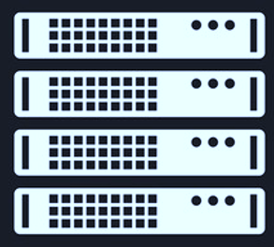


DIFI Real World Traffic Scenario: DIFI Distribution to DIFI Modems
SATCOM Building
DIFI Modems
Network Switch
Hub Antennas
Digital IF
Converters
Digital IF Combiner
Coax (RF)
Fiber
Notes:
Traditional DIFI setup with DIFI Modems
- Full DIFI Setup with DIFI Modems in place of Legacy Analog Modems and their respective Digital IF Converters

Slide 10
DIFI Real World Traffic Scenario: DIFI Distribution to Legacy Modems
SATCOM Building
Legacy Analog Modems
Digital IF
Converters
Network Switch
Hub Antennas
Digital IF
Converters
Digital IF Combiner
Coax (RF)
Fiber
Notes:
Example of real-world application
*From Right to Left*
- Start with Antenna and IFC in the Hub Antenna
- IFC does digital conversion and sends signal to SATCOM Building via fiber
- If you have multiple antennas, you can use the Digital IF Combiner in the next step to send the combined signal to your network
- Next would be sending the combined IF signal through another Digital IF Converter to convert the signal back to RF
- Finally, the resulting RF signal is sent to Legacy Analog Modems
In the cloud of network switching, more elements will need to be tested on top of regular RF testing
(Quality of Service, Peak Band rates, Packet Rates, etc)

Slide 11
DIFI Real World Traffic Scenario: Failover Scenario
SATCOM Building
Hub Antennas
DIFIModems
Digital IF
Converters
Digital IF
Converters
Network Switch
Digital IF Combiner
Coax (RF)
Fiber
Notes:
Example of real-world application
*From Right to Left*
- Start with Antenna and IFC in the Hub Antenna
- IFC does digital conversion and sends signal to SATCOM Building via fiber
- If you have multiple antennas, you can use the Digital IF Combiner in the next step to send the combined signal to your network
- Next would be sending the combined IF signal through another Digital IF Converter to convert the signal back to RF
- Finally, the resulting RF signal is sent to Legacy Analog Modems
In the cloud of network switching, more elements will need to be tested on top of regular RF testing
(Quality of Service, Peak Band rates, Packet Rates, etc)

Slide 12
DIFI Real World Traffic Scenario: Failover Scenario
SATCOM Building
Hub Antennas
DIFIModems
Digital IF
Converters
Digital IF
Converters
Network Switch
Digital IF Combiner
Coax (RF)
Fiber
Notes:
Example of real-world application
*From Right to Left*
- Start with Antenna and IFC in the Hub Antenna
- IFC does digital conversion and sends signal to SATCOM Building via fiber
- If you have multiple antennas, you can use the Digital IF Combiner in the next step to send the combined signal to your network
- Next would be sending the combined IF signal through another Digital IF Converter to convert the signal back to RF
- Finally, the resulting RF signal is sent to Legacy Analog Modems
In the cloud of network switching, more elements will need to be tested on top of regular RF testing
(Quality of Service, Peak Band rates, Packet Rates, etc)

Slide 13
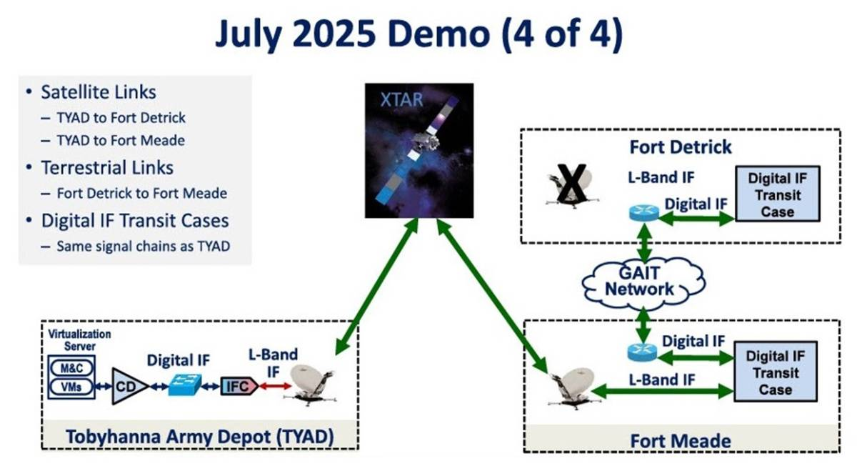
July PdM WESS
DR AJ Vigil
“At PdM WESS we put together a demonstration across three sites,” he said. (See related story here.) In the middle, “We pulled the plug on the antenna at one site and the link failed over to the antenna at the remote site without skipping a beat. We demonstrated some things for the first time to our audience: full-digital IF signal chains, including a virtual digital IF modem, and digital IF combiner/divider through digital IF conversion (IFC), using multiple carriers, two different vendors, and transport over the Army’s Global Agile Integrated Transport Network (GAIT).”
Quote from A.J. Vigil taken from Stuart Daughtridge’s Constellations article Feb 24th, 2026
https://www.kratosspace.com/constellations/difi
https://www.kratosspace.com/constellations/articles/digital-transformation-the-next-battleground-for-milsatcom
Notes:
WESS Wideband Enterprise Satellite Systems

Slide 14
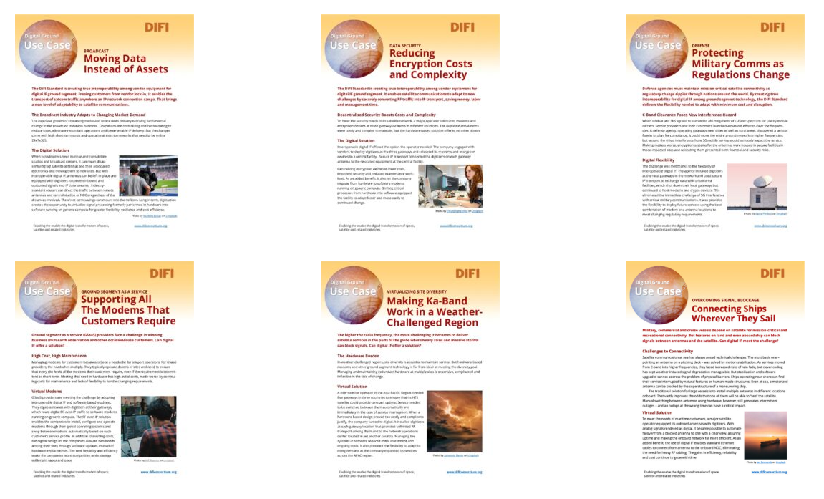
Example Use Cases on DIFI Consortium Website
Notes:
Broadcast: Moving Data Instead of Assets
Data Security: Reducing Encryption Costs and Complexity
Defense: Protecting Military Comms as Regulations Change
Ground Segment As a Service: Supporting All the Modems that Customers Require
Virtualization Site Diversity: Making Ka-Band Work in a Weather-Challenged Region
Overcoming Blockage: Connecting Ships Wherever They Sail

Slide 15
DIFI: Packetized RF

Slide 16
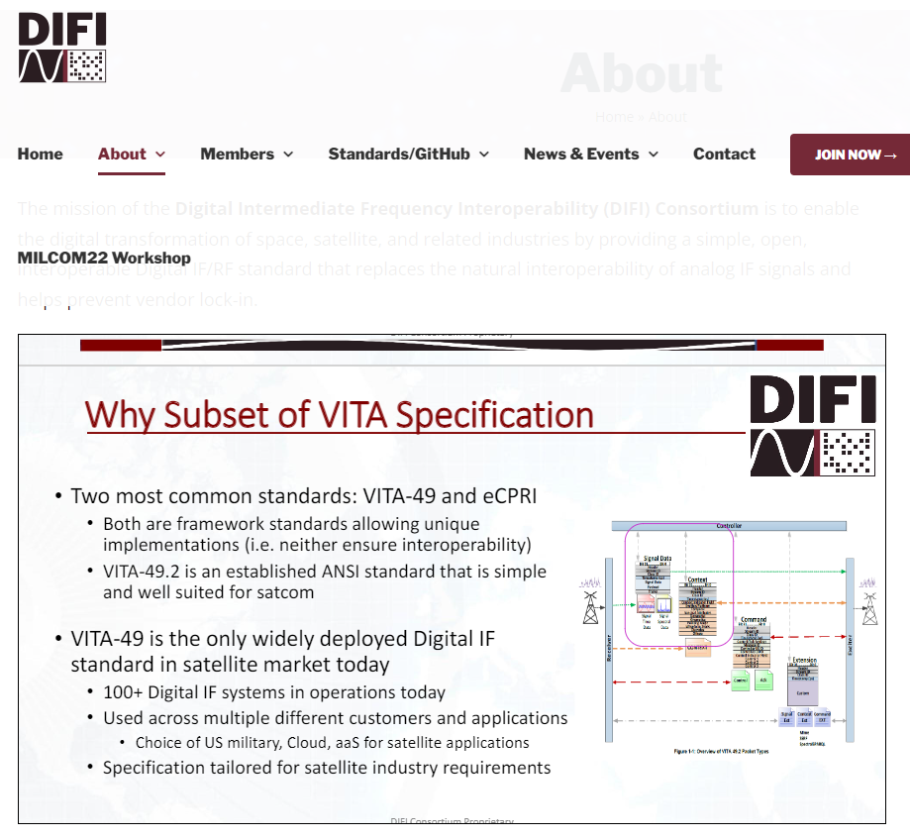
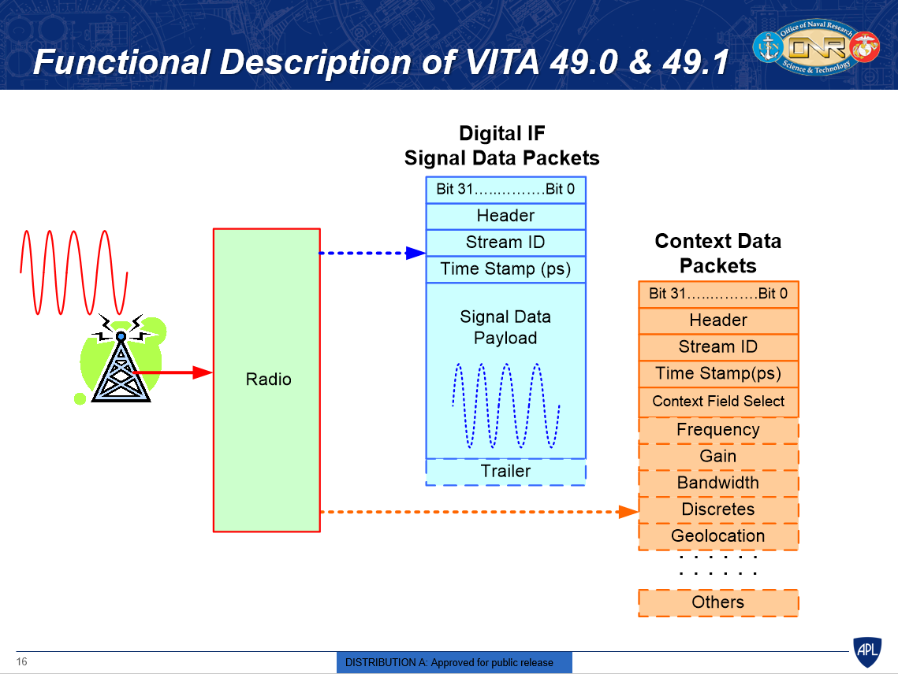
DIFI Consortium: Subset of VITA Specification (Strong Standard)
Note: DIFI dictates specificity on the Data and Context Packets
Notes:
The DIFI standard has been adopted from VITA-49 (currently VITA-49.2) which is the widely used standard for digital IF in the satellite market today.
3 main packet types in DIFI.
- Context packets
- Data packets
- Command packets

Slide 17
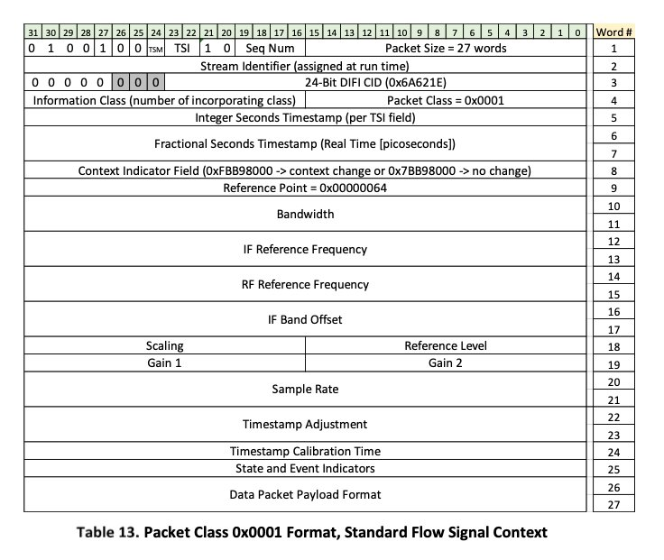

DIFI Protocol Overview: Context Packets
DIFI PROTOCOL STACK
Context Packet defines the RF data:
VITA 49.2
150-byte
Center Frequency
Bandwidth
Sample Rate
DIFI Application
Context Packet
Signal Data Packet
Command Packet
DIFI Protocol Layer
User Datagram Protocol
IPv4
IPv6
Ethernet
Notes:
The standard is based on VITA 49. It is an older RF standard for packetization, and it has three components: It has your context packets, your signal data packets, and your command packets. The protocol layer sits inside of UDP and then the headers can be IPV4, IPV6. The context packets are required and are 150-byte packets, and they define the center frequency, the bandwidth and the sample rate. And then the IQ data is put into the payloads of the data packets and the data packets can be any anywhere from small packets 64-byte packets to jumbo frames up to 9000-byte. And they get put together in aggregate to build a waveform.
The data packets contain the IQ data. Now I've sort of misrepresented with this image here, it is not a context packet and then a data packet. Context packets can happen anywhere from every other packet to every thousand packets. It's not a one-to-one packet rate and it's not necessary. But they are required to tell the DIFI device how to decode it. And so over many data packets and payloads you get a full waveform. Hence, packetized RF over IP.
--------------------------------------------------------
Context Packets:
- Defines the Center frequency, Bandwith, and Sample Rate
- 150-byte packet size (with header)

Slide 18
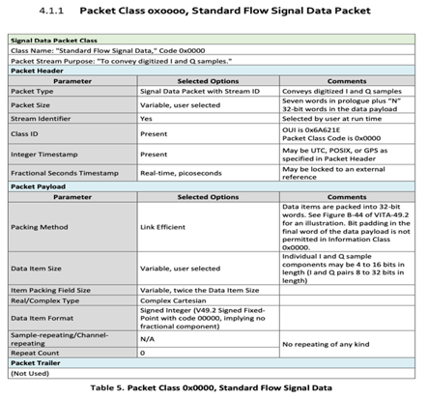

DIFI Protocol Overview: Data Packets
Data Packets:
VITA 49.2
64-byte to 9000-byte packets
Time stamps
DIFI PROTOCOL STACK
DIFI Application
Context Packet
Signal Data Packet
Command Packet
DIFI Protocol Layer
User Datagram Protocol
IQ RF Data Stream
IPv4
IPv6
Ethernet
Notes:
The standard is based on VITA 49. It is an older RF standard for packetization, and it has three components: It has your context packets, your signal data packets, and your command packets. The protocol layer sits inside of UDP and then the headers can be IPV4, IPV6. The context packets are required and are 150-byte packets, and they define the center frequency, the bandwidth and the sample rate. And then the IQ data is put into the payloads of the data packets and the data packets can be any anywhere from small packets 64-byte packets to jumbo frames up to 9000-byte. And they get put together in aggregate to build a waveform.
The data packets contain the IQ data. Now I've sort of misrepresented with this image here, it is not a context packet and then a data packet. Context packets can happen anywhere from every other packet to every thousand packets. It's not a one-to-one packet rate and it's not necessary. But they are required to tell the DIFI device how to decode it. And so, over many data packets and payloads you get a full waveform. Hence, packetized RF over IP.
--------------------------------------------------------
Signal Data Packets
- Carry the time stamping
- ID of device sending the data (Stream ID)
- 64-byte to 9000-byte packet size
- Breaks up IQ RF data into the payload

Slide 19
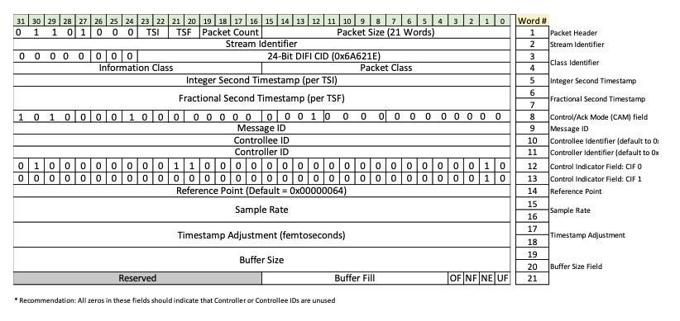
DIFI Protocol Overview: Command Packets
Command Packets:
DIFI v1.3
Control Packets
Acknowledge Packets
Flow Control
DIFI PROTOCOL STACK
DIFI Application
Context Packet
Signal Data Packet
Command Packet
DIFI Protocol Layer
User Datagram Protocol
IPv4
IPv6
Ethernet
Notes:
The standard is based on VITA 49. It is an older RF standard for packetization, and it has three components: It has your context packets, your signal data packets, and your command packets. The protocol layer sits inside of UDP and then the headers can be IPV4, IPV6. The context packets are required and are 150-byte packets, and they define the center frequency, the bandwidth and the sample rate. And then the IQ data is put into the payloads of the data packets and the data packets can be any anywhere from small packets 64-byte packets to jumbo frames up to 9000-byte. And they get put together in aggregate to build a waveform.
The data packets contain the IQ data. Now I've sort of misrepresented with this image here, it is not a context packet and then a data packet. Context packets can happen anywhere from every other packet to every thousand packets. It's not a one-to-one packet rate and it's not necessary. But they are required to tell the DIFI device how to decode it. And so over many data packets and payloads you get a full waveform. Hence, packetized RF over IP.
--------------------------------------------------------
Command Packets
- Flow Control
- synchronize with time stamps in context packets
- enables DIFI devices to monitor their own buffers
- if device buffers are over running with too much packet loss, flow control messages are sent to partner device and control data rate speeds.

Slide 20
DIFI Protocol Overview: IP Packetized RF
Leading DIFI IFC vendors currently supporting 10G and below will transmit 1500-byte packets and >10G will be 9000-byte packets.
EDIM Modem users need to be able to select packet sizes from 64-bytes to 9000-bytes.
Wave full period
IPv4 Payload I/Q Data + Context Packets
Context Packets
Data Packets
Command Packets
Notes:
The standard is based on VITA 49. It is an older RF standard for packetization, and it has three components: It has your context packets, your signal data packets, and your command packets. The protocol layer sits inside of UDP and then the headers can be IPV4, IPV6. The context packets are required and are 150-byte packets, and they define the center frequency, the bandwidth and the sample rate. And then the IQ data is put into the payloads of the data packets and the data packets can be any anywhere from small packets 64-byte packets to jumbo frames up to 9000-byte. And they get put together in aggregate to build a waveform.
The data packets contain the IQ data. Now I've sort of misrepresented with this image here, it is not a context packet and then a data packet. Context packets can happen anywhere from every other packet to every thousand packets. It's not a one-to-one packet rate and it's not necessary. But they are required to tell the DIFI device how to decode it. And so over many data packets and payloads you get a full waveform. Hence, packetized RF over IP.
--------------------------------------------------------
All 3 packet types all come together into a stream to build a contiguous IQ data stream that can be demodulated by a DIFI aware device.

Slide 21
DIFI Tester – Minimum NIC Requirements
The data rate required at the network interface card (NIC) would depend on the channel bandwidth and bit depth of the IQ samples.
Min NIC Data Rate (Gbps) Requirements
Bandwidth (GHz) | 0.1 | 0.5 | 1 | 1.5 | 2
BW / Sample Rate | 70% | 70% | 70% | 70% | 70%
Sample Rate (Gsamp/sec) | 0.1 | 0.7 | 1.4 | 2.1 | 2.9
Bit Depth | 8 | 16 | 16 | 16 | 16
Overhead | 20% | 20% | 20% | 20% | 20%
Min NIC Datarate (Gbps) | 1.4 | 13.7 | 27.4 | 41.1 | 54.9

Slide 22
DIFI Consortium

Slide 23




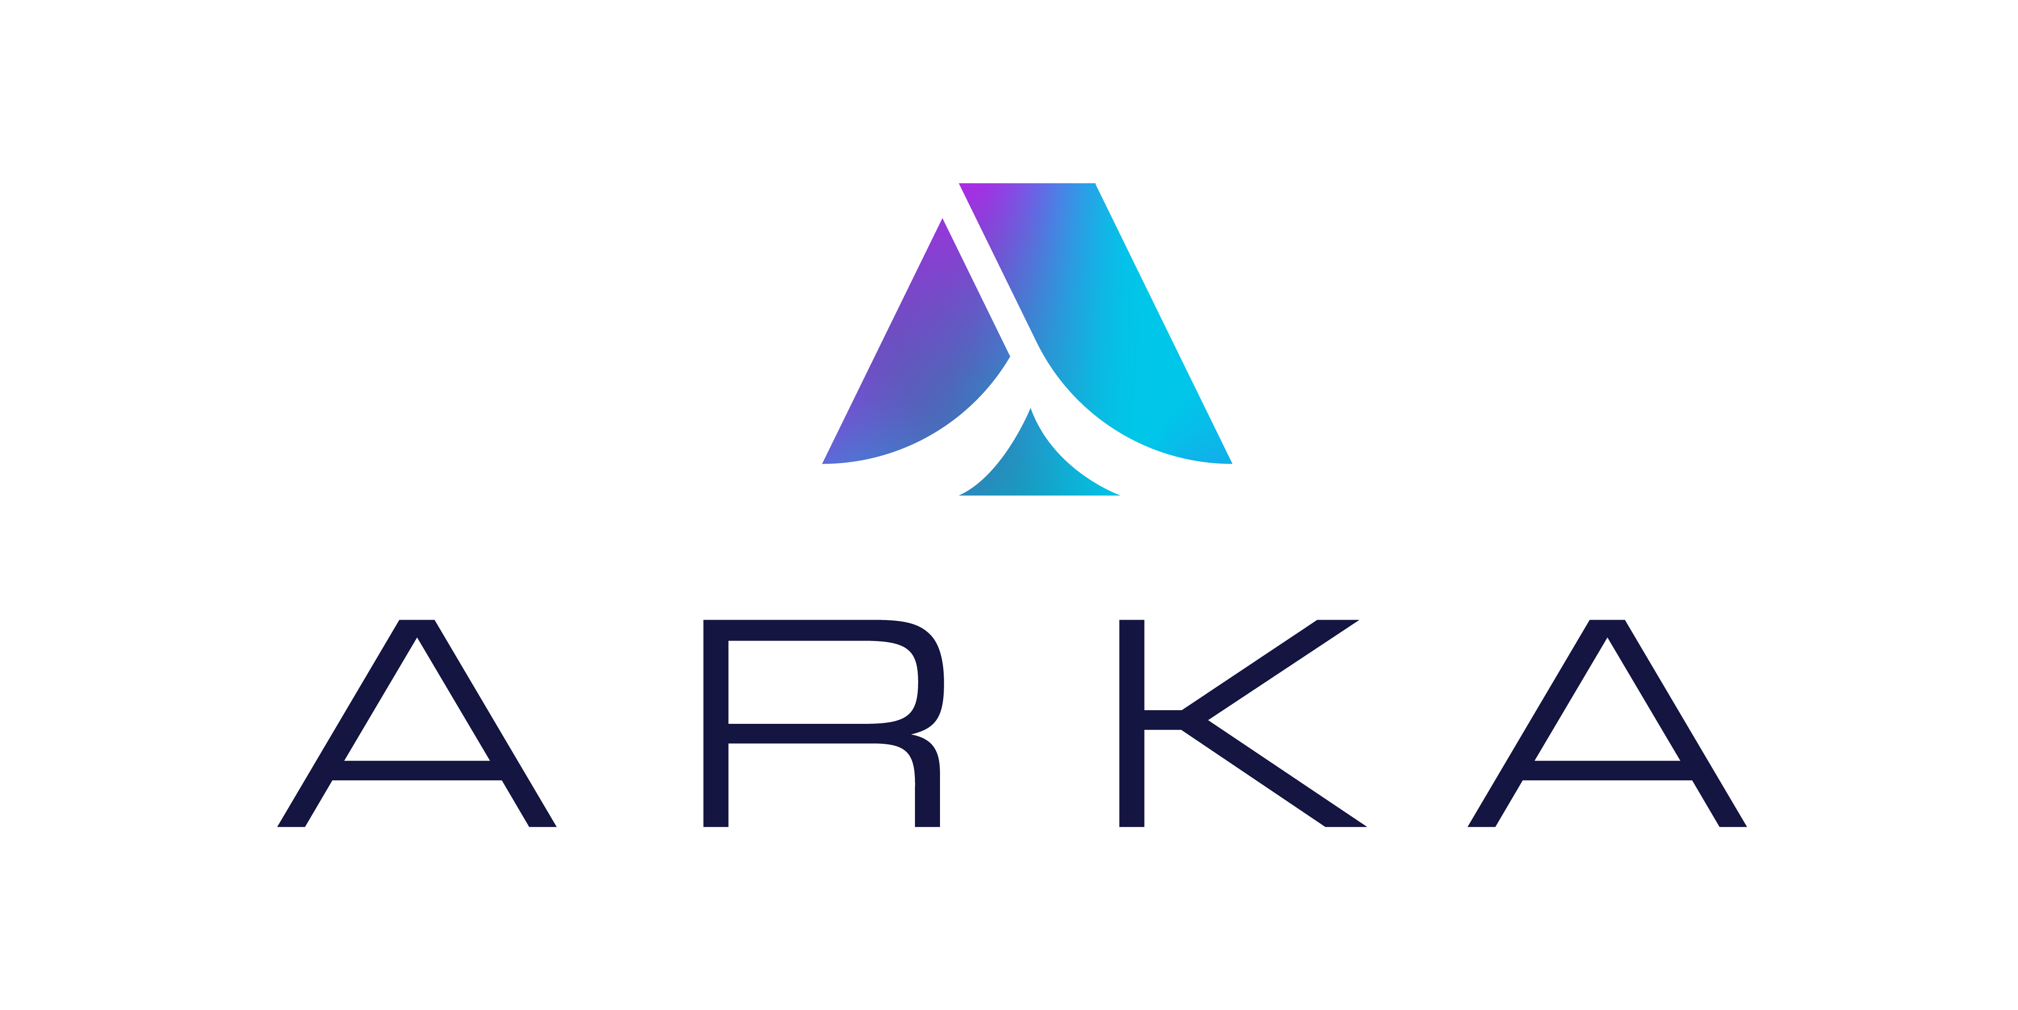








DIFI Consortium Board Members (12)
Notes:
You'll find a lot of these names on the DIFI Consortium Board, and we just joined the DIFI board, it is headed by Simon Swift who is an engineer at ETL. But we have been working very closely with Kratos. We have worked on a converter of theirs, and in addition, we have purchased one of the newer Kratos IFCs that supports 40 GE data speeds and we're building a DIFI lab out in Keysight’s Columbia Maryland facility. And we're also working closely with the VSA software team out in Washington. Fred Christensen is the lead engineer on that. We've also seen some deployments with ETL and ATG and we've been in discussions with them. ATG and ETL also make intermittent frequency converters. These are all the board members. There's over 40 companies contributing to the standard currently.

Slide 24
































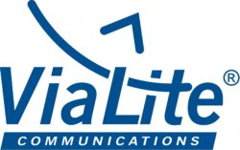


DIFI Consortium Corporate Membership (36)
Notes:
List of current corporate members (companies) contributing to the DIFI standard currently.

Slide 25













DIFI Consortium Government Non-Profit Members (13)
Notes:
Significant Non-profit board members (Government Organizations) working towards solutions that utilize the DIFI standard.

Slide 26

Leading End Users To Date
Each have contributed $45 million to develop a DIFI Modem
Notes:
The two biggest players, The US Navy and US Army, have both contributed a total $90 million to develop a EDIM modem. They are both very serious about further development of this technology.

Slide 27


Angelo Ricciardi, SATCOM Space Segment Lead Engineer, of NATO’s Communications and Information Agency (NCIA), the technology and cyber security arm of NATO- Kratos DIFI POC July 2025.
“Not a matter of if but when.”
Notes:
The two biggest players, The US Navy and US Army, have both contributed a total $90 million to develop a EDIM modem. They are both very serious about further development of this technology.

Slide 28
DIFI Test Solutions

Slide 29
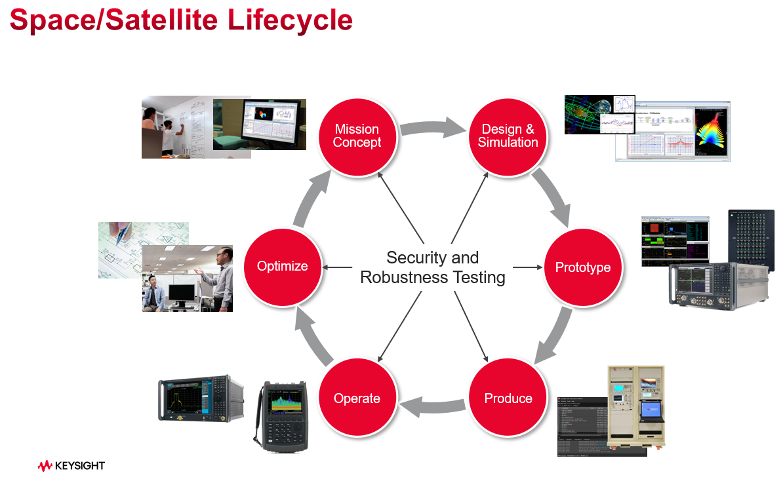

Slide 30
DIFI Ecosystem
0100101
1001101
Public or Private Cloud
0100101
DIFI
Public or Private Core Network
DIFI
DIFI RF/IF Converter (IFC)
1001101
0100101
Software Modem
Notes:
DIFI stands for digital intermediate frequency interoperability. Otherwise known as Packetized RF. And two of the key components are an RF/IF converter (IFC) which will take satellite signals and convert them to an intermediate frequency that can be dealt with small electronics, which are all very aware of and then packetize it. And this enables us to send actual IQ data over a public or private core network or cloud, to an EDIM modem (enterprise digital intermediate frequency multi-carrier). This is then decoded and sent to a broadcast customer or GPS data, or the military.
EDIM Modem (Enterprise Digital Intermediate Frequency Multi-Carrier)

Slide 31

DIFI Ecosystem – Ground Station RF Emulation
Signal Generation
0100101
1001101
Public or Private Cloud
“Golden”
RF Signal Source
0100101
DIFI
Public or Private Core Network
DIFI
DIFI RF/IF Converter (IFC)
1001101
0100101
Software Modem
Notes:
Ground Station RF Emulation set up
- Use Signal Generator to emulate Satellite RF Transmission
Allows for various modulation settings (QPSK, 16-QAM)
You can create CW signals for simpler DIFI generation in the downstream

Slide 32
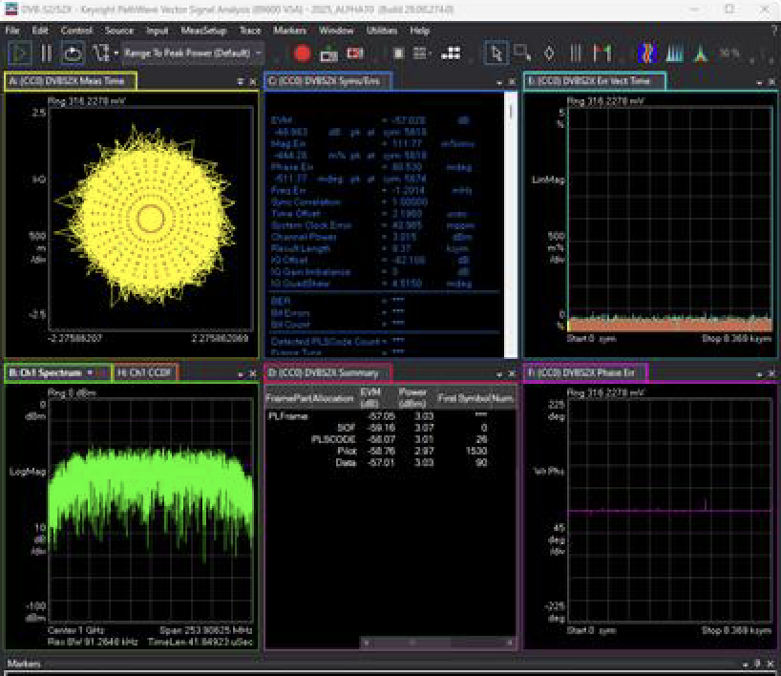
DIFI Ecosystem – Ground Station RF Emulation
Signal Generation
Vector Signal Analysis Software
Running on PC Workstation, ESXi VM WARE Instance, DIFI / VITA 49 Spectrum Analyzer
“Golden”
RF Signal Source
DIFI
Public or Private Core Network
DIFI
DIFI RF/IF Converter (IFC)
1001101
0100101
VSA RF Receiver
Notes:
Ground Station RF Emulation set up
- Use Signal Generator to emulate Satellite RF Transmission
Allows for various modulation settings (QPSK, 16-QAM)
You can create CW signals for simpler DIFI generation in the downstream

Slide 33
DIFI Ecosystem Upstream
0100101
1001101
Public or Private Cloud
0100101
DIFI
Public or Private Core Network
DIFI
DIFI RF/IF Converter (IFC)
1001101
0100101
Software Modem
Notes:
DIFI stands for digital intermediate frequency interoperability. Otherwise known as Packetized RF. And two of the key components are an RF/IF converter (IFC) which will take satellite signals and convert them to an intermediate frequency that can be dealt with small electronics, which are all very aware of and then packetize it. And this enables us to send actual IQ data over a public or private core network or cloud, to an EDIM modem (enterprise digital intermediate frequency multi-carrier). This is then decoded and sent to a broadcast customer or GPS data, or the military.
EDIM Modem (Enterprise Digital Intermediate Frequency Multi-Carrier)

Slide 34
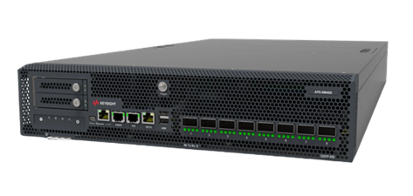
DIFI Ecosystem Upstream
DIFI
DIFI RF/IF Converter (IFC)
0100101
DIFI Packet Generator
Notes:
DIFI stands for digital intermediate frequency interoperability. Otherwise known as Packetized RF. And two of the key components are an RF/IF converter (IFC) which will take satellite signals and convert them to an intermediate frequency that can be dealt with small electronics, which are all very aware of and then packetize it. And this enables us to send actual IQ data over a public or private core network or cloud, to an EDIM modem (enterprise digital intermediate frequency multi-carrier). This is then decoded and sent to a broadcast customer or GPS data, or the military.
EDIM Modem (Enterprise Digital Intermediate Frequency Multi-Carrier)

Slide 35
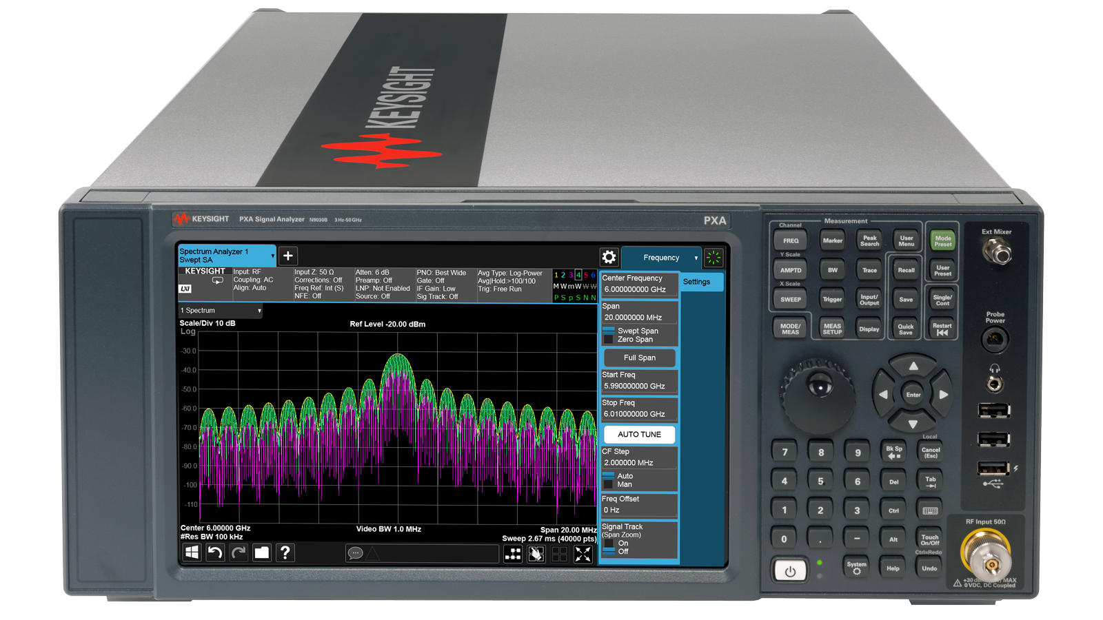
DIFI Ecosystem Upstream
Vector Signal Analysis Software
RF Receiver
DIFI
DIFI RF/IF Converter (IFC)
0100101
DIFI Packet Generator
Notes:
DIFI stands for digital intermediate frequency interoperability. Otherwise known as Packetized RF. And two of the key components are an RF/IF converter (IFC) which will take satellite signals and convert them to an intermediate frequency that can be dealt with small electronics, which are all very aware of and then packetize it. And this enables us to send actual IQ data over a public or private core network or cloud, to an EDIM modem (enterprise digital intermediate frequency multi-carrier). This is then decoded and sent to a broadcast customer or GPS data, or the military.
EDIM Modem (Enterprise Digital Intermediate Frequency Multi-Carrier)

Slide 36
DIFI Ecosystem Upstream
0100101
1001101
Public or Private Cloud
0100101
DIFI
Public or Private Core Network
DIFI
DIFI RF/IF Converter (IFC)
1001101
0100101
Software Modem
Notes:
DIFI stands for digital intermediate frequency interoperability. Otherwise known as Packetized RF. And two of the key components are an RF/IF converter (IFC) which will take satellite signals and convert them to an intermediate frequency that can be dealt with small electronics, which are all very aware of and then packetize it. And this enables us to send actual IQ data over a public or private core network or cloud, to an EDIM modem (enterprise digital intermediate frequency multi-carrier). This is then decoded and sent to a broadcast customer or GPS data, or the military.
EDIM Modem (Enterprise Digital Intermediate Frequency Multi-Carrier)

Slide 37

DIFI Ecosystem Upstream
0100101
1001101
Public or Private Cloud
Network Switch
DIFI Switch
0100101
DIFI
DIFI
DIFI RF/IF Converter (IFC)
1001101
0100101
Software Modem
Notes:
DIFI stands for digital intermediate frequency interoperability. Otherwise known as Packetized RF. And two of the key components are an RF/IF converter (IFC) which will take satellite signals and convert them to an intermediate frequency that can be dealt with small electronics, which are all very aware of and then packetize it. And this enables us to send actual IQ data over a public or private core network or cloud, to an EDIM modem (enterprise digital intermediate frequency multi-carrier). This is then decoded and sent to a broadcast customer or GPS data, or the military.
EDIM Modem (Enterprise Digital Intermediate Frequency Multi-Carrier)

Slide 38

DIFI Ecosystem Upstream
Network/DIFI Switches
Routers
Firewalls
QoS
Security
0100101
1001101
Public or Private Cloud
0100101
DIFI
DIFI
DIFI RF/IF Converter (IFC)
1001101
Public or Private Core Network
0100101
Software Modem
Notes:
DIFI stands for digital intermediate frequency interoperability. Otherwise known as Packetized RF. And two of the key components are an RF/IF converter (IFC) which will take satellite signals and convert them to an intermediate frequency that can be dealt with small electronics, which are all very aware of and then packetize it. And this enables us to send actual IQ data over a public or private core network or cloud, to an EDIM modem (enterprise digital intermediate frequency multi-carrier). This is then decoded and sent to a broadcast customer or GPS data, or the military.
EDIM Modem (Enterprise Digital Intermediate Frequency Multi-Carrier)

Slide 39
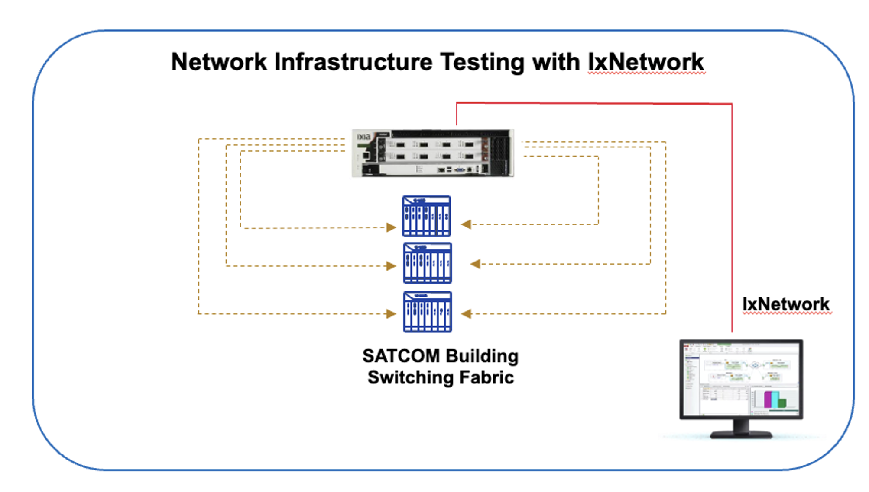
Network Test and Validation

Slide 40
DIFI Ecosystem
0100101
1001101
Public or Private Cloud
10KM
0100101
DIFI
Public or Private Core Network
DIFI
DIFI RF/IF Converter (IFC)
1001101
0100101
Software Modem
Notes:
DIFI stands for digital intermediate frequency interoperability. Otherwise known as Packetized RF. And two of the key components are an RF/IF converter (IFC) which will take satellite signals and convert them to an intermediate frequency that can be dealt with small electronics, which are all very aware of and then packetize it. And this enables us to send actual IQ data over a public or private core network or cloud, to an EDIM modem (enterprise digital intermediate frequency multi-carrier). This is then decoded and sent to a broadcast customer or GPS data, or the military.
EDIM Modem (Enterprise Digital Intermediate Frequency Multi-Carrier)

Slide 41
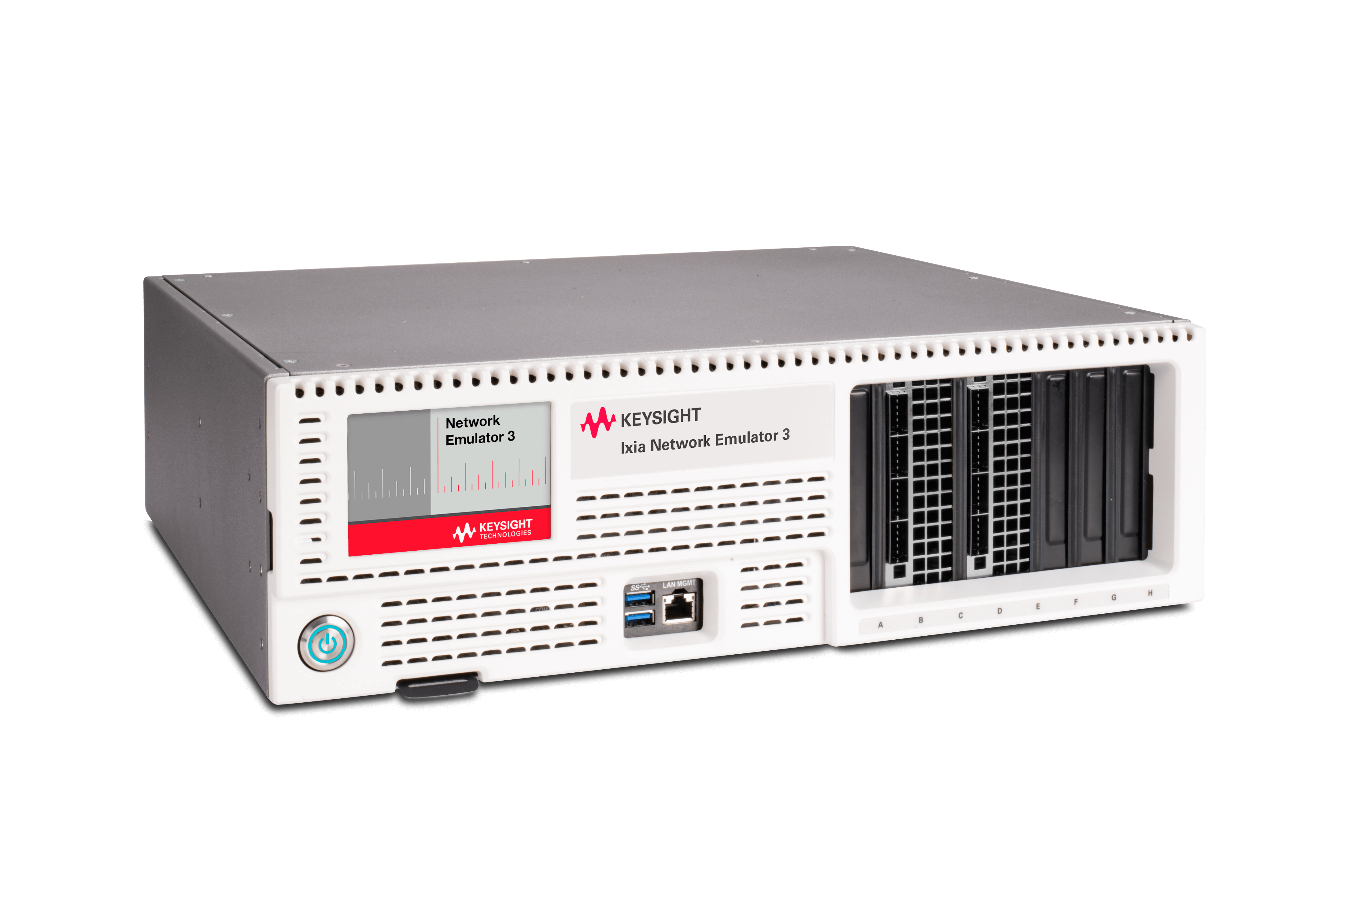
DIFI Ecosystem– Network Impairments
Delay (distance)
Packet loss
Bursting
Bit Errors
Out-of-order packets
0100101
1001101
Public or Private Cloud
100KM
0100101
DIFI
DIFI
DIFI RF/IF Converter (IFC)
1001101
0100101
Software Modem
Notes:
DIFI stands for digital intermediate frequency interoperability. Otherwise known as Packetized RF. And two of the key components are an RF/IF converter (IFC) which will take satellite signals and convert them to an intermediate frequency that can be dealt with small electronics, which are all very aware of and then packetize it. And this enables us to send actual IQ data over a public or private core network or cloud, to an EDIM modem (enterprise digital intermediate frequency multi-carrier). This is then decoded and sent to a broadcast customer or GPS data, or the military.
EDIM Modem (Enterprise Digital Intermediate Frequency Multi-Carrier)

Slide 42
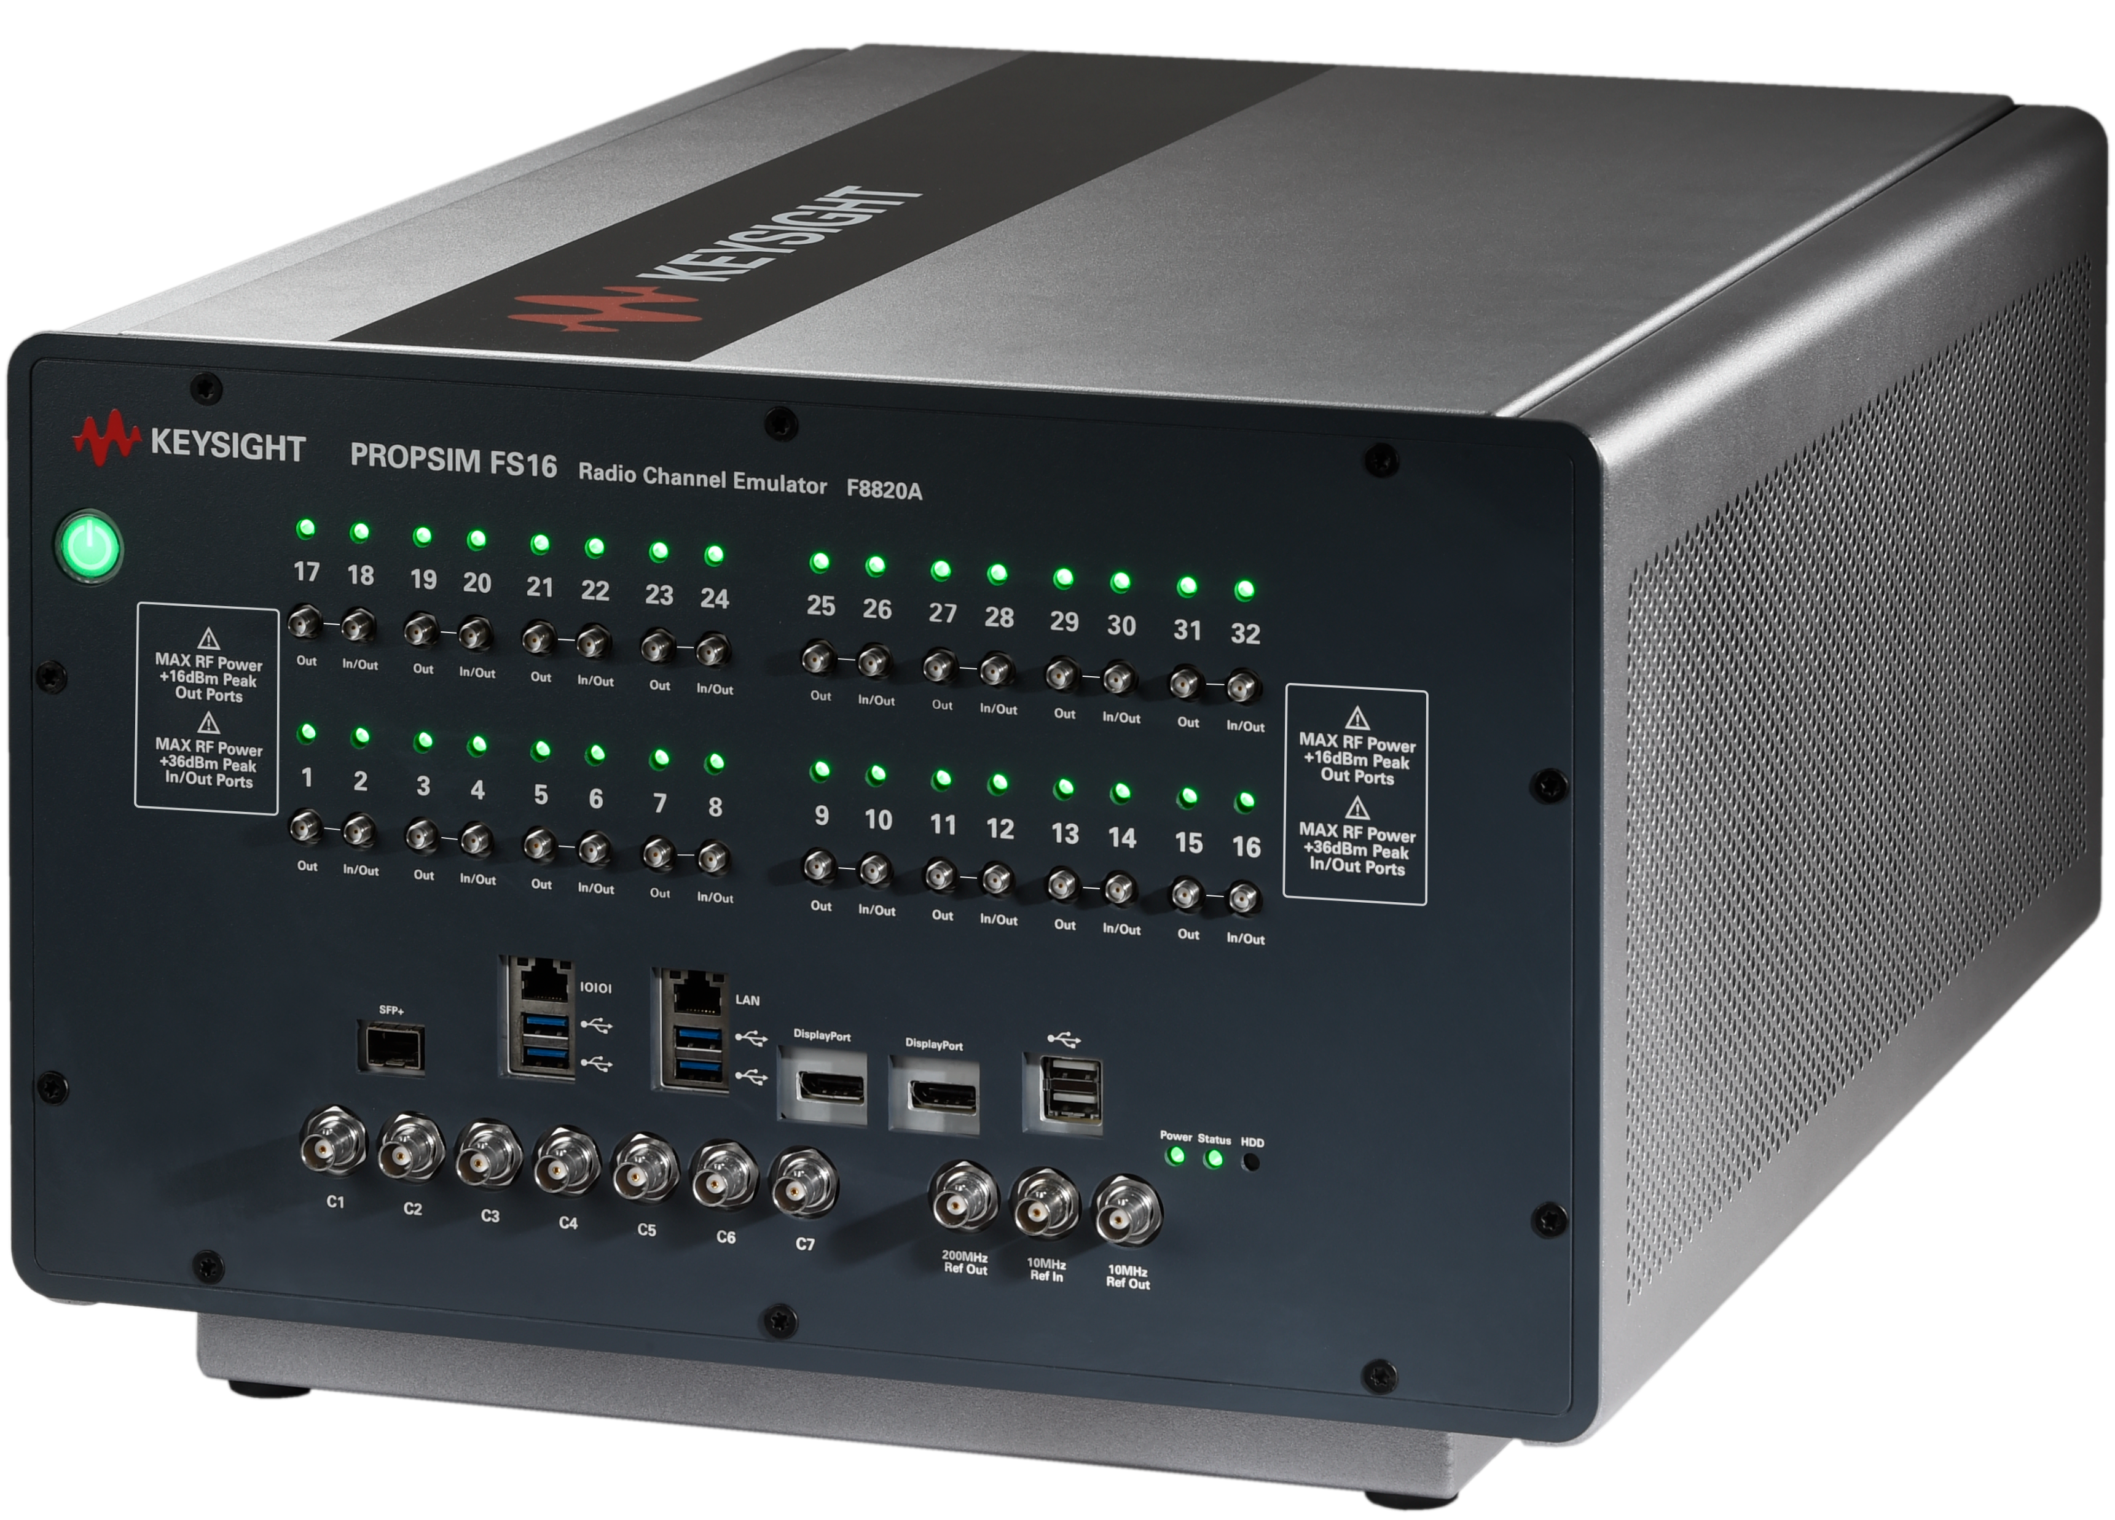
DIFI Ecosystem– Channel Emulation
Multipath fading
Doppler effects
Handover
Mobility
Interference
0100101
1001101
Public or Private Cloud
10KM
0100101
DIFI
Public or Private Core Network
DIFI
DIFI RF/IF Converter (IFC)
1001101
0100101
Software Modem
Notes:
PropSim: Designed for precise emulation of complex RF environments, including massive multiple-input / multiple-output (MIMO), beamforming, and high-speed mobility

Slide 43
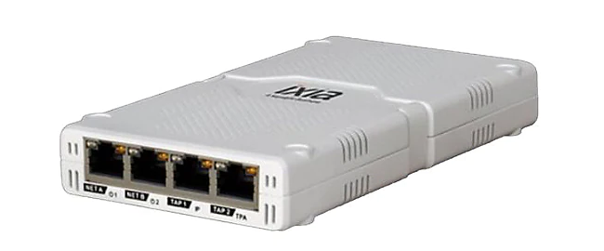
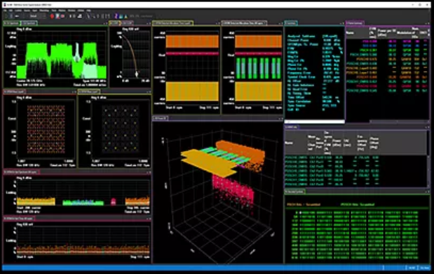
DIFI Traffic Monitoring and RF Analysis
Satellite Ethernet Transport Network
RF streamId 0
RF streamId 2
RF streamId 1
DIFI Satellite Modems
Fiber or copper tap
DIFI/VITA49
DIFI/VITA49
DIFI streamId 0
DIFI streamId 0
DIFI streamId 1
DIFI streamId 1
DIFI streamId 2
DIFI streamId 2
DIFI RF/IF Converter
(IFC)
Individually filtered DIFI streams
Packet Broker
Vita49 streamId 0
Vita49 streamId 1
Vita49 streamId 2
Vector Signal Analysis
Running on servers in cloud
VSA #1
VSA #2
VSA #3
Notes:
This process applies the same for DIFI in its traditional use case
- With DIFI Satellite Modems

Slide 44
Summary / Reference
Digitizing RF adds flexibility to transporting data
DIFI expands on VITA49, focus on vendor interoperability
Introduces new challenges that require testing
Pre- and post-deployment
Before, during, and after conversion in the DIFI ecosystem
DIFIConsortium.org
Keysight Booth at Satellite 2026: 1731
Notes:
This process applies the same for DIFI in its traditional use case
- With DIFI Satellite Modems

