Slide 1
Laser-Precise Navigation: Integrating Free-Space Optical Communications Technology with PNT Systems
Joachim Horwath
23rd March 2026
Publicly Released Presentation

Slide 2
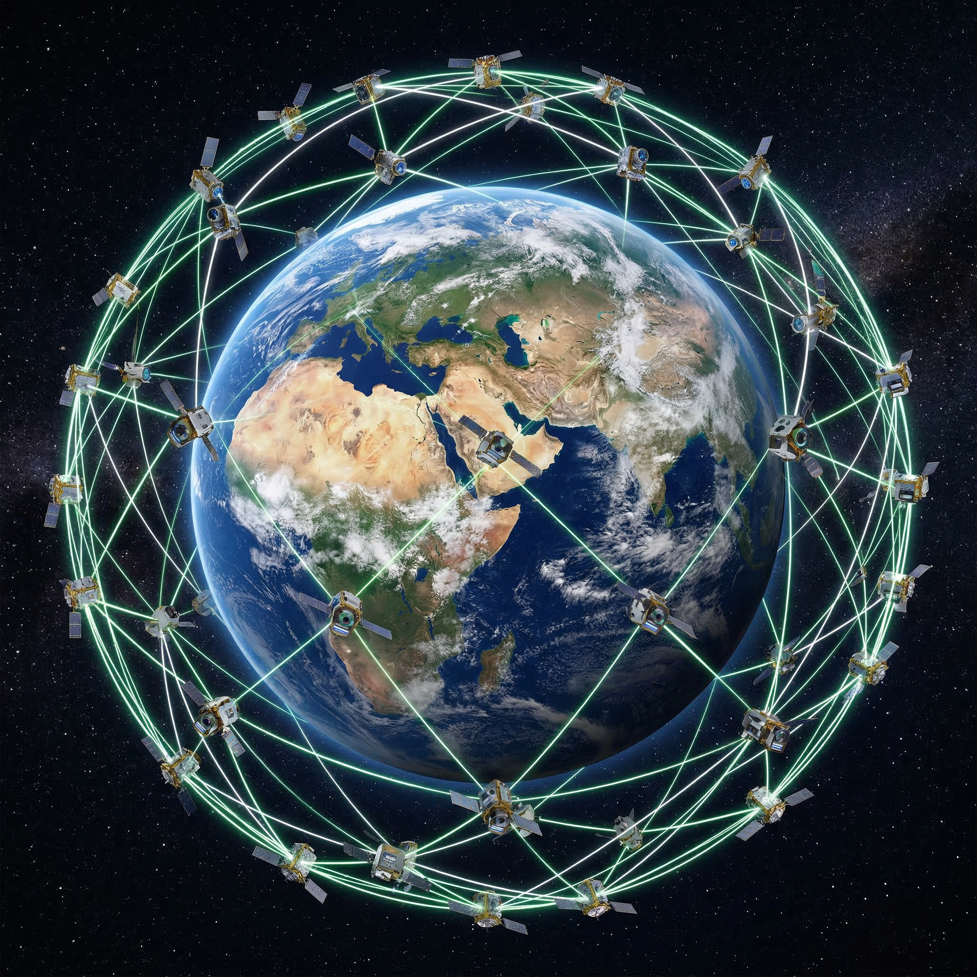
Content
Proliferated Lasercom
Timing Domains
Laser Communications for PNT
Time Transfer
System
Optical Terminal considerations

Slide 3
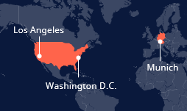
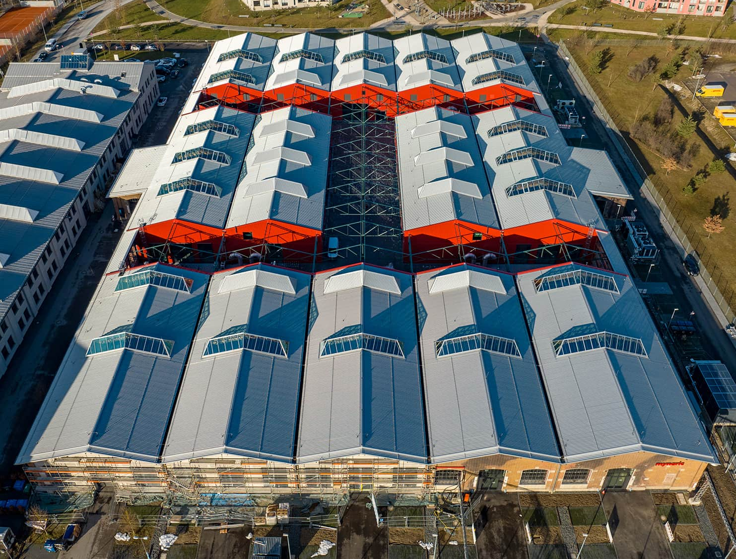

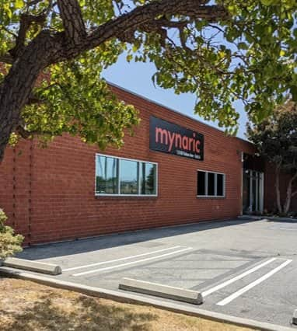
Our Facilites “Mynarica”
Large investment in serial manufacturing
Future-proof manufactoring facility with output of up to 2,000 units/year
Nearly 400 employees on site with >150 dedicated to engineering
Munich,
Germany
Oberpfaffenhofen, Germany
Hawthorne, C.A.,
USA
Product development, qualification testing SMT line and final assembly line: 11,000 sq meters (118,400 sq ft)
Optics Production: Total size of 1,600 sqm (17,200 sq ft)
Los Angeles US facility: Optical Communications Controller (OCC) production, Testbeds (20,200 sq ft)

Slide 4
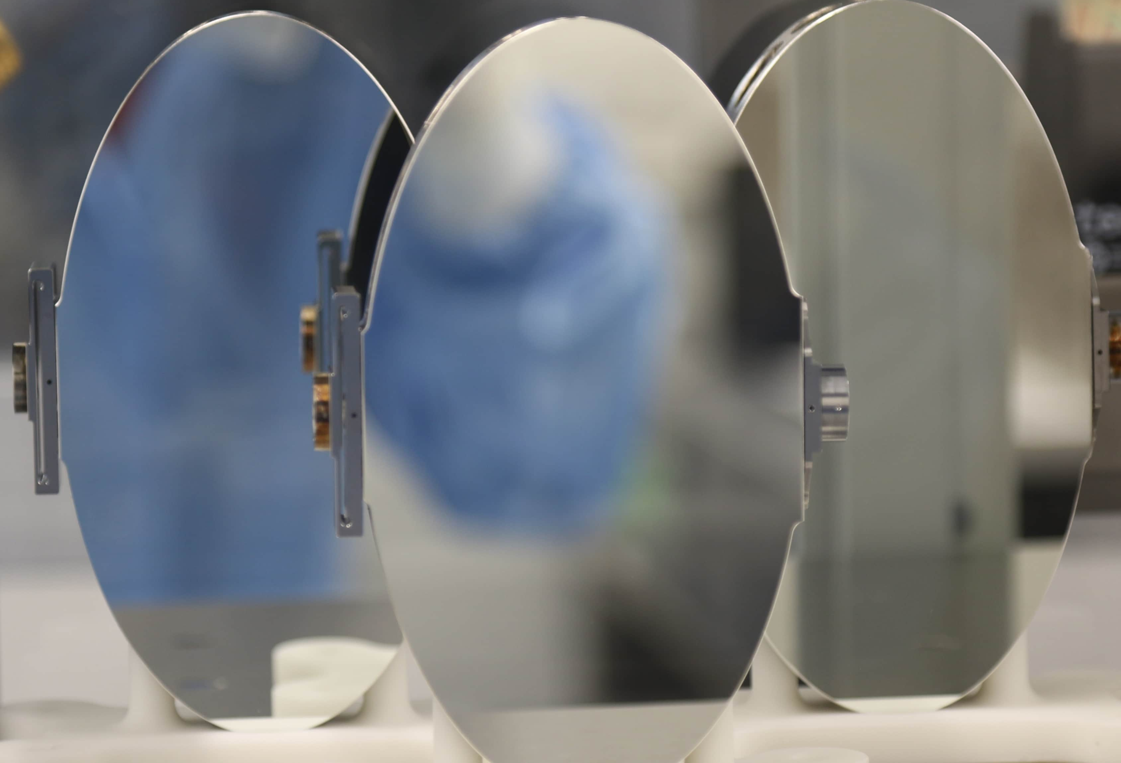
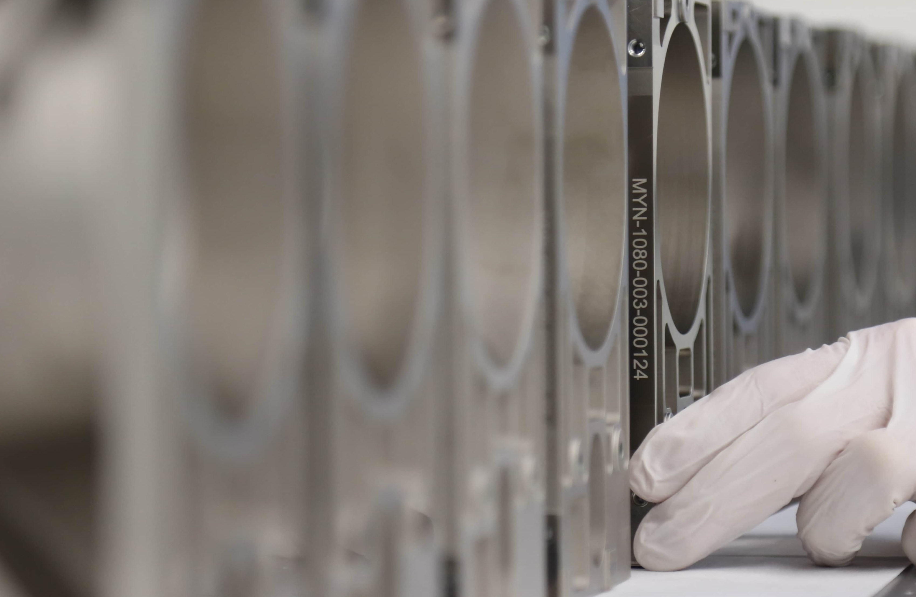
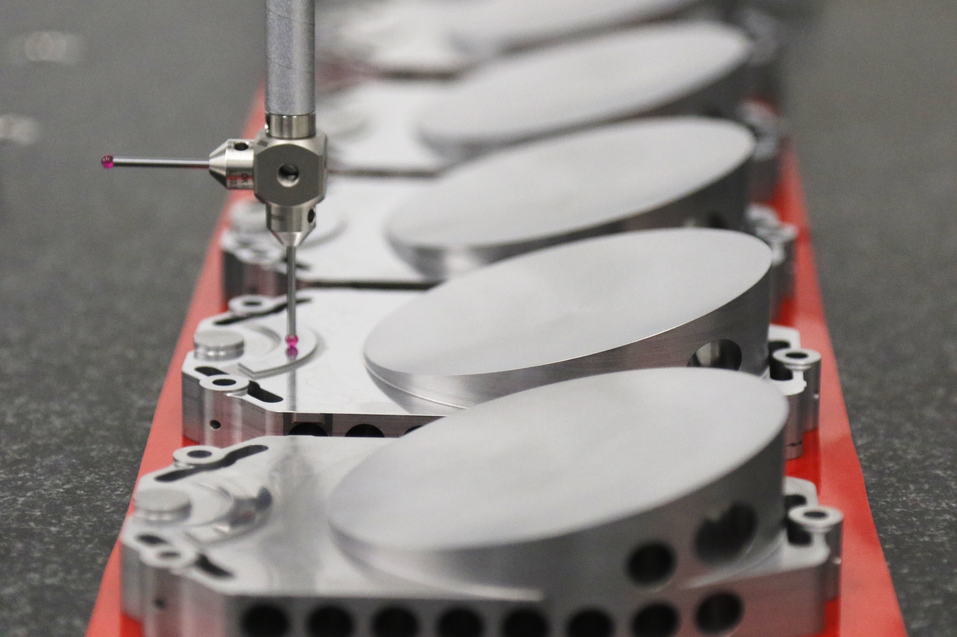
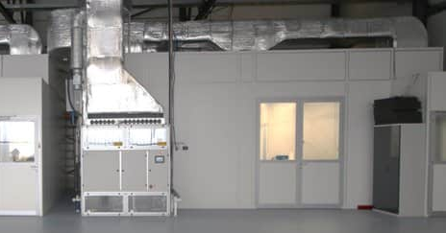
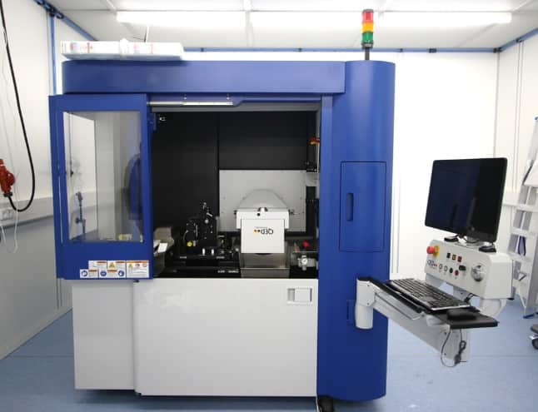
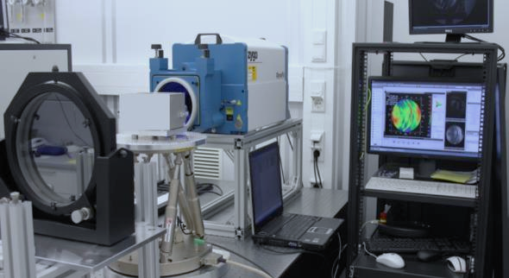
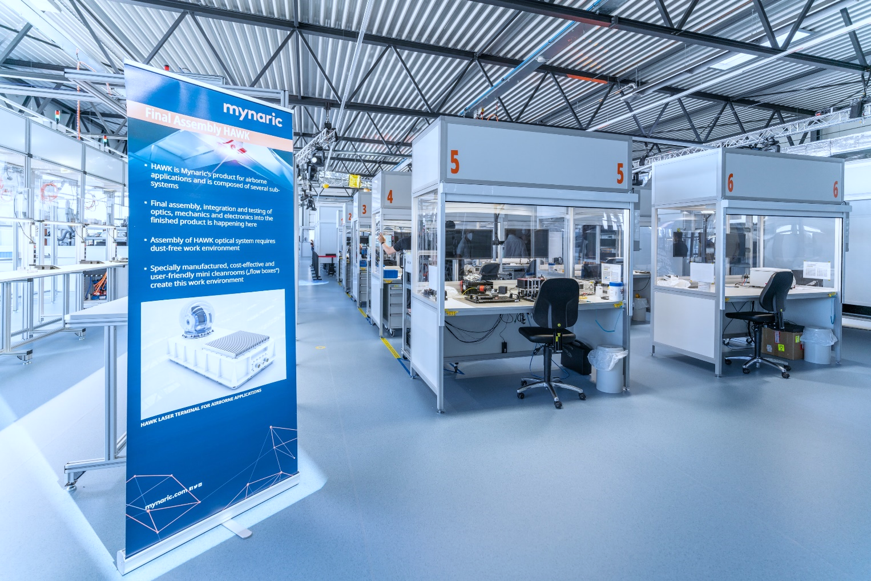
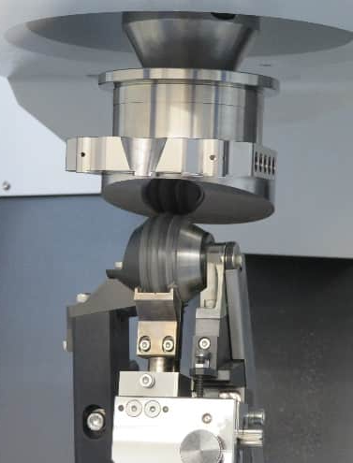
SCALABILITY: INSOURCED OPTICS PRODUCTION
Utilization of metal telescopes over typical (but more expensive) materials
Significant cost-savings compared to external sourcing and other telescope materials

Slide 5
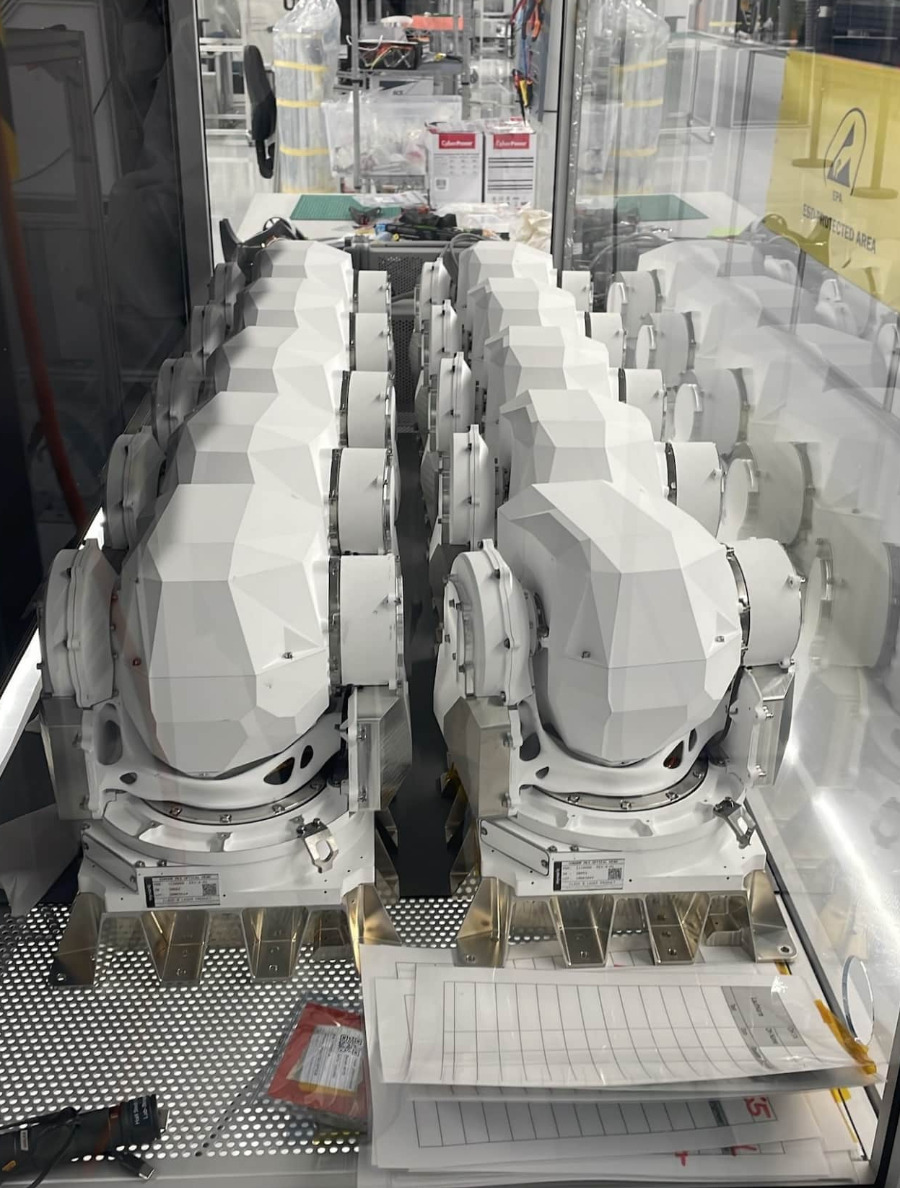
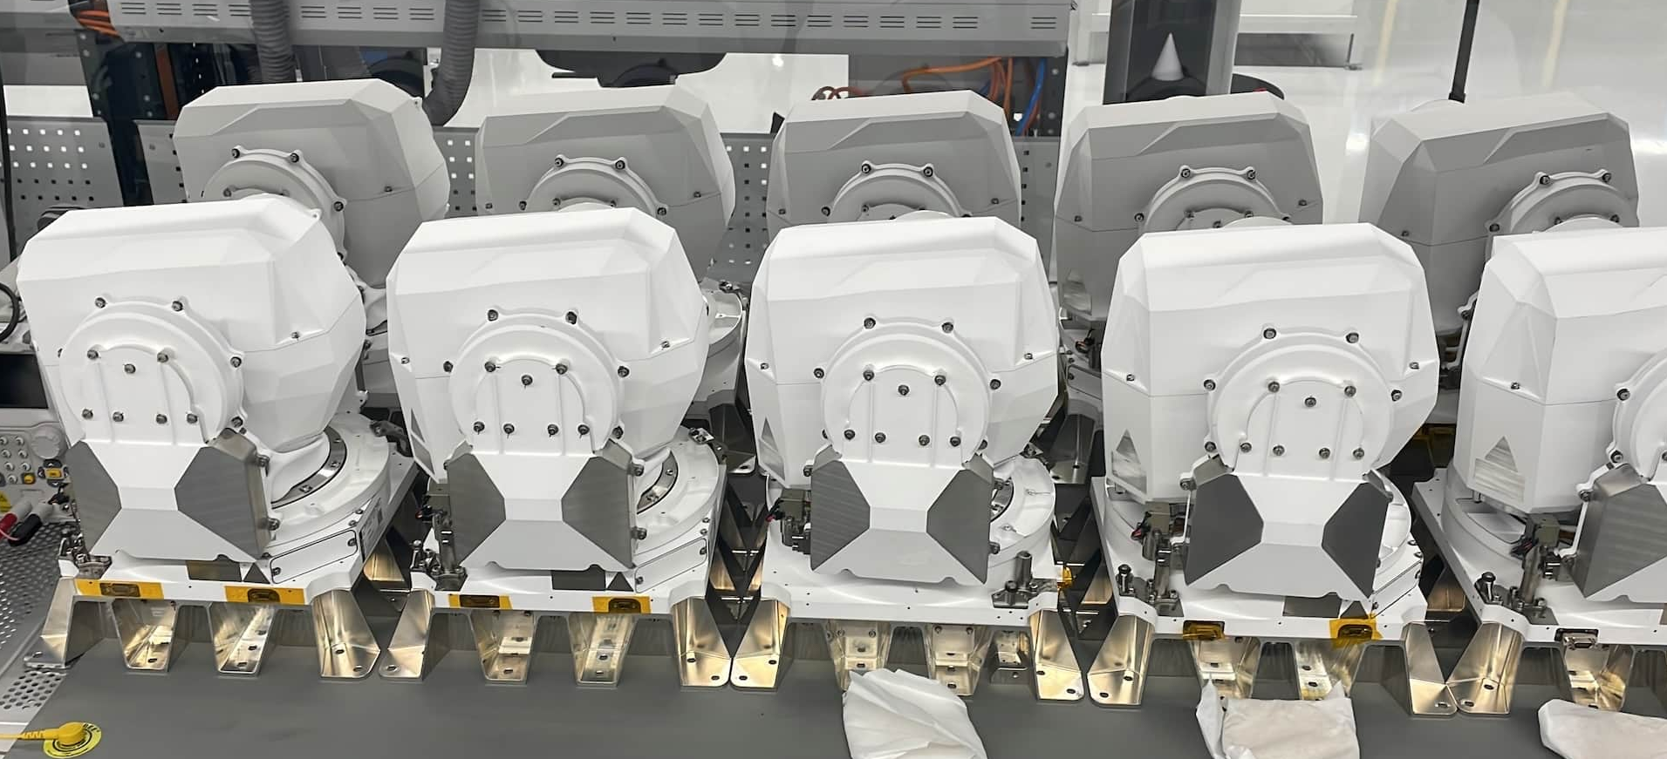
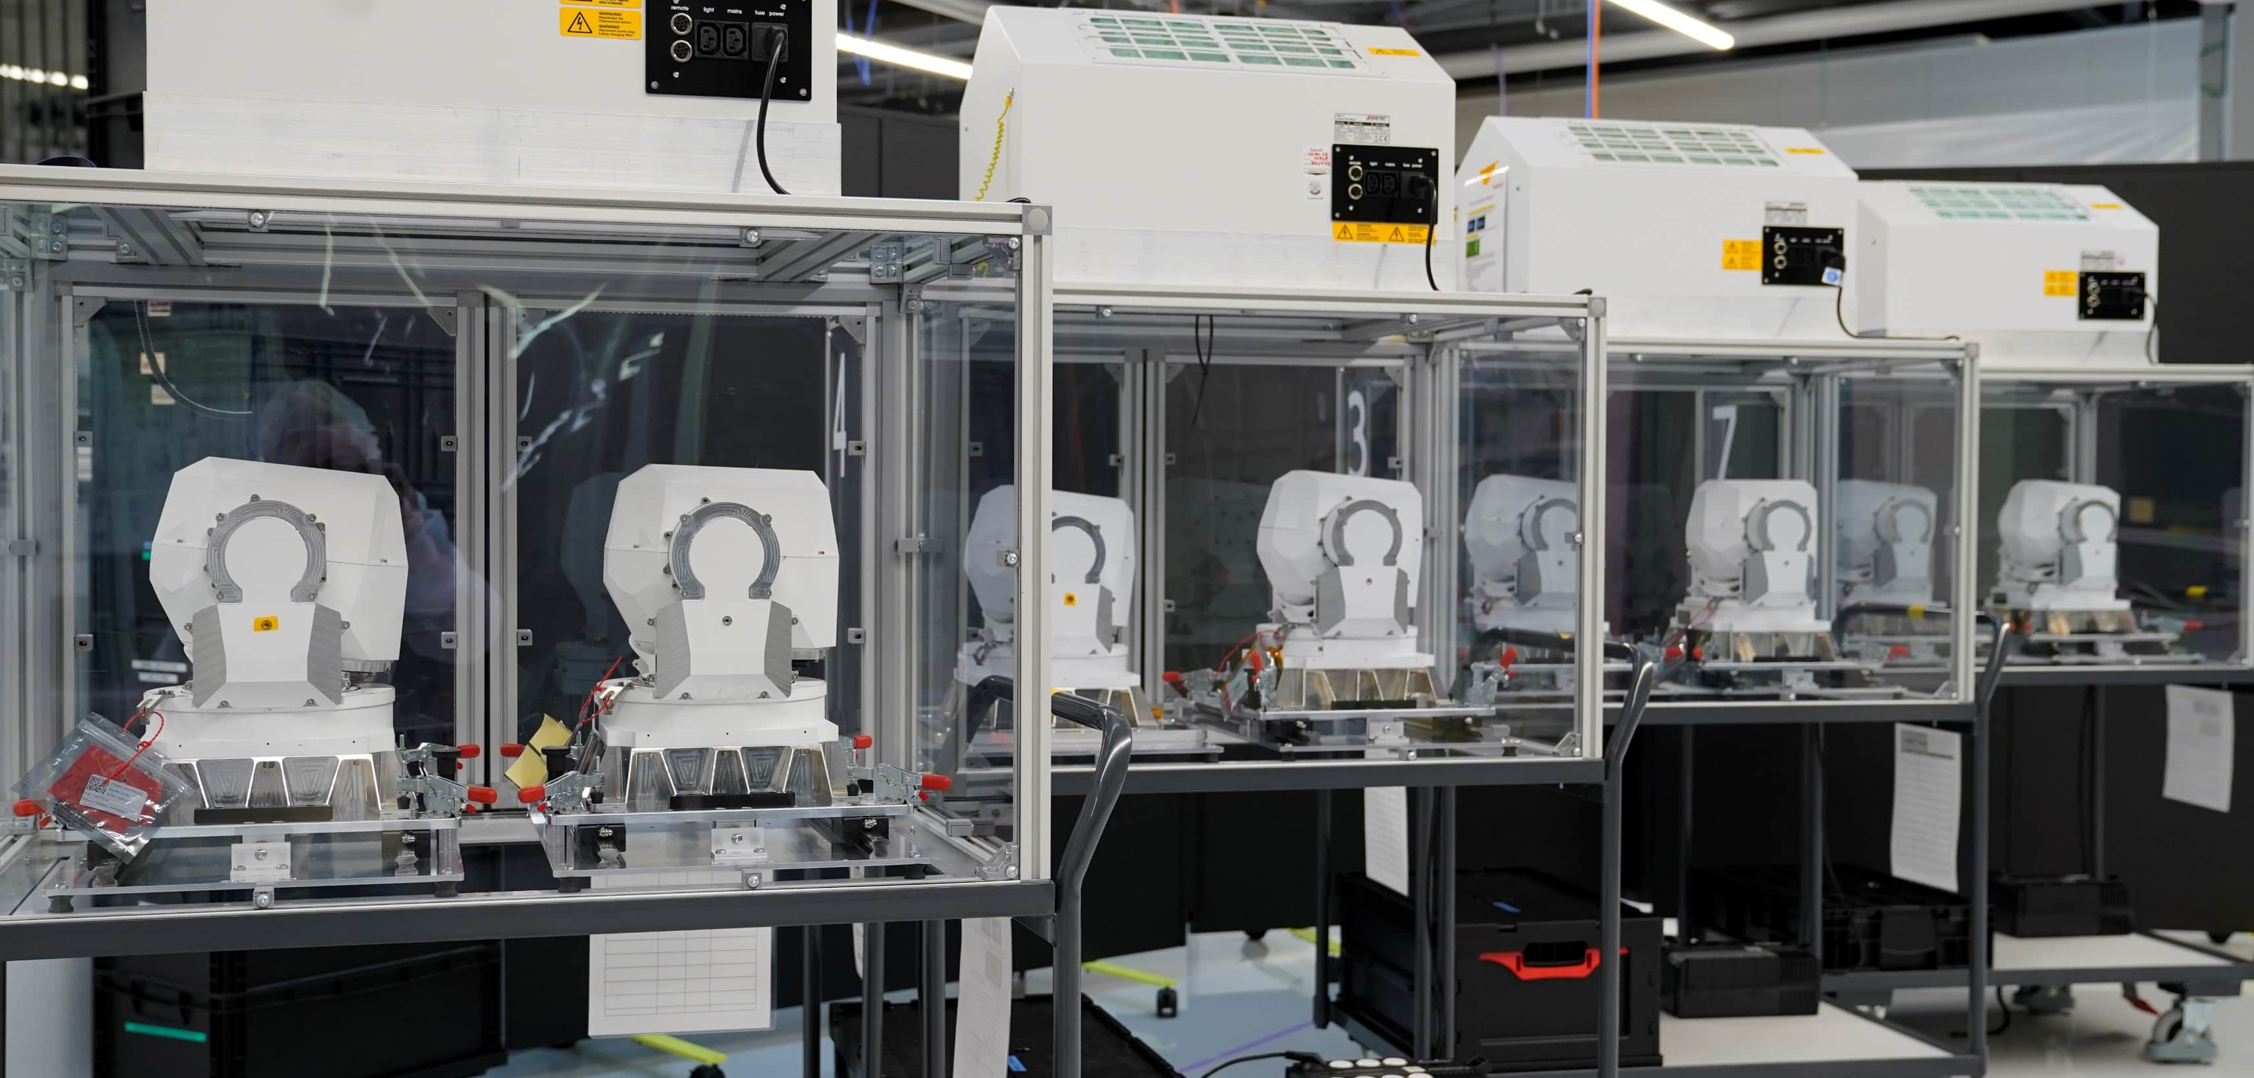
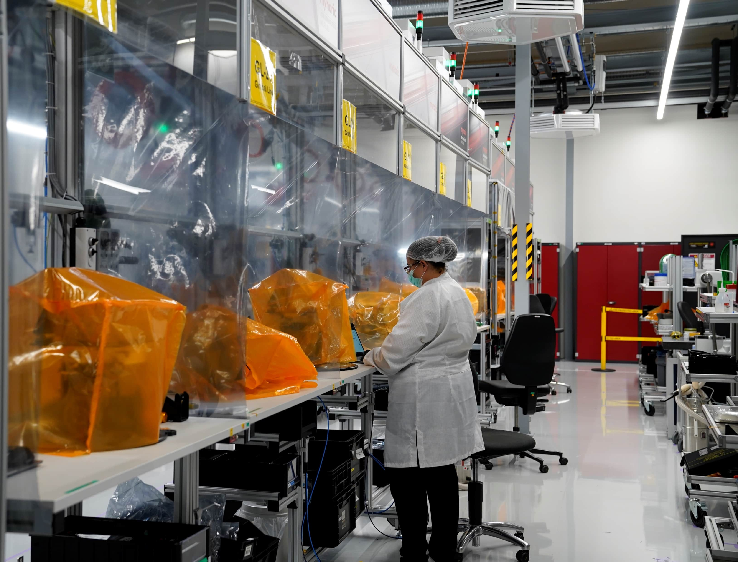
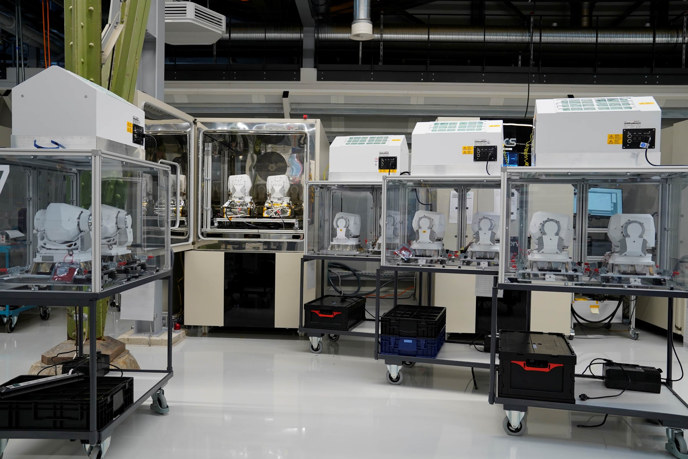
Serial Manufacturing

Slide 6
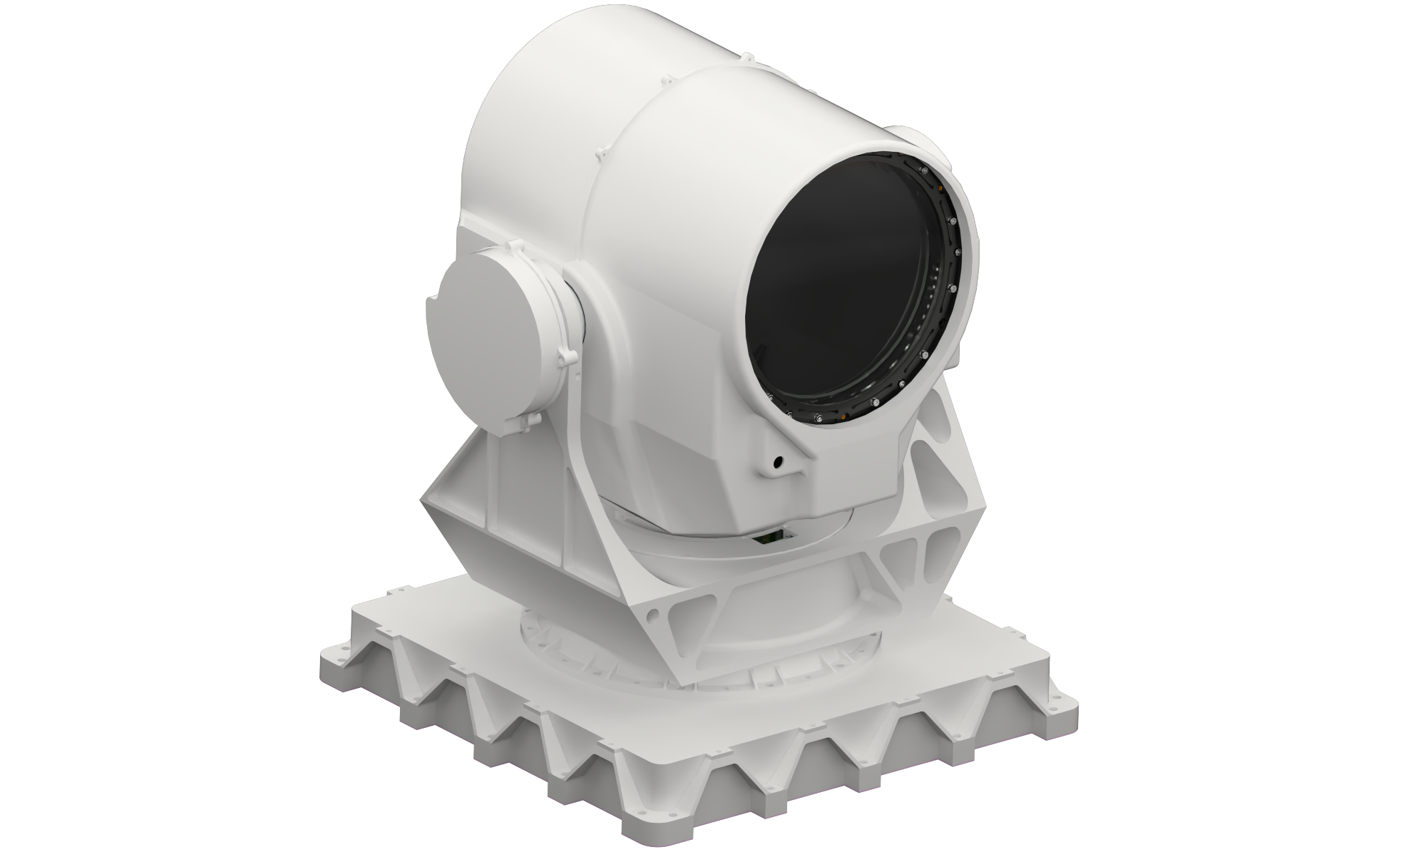


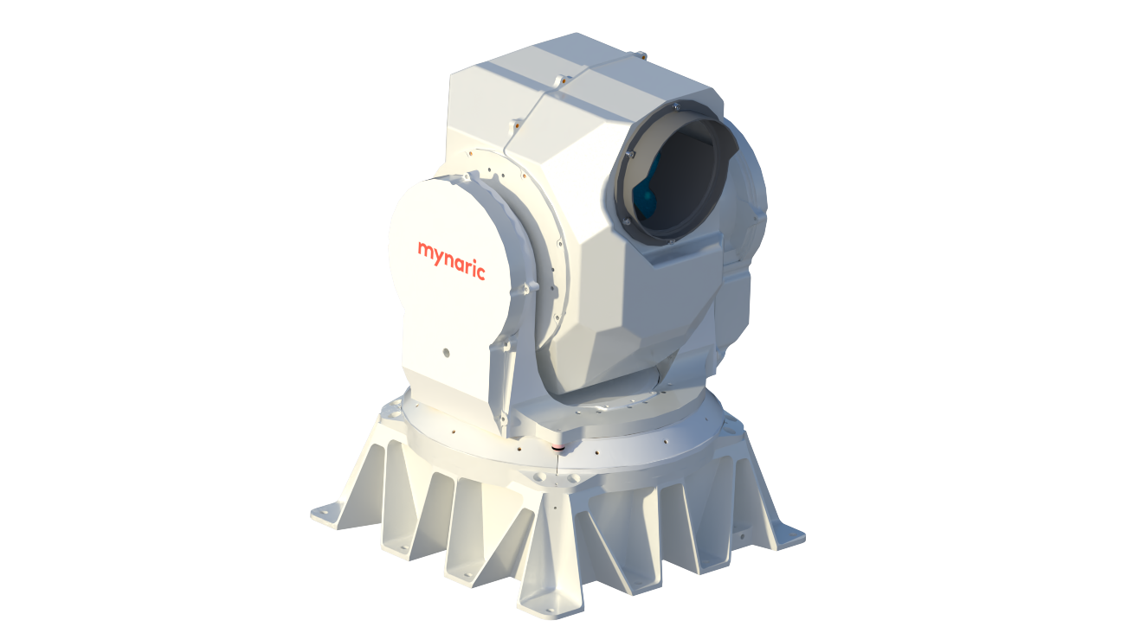
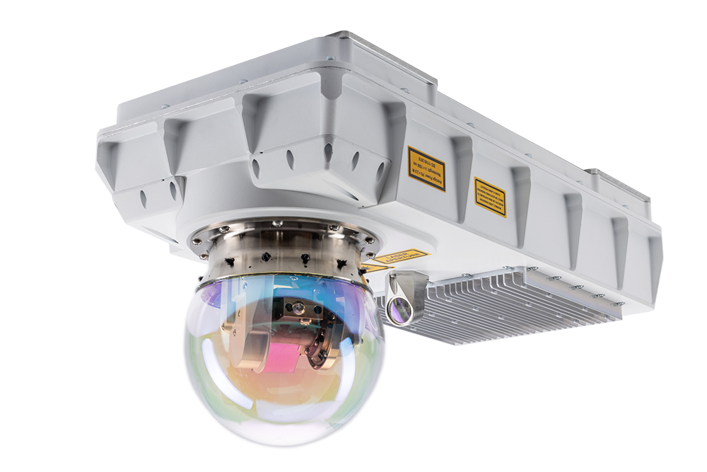

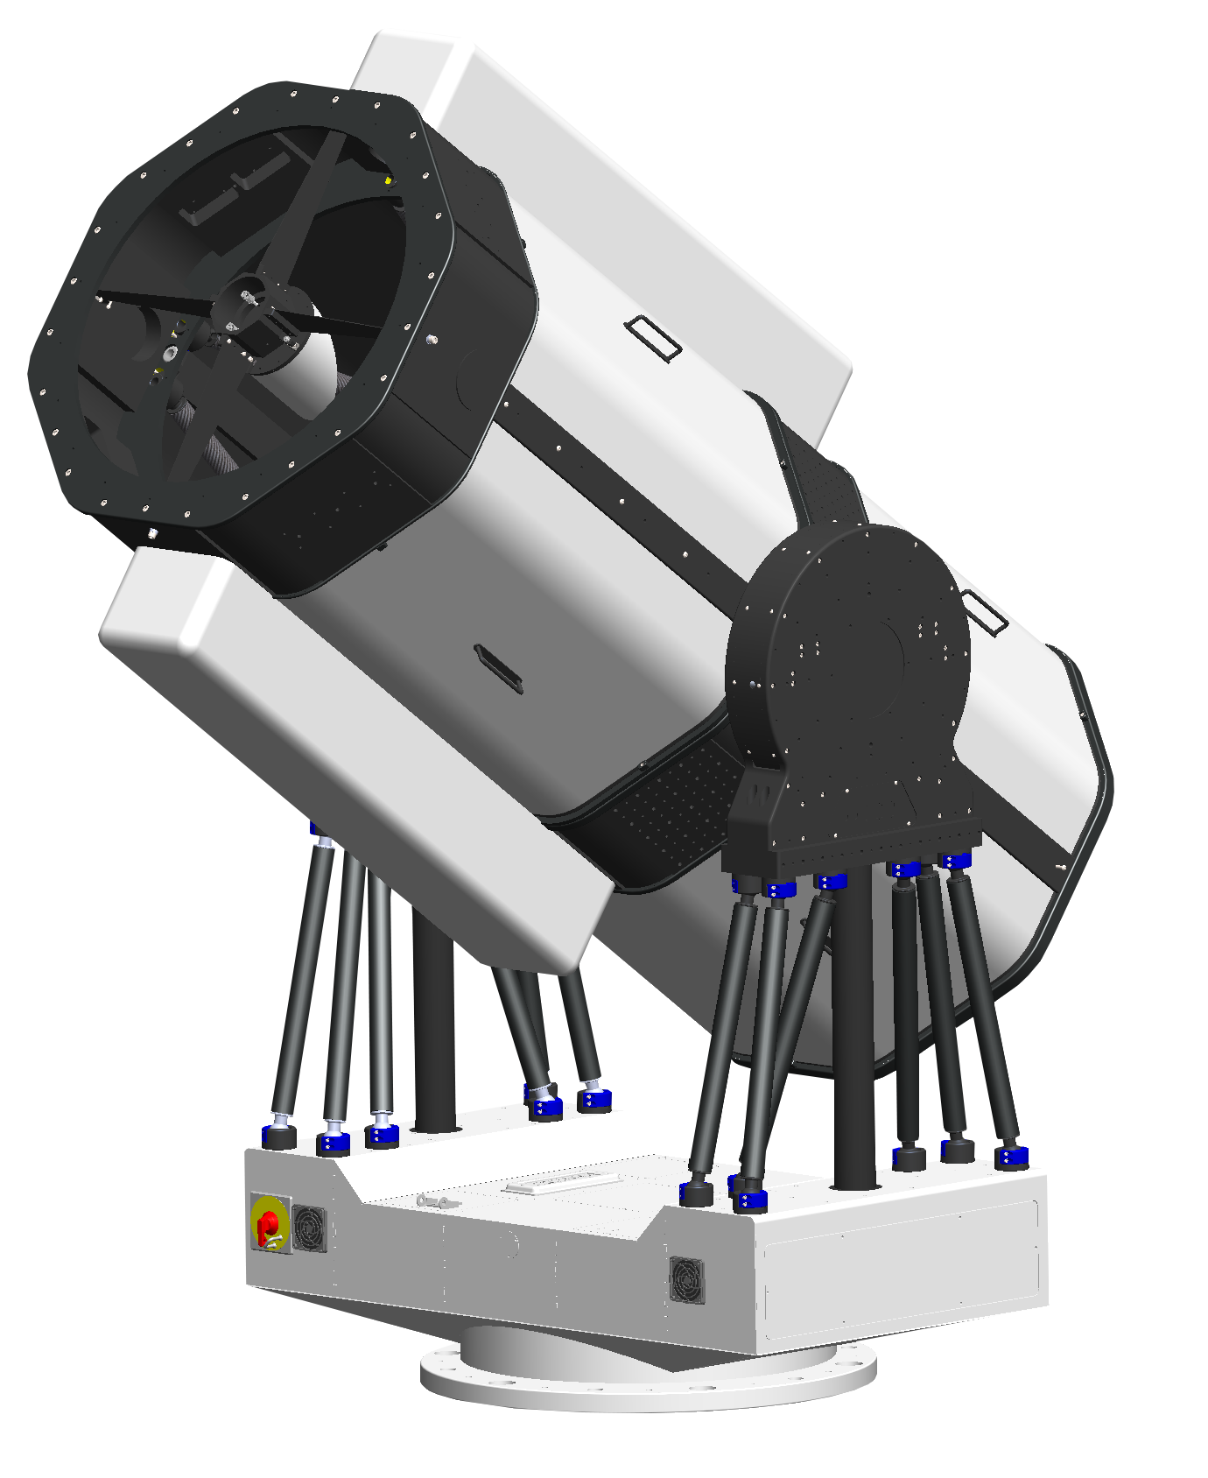




Areas of Communication
Multi-Orbit Satellite Networks
CONDOR
PLUS Product under development
3rd Party data transfer
Data relay
GEO
CONDOR
PLUS Product under development
Earth observation
In-orbit data
processing
MEO
CONDOR
Mk3 / Mk3.1
Laser
Communication
Broadband Constellations
LEO
HAWK Pre-series demonstrator
RF
Communication
AIRSPACE
Aviation
Intelligence
HALE/HAPS
RHINO
Product under development
GROUND
Commercial &
Residential
Internet of Things
Fixed
Ground Stations
Mobile Vehicles
Maritime

Slide 7
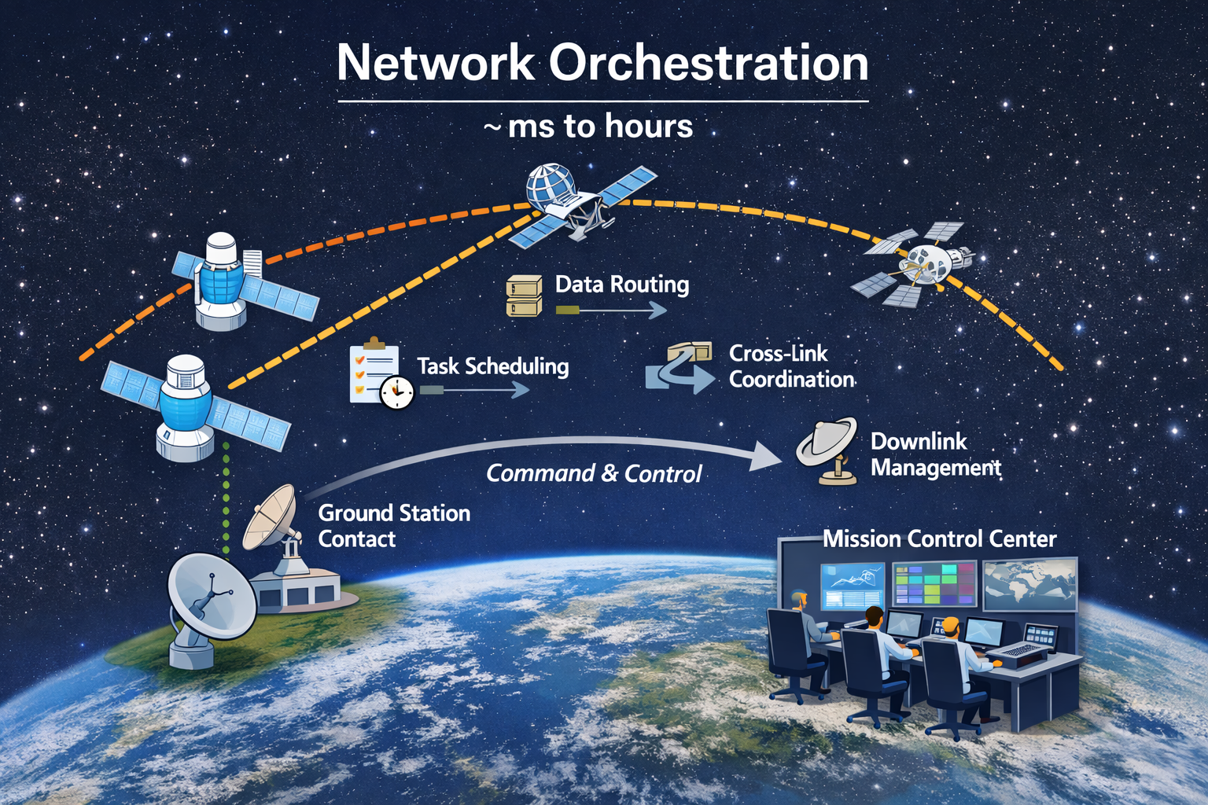
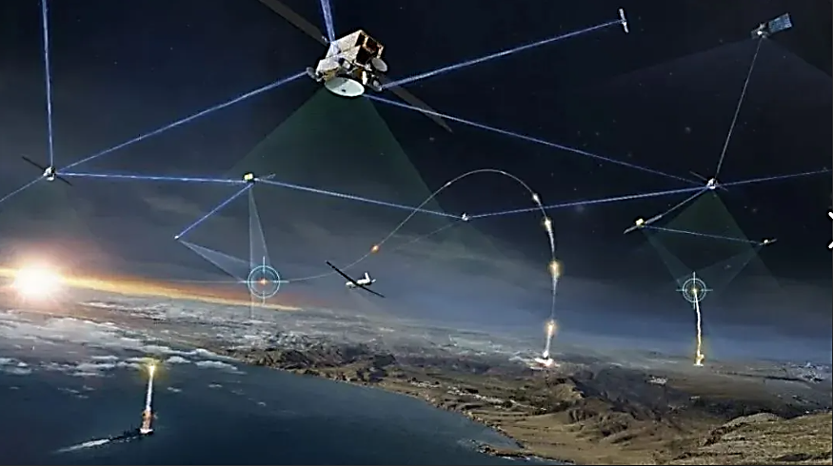
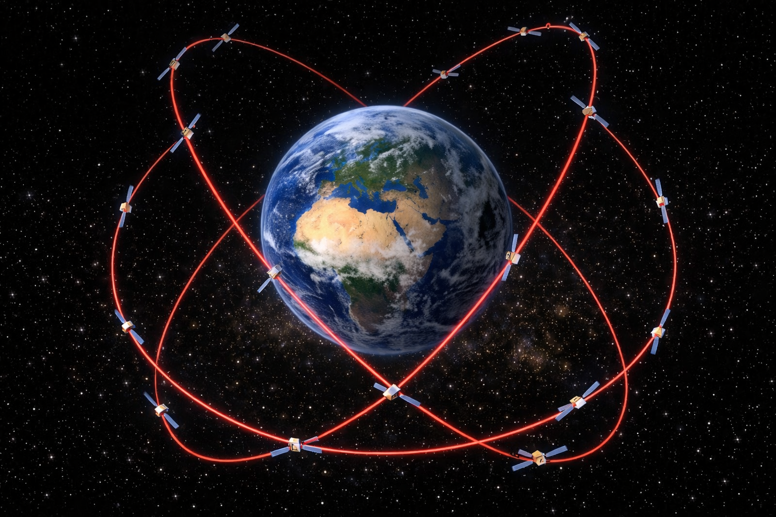
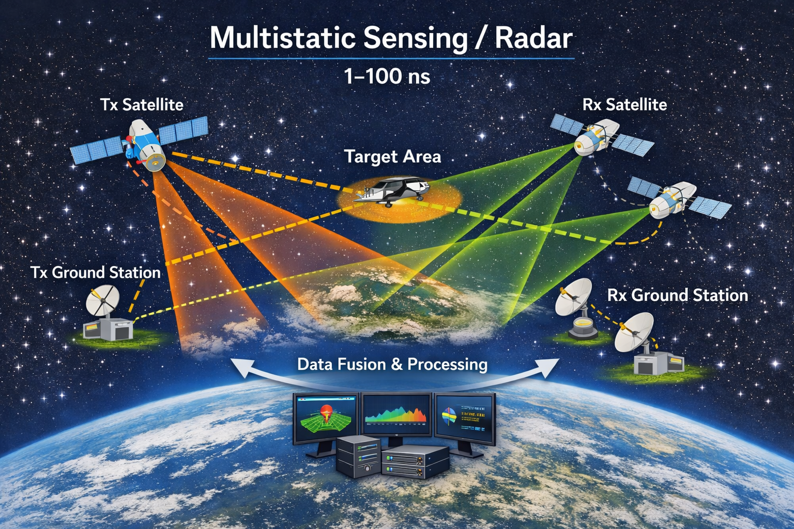
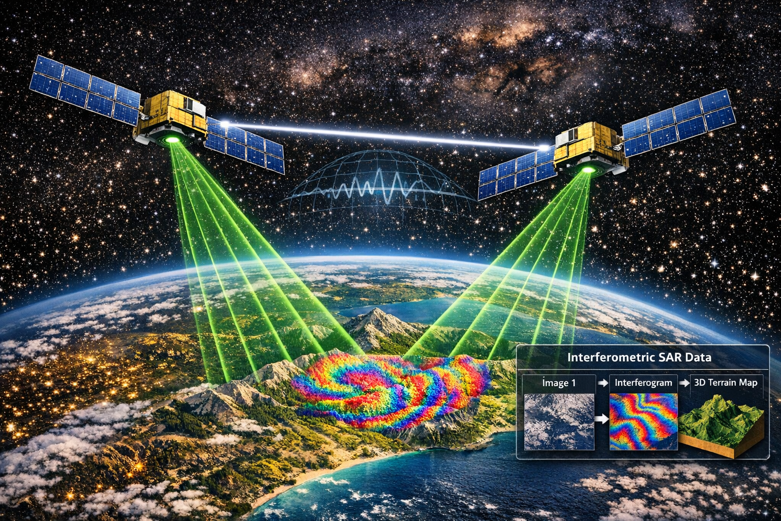
Timing Domains
SDA PWSA
GNSS Systems
Increasing
timing
accuracy
Mission level coordination
scheduling contacts
routing data
coordinating cross‑links
managing downlink windows
synchronizing protocol events
GPS-independent navigation
Resilient PNT
Space Domain Awareness
Navigation Warfare resilience
hours to ms 0.1ms to 100 ns 1 ns (30 cm, 1 ft) ps (mm) ps to fs
Interferometric Sensing
Sensor Synchronisation
Multiple transmitters/receivers in different positions
All observing the same target area
Frequency stability < 10⁻¹² to 10⁻¹⁴
Clock synchronization between platforms ps to fs
cancel path delays
Phase‑coherent LO distribution or phase‑locking across nodes
Requirement | Radar Interferometry (RF) | Optical Interferometry
Carrier frequency | 1–40 GHz | 200–300 THz
Phase period | 25–100 ps | 3–5 fs
TWTT clock sync | 1–10 ps | 10–100 fs

Slide 8





Two Way Time Transfer
Terminal A
Leader
Terminal B
Follower
Based on IEEE 1588 Standard: works for laser-links
t’=t+ $t_{LO}$
t₁
t₁ — when A sends
t₂′ — when B receives
t₃′ — when B sends the return message
t₄ — when A receives the return message
Time stamp here
Message
t₁
t₁
t’₂
t₁
t’₃
t₄
$$τ_{D}=\frac{\left(t_{2}^{′}−t_{1}\right)+\left(t_{4}−t_{3}^{′}\right)}{2}$$
Estimated Channel Delay
t₄
$$t_{LO}=t_{2}^{′}−\left(t_{1}+τ_{D}\right)$$
t₄
Estimated Clock Offset
Time
Adjust follower clock frequency
to align clocks
d
Phase Detector
LPF
VCO
Stationary link assumes d_{AB} =d_{BA}

Slide 9


Satellite Two Way Time Transfer: velocity difference
Terminal A
Leader
Terminal B
Follower
t’=t+ $t_{LO}$
Follower wants Leader to appear Stationary
Control loop in follower’s reference frame needs corrected offset
t’₄ — when A would have received return message if there would be no motion
V_{est} — estimated velocity between follower and leader
c — speed of light
t₁
t₁
t’₂
V_{est}
t₁
t’₃
$$τ_{D}′=\frac{\left(t_{2}^{′}−t_{1}\right)+\left({t′}_{4}−t_{3}^{′}\right)}{2}$$
t’₄
t₄
Estimated Channel Delay
t₄
$$t_{LO}=t_{2}^{′}−\left(t_{1}+τ_{D}\right)$$
t₄
Estimated Clock Offset
Time
$${t′}_{4}=t_{4}−\frac{\left(t_{4}−t_{1}\right)∗v_{est}}{c}$$
Compensated delay
Velocity compensation
Uncompensated delay
Satellite link d_{AB} ≠d_{BA}

Slide 10

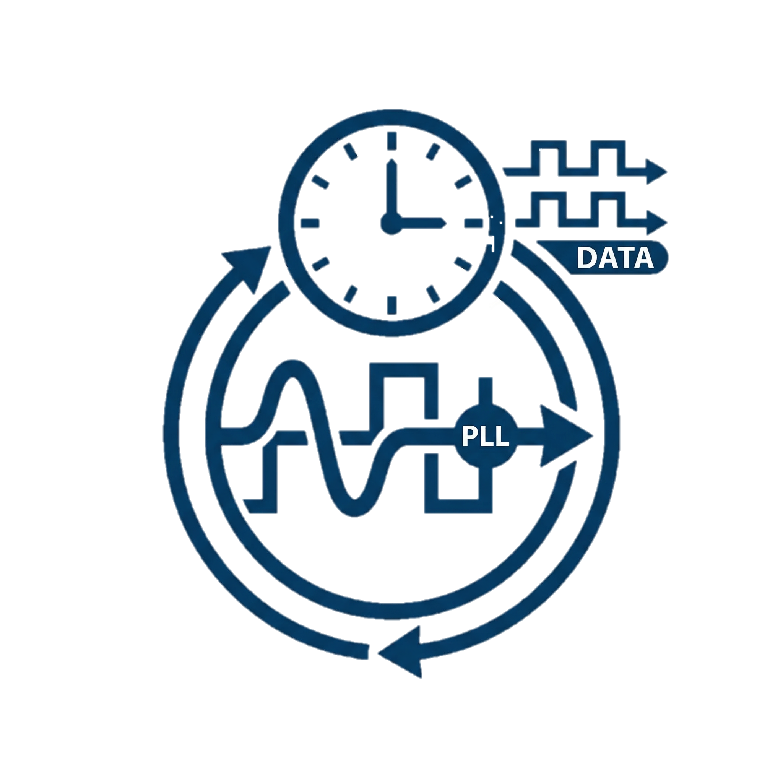
Sub Symbol phase resolution: DDMTD
Atomic Clock
(CSAC)
Simple approach or Intensity Modulation with Direct Detect (OOK)
Atomic Clock
(CSAC)
Sub-symbol phase difference measurement necessary
PPS
10.23 MHz
Terminal A
Leader
Terminal B
Follower
PPS
10.23 MHz
CLK Generator
(PLL)
CLK Generator
(PLL)
CLK1
CLK2
CLK3
CLK1
CLK2
CLK3
2.5 Gbps (400 ps)
Tx-System
Rx-
System
Rx-
System
CDR
CDR
Tx-System
CDR locks to Terminal B
Phase difference / phase change over time (Doppler)

Slide 11
Sub Symbol phase resolution: DDMTD
DDMTD: Digital Dual Mixer Time Difference
High‑precision digital phase‑measurement technique
used to resolve time differences between two clocks with picosecond‑ to sub‑picosecond‑level resolution
even when the clocks themselves run at multi‑Gbps data rates.
The challenge: direct sampling ns to ps differences with an FPGA logic clocked at a few hundred MHz
2.5 Gbps (400 ps)
Tx-System
Rx-
System
CDR
CDR locks to Terminal B
RMS=64.3 ps

Slide 12
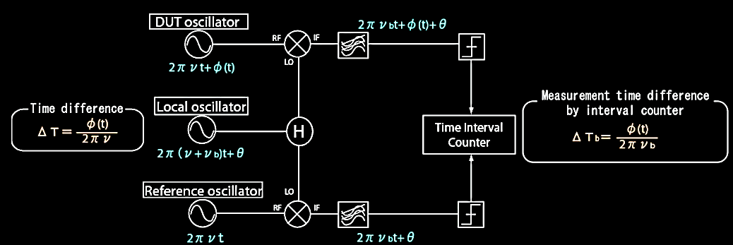
Digital Dual Mixer Time Difference: ps time stamping
Rx-
System
CDR
Tx-System
Local Oscillator is “zoom” factor: slightly offset, therefore two mixed signals appear as low frequency beat signals
Tx-Clk
2.5 Gbps (400 ps)
Time interval Counter (phase counter): ps resolution
Rx-Clk
Locked to B Terminal
These slow beat waveforms preserve the original high‑frequency phase difference
Notes:
Digital Dual Mixer Time Difference (DDMTD) — Principle
DDMTD is a high‑precision digital phase‑measurement technique that measures the timing difference between two independent clock domains with sub‑nanosecond to tens‑of‑picoseconds accuracy.
Your internal files describe it as the mechanism that:
“manages the ambiguity to the local reference time” and
“increases the resolution below 100 ps,” with breadboard tests showing ~30 ps equivalent resolution. [2023_03_11...SLIDE DECK | PowerPoint], [NGC CDR Day 3 | PowerPoint], [ork | PowerPoint]
How the principle works (step‑by‑step)
Two clocks (Clock A and Clock B) with very high frequency (e.g., data‑recovered CDR clock and local system clock) enter the DDMTD sampler.
A slightly offset sampling clock is applied to both using latch/mixer logic:
$$f_{\text{ddmtd}}=f_{\text{clk}}⋅\frac{N}{N+1}$$
Because the sampling frequency is only slightly different, the two sampled signals appear as low‑frequency beat signals:
$$f_{\text{beat}}=∣f_{\text{clk}}−f_{\text{ddmtd}}∣=\frac{f_{\text{clk}}}{N+1}$$
These slow beat waveforms preserve the original high‑frequency phase difference between Clock A and Clock B, but at a measurable rate (e.g., hundreds of Hz).
A phase counter then measures the relative edge positions of the two beat signals and reconstructs the original time offset:
$$Δt=Δφ_{\text{beat}}⋅\frac{f_{\text{beat}}}{f_{\text{clk}}}$$
This matches the block‑diagram descriptions in your files:
“Latch → de‑glitcher → XOR → beat f → phase counter” [2023_03_11...SLIDE DECK | PowerPoint], [NGC CDR Day 3 | PowerPoint]
And from the DDMTD diagrams you generated:
input clocks → mixers → beat‑frequency generation → phase counter [DDMTD_diagram | PowerPoint], [DDMTD_diagram_dark | PowerPoint]
⭐ Why DDMTD Is Used — Key Advantages
1. Picosecond‑level resolution using low‑speed FPGA logic
DDMTD converts GHz‑scale timing information into a beat frequency of only a few hundred Hz. Your internal CDR/PNT files show:
<100 ps resolution, and
~30 ps demonstrated in lab hardware. [2023_03_11...SLIDE DECK | PowerPoint], [NGC CDR Day 3 | PowerPoint]
This allows:
accurate timestamping
clock‑offset measurement
deterministic latency calibration without requiring exotic high‑speed TDCs.
2. Robust clock‑ambiguity resolution in SERDES / CDR systems
The technique is specifically cited as the block that resolves ambiguous CDR phase alignment:
“Ambiguity to local ref time is managed by the DDMTD logic” [2023_03_11...SLIDE DECK | PowerPoint], [NGC CDR Day 3 | PowerPoint]
This is essential for:
SDA modem timing
PNT timing loops
TWTT ranging
Condor Mk3 deterministic latency transceiver configuration
3. Works entirely in digital logic (FPGA‑friendly)
DDMTD uses:
latch mixers
de‑glitchers
XOR phase detectors
counters
Your internal vector diagram files highlight that the full chain is implementable as standard FPGA logic without analog circuitry. [DDMTD_vector_diagram | PowerPoint]
4. Immune to high‑frequency jitter that would break direct sampling
Because the beat frequency is slow, measurement is averaged over many UI periods, improving SNR and eliminating the need for high‑bandwidth TDCs.
5. Ideal for high‑speed links (e.g., 2.5 Gbps → 400 ps UI)
As referenced in your PNT + Laser‑Navigation deck:
CDR at 2.5 Gbps (400 ps UI)
Sub‑symbol resolution via DDMTD [Laser-Prec...27May2025 | PowerPoint]
This makes it suitable for:
symbol‑level TWTT
ranging accuracy improvement
tight synchronization in LEO/GEO
6. Extremely stable and deterministic
The down‑mixing process filters out:
jitter
thermal variation
asynchronous startup effects
Internal files show it used as part of:
“time stamping strategy”
“SDA MGMT/TWTT definition” for precision timing layers. [2023_03_11...SLIDE DECK | PowerPoint], [503AR33818...t_Analysis | PDF]
⭐ Summary (What DDMTD gives you)
RequirementDDMTD BenefitSub‑ns or ps timingAchieves <100 ps, proven ~30 psDeterministic latencyResolves CDR ambiguity and SERDES uncertaintyFPGA integration100% digital, low‑resource implementationHigh‑speed systemsWorks with 2.5 Gbps, 10 Gbps, etc.Optical PNT / TWTTEnables precise timing offset measurementSDA‑compatible timingMatches Condor Mk3 modem architecture

Slide 13
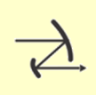
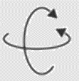
Terminal Block Diagram and PNT impact
Tip/tilt optical head
Telescope Assembly
FSA
Fine Steering Assembly
Tx/Rx Beam
Separation Assembly
PAA
Point Ahead Assembly
Az/El Fiber Wrap
Booster
(HPOA)
Collimator
EYDFA
From Modem
1530-1565 nm
λtune
Fiber Coupling Assembly
Optical (Free Space)
Optical (Fiber)
Electrical
M
µC
M
Az/El Fiber Wrap
EDFA
µC
Pre-amp
(LNOA)
Non-PM
To Modem

Slide 14
Summary
Accuracy
Timing
Bandwidth
Resilience
Inter-Satellite Links
Cost
Notes:
1. Superior Ranging Accuracy
Laser ranging uses light waves with wavelengths in the micrometer range, enabling millimeter to centimeter-level distance measurements.
In contrast, RF-based ranging (e.g., L-band) typically achieves meter-level accuracy due to longer wavelengths and atmospheric distortion.
Impact: More accurate satellite position determination → improved user location precision.
🔹 2. Sub-Nanosecond Timing Precision
Lasercomms support Two-Way Time Transfer (TWTT) with extremely low latency and high stability.
Enables direct measurement of clock offsets between satellites or between satellite and ground.
Impact: Better synchronization of satellite clocks → reduced pseudorange errors → tighter positioning and timing accuracy.
🔹 3. High Bandwidth and Low Latency
Laser links can transmit gigabits per second, far exceeding RF capacity.
Supports frequent updates of ephemeris and clock data between satellites and ground.
Impact: Faster convergence times for receivers, more responsive navigation, and real-time integrity monitoring.
🔹 4. Resilience
Laser beams are narrow and directional, minimizing reflections and signal scattering.
Less susceptible to jamming, spoofing, and RF congestion.
Impact: More robust and secure signal environment, especially in urban or contested areas.
🔹 5. Enabling Inter-Satellite Communication
Satellites can form a mesh network, sharing timing and position data directly.
Reduces reliance on ground stations for synchronization and control.
Impact: Greater autonomy, resilience, and scalability of the constellation.
🔹 6. Long-Term Cost Efficiency
While laser terminals are more complex, they reduce the need for:
Frequent ground uploads
Dense ground station networks
Impact: Lower operational costs and improved scalability for large constellations (e.g., LEO PNT systems).

Slide 15

Thank you & Questions
Joachim Horwath
CTO
Joachim.horwath@mynaric.com
THANK YOU FOR YOUR ATTENTION

