Slide 1
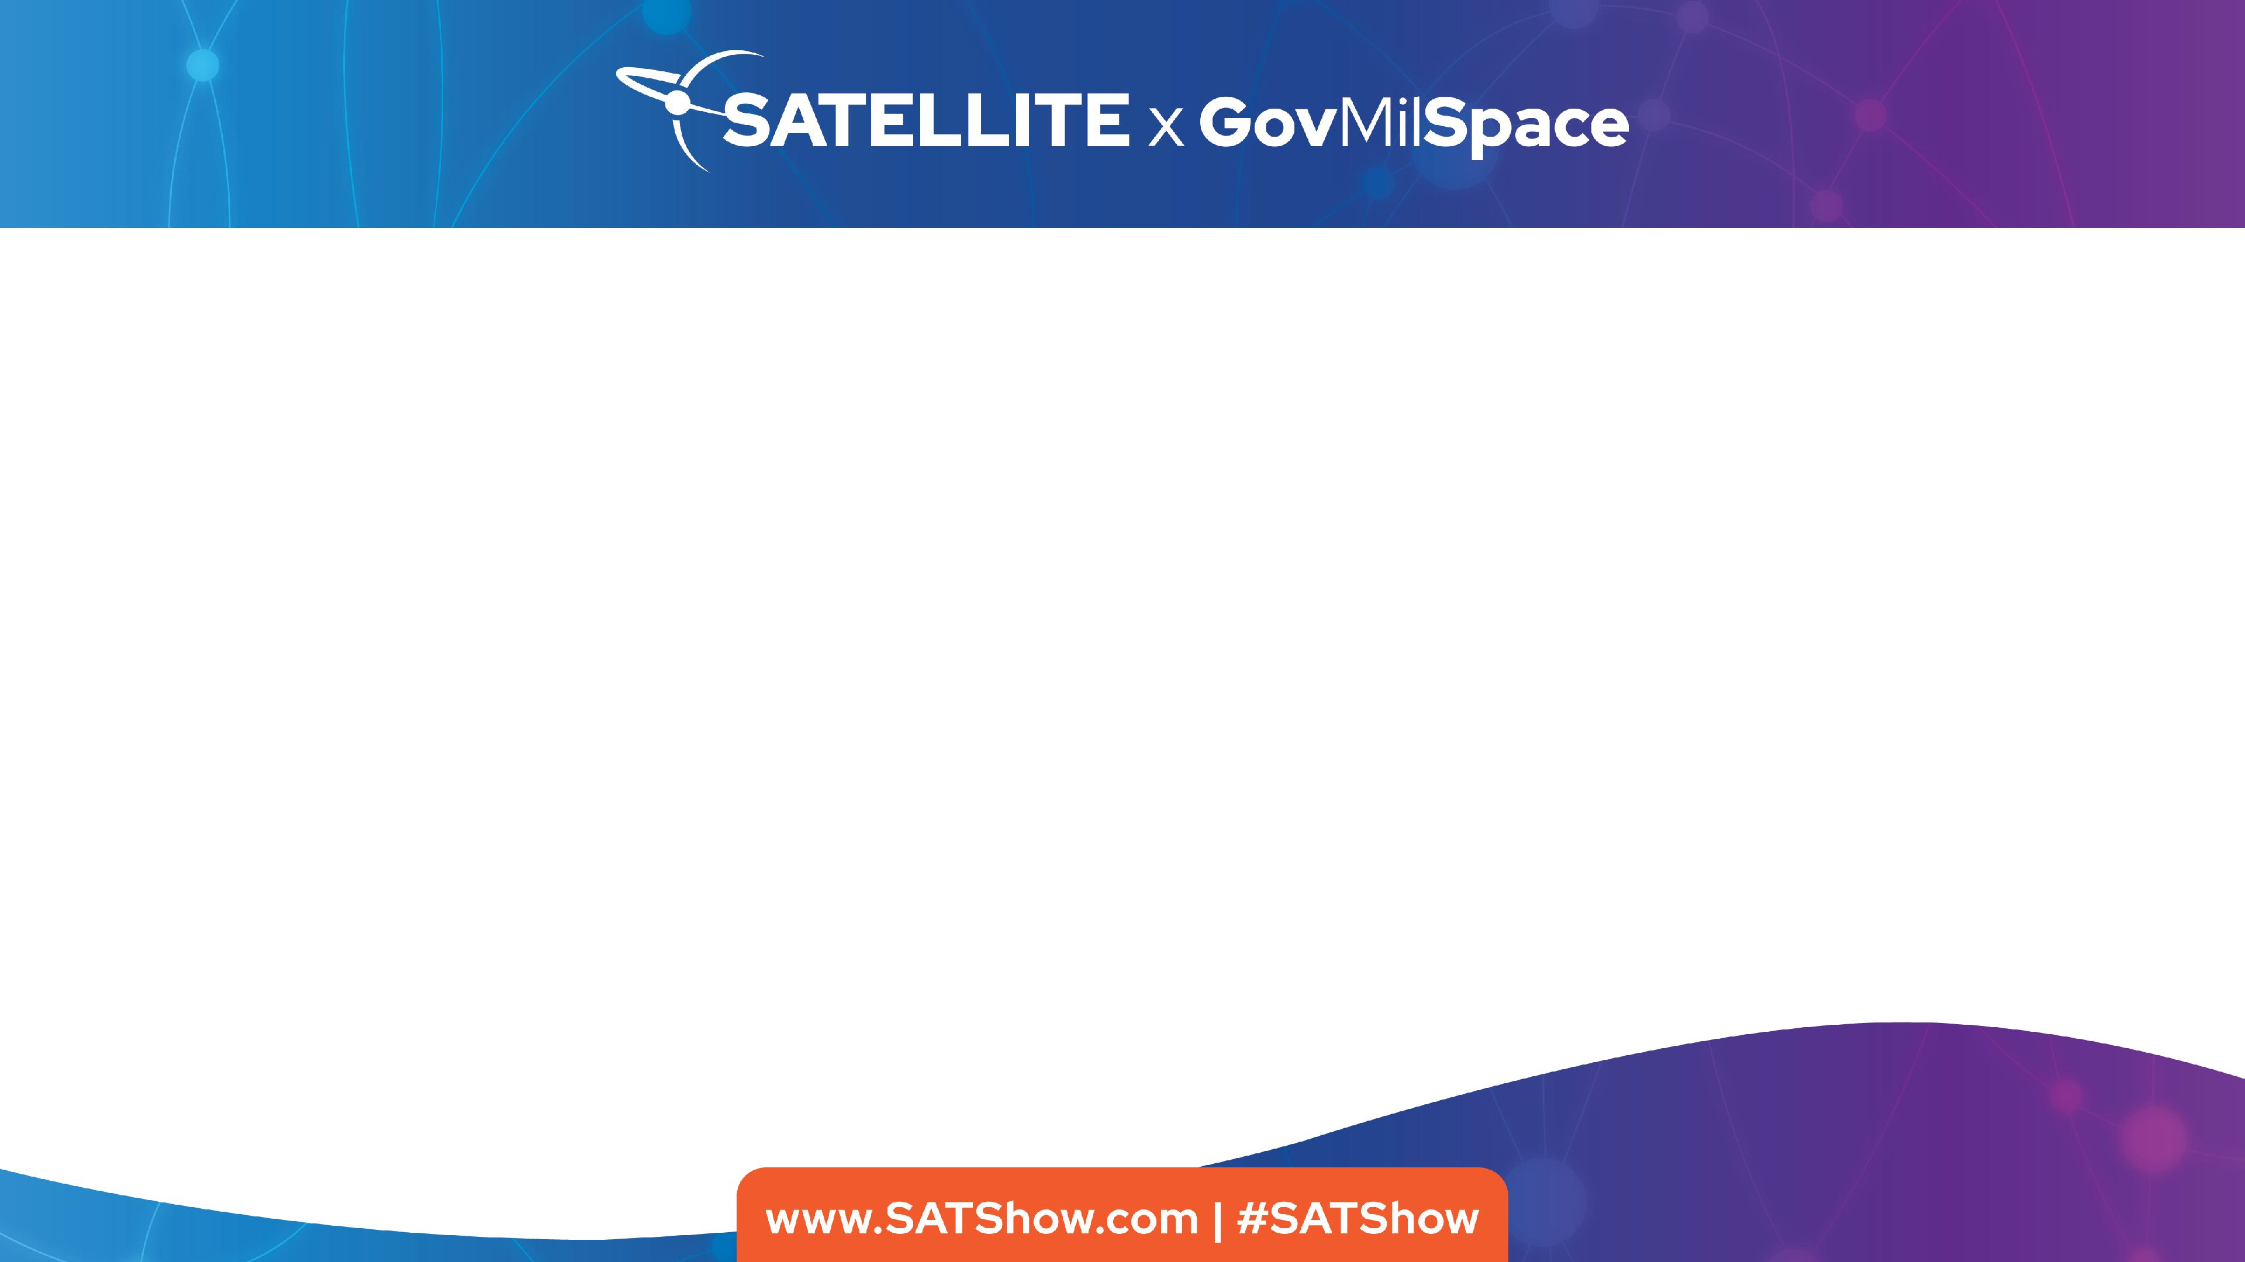

Navigating the Shift to Software-Defined Space Missions
John Trionfo
President, Defense Solutions

Slide 2
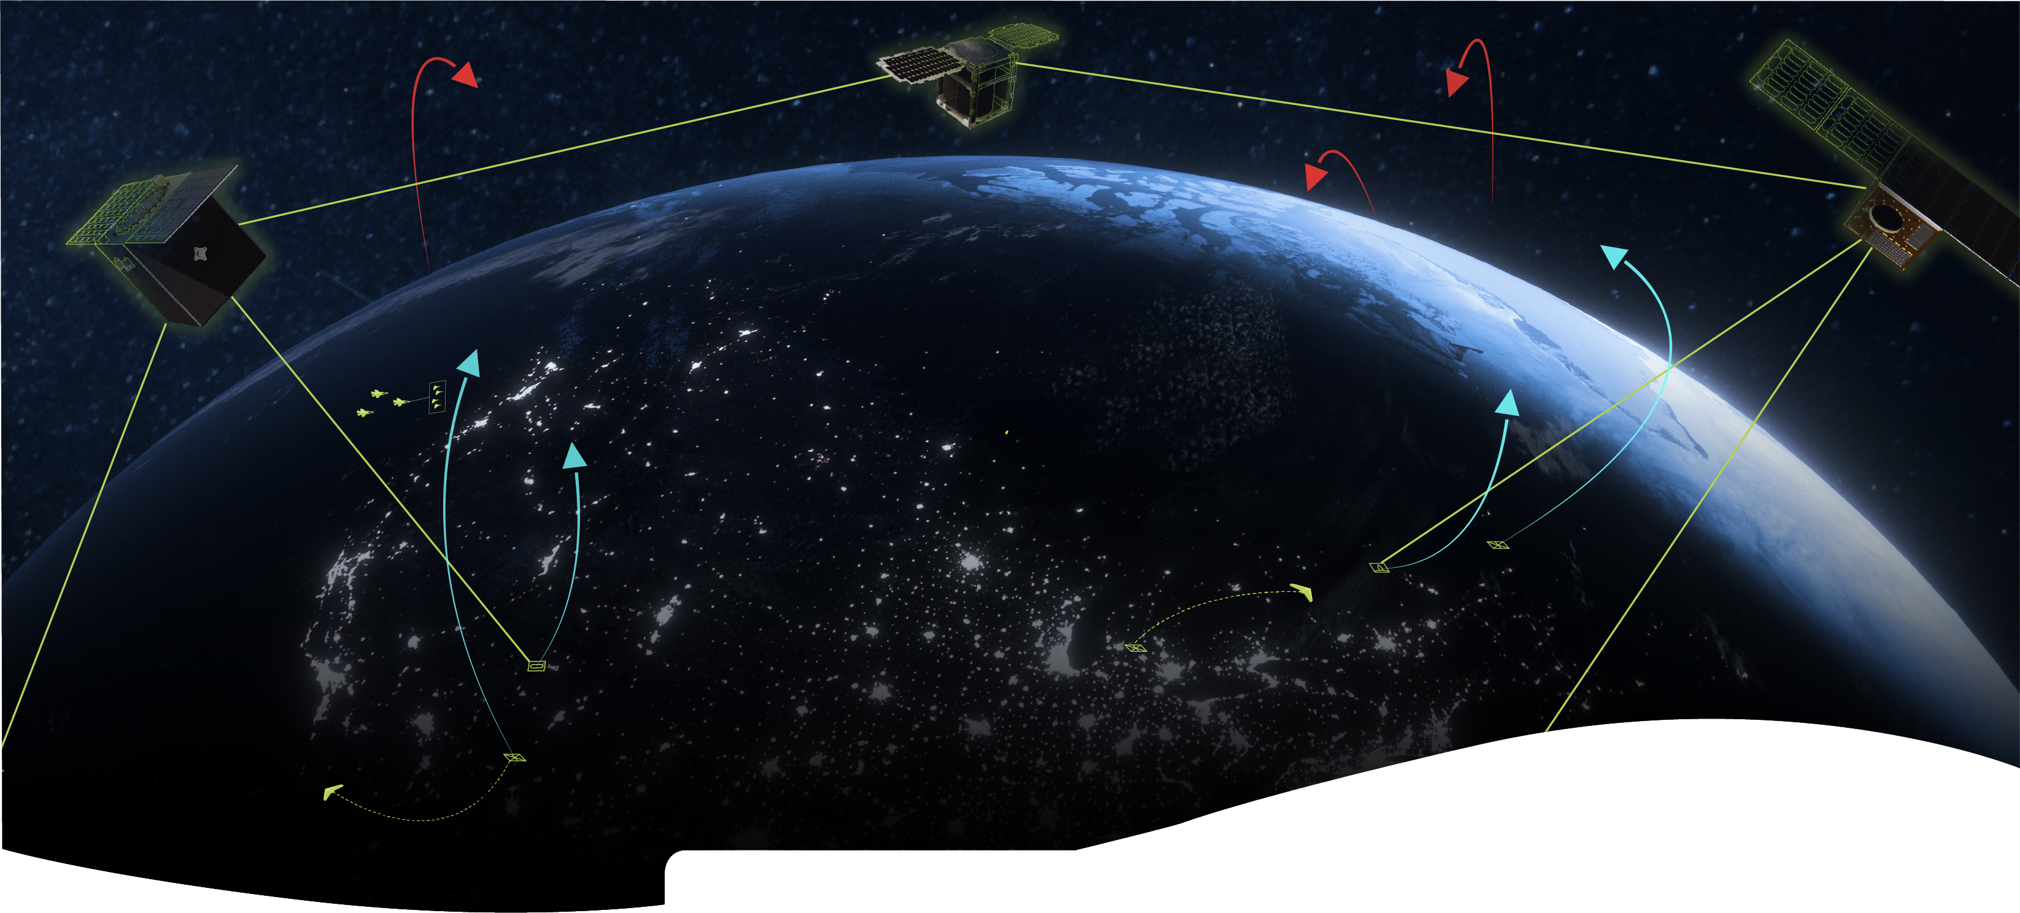





SEA
AIR
LAND
SPACE

Slide 3



Government & Commercial Applicability
EXISTING SYSTEM OPERATIONS
NEW SYSTEM DESIGN

Slide 4







Slide 5

Operational questions are hiding in our engineering discussions.

Slide 6
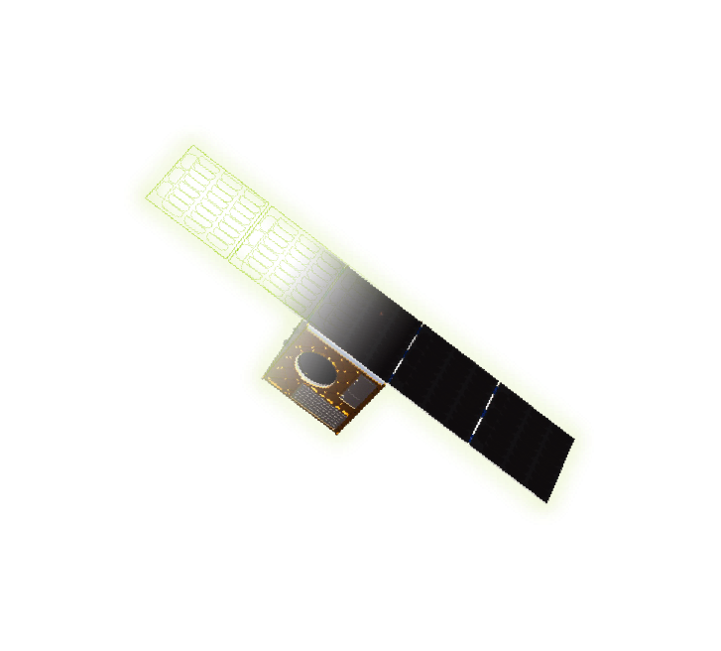



What is the RF link budget for these conditions?
What is the maximum possible slew rate for SV-4?

Slide 7
How do I get data to this user in less than 10 minutes?
What coverage do we have of a threat?
Where and when are we blind?
What happens to our mission if….?

Slide 8

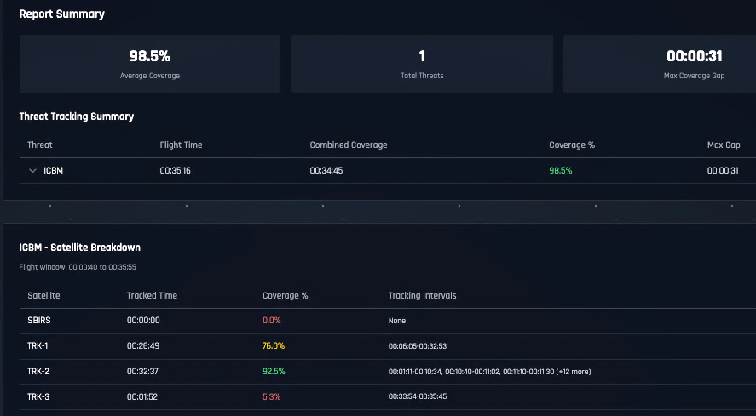
Mission Impact

Slide 9
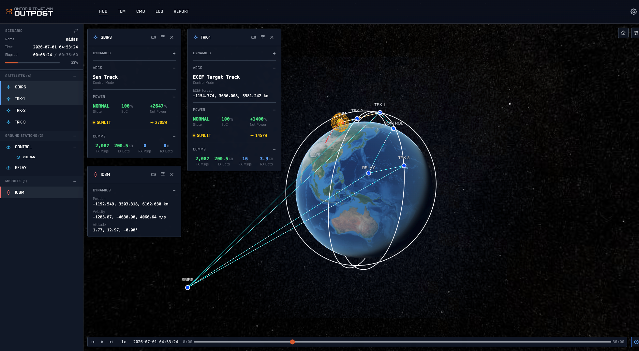


Slide 10
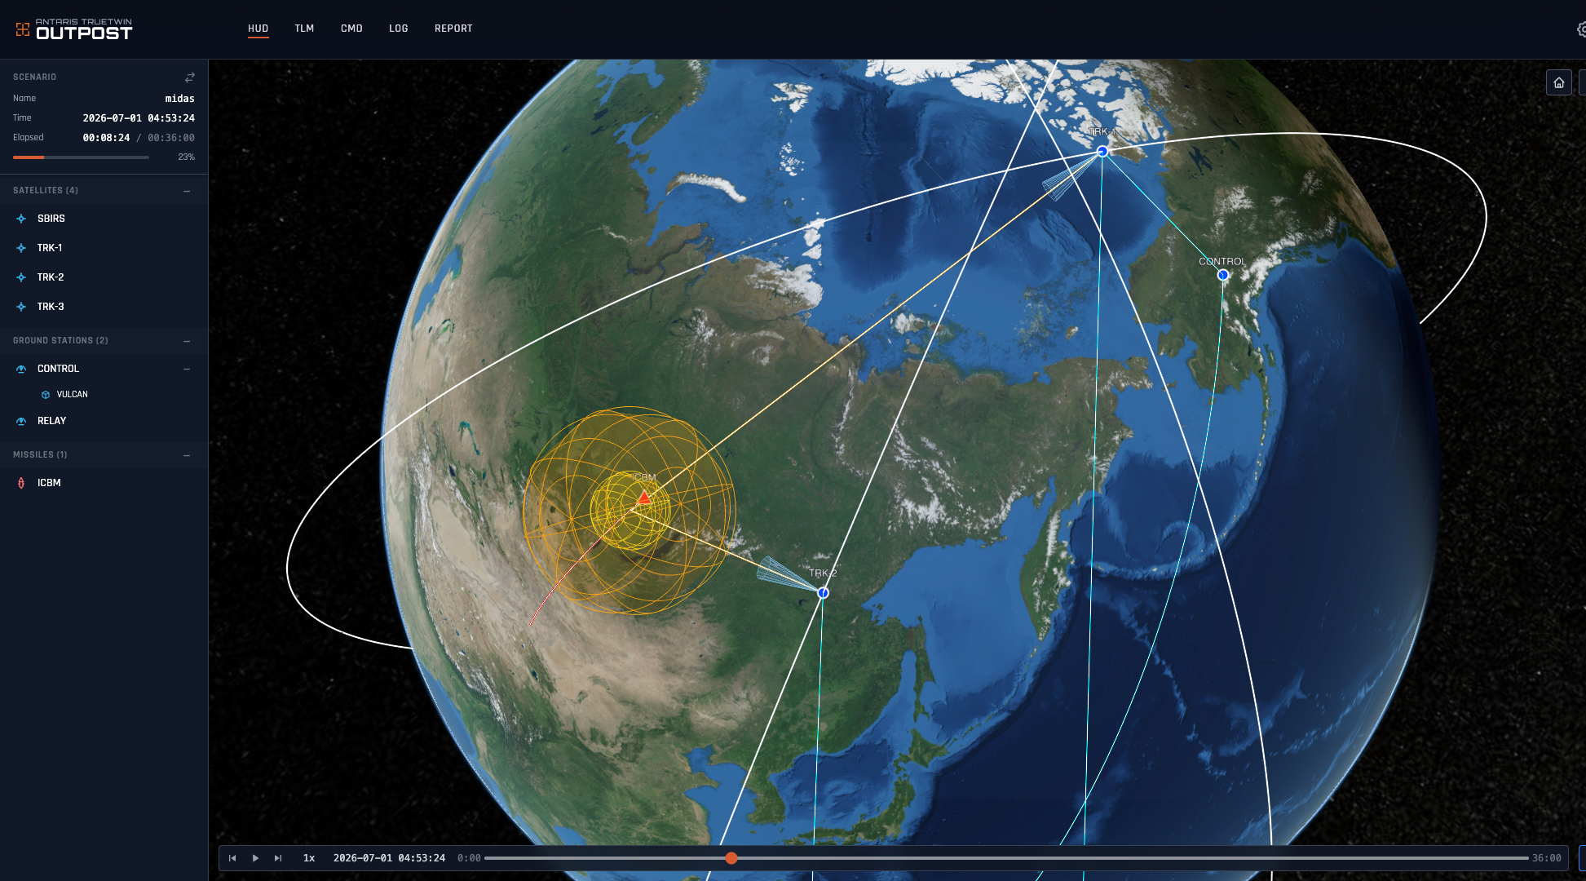


Slide 11
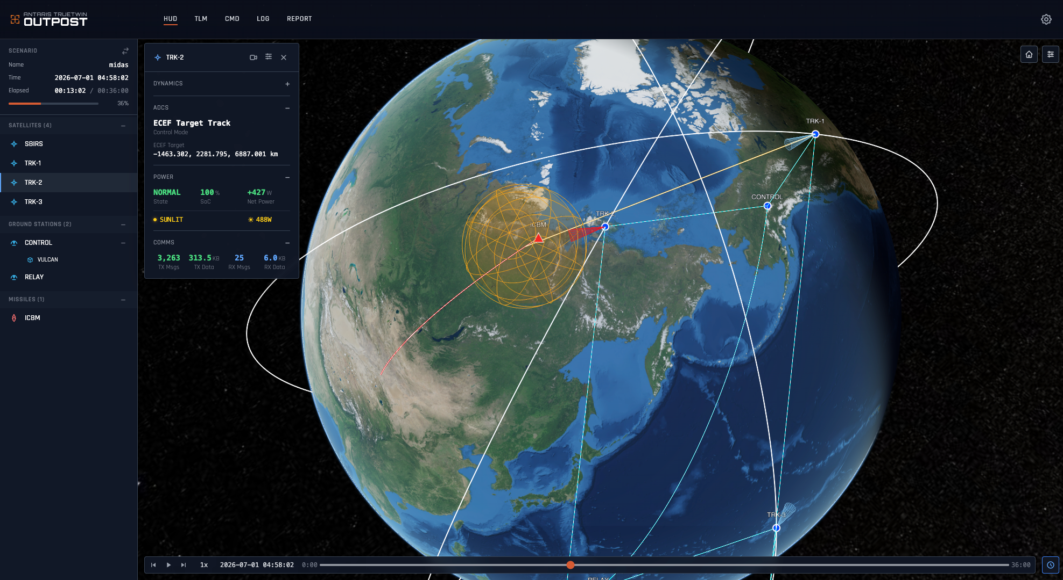


Slide 12
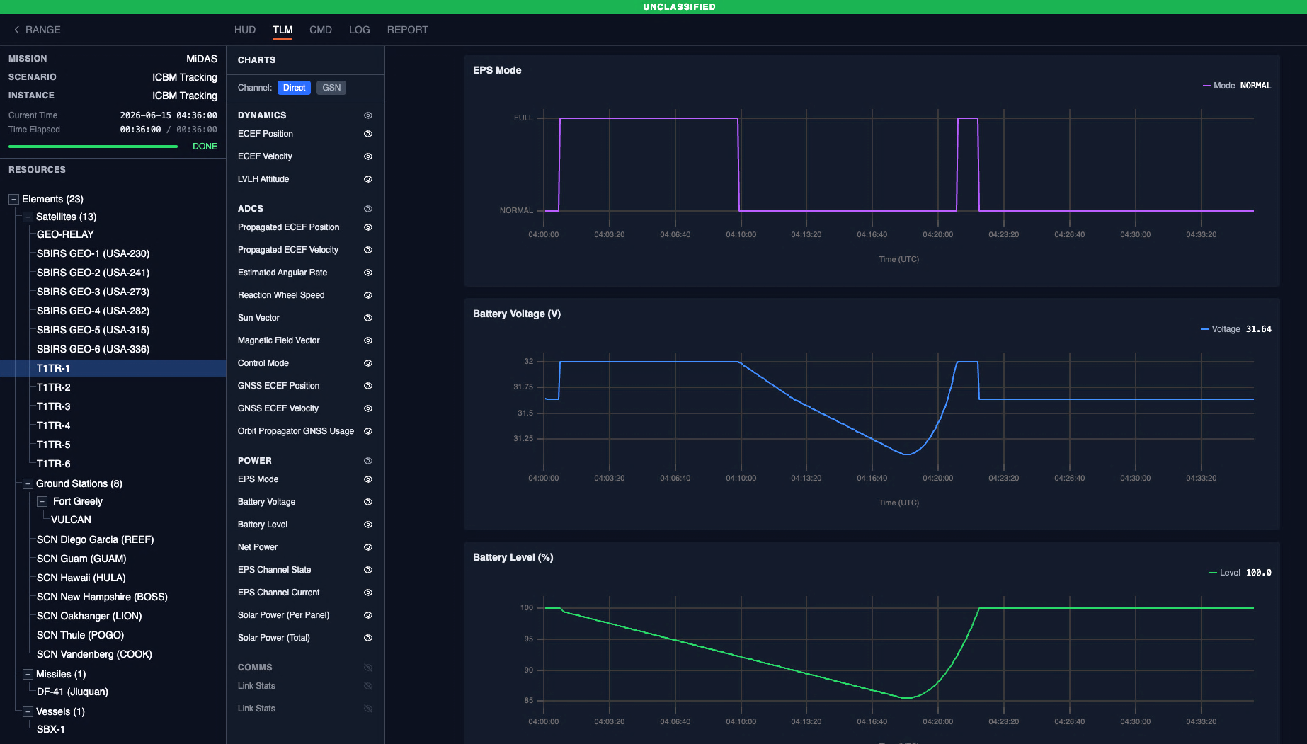


Slide 13
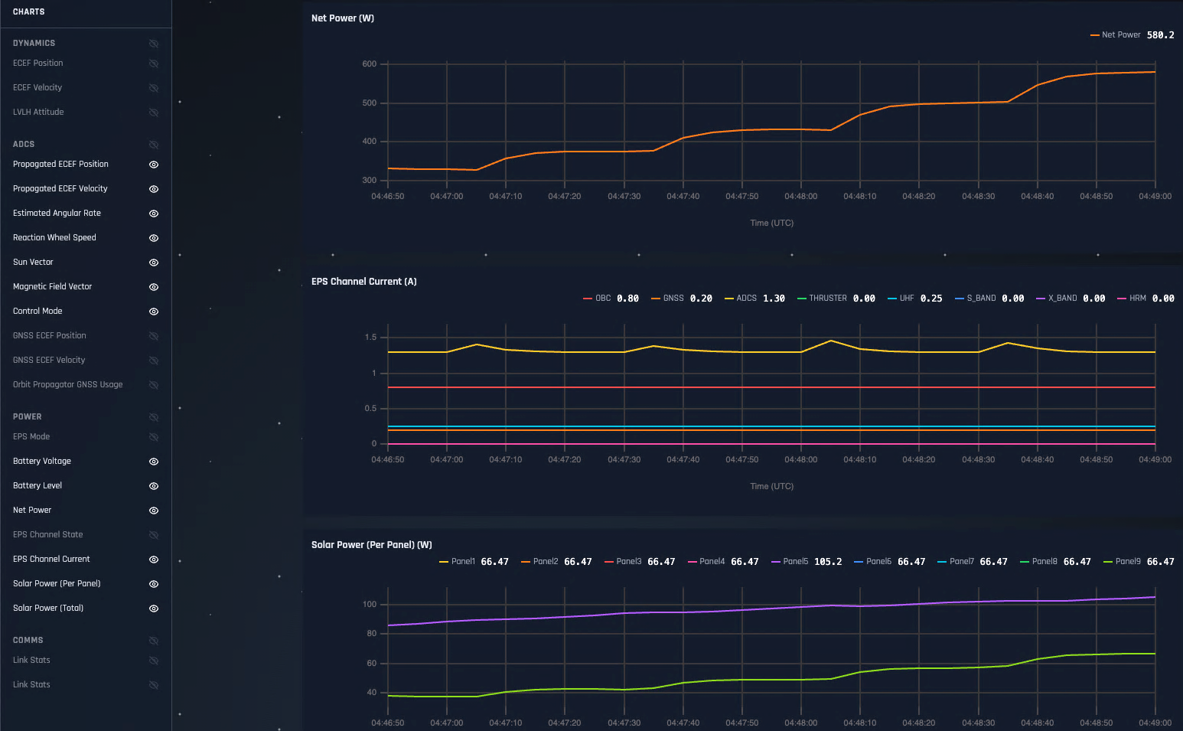


Slide 14
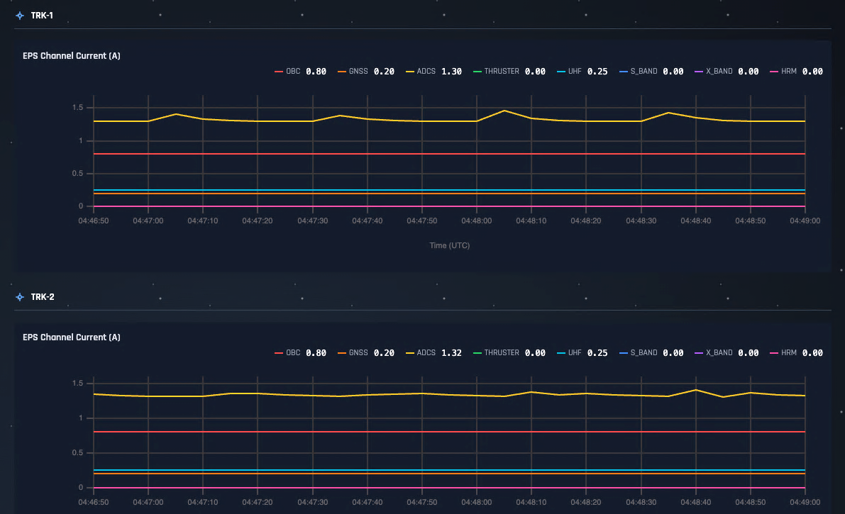

Slide 15
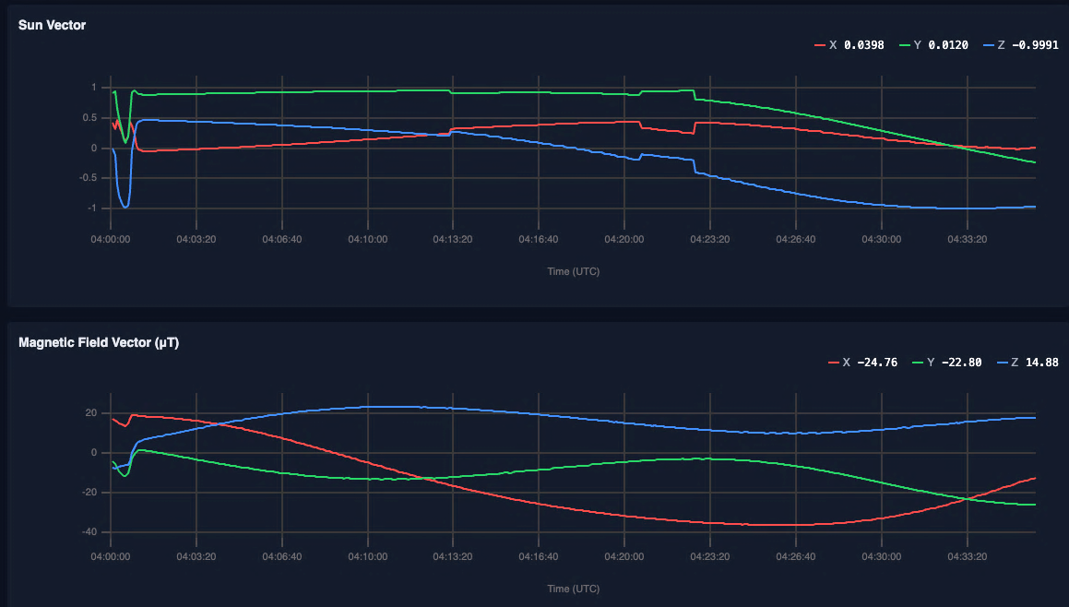

Slide 16
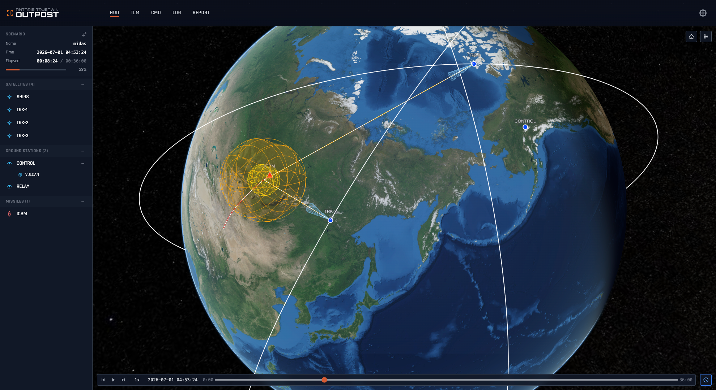


Slide 17
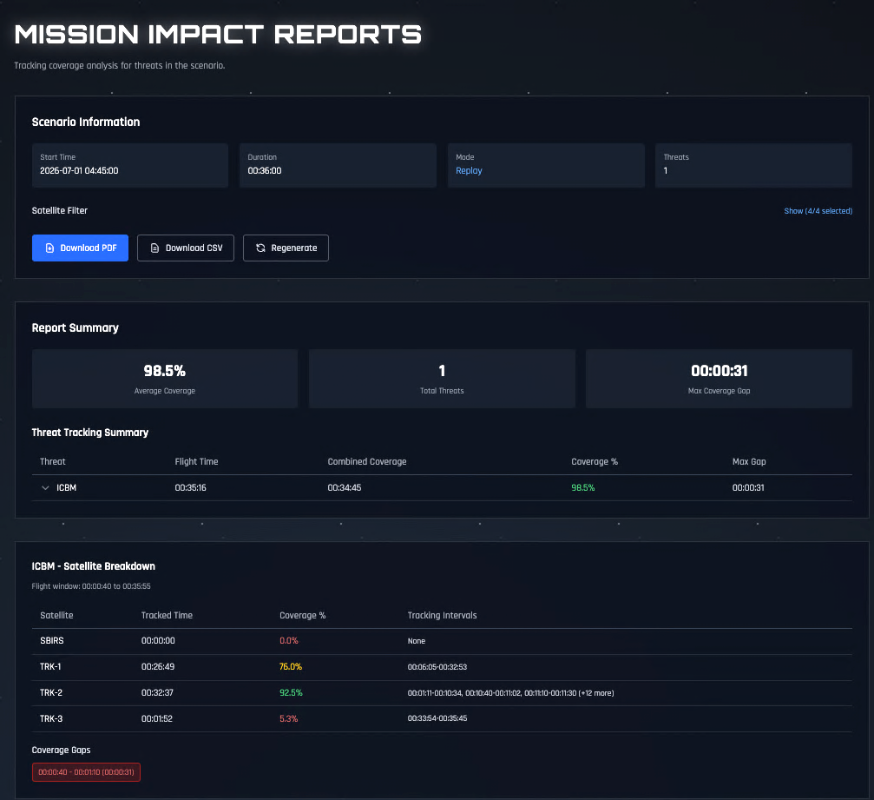

Mission Impact
How do I get data to this user in less than 10 minutes?
What coverage do we have of a threat?
Where and when are we blind?
What happens to our mission if….?

Slide 18
Booth # 2643
John Trionfo
President, Defense Solutions

