Slide 1
Rethinking the device in 6G: Architecture, constraints, and the case for disruption
Lewis Davies
March 2026

Slide 2
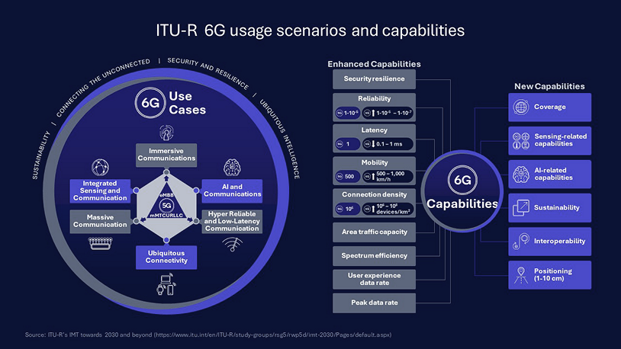
Vision for 6G
Notes:
The ITUs vision for 6G is bold, and as you can see from the slide very diverse and complex with many NEW USE CASES. It includes complete coverage, extreme throughput, and ultra-low latency.
A key step towards complete coverage is seamless integration of terrestrial and non-terrestrial networks.
For that complete coverage SATELLITES are needed to fill for terrestrial coverage once the user gets out of reach of terrestrial base-stations, for instance in rural areas, not spots and at sea

Slide 3

Practically served with this user device
Notes:
Practically mobile connectivity to people is through a smart phone. Most traffic to our devices isn’t cellular, something like 80% of it is Wi-Fi. Once we get away from a friendly Wifi router we depend on cellular connections. As we move into the world with NTN, a tiny fraction of a percentage of that cellular traffic will be through satellites.
Over a billion phones are sold a year, they are the worlds best selling consumer device. Key positive selling factors are value for money, aesthetics, branding and the eco system they belong to for apps, data cloud storage etc.
Extra features such as NTN operation are probably at best a marginal selling feature.
Cellular performance is a given, and only becomes an issue when its obviously not good enough
FR2 bands

Slide 4
Smartphone traffic away from the home
Data type | Traffic
Wi-Fi | 80%
3GPP: Terrestrial | 20%
3GPP: Non-terrestrial | 0.00….%

Slide 5
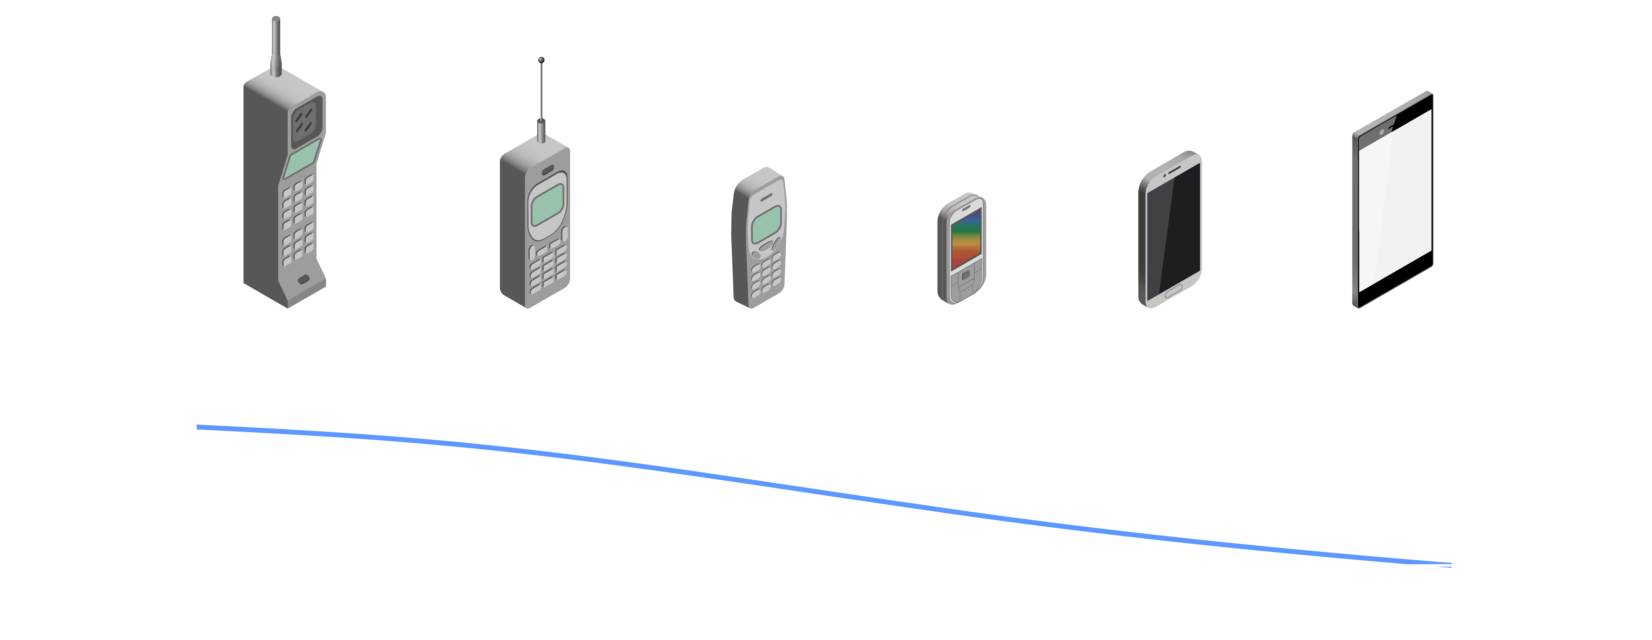
The decline of antenna performance
Form factor vs antenna performance
Notes:
In the 30 plus years of cellular our devices have changed radically
from the bricks of the 90, to the modern smart phone, little more than a thin screen .
Early phones had a very obvious antenna and only had to cover a single frequency band - today’s devices have multiple tiny deeply integrated antennas needing to cover the tens of different frequency bands used around the world covering both Fr1 – up to 6GHz and likely also the mmWave FR2 bands needed to help address the growing capacity requirements
Antenna size is related to antenna performance. It’s been reported that, the typical antenna gain has probably dropped by 15dB over the period

Slide 6
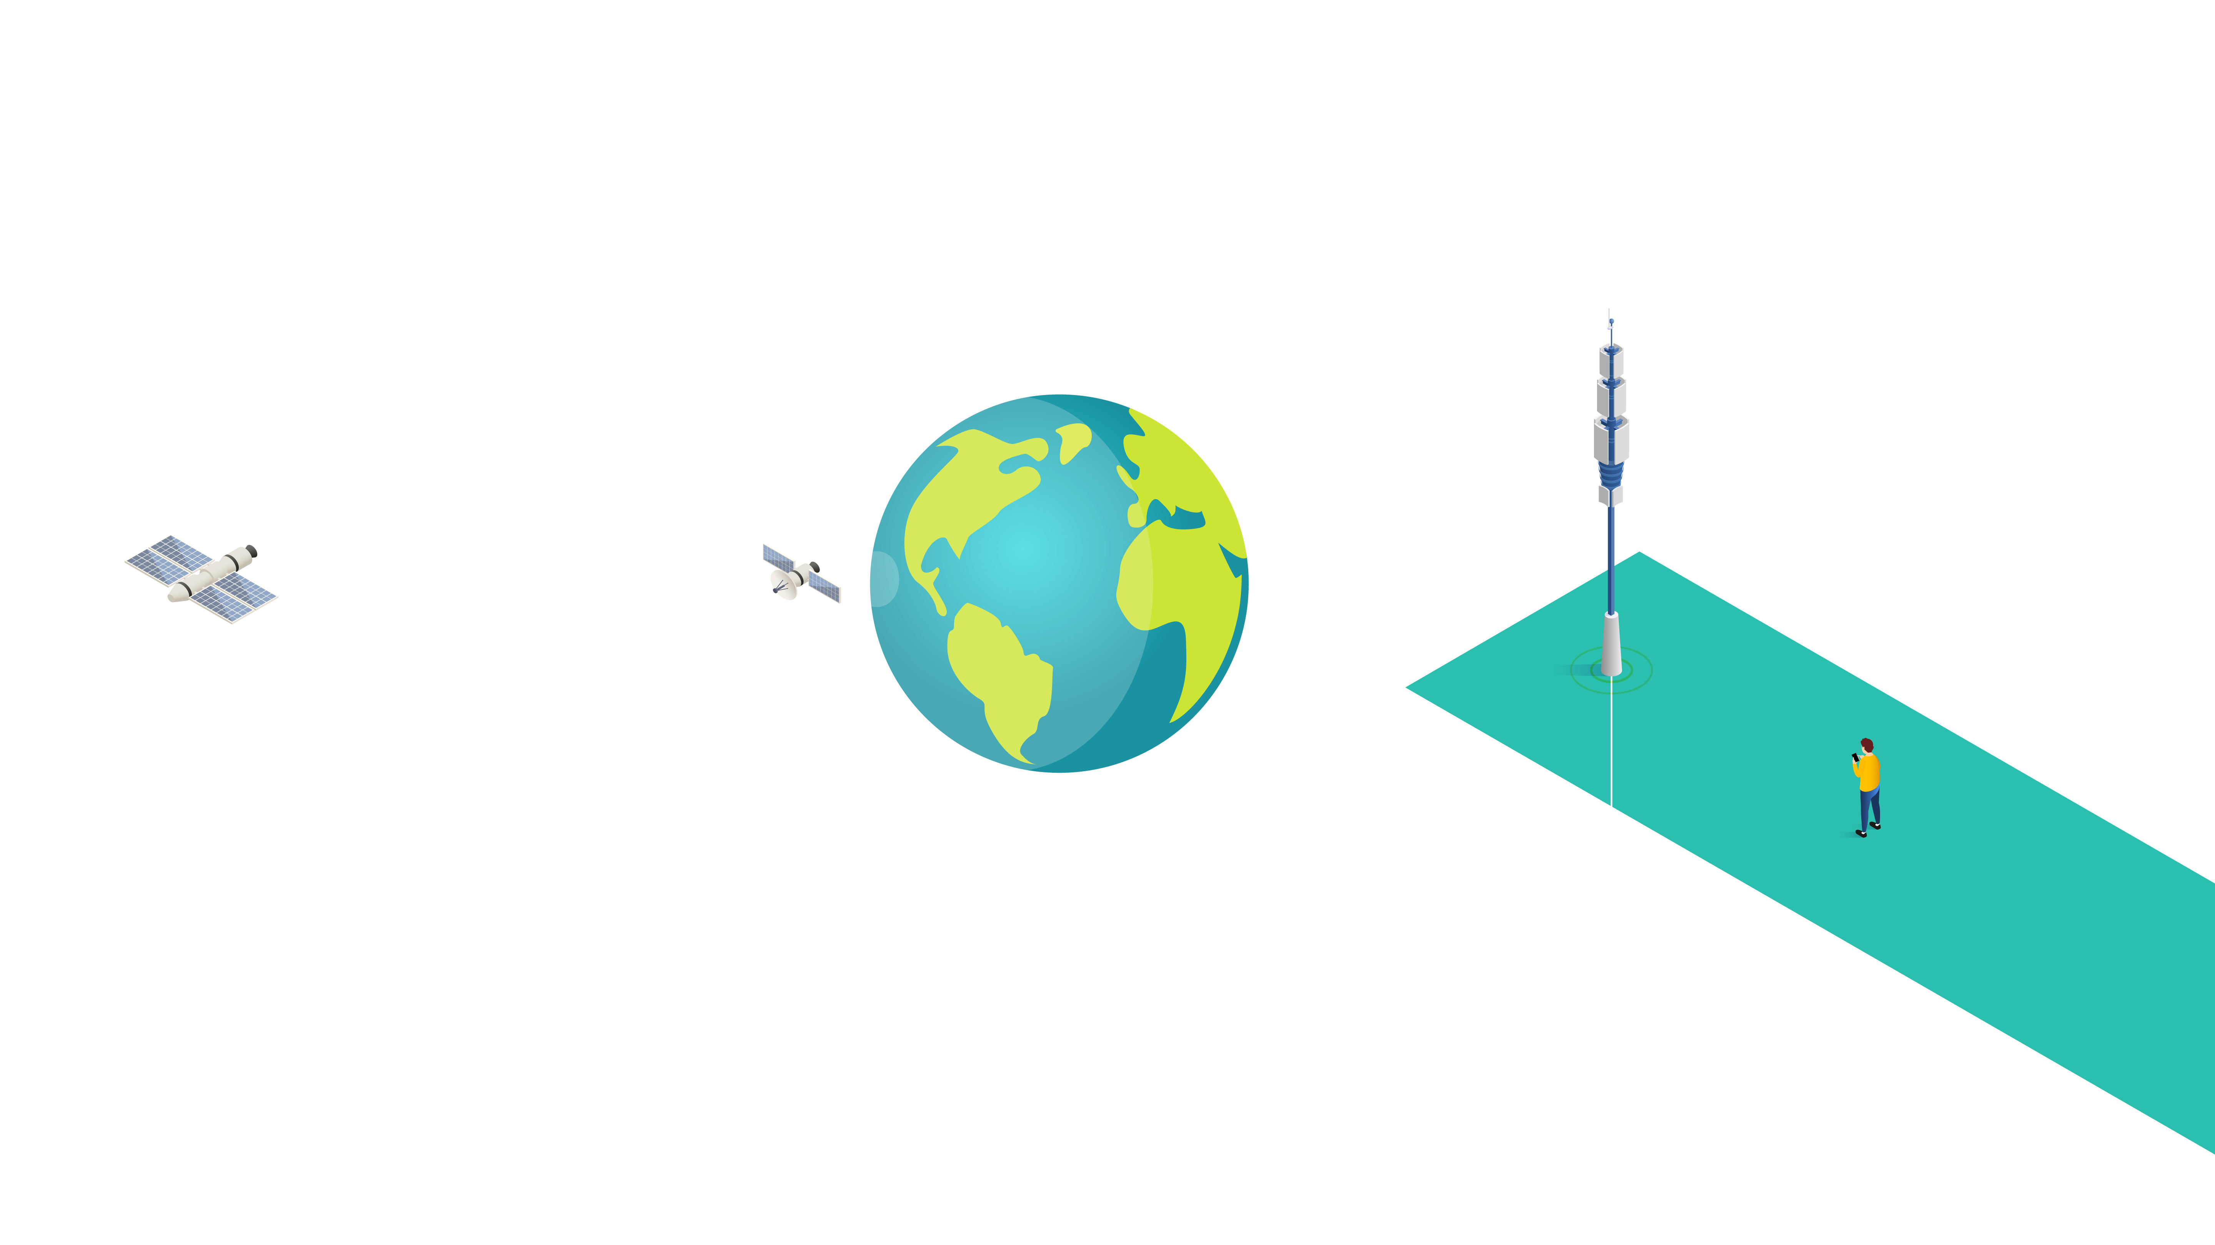
Satellites are far away
The physics of link budgets
Notes:
A terrestrial link with a 98 dB free space at 1 km, enables 10’s of Mbps data rates and has an operating margin of 45dB before reliable operation is lost, enough to provide reasonable indoor coverage
Looking at NTN over LEO, the satellite is typically around 1000km away, giving a free space path loss of 158 dB, and can provide a service of a few mbps, enough for streaming video to devices, but not enough for high quality HDR. The operating margin is reduced from 45 dB to less than ten, limiting its use to outdoor operation
Moving to Geo, the satellite is 36000km away, giving a 190dB path loss. Little more than narrow band messaging is possible with technologies such as NB-IOT. The link margins are tiny and leaving little room for error
Wouldn’t operators love to get back that 15dB of antenna perfromnace

Slide 7
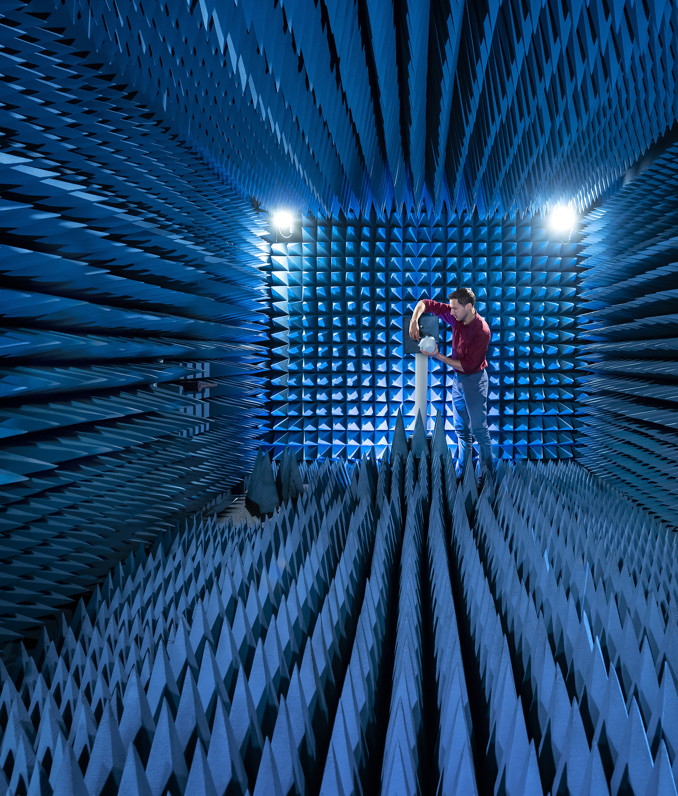
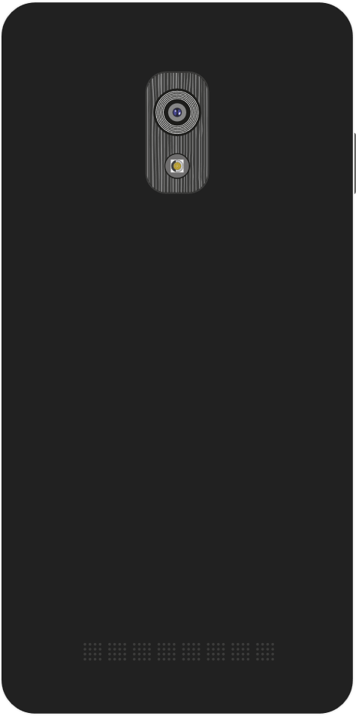


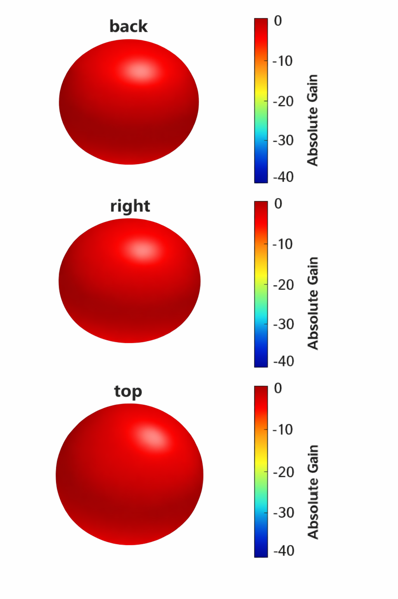
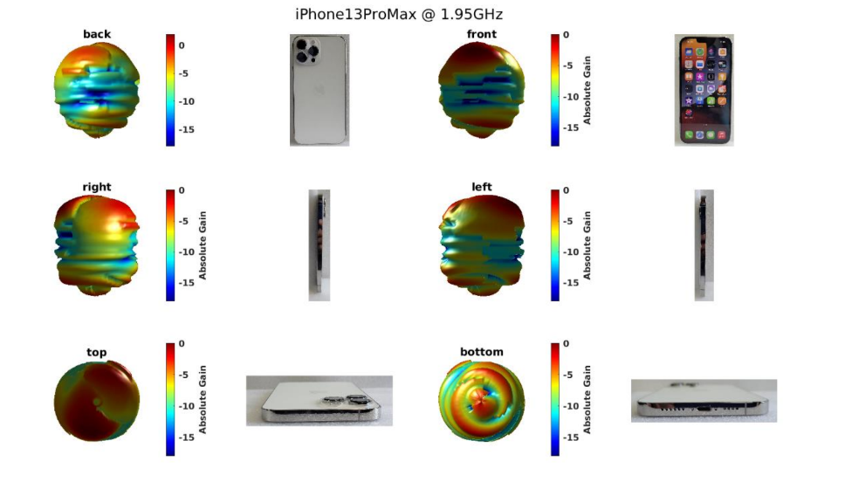


The fallacy of the omni directional 0dBi antenna
Device orientation
Ideal
Measured
-15
-10
-5
0

Slide 8
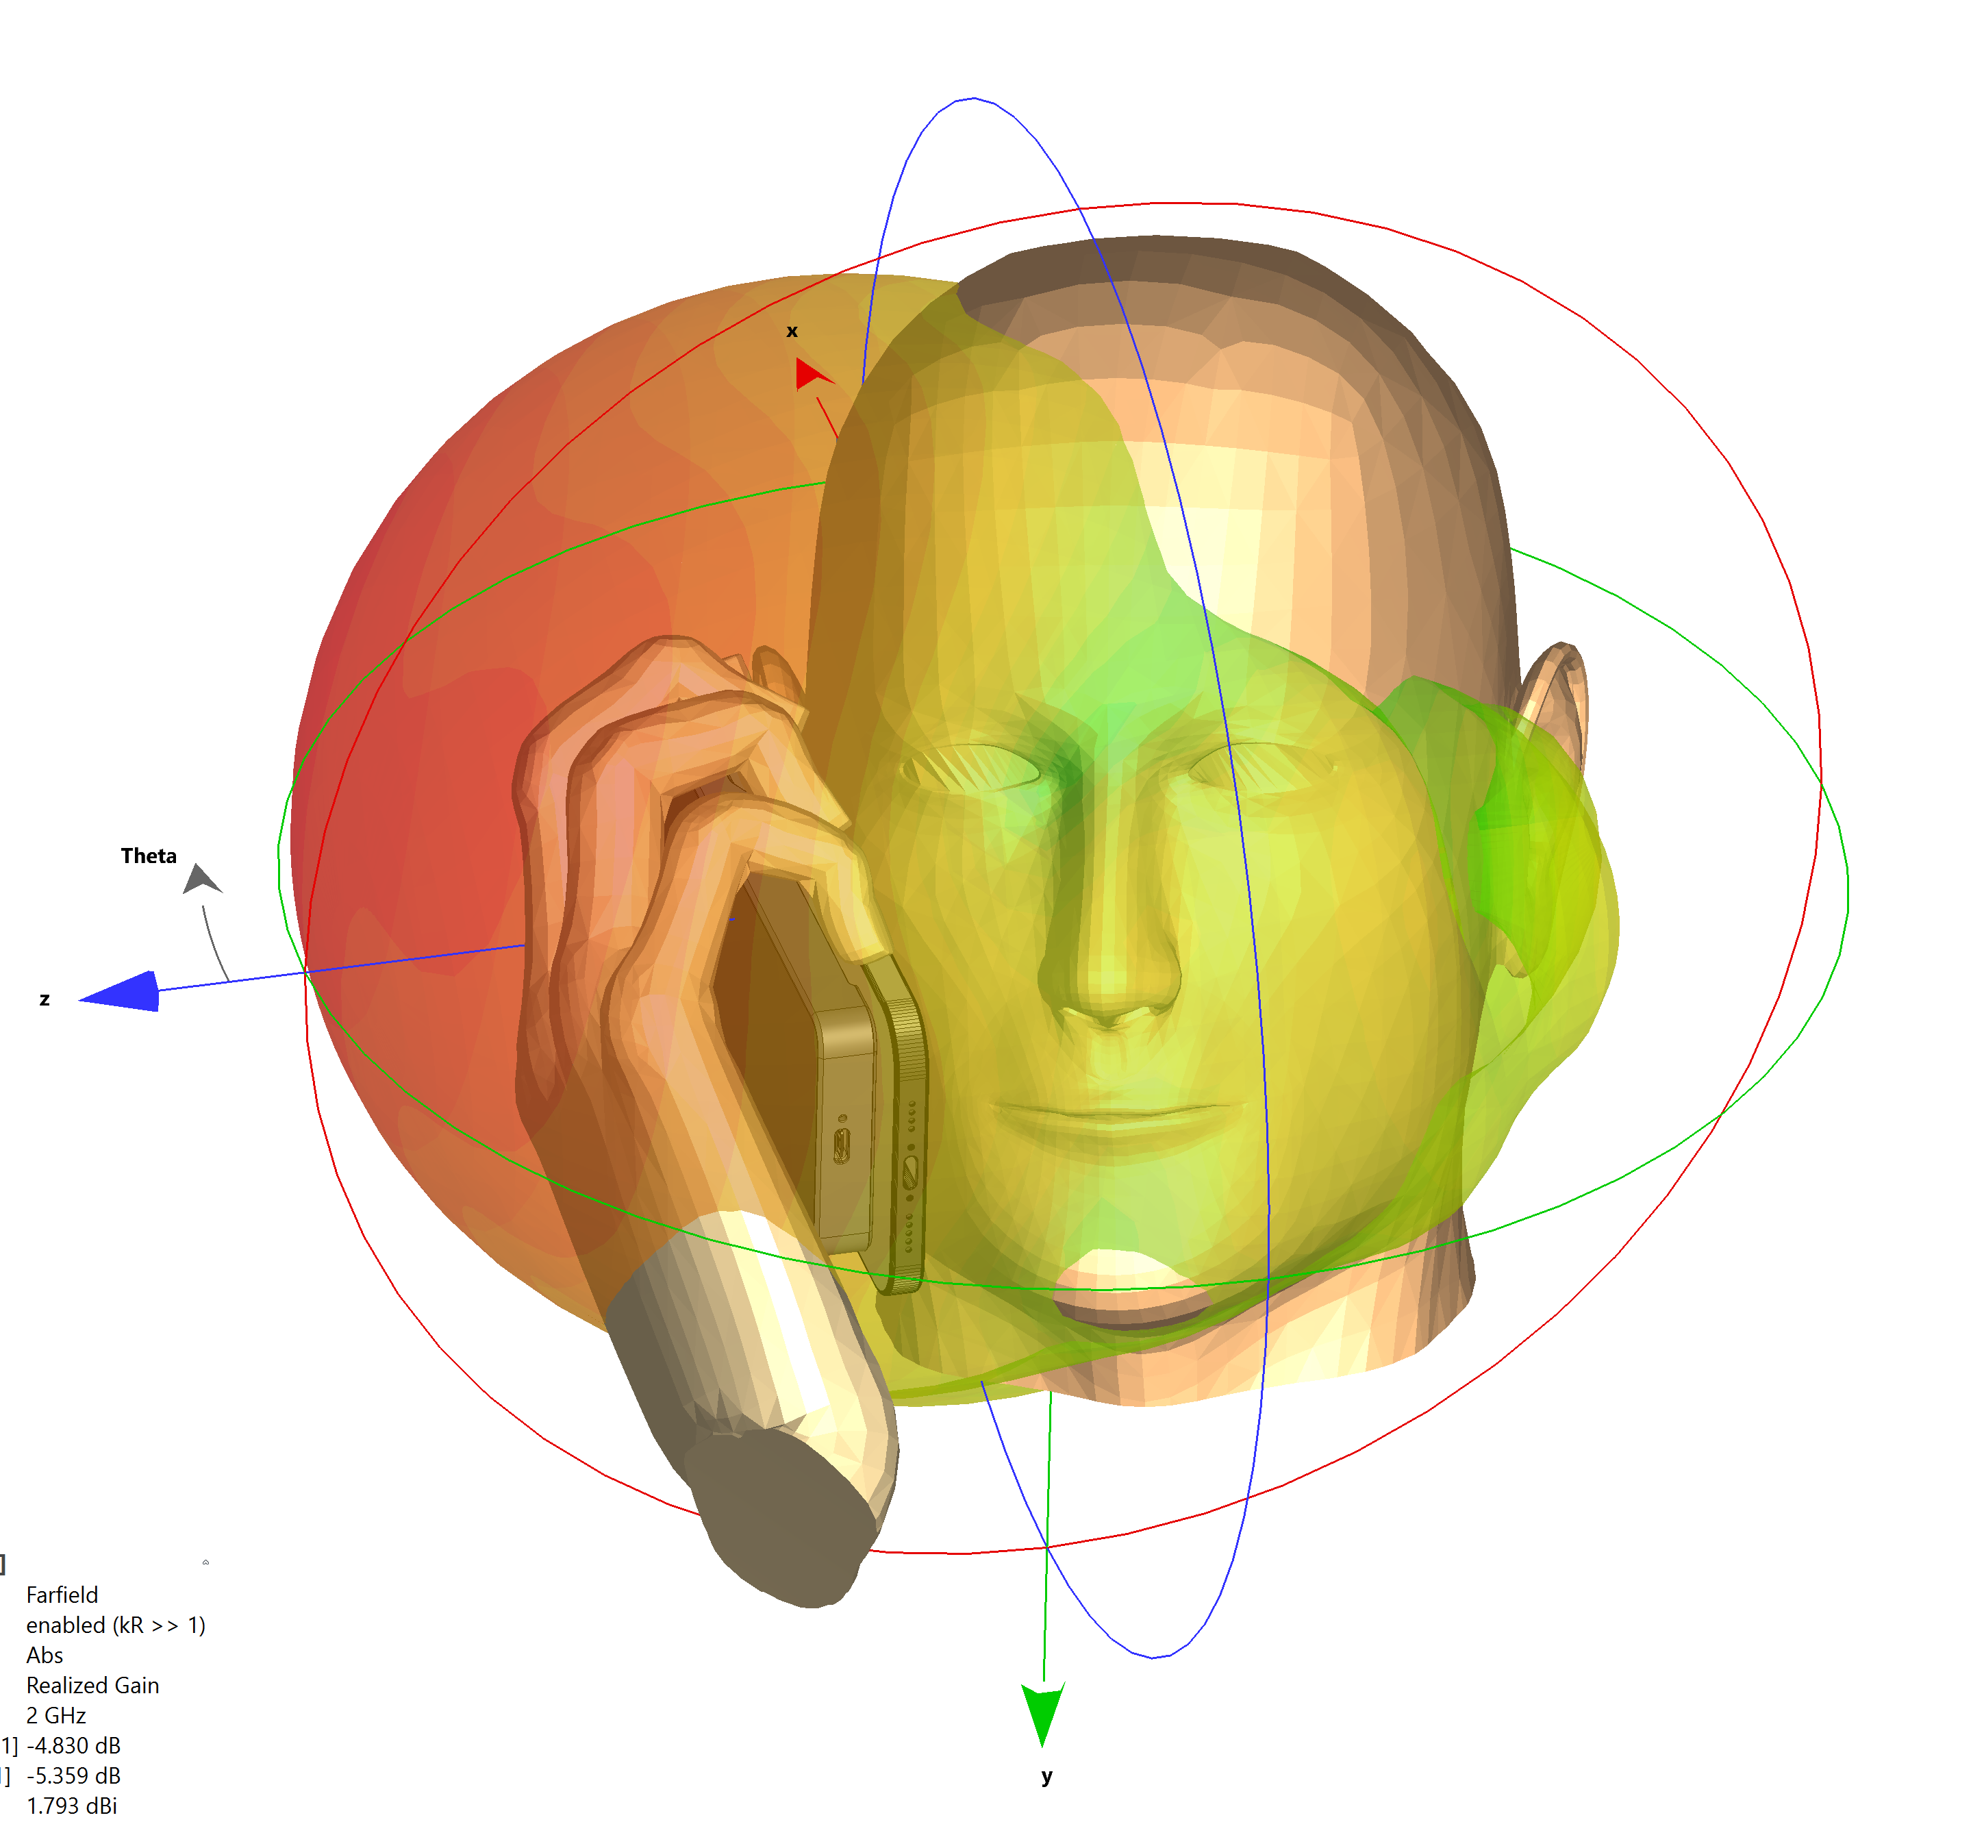
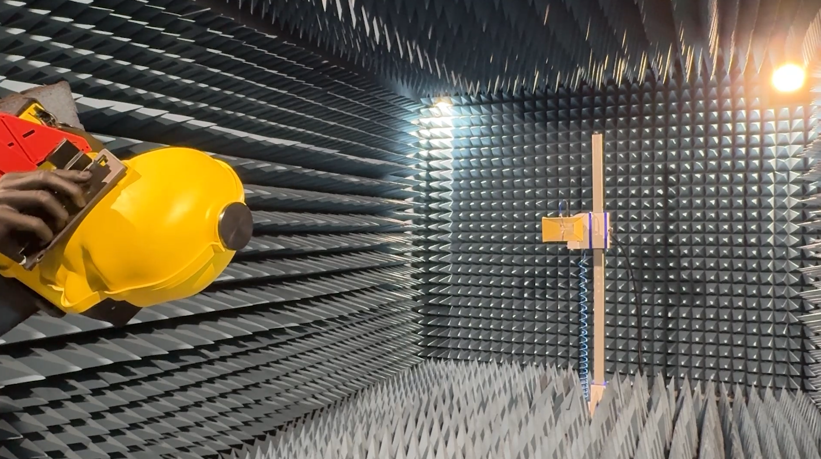
Specific absorption rate
Avoiding frying brains
Notes:
Even if we had 0dBi antenna the amount of RF power that can be radiated from the phone, ideally towards the base-station is limited.
A key constraint is SAR, specific absorption rate. It’s a measure of how much how much radio-frequency energy the human body absorbs when exposed to electromagnetic fields, literally how much our body heats up from the RF energy form our phons
There are strict regulatory limits put in place to ensure any heating effects are exceedingly small
the problem is most acute when we use the phone as a traditional telephone with the antenna close to our head.

Slide 9
Smartphone RF
5G mW Trxv
mmWave ant
5GHz WiFi
Lots of antennas in a small space with many lossy passive components between the active components and antennas
  Multiple switch layers
  carrier aggregation cross-routing
  4x4 MIMO parallel path
  SAR antenna re-routing
  Global band support
  2–3 dB cumulative insertion loss and impact on Noise Figure
  Long PCB routing paths
UWB
MB-LTE
WiFi6
DRX
5G Modem
DP3T
4G 5G Trxv
LB-LTE
GSM
Tuner
UHB-LTE
PMIC
ET
HB-LTE
2.4GHz WiFi
Bluetooth
GPS
Application Processor
UHB-LTE
5GHz WiFi
2.4GHz WiFi
DRX
Notes:
So how does the phone design team manage to fit the antennas needed to cover the multitude of frequencies bands spanning up to 6GHz into this tiny box and make it all work reasonably well? What compromises are needed?
First of all around 8 antennas are needed – to cover the frequency range and provide MIMO coverage – MIMO is where multiple antennas are used in parallel to help overcome fading on individual radio channels. And boost performance
Any radio designer, for best link budget defining Noise Figure, G/T and EIRP wants to put the active elements as close to the antenna as possible. Ideally they be directly behind the antennas , practically this isn’t the case
Antenna tuners, effectively variable capacitors are needed to tune the antennas to resonate at the correct frequency
Duplexers are needed to isolate each frequency bands transmit and receive paths. This is made more much complicated as different overlapping band plans are used across the world
Several layers of switches are needed to route signals to the desired antennas from the transceivers, This routing isn’t simple, for instance, the antennas being used at any time are changed to keep RF power away from the head, for carrier aggregation multiple frequency bands are used simultaneously,
Additional filtering is needed as cellular needs to coexist with Wifi, Bluetooth and GNSS
r
This wizardry may be very clever, practically its built into a number of Front end modules or FEMs which also contain the low noise amplifier which set the Phones Noise Figure and receive performance plus the PA which sets the phones transmit performance
As its all very tightly integrated with the phones chipsets the outcome is:
the amplifiers are now a long way from the antennas. This introduces 2 to 3dB of insertion loss impacting the phones and therefore entire systems RF performance
it makes the entire UE design becomes pretty inflexible to meet 6G’s diverse requirements

Slide 10

Who pays the price for poor device antennas?

Slide 11
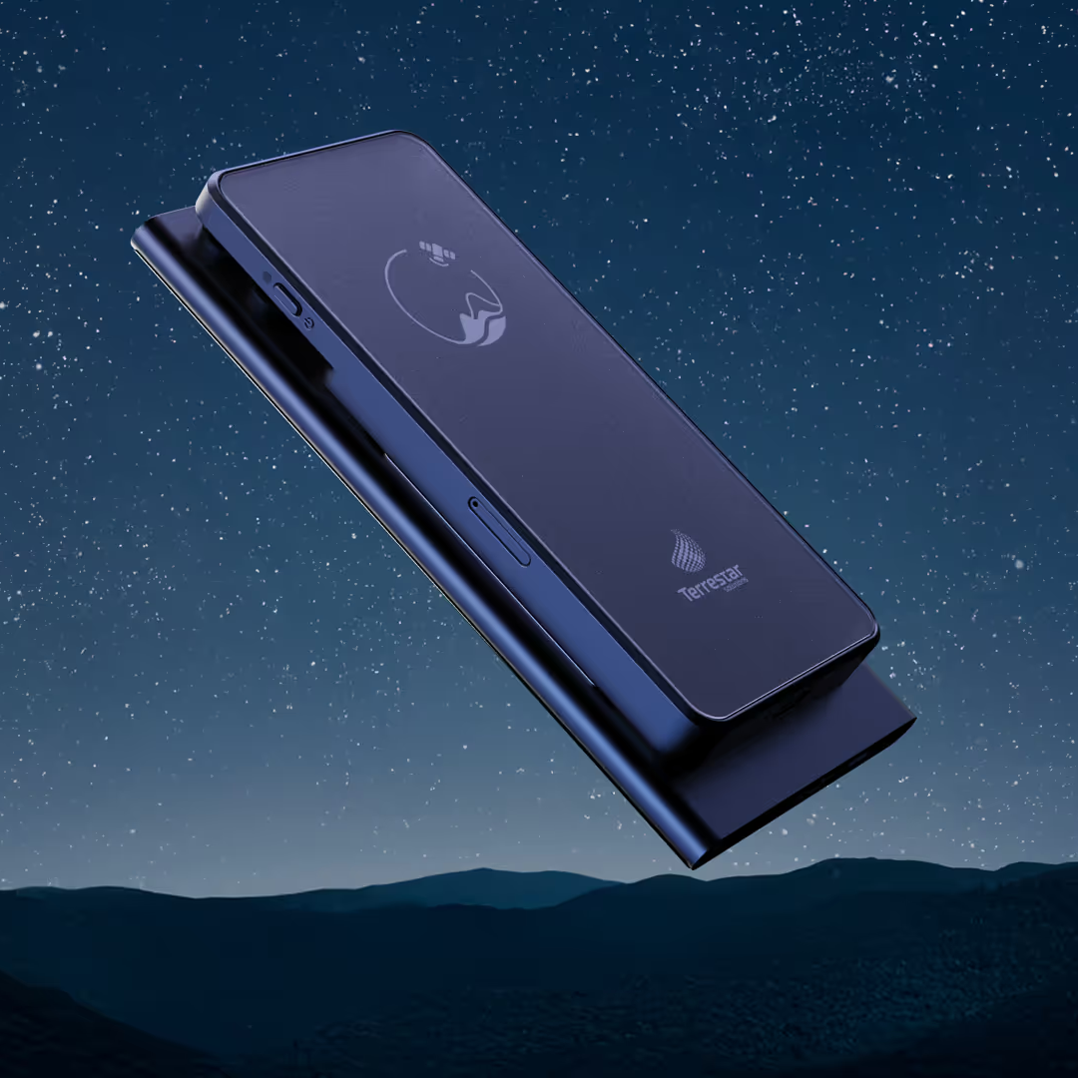
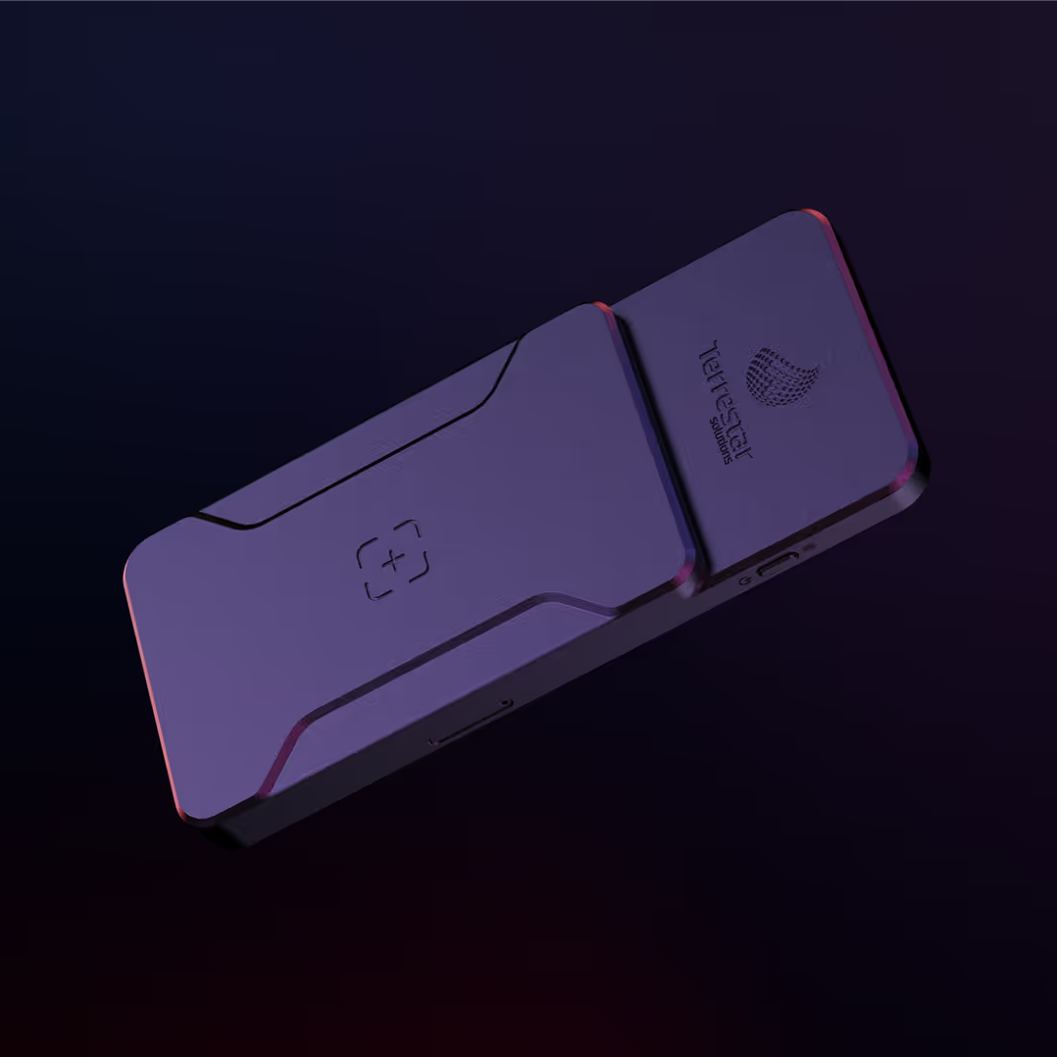
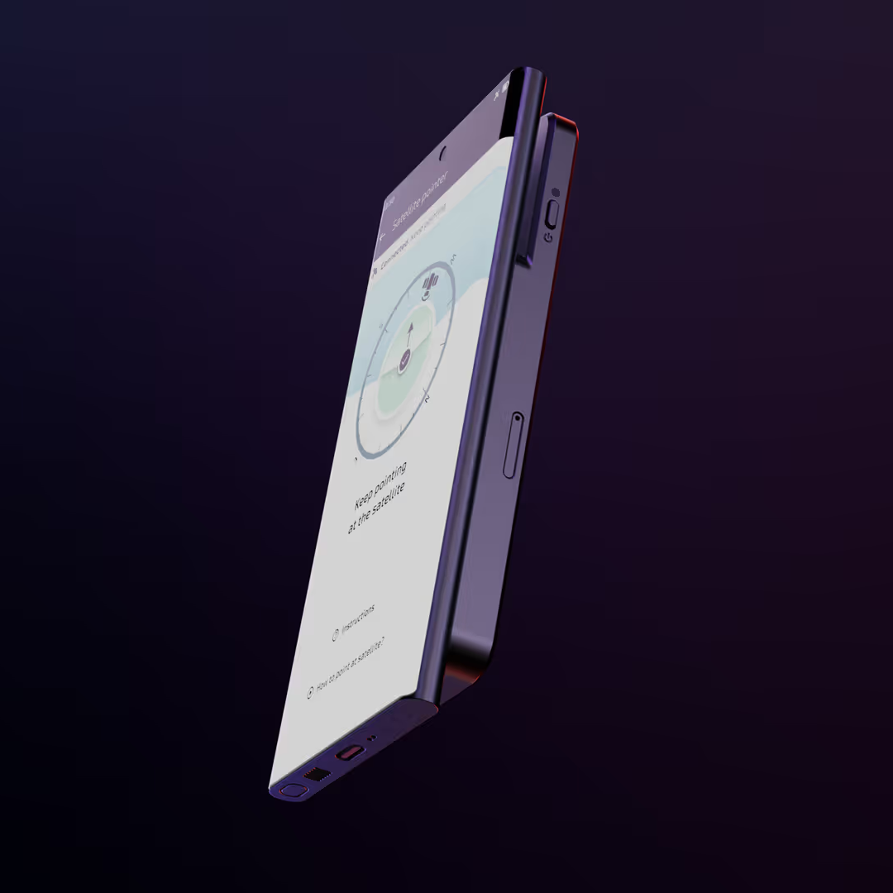
Possible alternatives
Companion devices
Notes:
So how might the devices change to help meet the requirement for ubiquitous coverage whilst achieving more palatable capex costs for the operator?
Given all the constraints discussed, significantly improving smart phone RF performance to make phones suitable for the NTN scenario is extremely challenging and given proportion of time they are likely to be used with NTN, disproportionate.
Instead we anticipate a shift towards a broader application -based device ecosystem, where new mobile device types, with different design constraints to those of today’s smart phone emerge to take advantage of NTN’s coverage, fulfilling currently unmet needs.
Possible examples include
Antenna accessories which boost performance when NTN is needed, this is one we developed for Terrestar Solutions, the antennas are much larger than those in a smart phone, angled to work well with a satellite and the RF circuitry simpler and therefore more efficient

Slide 12
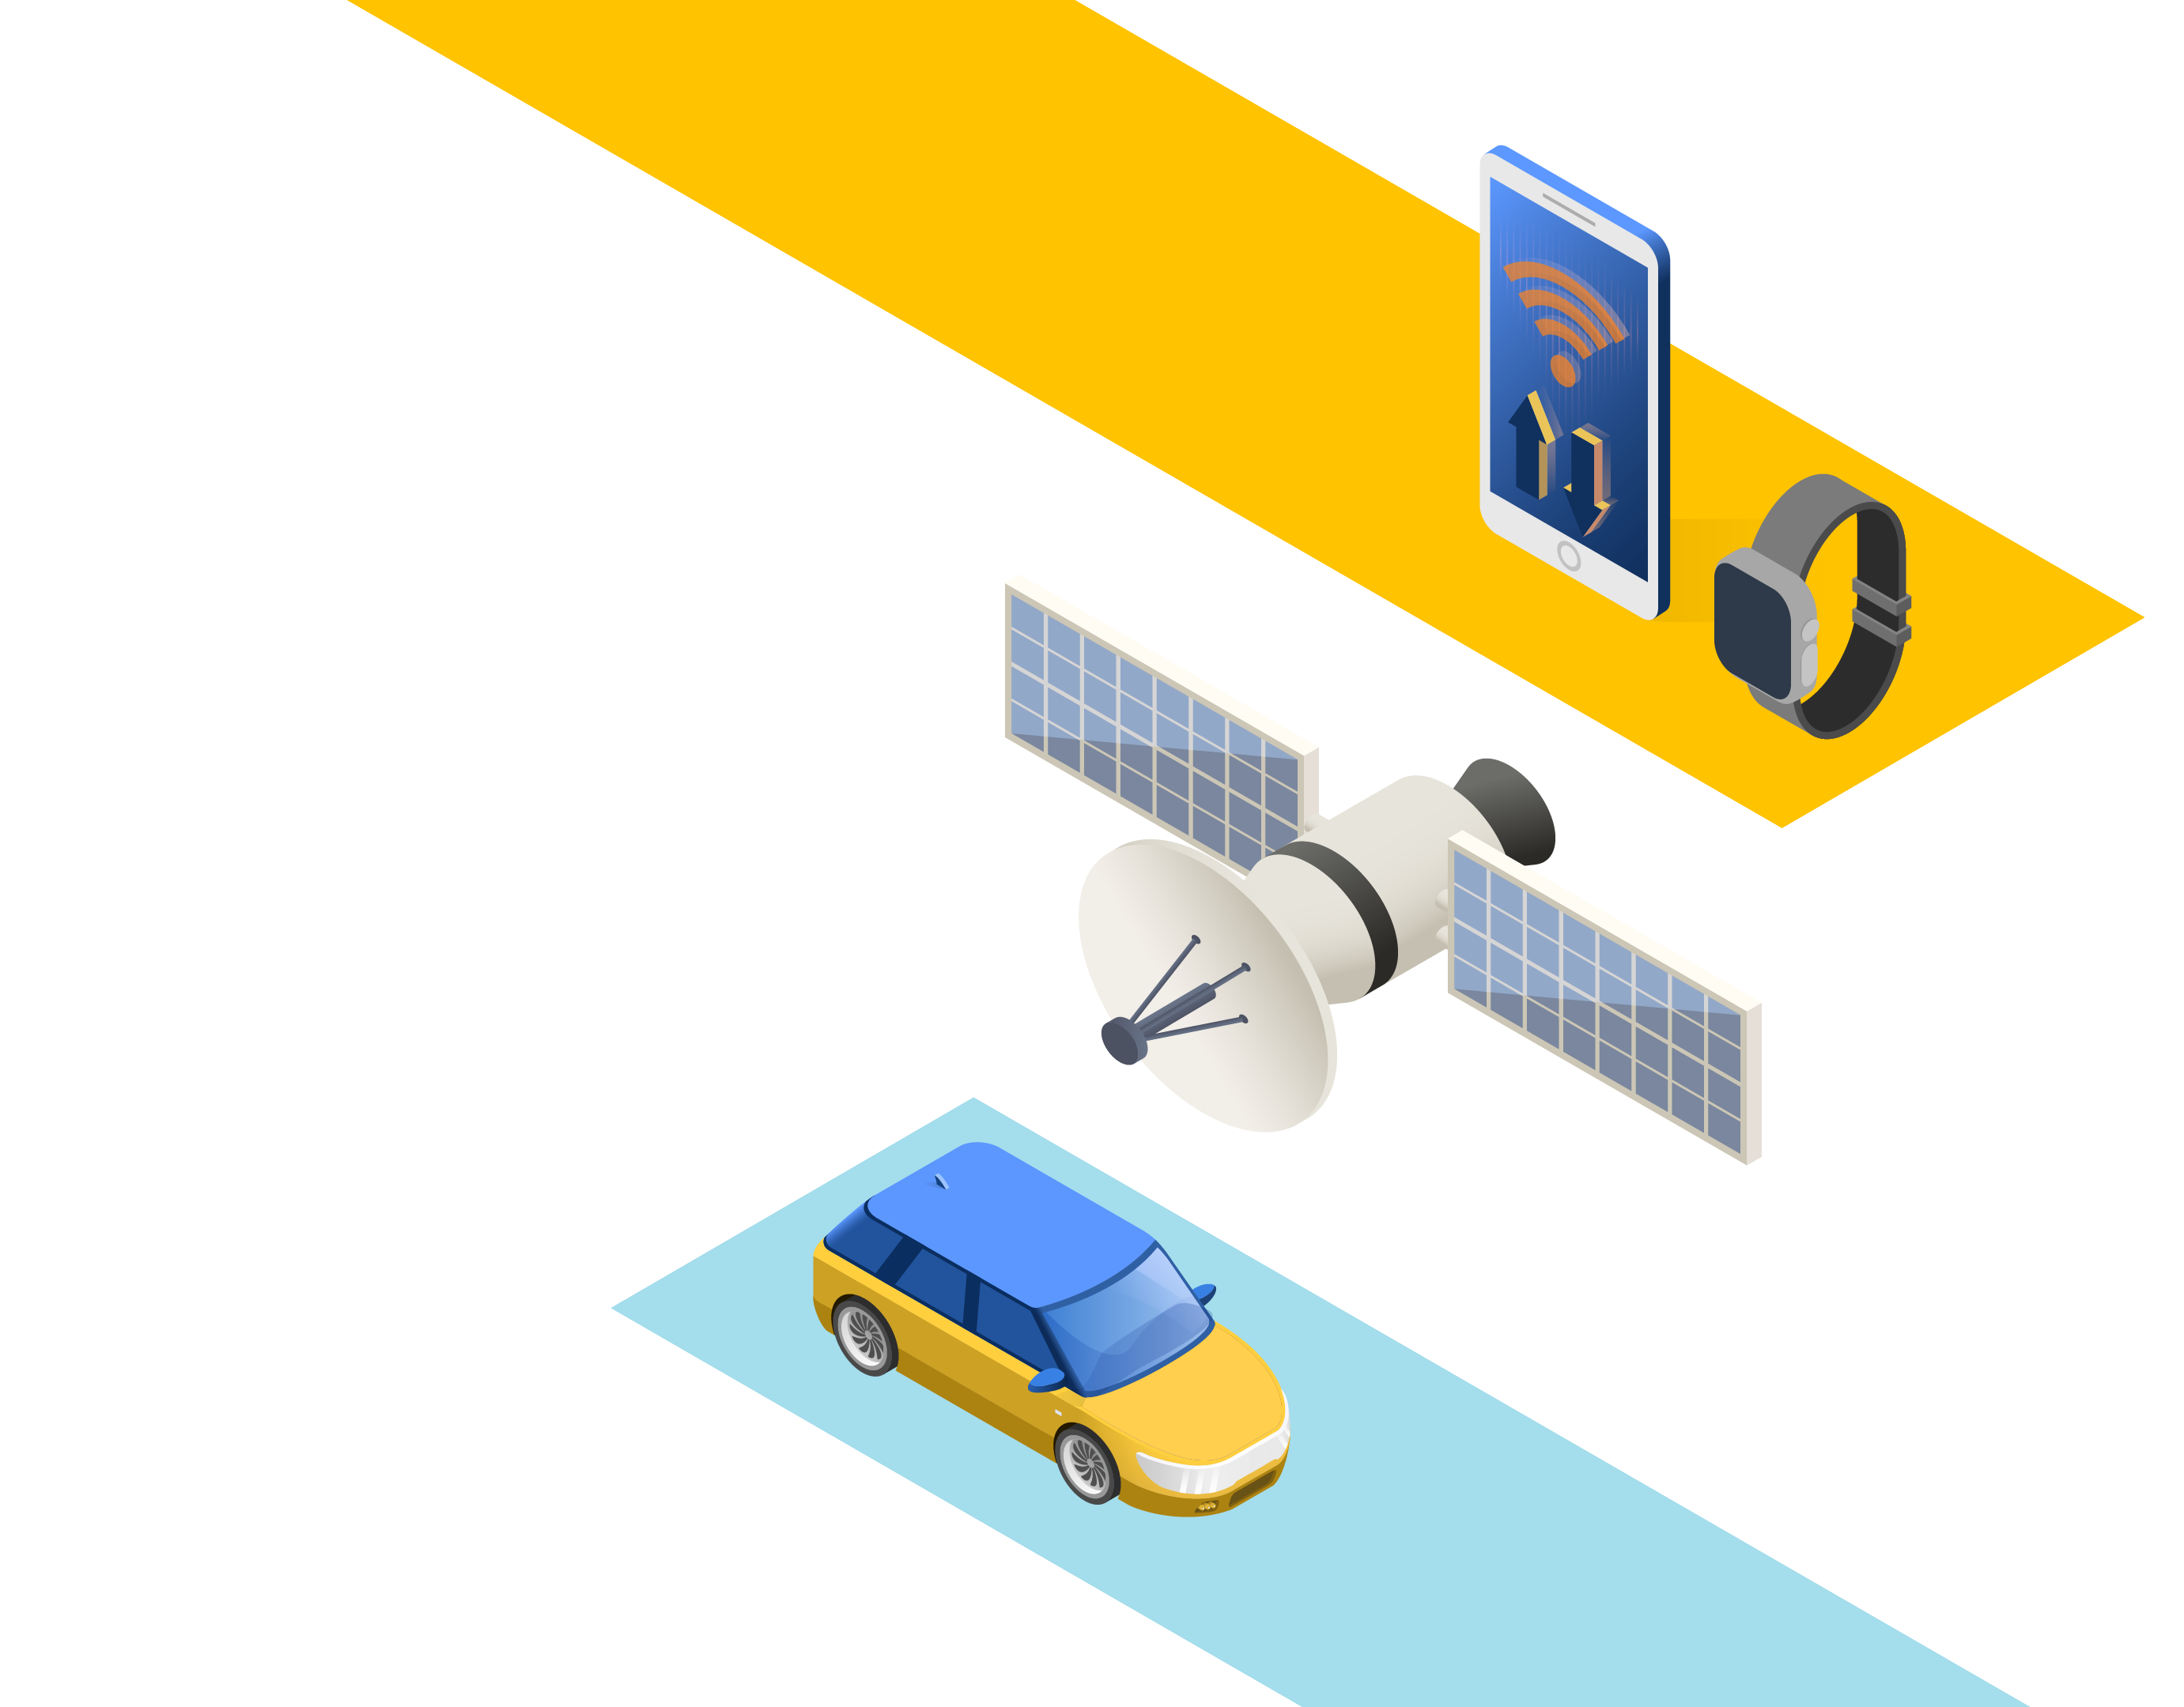
Possible alternatives
Notes:
Vehicular relays –Cellular modems are fitted to most new cars enabling apps, diagnostics, E911 and navigation updates. These modems aren’t constrained by the smart phones form factor and their need to occasionally operate close to the human head. This sounds like a good use to me
Why does my phone annoyingly stop working in areas with poor cellular coverage, with a car with NTN and a WiFi hot spot this could potentially be eliminated
Moving towards autonomous vehicles, isn’t some sort of continuous connectivity near essential – potentially this could be for UAV’s operating Beyond visual line of sight, not just for cars
Wearables, and phones, with their antennas all working together as one could be another route for improved performance,
These changes bring the prospect of deeper architectural disruption. Cellular chipsets are designed specifically for the Smart Phone market, with little flexibility to meet the wide range of applications looking to be addressed by the ITU’s 6G ambitions. A more fragmented device landscape may emerge, with components able to work at the higher RF power levels defined in the 3GPP standards but seldom used due to lack of availability, with FEM’s specifically optimised for NTN receive performance, not coexistence with a multitude of closely mounted antennas

Slide 13

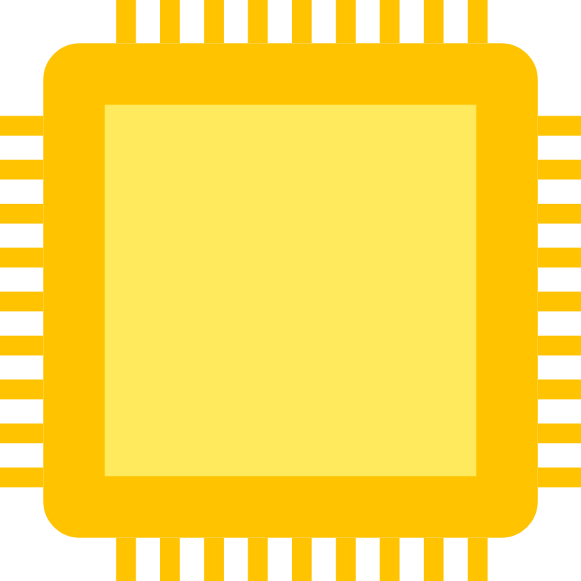
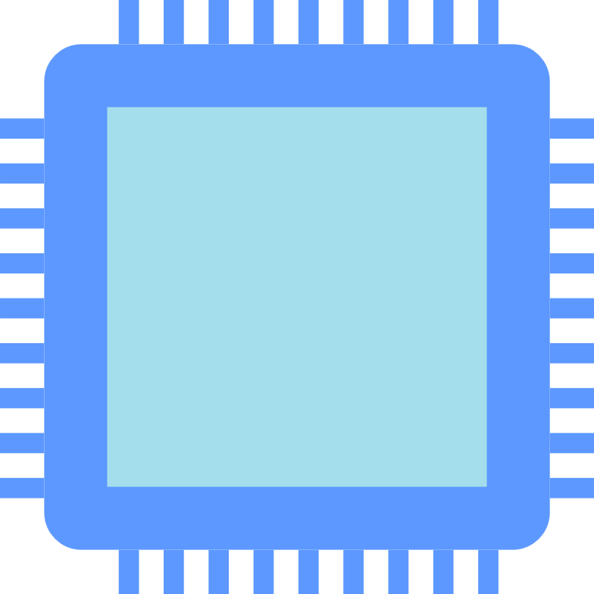
Disaggregated chipset architecture
….
Core modem
….
TRXV
TRXV
TRXV
TRXV

Slide 14
In summary
  6G is coming and NTN is a
  critical part of it
  6G will bring new use cases not able to be served with todays devices
  The need for better and different antenna solution will drive the chipset architecture

Slide 15

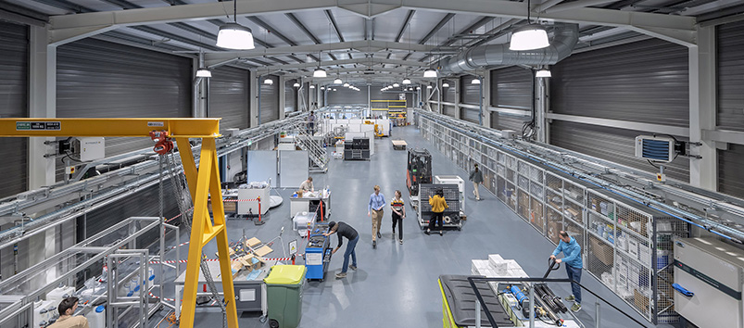
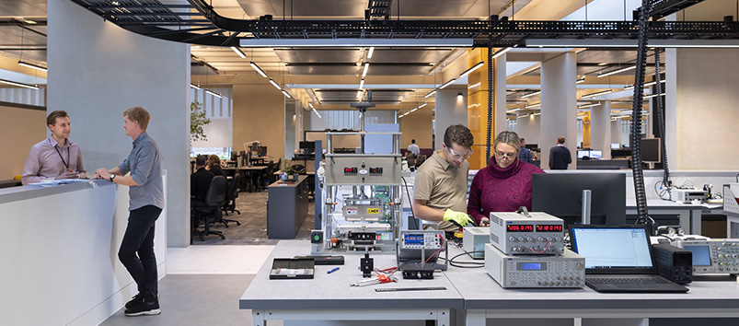
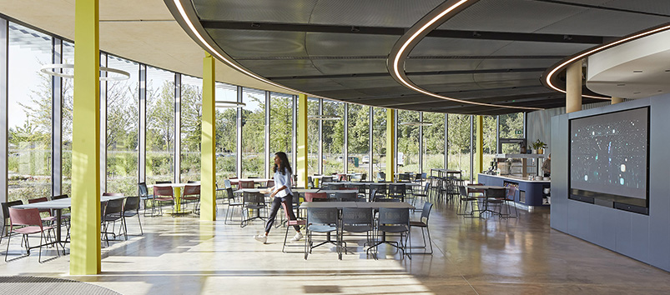
The TTP Campus,
Cambridge UK
      Our labs and facilities:
  Dedicated project and client collaboration labs
  Electronics lab
  Engineering labs
  Optics and laser labs
  Metrology lab
  Microfabrication
  Rapid prototyping and machining centre
  Controlled manufacturing areas (500m² )
  Cleanrooms (ISO6, ISO7 and ISO8)
  Wet chemistry and materials science
  Biology labs (nucleic acid, protein analytics, sequencing, cell culture)
  Bio-engineering integration labs
  RF and communications labs including anechoic chamber
  AI lab
  5G NTN test lab
      The Tech Barn
Our large-scale and industrial technology development and pilot manufacturing space.
      The Hive
Designed for interaction, creativity and innovation. The open-plan layout mixes engineering and science with working, meeting, and breakout spaces.
      The Exchange
Our social and event space, for us and our clients – where we gather to exchange ideas, eat, work out, and relax.​
© TTP plc

