Slide 1
Targeted, Jammed, Spoofed... Now What?
Rob Gillette
Director, Assured Positioning, Navigation, and Timing

Slide 2

NAL Technologies (Naltec)
Resilient Solutions. Global Reach.
Advanced satellite and mobile technologies delivering enhanced connectivity and resilient positioning, navigation, and timing to high-value assets anywhere on the planet.

Slide 3



APNT by Naltec: Trusted for any mission
  SAFETY AND SECURITY
Personnel and asset tracking
Humanitarian aid delivery
Non-governmental organizations
Maritime navigation
Aviation
  CRITICAL INFRASTRUCTURE
Autonomous vehicles
Commercial timing
Cybersecurity
Financial services
Transportation systems
Air traffic control
Telecommunications networks
  MILITARY & DEFENSE
Operating in EW contested environments
Land, sea, air, space, and cyber
Intelligence, surveillance, and reconnaissance
Crewed and uncrewed operations
Secure, reliable, and continuous—anytime and anywhere for any application

Slide 4

GNSS: The backbone of modern society
Industries that rely on GNSS:
  Utilities
  Telecom
  Finance
  Transportation
  Aviation
  Maritime
How they use it:
  Navigation
  Tracking
  Automation
  Synchronization
In 2024 estimated 6.8 billion devices in use, projected to be over 10 billion by 2030

Slide 5

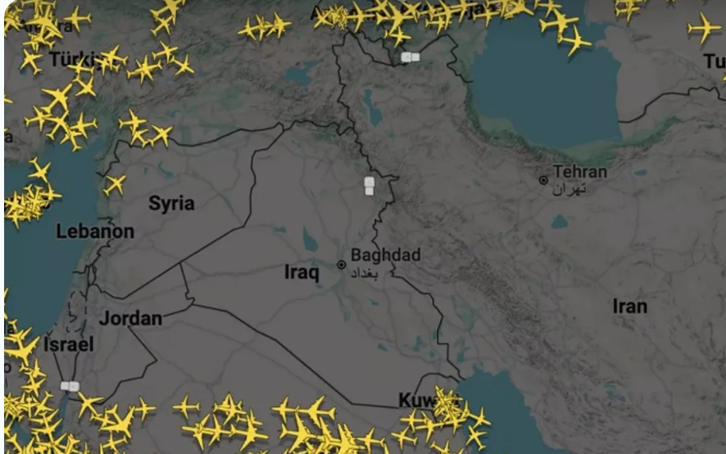
The war in Iran - unprecedented disruption
100% of all flights
in the region are impacted daily
16.5% of total global shipping trade is impacted daily
The impact is vast and the economic impacts will persist for decades!
Sources: https://aviationweek.com/aerospace/emerging-technologies/spoofing-clear-present-danger-airlines
https://windward.ai/blog/gps-jamming-surges-in-the-middle-east-gulf-1650-ships-hit/

Slide 6

Utilities & financial institutions are vulnerable
Commercial organizations are now on the front lines of GNSS disruption
70–80% of power grid monitoring and control relies on GNSS timing.
GNSS timing supports ~$1.4 trillion in economic activity in the U.S. alone.
A $0.10 slippage caused by a 1-ns timing delay for 1% of NYSE trading could result in a loss of ~$9B*
*See back-up slide for assumptions

Slide 7
So now what?
APNT Technology in Action

Slide 8
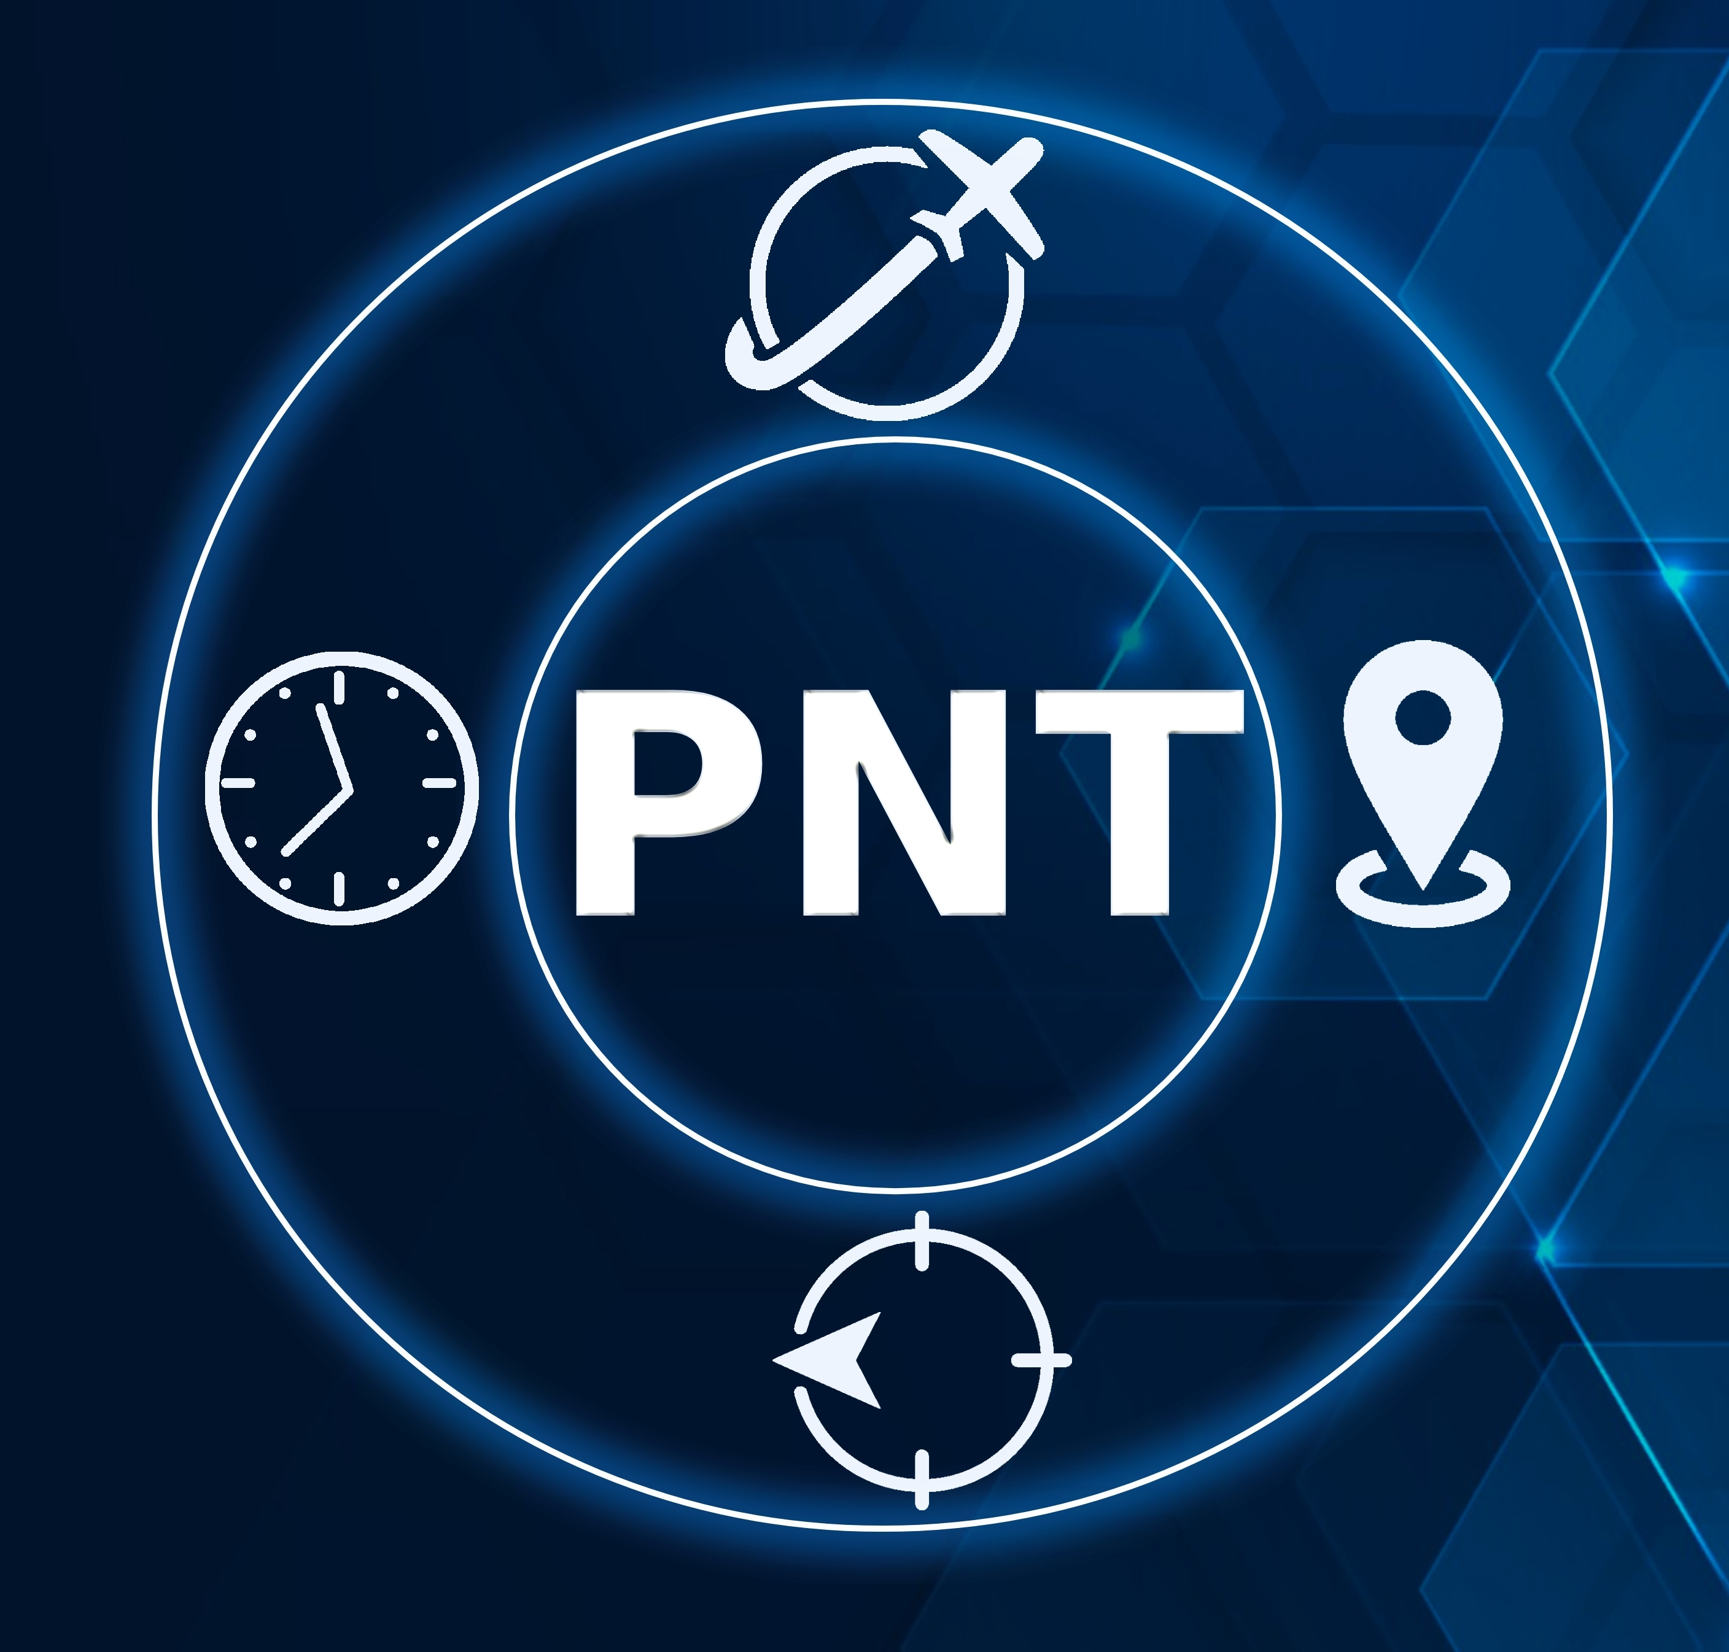
Sources of PNT available today
  GNSS (Global Navigation Satellite Systems): Government run GPS, Galileo, GLONASS, BeiDou, NavIC, SBAS, QZSS
  Inertial Navigation Systems: Accelerometer and Gyroscope
  Provides position holdover when GNSS disrupted or unavailable
  Alternate Space Based PNT: Satellite Based Alternative signals
  LEO satellites that can offer a PNT solution when GNSS cannot
  CSAC: Chip Scale Atomic Clocks (and others)
  Highly precise oscillators that maintain timing synchronization signals
  VIO: Visual Inertial Odometry (AI Based)
  Combines camera images with other sensors (IMUs) to derive PNT

Slide 9
Deep experience with assured PNT
2025
PntGuardTM for maritime released
ALTM-T for timing synchronization released
2008
Introduced first GPS-enabled asset tracking solution
2015
Partnered with Satelles (Iridium®) to develop initial STL solutions
2021
Introduced ALTM GEN2
with enhanced features
2023
Defense, aviation, & uncrewed system integrations
Handheld device module integrations
2019
Launched industry-first AltPNT receiver, “Alternative Location & Timing Module” (ALTM)
2022
1st partner product launched with
OEM module
2024
Partnered with SGM Technologies and Tschudi Shipping to address maritime challenges
APNT by Naltec
Industry-leading provider of Assured PNT solutions
Continuous innovation to improve capabilities
10,000+ Assured PNT-enabled products
in use globally
9

Slide 10


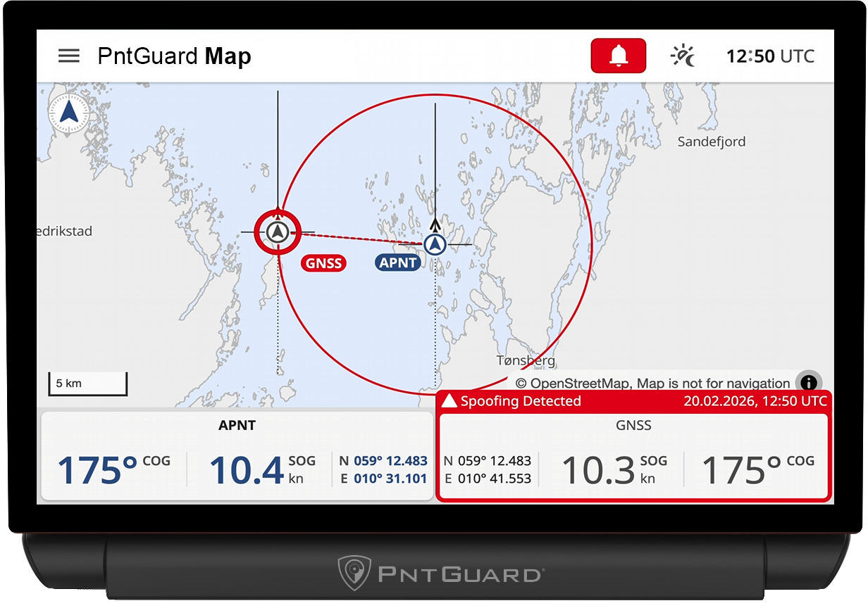
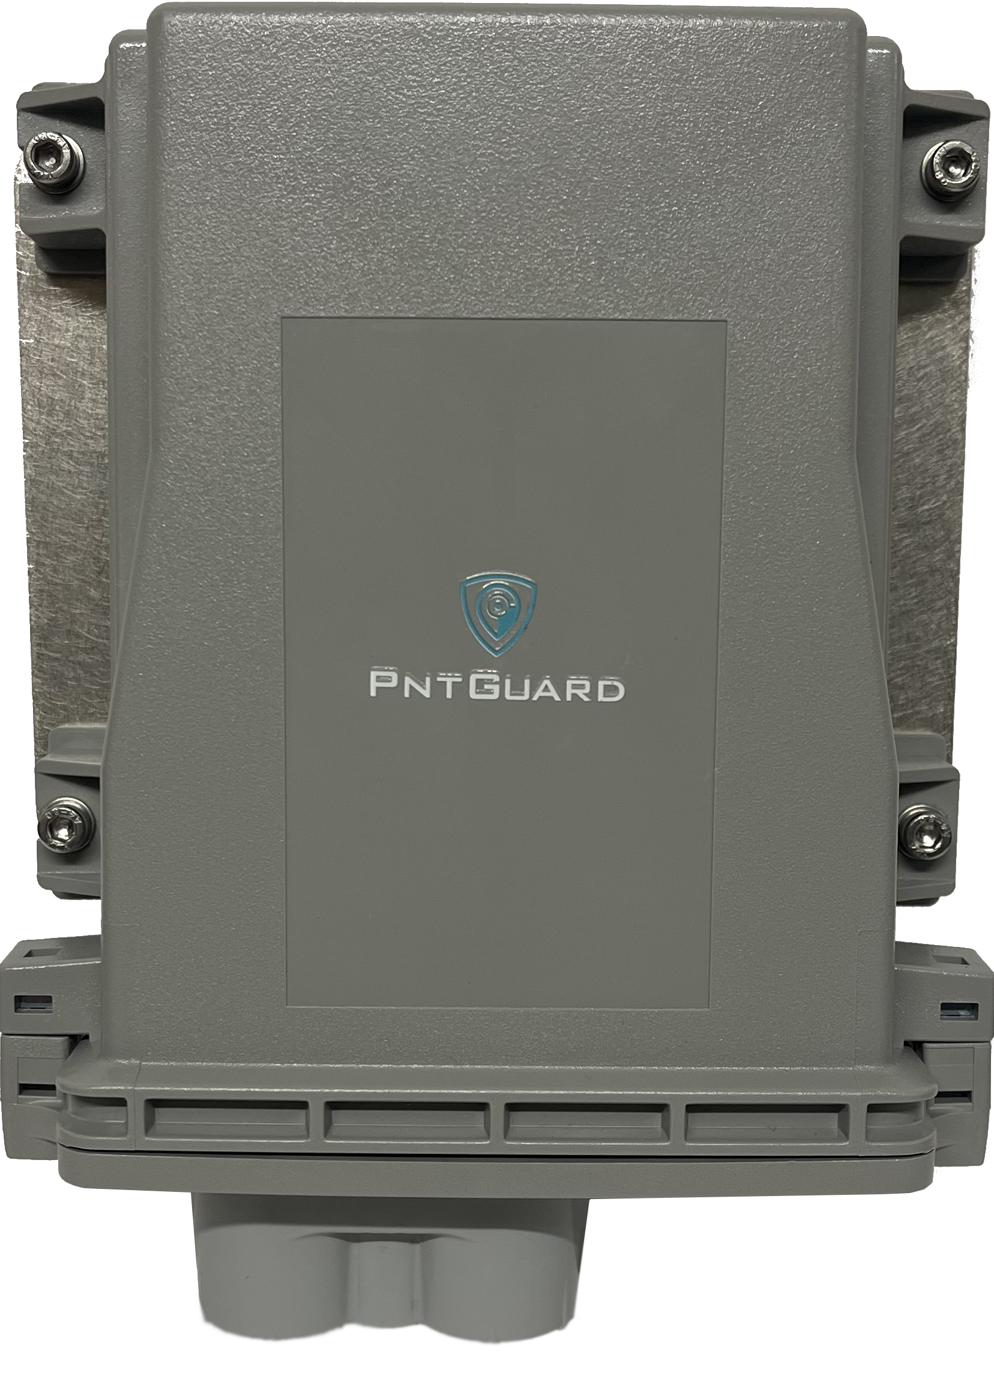
Resilient multi-source PNT
Modern multi-constellation, multi-frequency GNSS
Iridium® PNT
Automated monitoring and alarming
  Continuous monitoring of PNT performance
  Delivers real-time, critical alerts of GNSS
  disruption (jamming or spoofing)
  Real-time tracking and reporting
  Provides global asset monitoring and vessel tracking
  Automated reporting to remote operations center

Slide 11
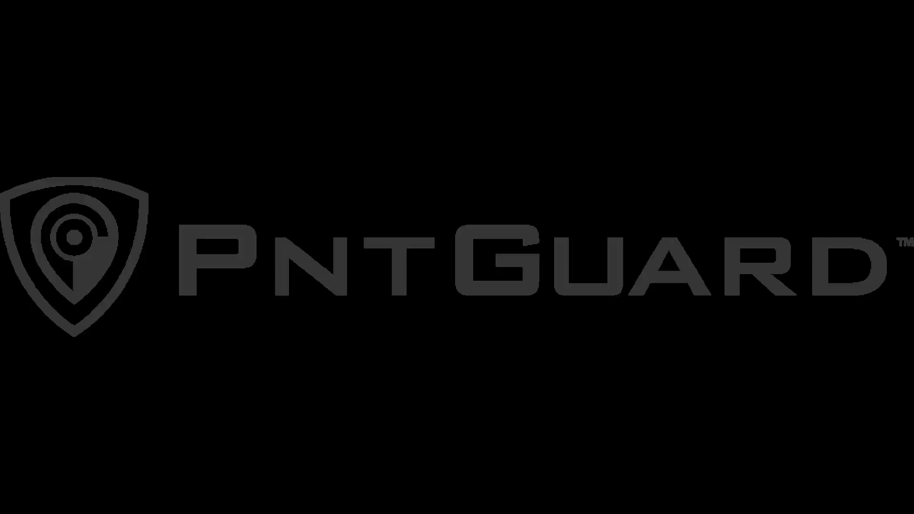
Real-World Results

Slide 12
Thank you!

Slide 13
Back-up Slides

Slide 14
Hypothetical NYSE timing disruption scenario
Assumptions:
  Average NYSE matched volume ≈ 8.894B shares/day
  1 ns timing disruption; assume 1% of trades delayed
  Shares affected ≈ 88.94M
Illustrative Financial Impact (Execution Slippage):
  $0.01/share adverse execution → ≈ $0.89M loss
  $0.05/share adverse execution → ≈ $4.45M loss
  $0.10/share adverse execution → ≈ $8.89M loss
Illustrative Notional Exposed:
  ~ $5B of trade flow potentially re-sequenced

Slide 15
GPS/GNSS service is easily disrupted
The Causes
The Impact
  Can be Intentional or unintentional
  No longer confined to military conflict zones
  Easy to execute with inexpensive equipment
  Infrastructure instability
  Operational downtime
  Safety and asset protection
  Business continuity
  Trust in automation and digital systems
Commercial organizations are now on the front lines of GNSS disruption

