Slide 1

Pioneering mmWave Radar for Space Situational Awareness
SATELLITE, Washington DC
Richard Jacklin, Space & Satellite Lead, March 2026
1

Slide 2
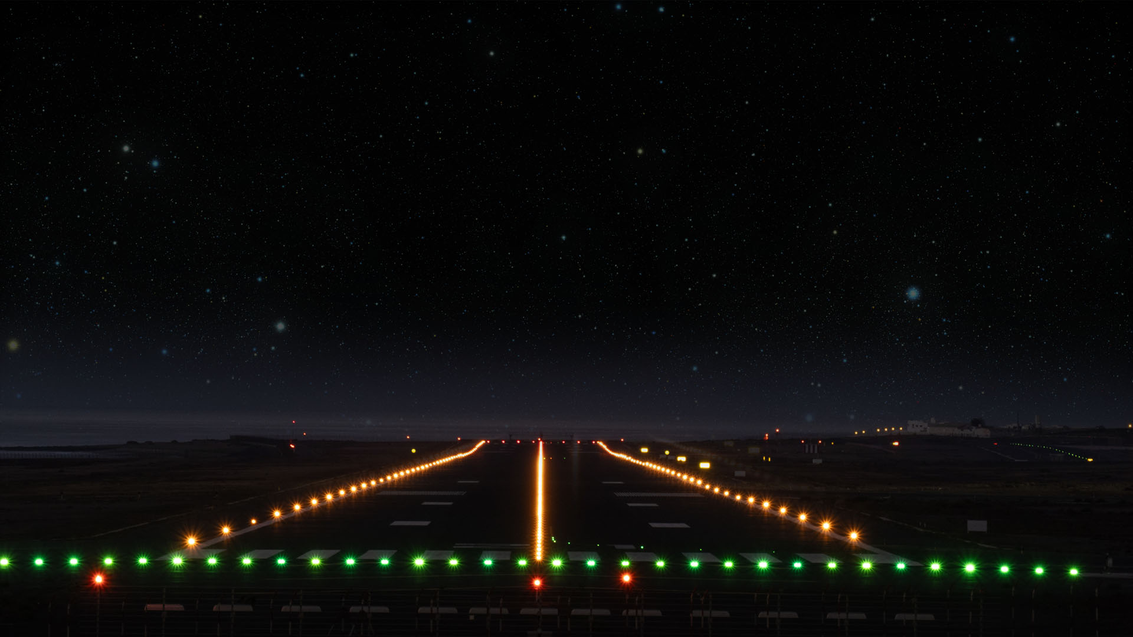
How does Radar work?
Radar works by sending out radio waves and measuring the time and strength of the echoes that bounce back from objects to determine their distance, speed, and direction.
Emitted wave
Reflected wave

Slide 3

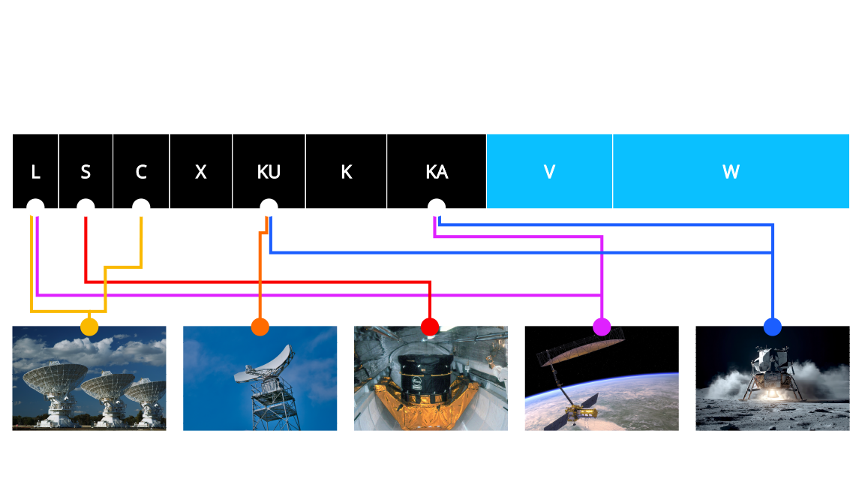
When we think about radar in space…

Slide 4
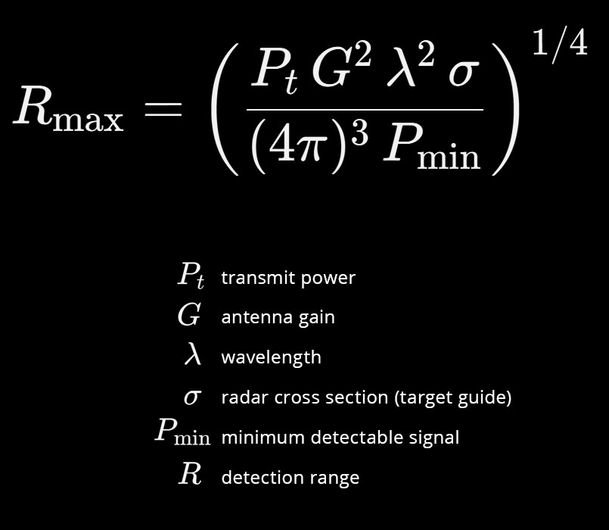
Radar design is often making tradeoffs…
The Core Relationship Radar Equation - Monostatic

Slide 5
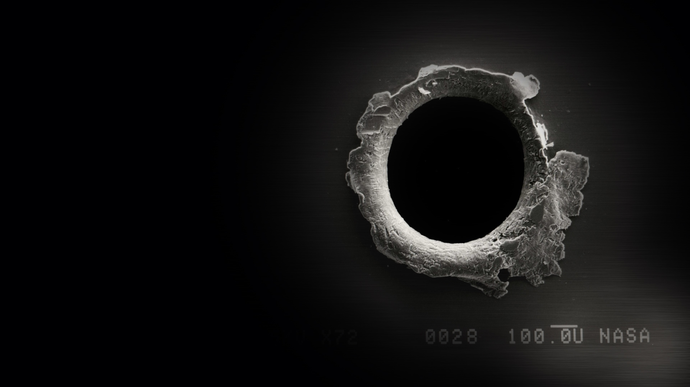
Space Debris Threat
ESA's latest Space Debris Environment Report estimates 140 million untracked small debris pieces in LEO, posing a significant threat to satellite and spacecraft
The risks escalate as debris increases . . .
. . . and the debris is increasing!
1 gram debris fragment in LEO has 100x more destructive kinetic energy than a 9mm bullet on Earth
Source: Space Environment Statistics · Space Debris

Slide 6
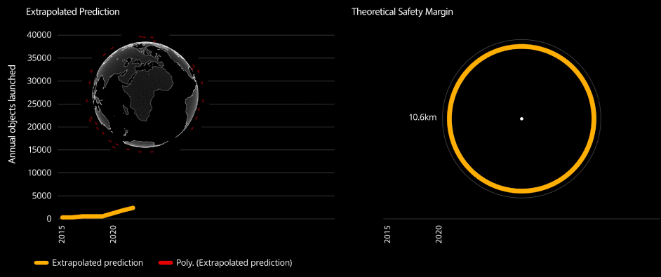
How comfortable does our LEO make you feel?
Today?…..
Plextek model

Slide 7
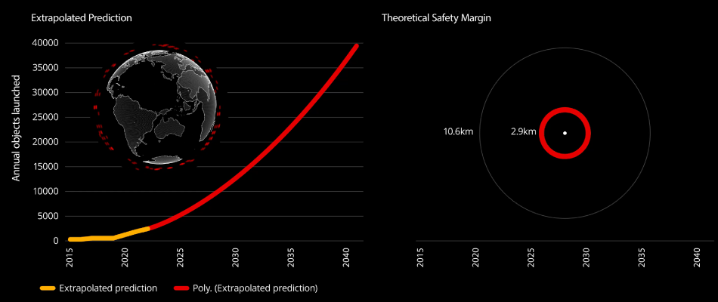
How comfortable does our LEO make you feel?
Future?...
Plextek model

Slide 8

mmWave FMCW RADAR
< 1mm debris detection radar

Slide 9
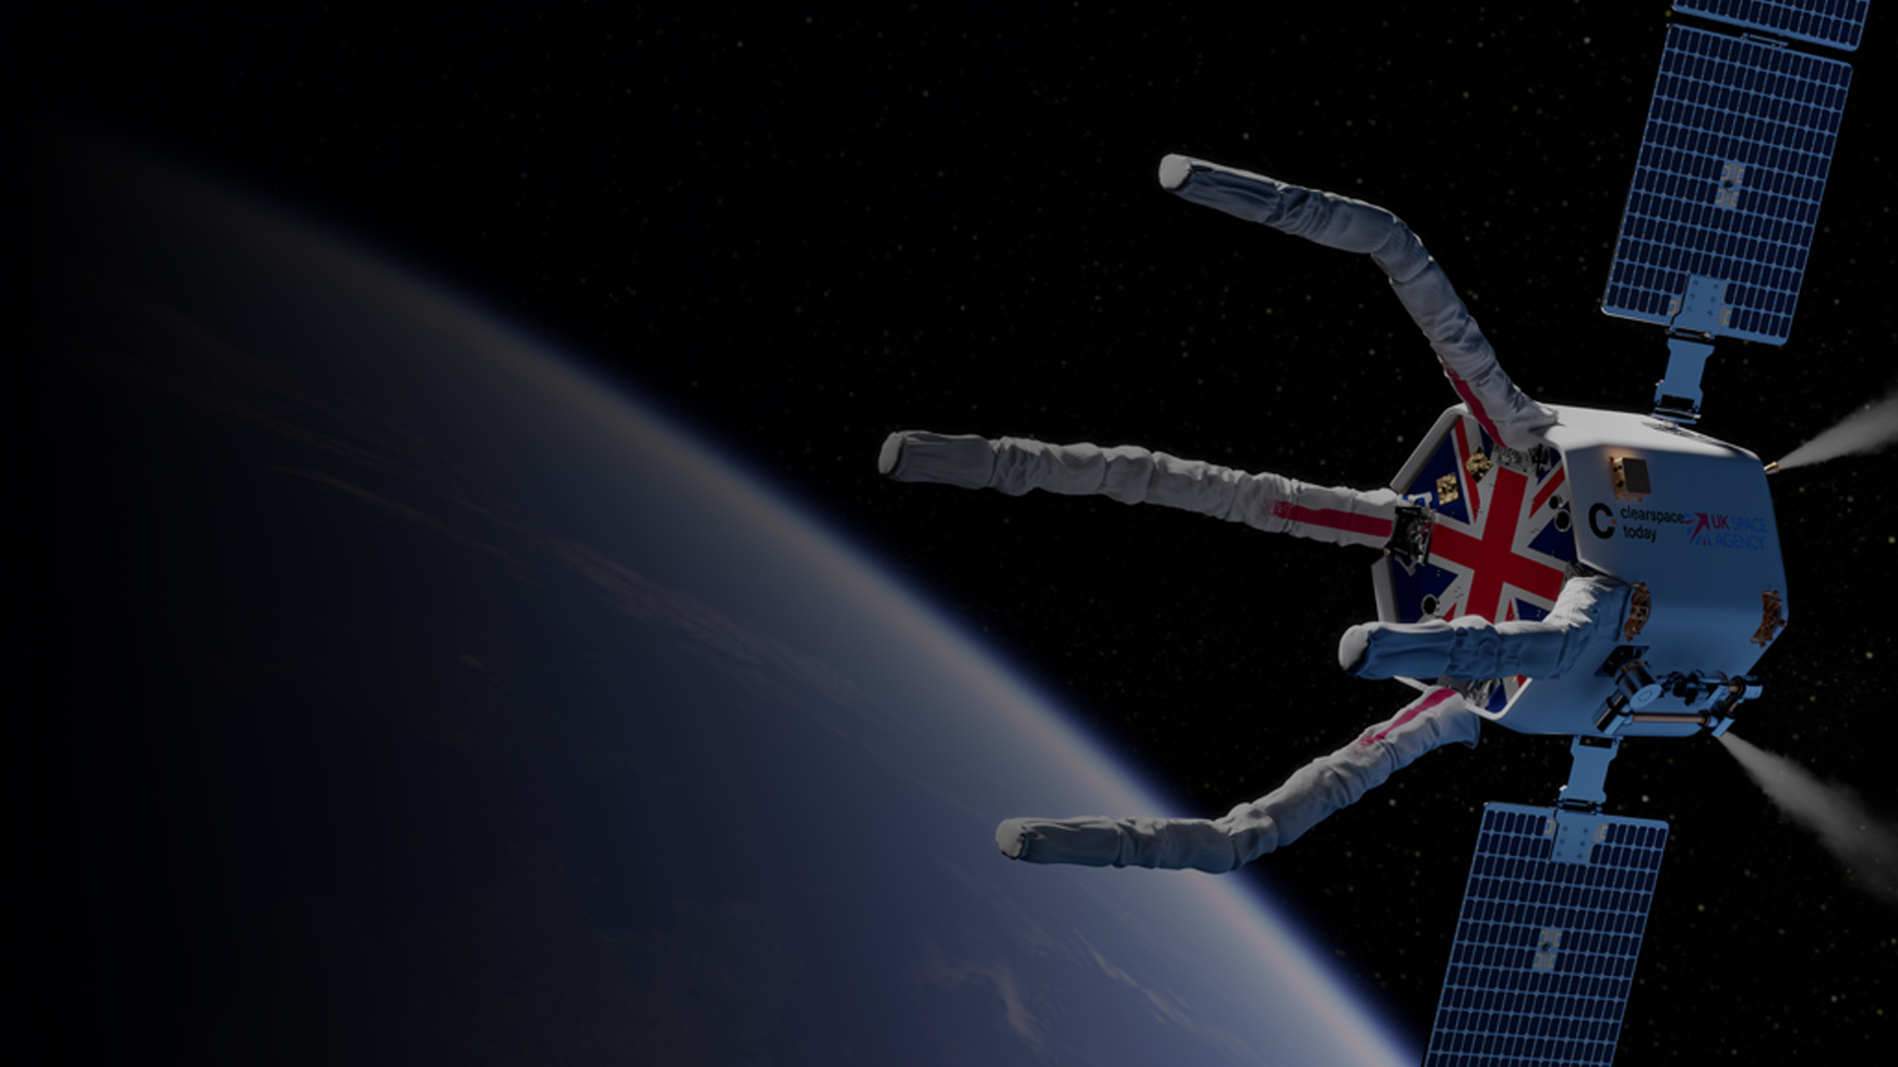
CLEAR Mission & RPO RADAR
“
Pioneering in-orbit services for future space operations
”
An artistic impression of the CLEAR mission. © ClearSpace

Slide 10
Rendezvous & Proximity Operations
Space craft need sensors to…
Know position and orientation
Navigate course trajectory and speed
Avoid hazards
Do tasks autonomously

Slide 11
Snapshot of Sensors for Rendezvous & Proximity Operations
Rendezvous and Proximity Operations (RPO) are critical components of space missions involving two or more spacecraft that must SAFELY approach, align, and interact in orbit.
Final Approach <10m
Proximity Operations <2km
Far-Field >2km
Debris removal
Docking & re-supply
Service extension
In-orbit assembly
Camera
Infra-red
LiDAR
RADAR
Un-cooperative targets
Darkness / eclipse – visibility
Darkness / eclipse – power
Obscured FoV – plume / thruster
Reliability for autonomous operation
Sensors are critical enabler, technology and component of a ~$4.4bn market* (*Satellite Catapult estimate for 2030)
RPO APPLICATIONS
SENSOR TECHNOLOGIES
SENSOR CHALLENGES
$$$

Slide 12
Sensing technologies: The options
 | Camera | LIDAR | RADAR
Energy efficiency | ↑ High | ↓ Low | → Medium
Construction | → Optical | → Optical (typically moving parts) | ↑ Solid state
Detects range and velocity | ↓ No | ↑ Yes | ↑ Yes
Range vs accuracy | ↓ No | ↑ Best | → Good
Detection range | ↓ Short | ↑ Medium to Long | ↑ Medium to Long
Detection in dark / eclipse | ↓ No | ↑ Yes | ↑ Yes
Detection through dust and rocket plume | ↓ No | ↓ No | ↑ Yes

Slide 13
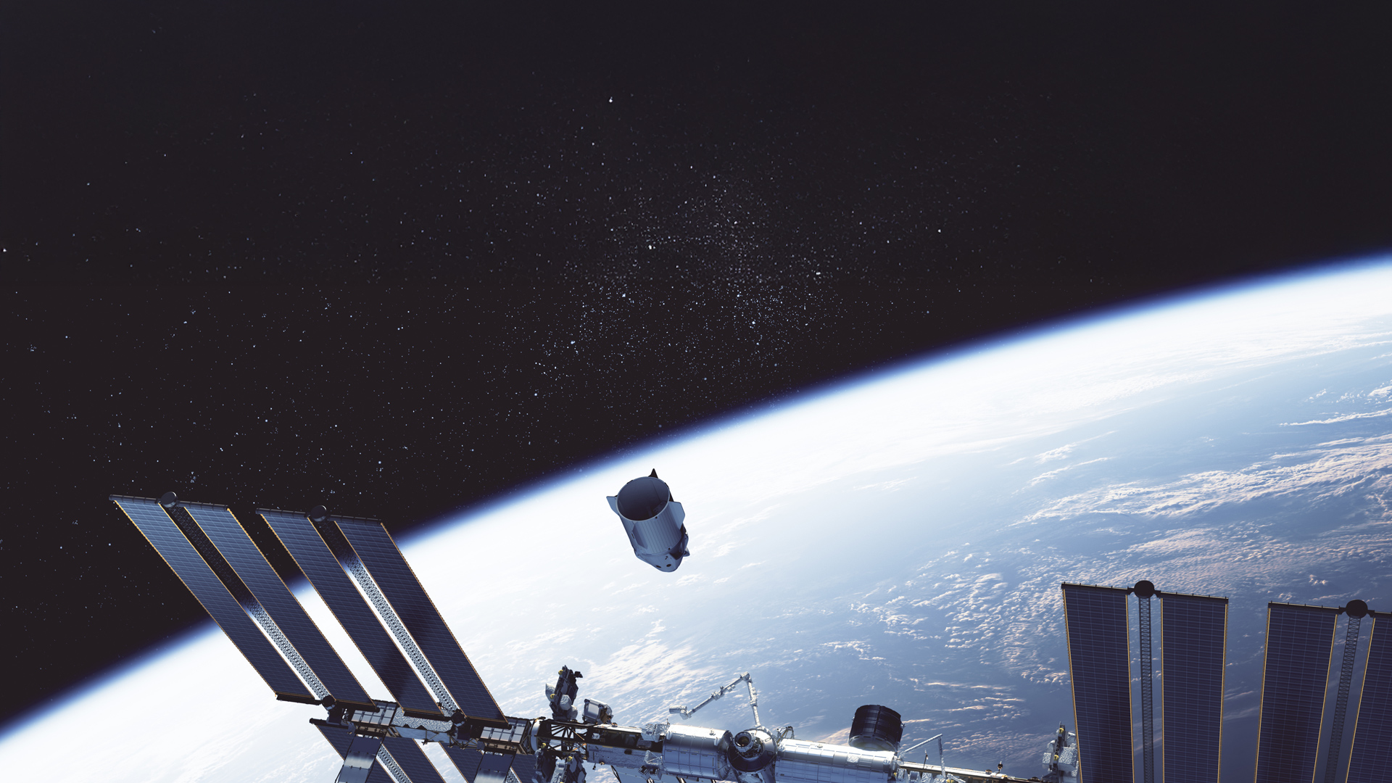
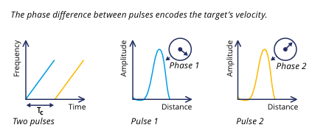
Rendezvous & Proximity Operations (RPO) RADAR
RPO RADAR Typical SWaP
Frequency: 60 to 80 GHz
Footprint: 15 x 10 x 5 cm
Weight: 250 gram
Power: < 10W average

Slide 14
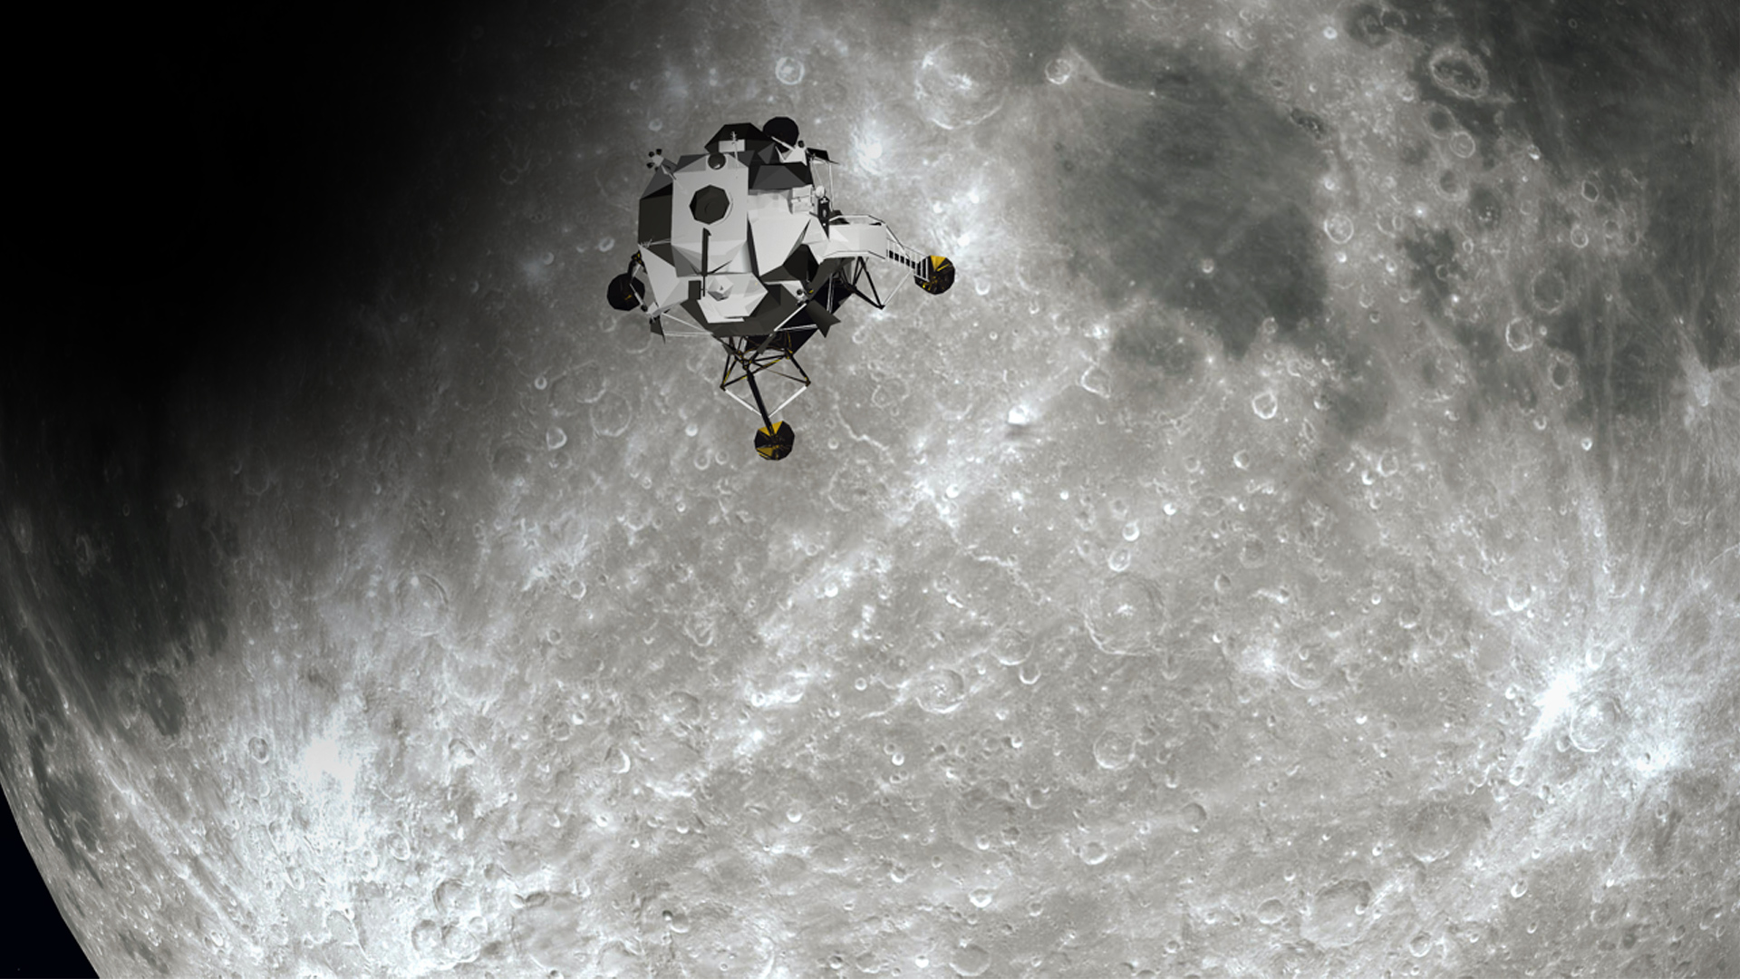
Lunar Lander
mmWave Radar Solutions

Slide 15
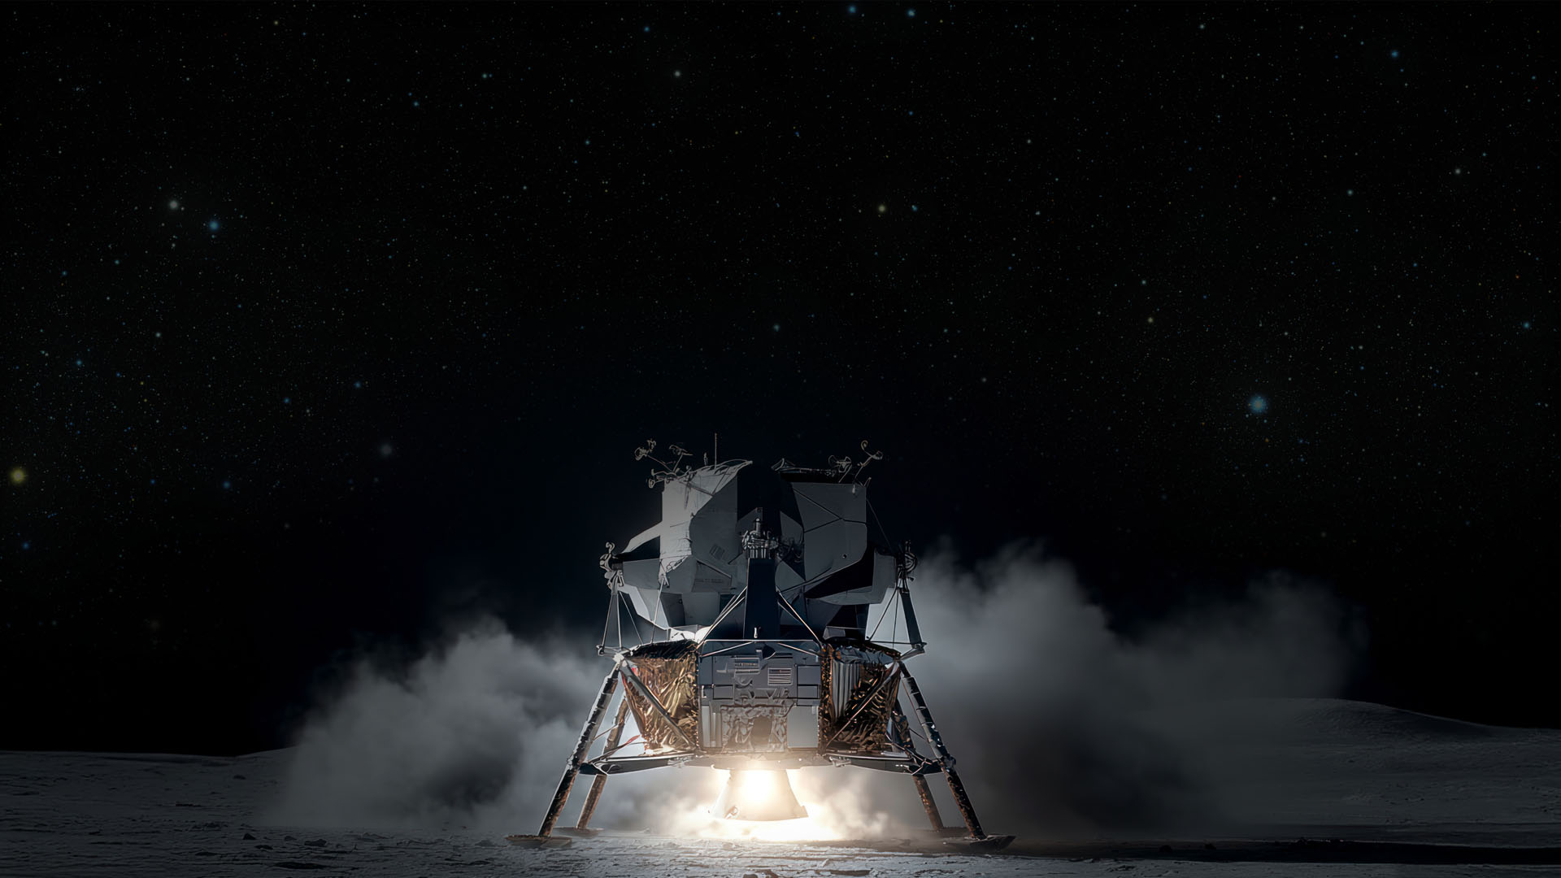
Landing on the Moon
Why is radar good for helping space craft land on the moon?
Accurate altitude
Accurate velocity
Requires no visual clues
Can work in darkness
Can work through dust and rocket plume

Slide 16
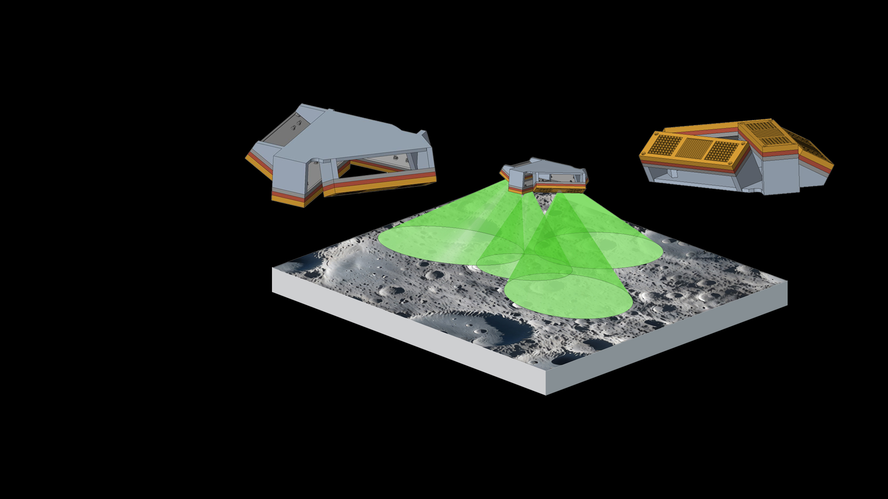
Example Lunar Lander Radar (3N + 1R)
4 sensors:
X, Y & Z
Altitude & Doppler
60 GHz Frequency
Each sensor:
5 to 40 degrees FoV
200 gram
~ 10 W
10Hz update rate

Slide 17
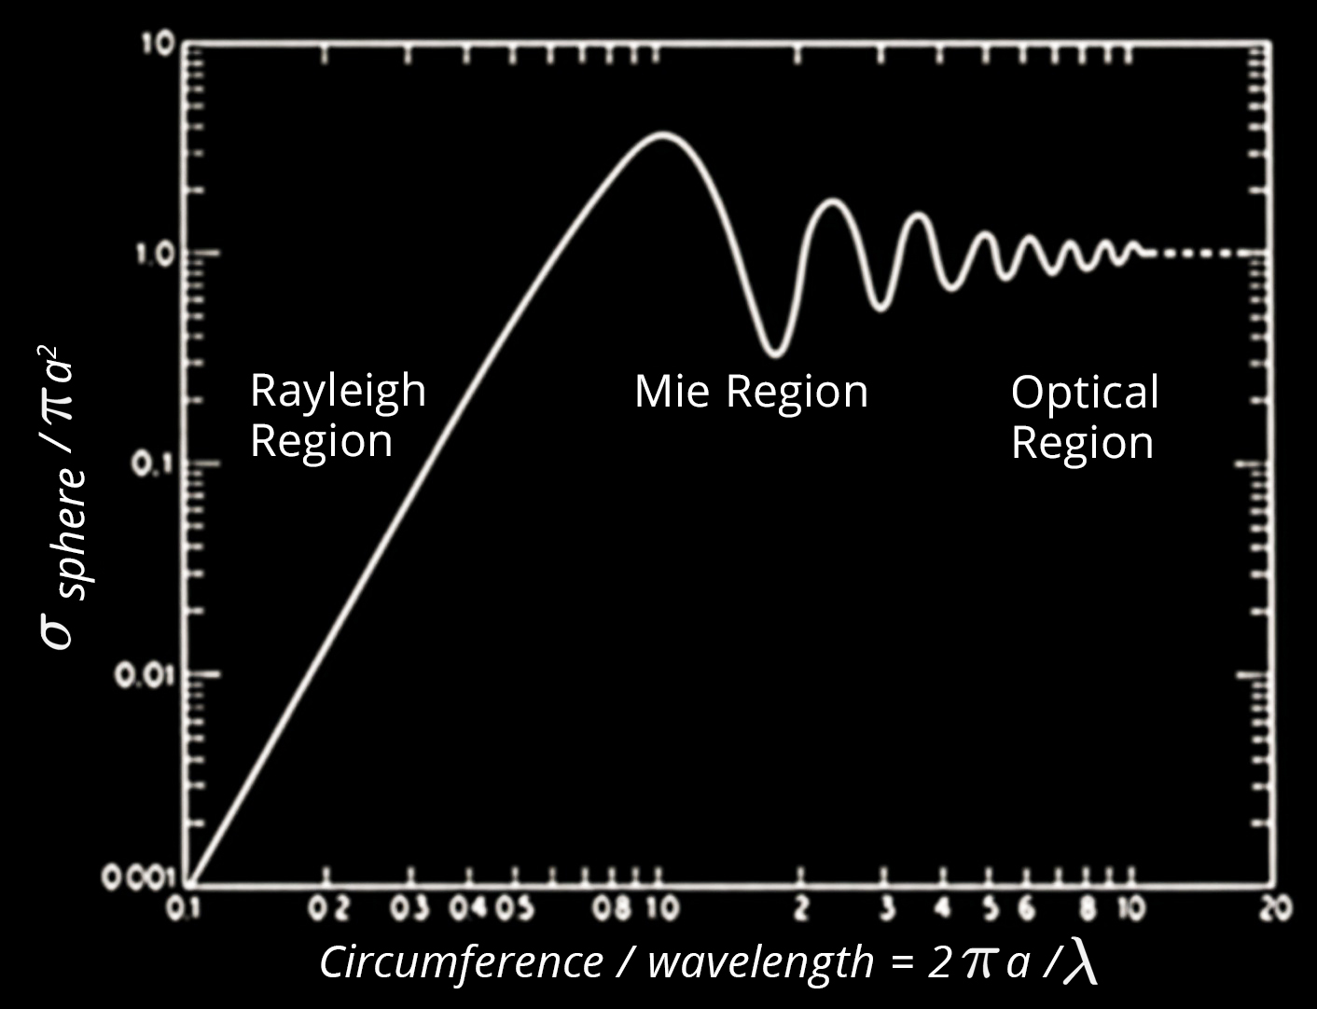
Regolith / Dust
Particle Size Distribution (PSD) = 100 nm and 1 µm diameter
mmWave radar = 1 mm to 10 mm, therefore PSD will have little effect / backscatter
Optical LIDAR = 750 nm and 1.5 µm, wavelength similar to PSD, a big problem with high backscatter

Slide 18
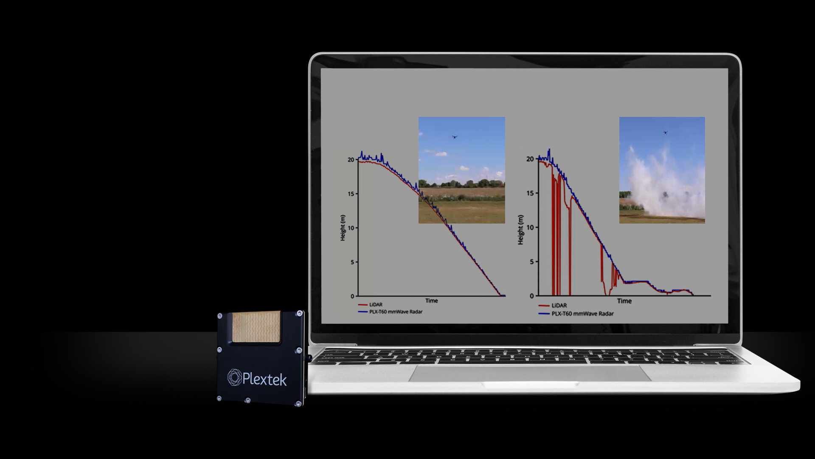
Simulated landing
Drone platform
RADAR & LIDAR
Clear & smoke condition
Plextek PLX-T60
60GHz mmWave radar

Slide 19

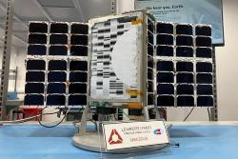



Plextek Services Limited
Over 35 years heritage designing and delivering RF communications and radar-based technology solutions
Cambridge, UK ~90 FTE Many spinouts including Blighter, Redtail, Telensa
Address many markets including; Defence, MedTech, Automotive and Space & Satellite

Slide 20
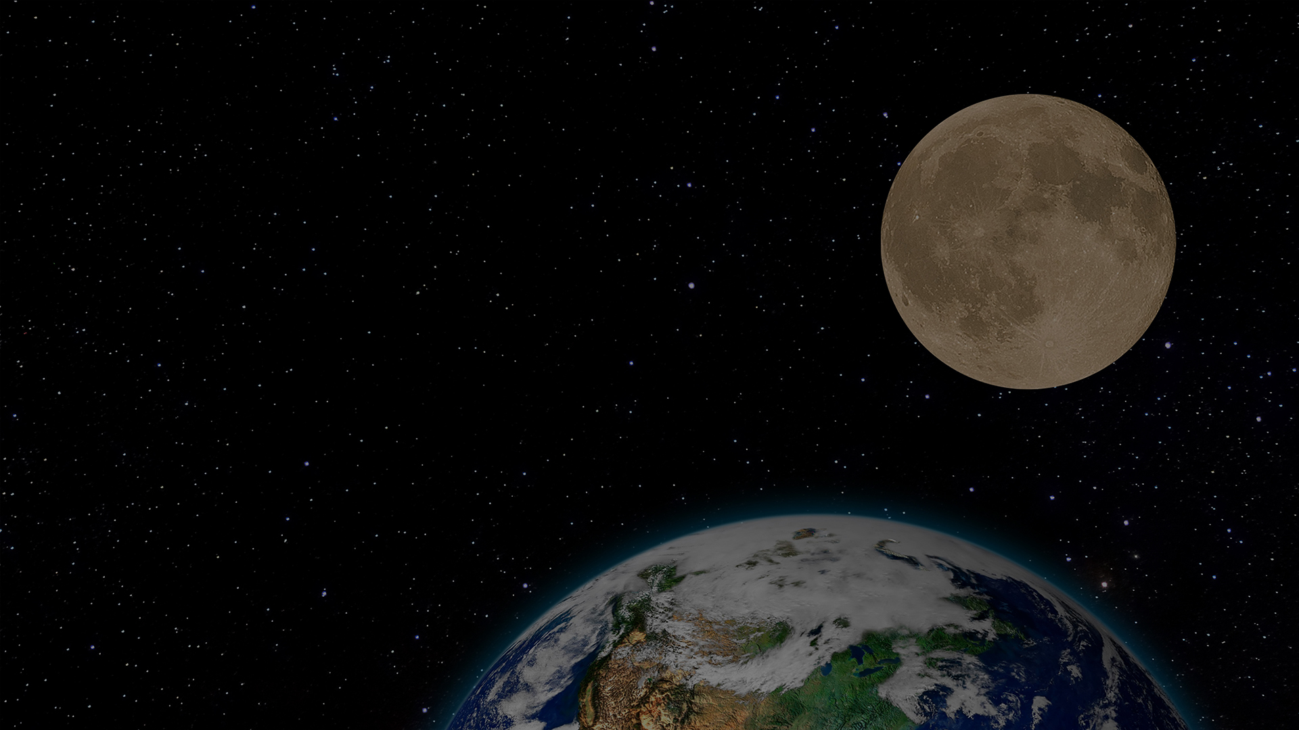
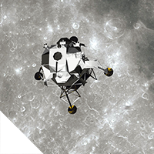
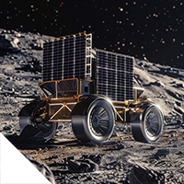
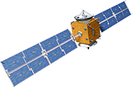
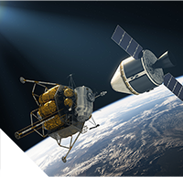


Space Market Capabilities in Radar
Lunar Landing
Lunar Terrain Vehicle Navigation
APPLICATION
Rendezvous & Proximity Operations
Lunar landing & terrain
Debris monitoring in LEO
Terrain (SAR)
Synthetic Aperture Radar
Rendezvous and Proximity Operations
DATA
Range, position, Doppler
Pre-processed or raw streaming
Debris
Detection
PLATFORMS
Discrete and SoC
X-band to mmWave
Midstream
Synthetic Aperture Radar
RADIO INTERFACE
Tx / Rx RF Front End
Antenna development
Phased array / beamforming
Upstream
Downstream

Slide 21


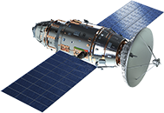
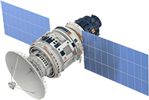
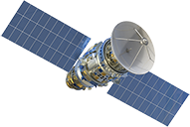



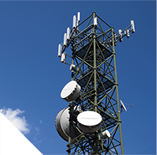


Space Market Capabilities in Communications
Inter-satellite Communications
and Routing
APPLICATION
Local and cloud based
Secure communications
AI / ML
Non-Terrestrial Network
Communications
Comms routing
Hardware optimisation
PROTOCOL
L2 – L3 stack development
Midstream
PHY
DSP / FPGA signal processing
Upstream
RADIO INTERFACE
Tx / Rx RF Front End
Antenna development
Downstream
GNSS Denied
Solutions
Telemetry, tracking
and Control

Slide 22
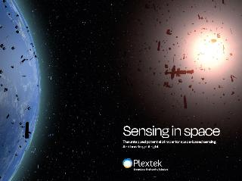

Thank you
Download our technical paper
See a live demonstration on Plextek’s booth 1251
Richard Jacklin richard.jacklin@plextek.com +44 7801 398 701

