Slide 1

Digital Twin-Enabled Design of 5G & 6G Satellite Links
Dr. Sassan Ahmadi
Keysight Technologies
March 2026
Notes:
Hello, my name is Sassan Ahmadi, and I am with Keysight Technologies. In this webinar, we are going to talk about Design and Validation of 5G/6G NTN systems using RF Digital Twins.

Slide 2

Outline
NTN System Design Challenges
What Makes a Simulation tool an RF Digital Twin?
How SystemVue Can Create a Digital Twin?
Realistic NTN Link Budget and Coverage Analysis
Summary

Slide 3
NTN System Design Challenges
RF and Antenna Array Design Challenges
Severe propagation conditions: Large free-space path loss, atmospheric attenuation, and dynamic satellite geometry significantly impact link margin and coverage.
High Doppler and timing variations: Fast-moving LEO satellites introduce large Doppler shifts and delay variations that complicate synchronization and waveform performance.
Large-scale phased-array design: Multi-beam satellite payload arrays must achieve precise beam steering, calibration, and sidelobe control while managing active impedance and mutual coupling effects.
RF impairments and nonlinearities: Power amplifier nonlinearity, phase noise, I/Q imbalance, and frequency offsets can degrade EVM, spectral compliance, and overall system performance.
Energy and resource constraints: Satellite payloads operate with limited power, requiring efficient beamforming, amplifier operation, and dynamic power management to maintain coverage and throughput.
Designing reliable NTN satellite links requires accurate system-level modeling that captures propagation, RF impairments, phased-array behavior, and power constraints—making high-fidelity RF digital twins essential for predicting real-world performance.

Slide 4
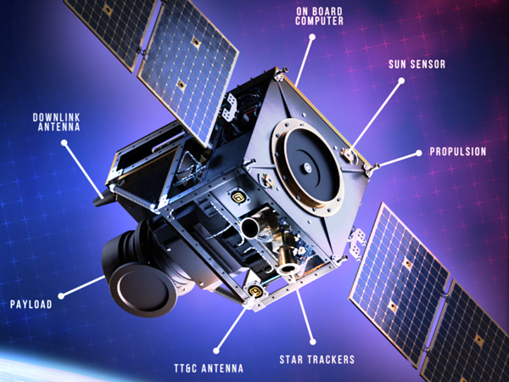
Energy Efficiency Considerations in Payload Design
Energy efficiency in satellite payloads is a critical design goal because satellites operate with limited onboard power and must maximize performance while minimizing energy consumption. Here are the main strategies used:
  Power Amplifier Efficiency
    Use of High-Efficiency Amplifiers: Technologies like GaN-based power amplifiers and Doherty architectures reduce power loss.
    Envelope Tracking (ET) and Digital Predistortion (DPD): These techniques optimize amplifier operation for varying signal conditions, improving efficiency without sacrificing linearity.
  Advanced Antenna Systems
    Phased-Array Antennas: Enable dynamic beam steering without mechanical movement, reducing energy waste.
    Beamforming Algorithms: Focus energy where needed, minimizing unnecessary radiation and power consumption.

Slide 5
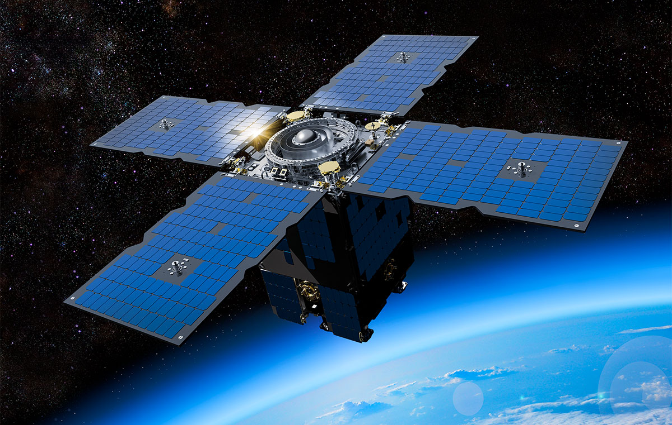
Energy Efficiency Considerations in Payload Design
  Power Management
    Adaptive Power Control: Adjusts transmit power based on link conditions and traffic demand.
    Energy-Aware Scheduling: Prioritizes tasks and payload operations to avoid peak power loads.
    Switching off transceivers or antenna sub-arrays when not in use (see below)
  Thermal and Hardware Optimization
    Low-Power RF Components: Use of efficient mixers, LNAs, and filters.
    Thermal Design: Efficient heat dissipation reduces cooling requirements, indirectly saving energy.
  Digital Signal Processing
    Onboard Processing: Reduces redundant transmissions by performing signal processing in the satellite.
    AI/ML for Resource Optimization: Predicts traffic and dynamically allocates power to active beams.
Study of Energy Efficiency During Payload Design and Validation is an Important Application Area for Digital Twins.

Slide 6
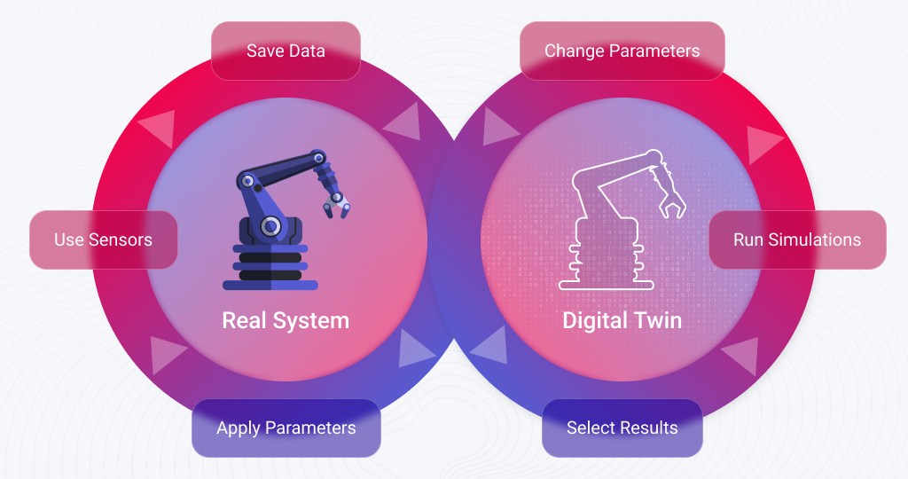
What Qualifies a Simulation Tool to be an RF Digital Twin?
End-to-End Cross-Domain Modeling
  Accurately integrate baseband waveforms (3GPP-compliant), RF impairments, phased-array antennas, feeder/service links, and space-channel dynamics within a single executable system model.
High-Fidelity RF Impairment Representation
  Support nonlinear power amplifier models (including memory effects), phase noise, I/Q imbalance, frequency offsets, active impedance/load-pull effects, and spectral compliance analysis.
Realistic NTN Channel Modeling
  Model large propagation delays, time-varying Doppler shifts, satellite trajectory dynamics, atmospheric attenuation, rain fade, shadowing, and frequency-selective fading aligned with 3GPP NTN assumptions.
Phased-Array & Beamforming Capability
  Enable modeling of large-scale arrays, multi-beam payloads, beam quantization, beam hopping, and calibration effects with spatial radiation pattern visualization.

Slide 7
What Qualifies a Simulation Tool to be an RF Digital Twin?
Standards Alignment & KPI Evaluation
  Generate and evaluate system-level KPIs such as EVM, SINR, CNR, throughput, latency, availability, and spectral emissions consistent with 3GPP 5G/6G specifications.
Coverage & Link Budget Analysis
  Provide Earth-surface CNR/RSSI contour mapping and link margin computation that correlate payload settings with real coverage performance.
Measurement Correlation & Calibration
  Allow import of measured device data and support correlation between simulated and physical hardware performance to ensure predictive accuracy.
Scalability & Automation
  Support HPC, scripting (e.g., Python APIs), and large parameter sweeps for constellation-level studies and multi-beam optimization.
Hardware-in-the-Loop
  Enable partial integration with real RF hardware for pre-deployment validation.
An RF digital twin for NTN must be physically realistic, standards-compliant, cross-domain, measurement-anchored, and scalable, capable of predicting real-world performance before hardware deployment.

Slide 8


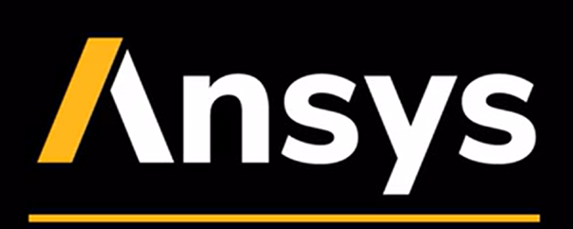
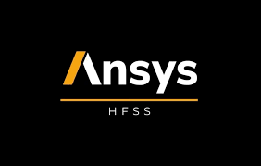



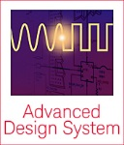
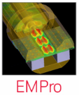

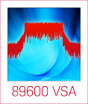
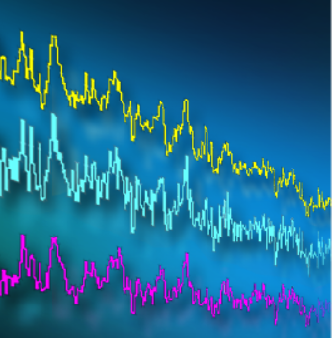

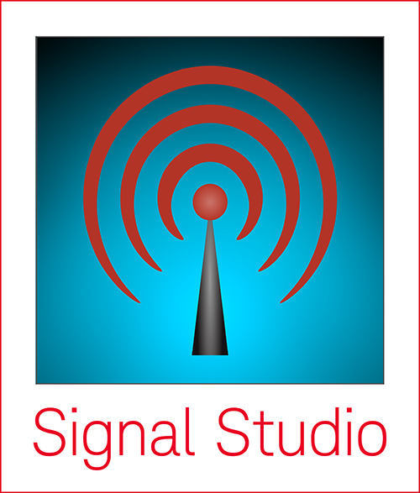
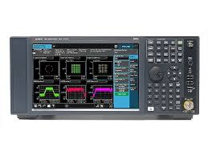



SystemVue Integrated Workflow
Import and Export Data from/to Keysight and External Hardware and Software Tools
RF Channel Modeler
Environmental
Modeling
Noise, loss, latency
Doppler shift, position
Interferers
Network
Accurate RF
Modeling
Native models, DPD
RF chain simulator
X-parameters, DGM
Link to Circuit/EM simulation
Baseband Modeling
MATLAB
C++
Python
Channel Emulation
PROPSIM/GCM
WirelessPro
Reference Libraries
Aerospace and Defense
Cellular & Connectivity
SatCom, MilCom, Navigation
Coexistence Studies
Wideband T&M
Integration
Download waveforms
Connect to T&M software
Multi-channel
X-Apps
WaveJudge

Slide 9
Building an RF Digital Twin with SystemVue
Model the complete signal chain
  Build an end-to-end representation of the system including baseband waveforms, RF impairments, power amplifiers, phased arrays, and propagation channels.
Incorporate measurement-based device models
  Use extracted behavioral models (e.g., PA nonlinearity, mixer characteristics, memory effects) to replicate real hardware behavior.
Simulate realistic environments
  Include dynamic channel conditions, Doppler, atmospheric losses, and mobility to reflect real-world operating scenarios.
Correlate with hardware and measurements
  Validate simulation results against lab data to calibrate and refine the model for predictive accuracy.
Perform parametric sweeps and optimization
  Use automation and HPC to explore design tradeoffs and predict performance before hardware implementation.
SystemVue NTN modeling capabilities can be used to build high-fidelity digital twins of NTN systems during design and validation phases.

Slide 10

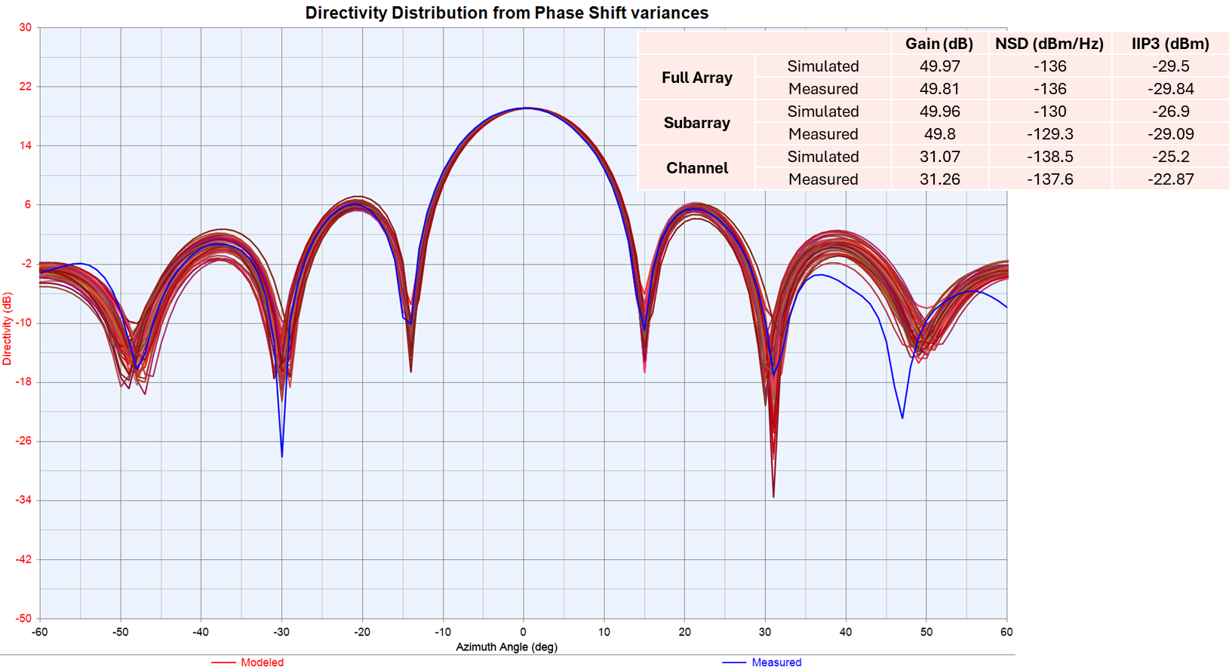
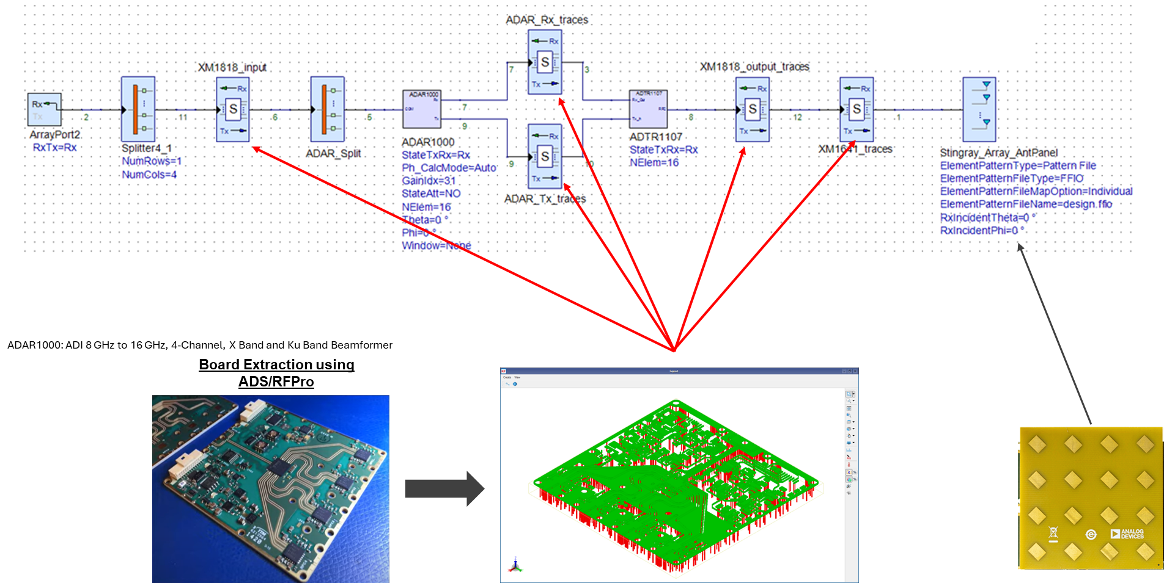
SystemVue: An RF Digital Twin
Measured and Simulated RF KPIs of the Phased Array Match Perfectly
SystemVue is a Measurement-based High-Fidelity RF Simulation Tool for Modeling RF and Antenna Systems.
SystemVue Comprises Time and Frequency Domain Analyses and Phased-Array
Near-Circuit Fidelity, Libraries for Radar, Aerospace, 5G/6G, and Wi-Fi, BT, GNSS, etc.
Phased Array Model in SystemVue
Physical System to be Replicated
Phased Array Architecture
RFPro Model of the Physical System

Slide 11
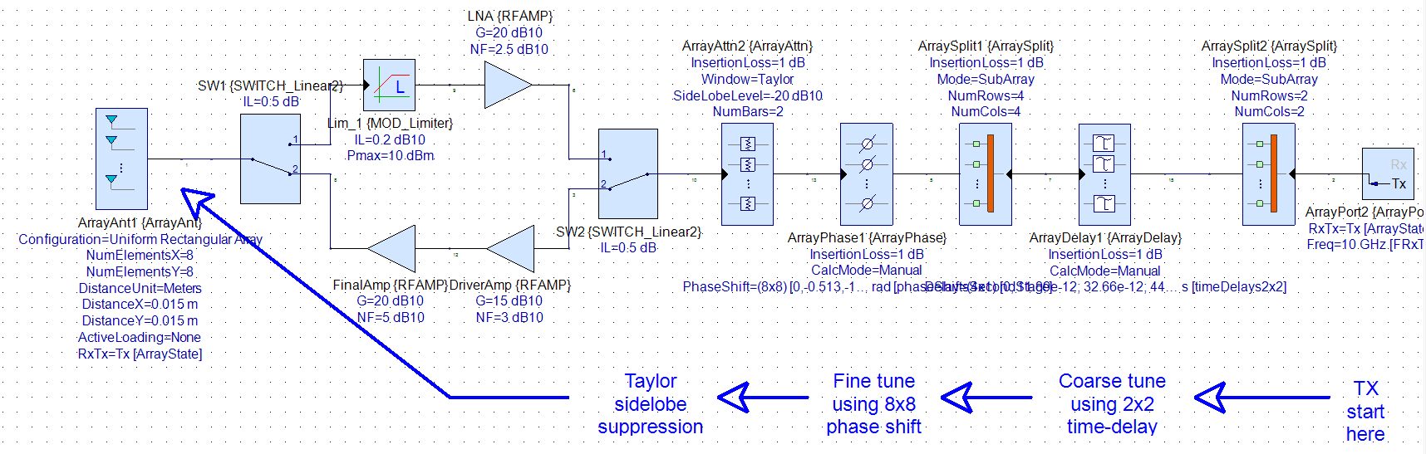
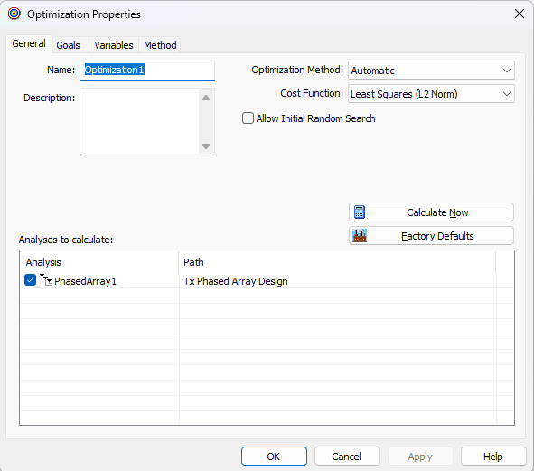
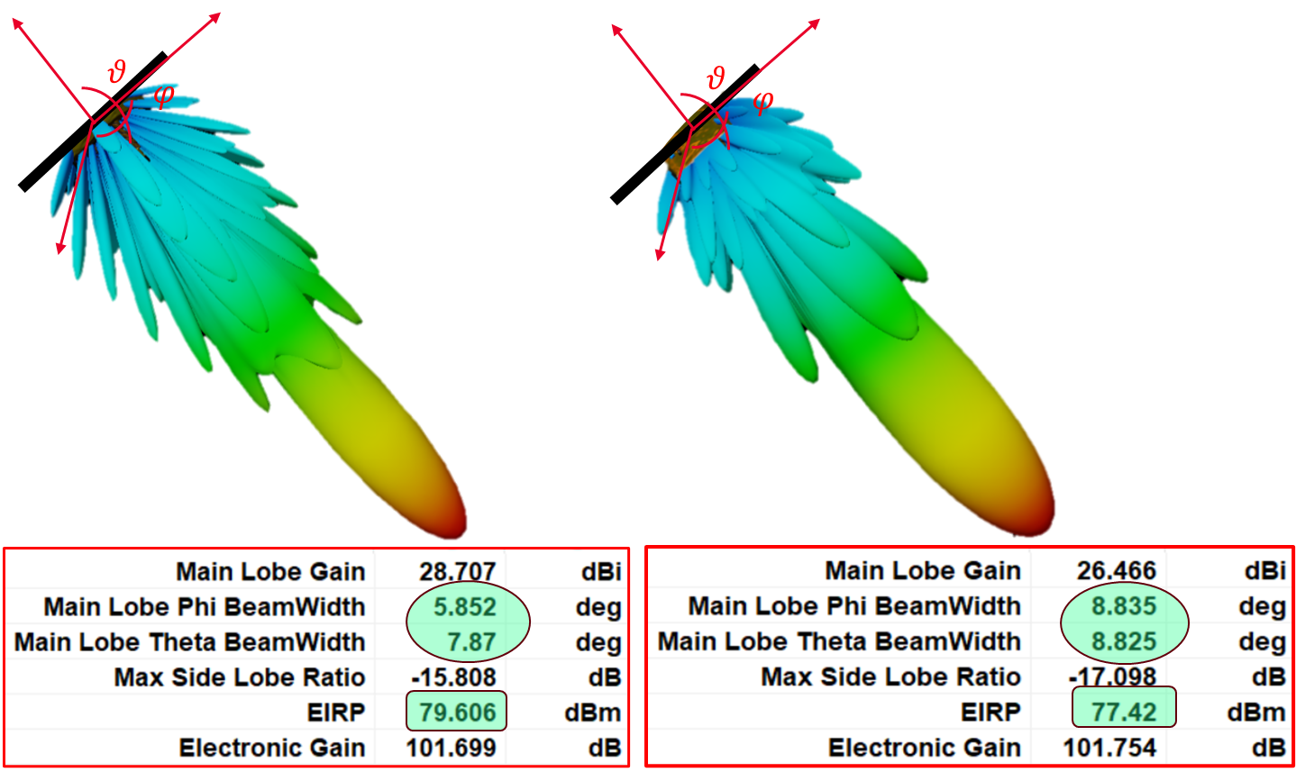

Satellite Phased-Array Beam Optimization
Modeling Realistic RF Impairments and Active Impedance
SystemVue Models RF Impairments of the Transceiver and Active Impedance while Optimizing the Phased Array KPIs.
Dynamic Complex Weights and Delay Optimization to Achieve Target Beam Shape, EIRP Maximization and Sidelobe Minimization

Slide 12


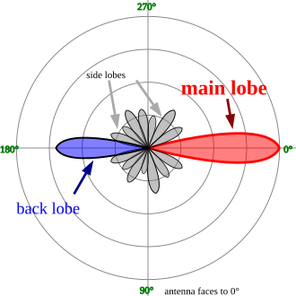

NTN System Model
PAYLOAD TRANSCEIVER
Antenna → Circulator → RX BPF → LNA → Mixers → BPF → VGA/PA → TX BPF → Circulator → Antenna
Payload RF Processing at F1
Payload RF Processing at F2
Payload TX Antenna Parameters
Gain, EIRP, Beam Misalignment, Output Power, Efficiency, etc.
Payload RX Antenna Parameters
Gain, RX G/T, EIS, Efficiency, etc.
Feeder Link Propagation Parameters and Losses
Gateway Baseband Signal Processing
Gateway TX RF Processing
Service Link Propagation Parameters and Losses
UE RX RF Processing
UE Baseband Signal Processing
TX Antenna Parameters
TX Gain, EIRP, Phase Error, Beam Misalignment, Output Power, Antenna Efficiency, Cable Loss, etc.
Baseband Signal Parameters
Modulation and Coding
GATEWAY Transmitter
I/Q LPF → Mixers → BPF → VGA/PA → TX BPF → Circulator → Antenna
RX Antenna Parameters
RX Gain, RX G/T, EIS, Efficiency, etc.
Baseband Signal Parameters + SINR, Repetition, CNR, CIR Calculation
UE RECEIVER
Antenna → Circulator → RX BPF → LNA → Mixers → I/Q LPFs

Slide 13
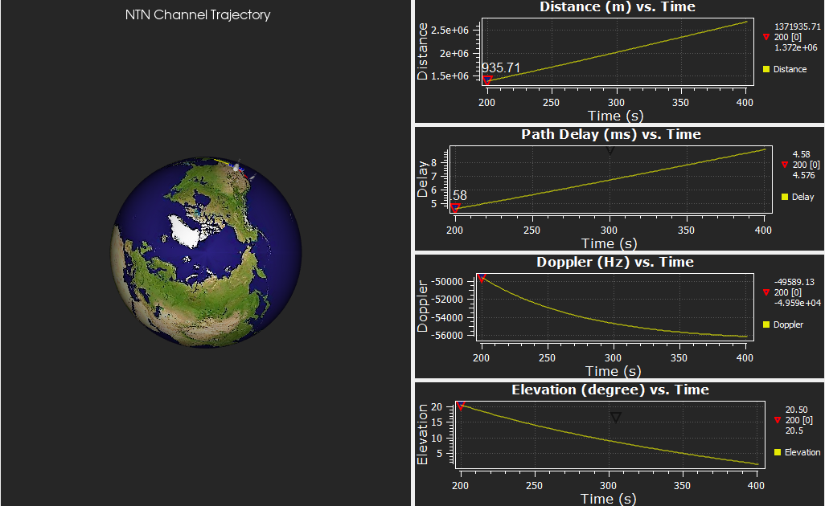

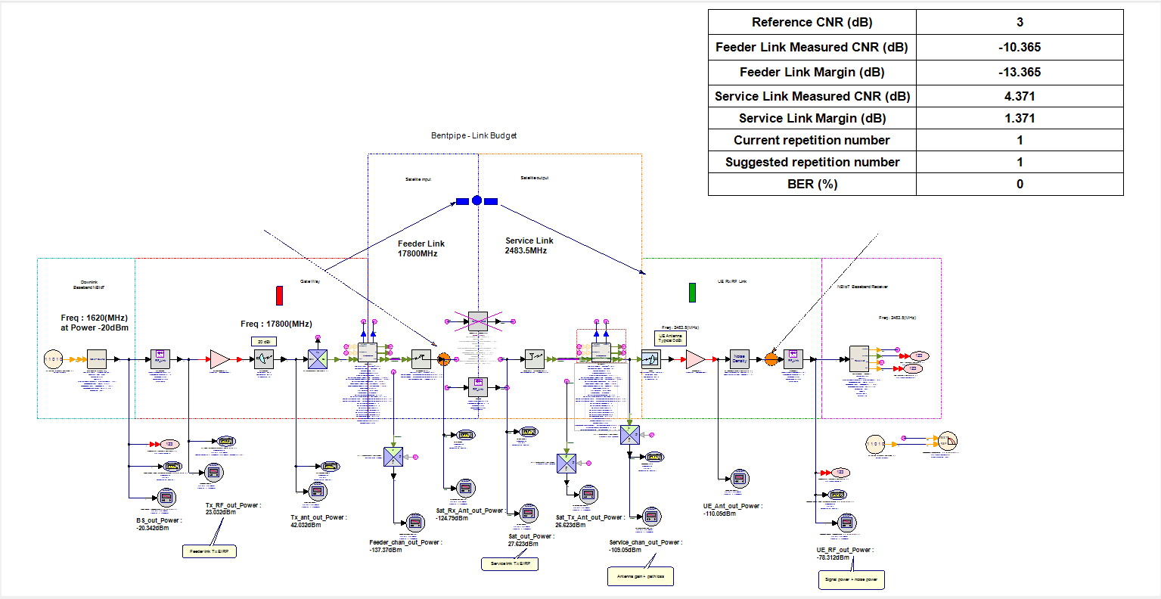
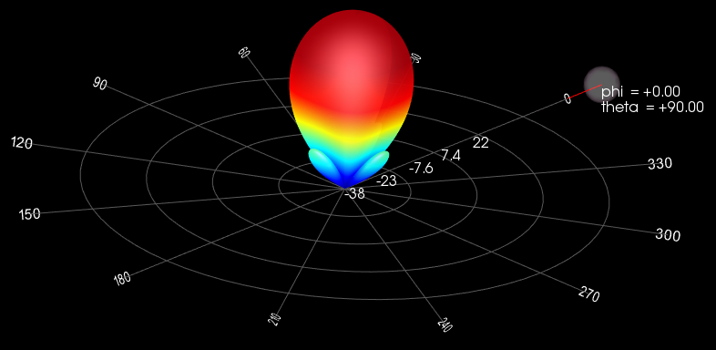
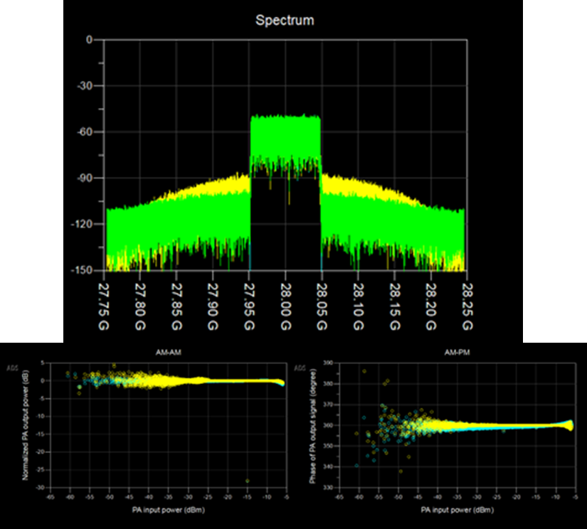
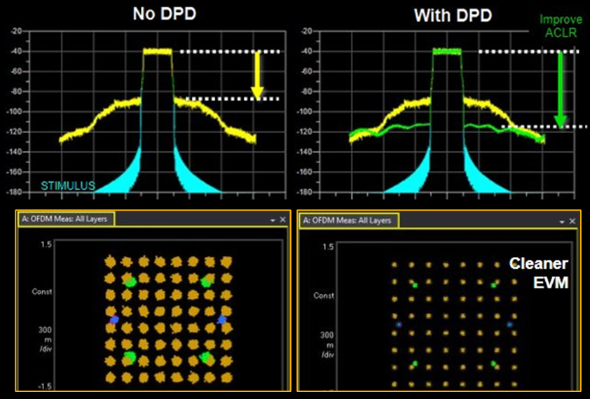
NTN System Modeling in SystemVue
Dynamic Table of KPIs
Set Payload Type
Gateway, Payload and UE Antenna Array Modeling
Payload RX Array
3D Visualization of SAT Trajectories and Propagation Effects
Payload TX Array
Generate Waveform
Detect Waveform
Nonlinearity Modeling
Feeder Link Parameters
Service Link Parameters
SystemVue NTN Examples can be Customized based on User Scenarios
Gateway RF TRX
UT RF TRX
Realistic Modeling of GW, SAT, and UE RF Processing and Impairments
Realistic Modeling of Feeder/Service Link Propagation and Channel Effects
Monitoring Signal Spectrum, Power CCDF, etc. on the Transmission Paths

Slide 14
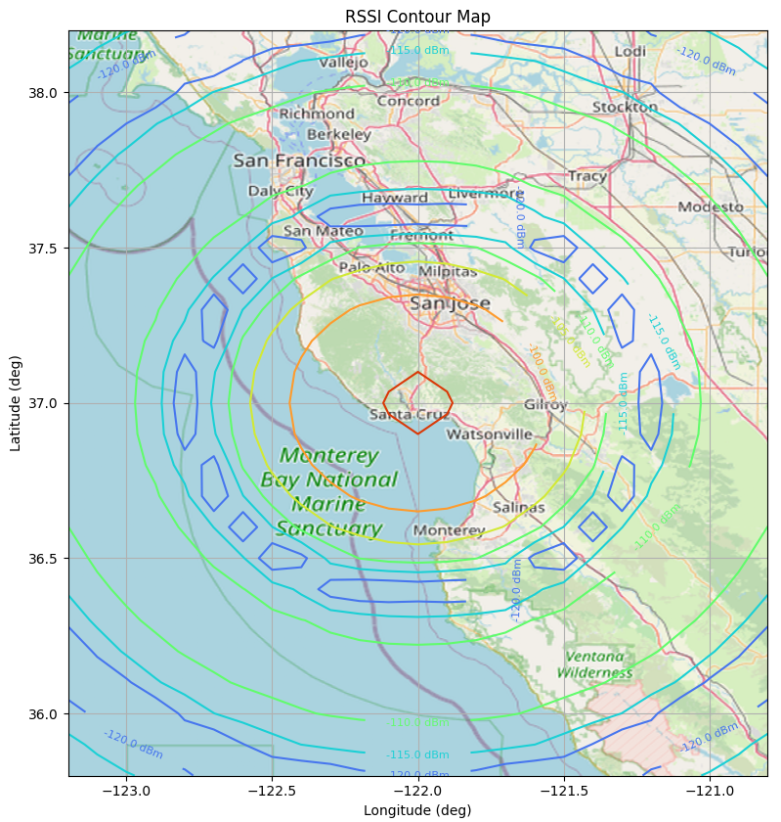


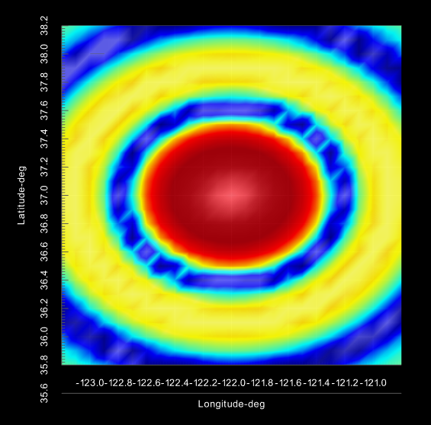

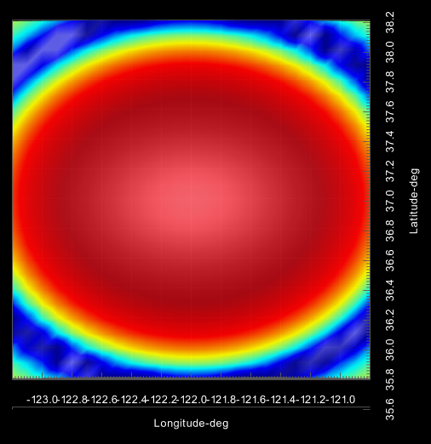

NTN Coverage Maps
LEO Satellite Flying over San Francisco Bay Area at 600 km (256 Element Rectangular Array)
Coverage Maps can be Used as an Optimization Criteria for Payload Antenna Array Design

Slide 15
Summary
Simulating the End-to-End NTN Transmission Path
5G NTN and 6G Satellite Evolution: Bridging terrestrial and non-terrestrial networks for global coverage.
Challenges in NTN Design: Spectrum sharing, interference modeling, and validation of the systems under realistic conditions.
Experience SystemVue software solution for multi-domain modeling and simulation of complex RF systems, encompassing analog/RF and baseband/DSP stages.
Use High-Fidelity Modeling to reduce risks with advanced RF-aware design workflows, which integrate decades of Keysight measurement science into RF instrumentation.
Validate complete physical layer system designs for 5G/6G NTN operation, estimate link budgets, and evaluate configuration trade-offs for different scenarios.
Notes:
NTNs are becoming essential for bridging terrestrial and satellite communication in 5G and 6G. Key challenges include spectrum coexistence, link-budget realism, interference modeling, and RF impairments. SystemVue offers a high-fidelity, multi-domain digital-twin platform for accurate modeling of RF, baseband, phased arrays, and space channels. Using these capabilities, engineers can evaluate architecture choices, optimize performance, and validate complete NTN physical-layer designs under realistic environmental and hardware conditions.

Slide 16
Notes:
Thank You!

