Slide 1

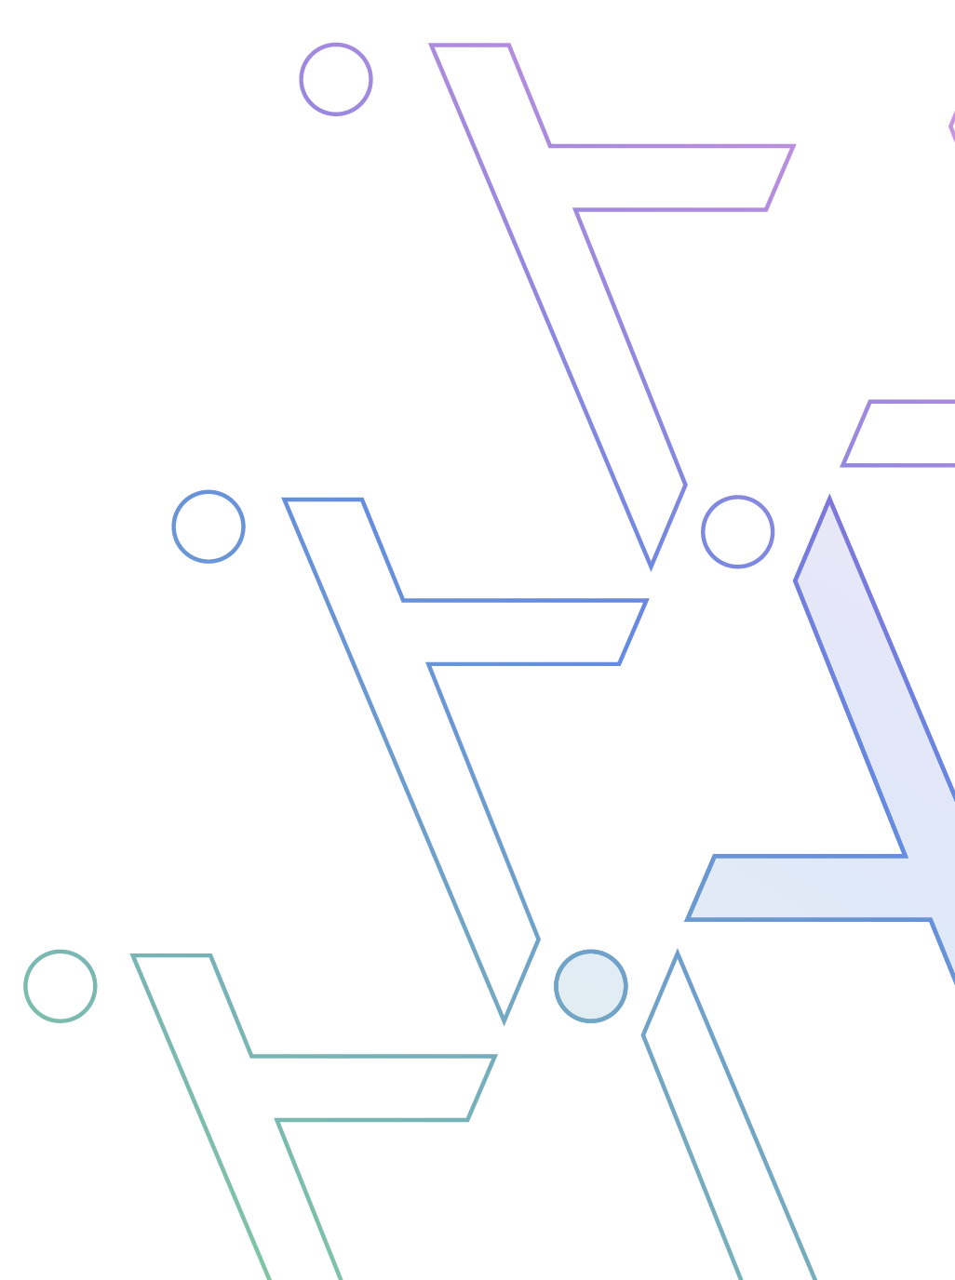

Accelerating Ecosystem Innovation through an Open-Source Data Model & APIs
Nihar Agrawal
nihar@aalyria.com
on behalf of the Data Model and API team

Slide 2
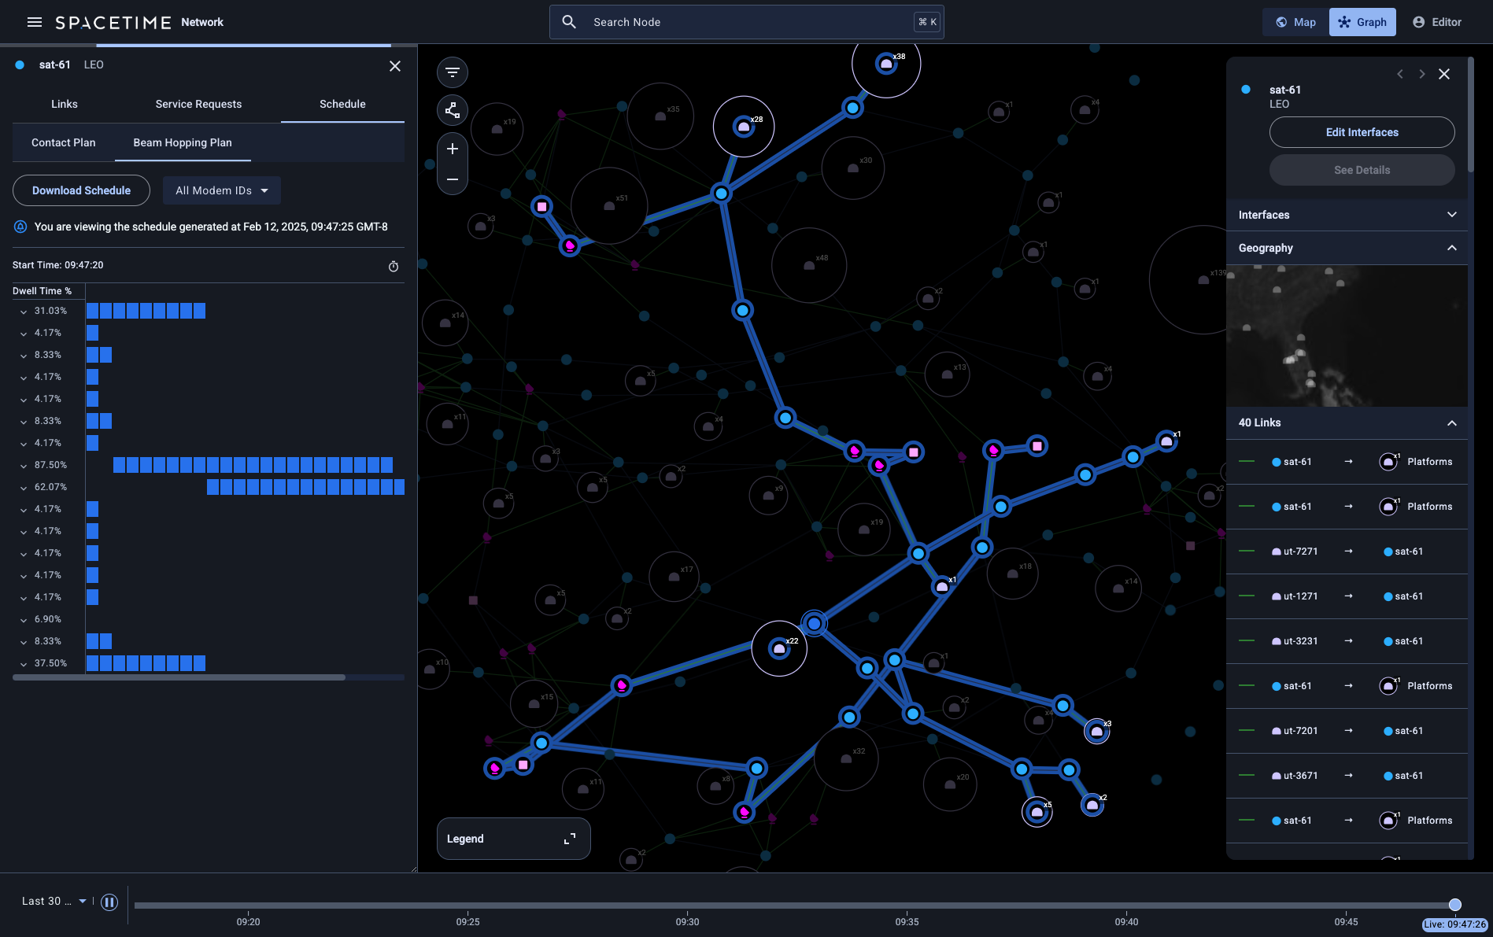
Spacetime: A temporospatial network orchestration platform

Slide 3
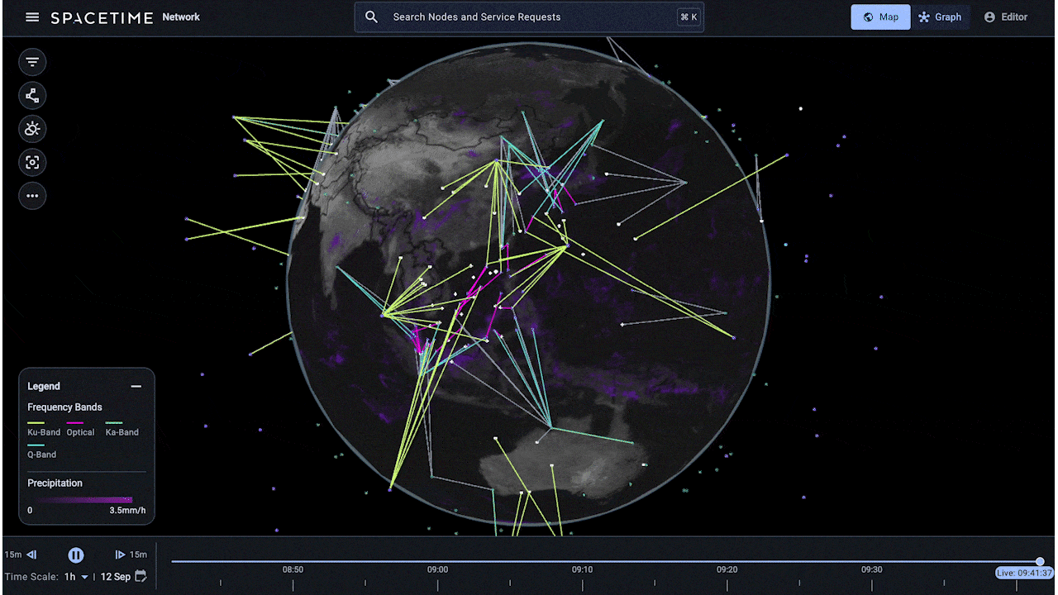
Spacetime: A temporospatial network orchestration platform

Slide 4


Our team’s charter
Data Model
APIs
A schema that describes the capabilities and constraints of the system
Programmatic interfaces that enable users to operate production networks
Notes:
document exchange by Soekahurip from <a href="https://thenounproject.com/browse/icons/term/document-exchange/" target="_blank" title="document exchange Icons">Noun Project</a> (CC BY 3.0)

Slide 5




Data model and API scope
All domains
All network layers
All operational workflows
Satellites in any orbit, aircraft, ships, ground terminals…
Detailed RF modeling, all networking protocols
Service provisioning, scheduling downtime, spectrum policies…
Notes:
Satellite by Creative Mahira from <a href="https://thenounproject.com/browse/icons/term/satellite/" target="_blank" title="Satellite Icons">Noun Project</a> (CC BY 3.0)
freight companies by Niklas Schmeinck from <a href="https://thenounproject.com/browse/icons/term/freight-companies/" target="_blank" title="freight companies Icons">Noun Project</a> (CC BY 3.0)
network centrality by Stefanie Peschel from <a href="https://thenounproject.com/browse/icons/term/network-centrality/" target="_blank" title="network centrality Icons">Noun Project</a> (CC BY 3.0)
Workflow by Omah Icon from <a href="https://thenounproject.com/browse/icons/term/workflow/" target="_blank" title="Workflow Icons">Noun Project</a> (CC BY 3.0)

Slide 6





Why do data models matter?
System & radio resource optimization
Network path computation
Monitoring and debugging
Digital & virtual architectures (DIFI)
Simulation and capacity planning
A flexible and robust data model allows teams to ship features fast
Notes:
hexagons by Med MB from <a href="https://thenounproject.com/browse/icons/term/hexagons/" target="_blank" title="hexagons Icons">Noun Project</a> (CC BY 3.0)
Path testing by Shocho from <a href="https://thenounproject.com/browse/icons/term/path-testing/" target="_blank" title="Path testing Icons">Noun Project</a> (CC BY 3.0)
monitored by Dahlia nur aini from <a href="https://thenounproject.com/browse/icons/term/monitored/" target="_blank" title="monitored Icons">Noun Project</a> (CC BY 3.0)
forecast by Hanbai from <a href="https://thenounproject.com/browse/icons/term/forecast/" target="_blank" title="forecast Icons">Noun Project</a> (CC BY 3.0)

Slide 7
A thought experiment of the ideal data model
GroundStation
GEOSatellite
UserTerminal
IP address
Latitude, longitude
Parabolic antenna
TLE
Feeder & user antennas
Feeder & user channels
IP address
Latitude, longitude
Parabolic antenna

Slide 8
A thought experiment of the ideal data model
GroundStation
GEOSatellite
UserTerminal
IP address
Latitude, longitude
Parabolic antenna
TLE
Feeder & user antennas
Feeder & user channels
IP address
Latitude, longitude
Parabolic antenna
LEOSatellite
MEOSatellite
AeroUserTerminal
State vector(s)
Feeder & user antennas
Feeder & user channels
TLE
Feeder & user antennas
Feeder & user channels
IP address
Latitude, longitude, altitude
Phased array antenna

Slide 9
A thought experiment of the ideal data model
GroundStation
GEOSatellite
UserTerminal
IP address
Latitude, longitude
Parabolic antenna
TLE
Feeder & user antennas
Feeder & user channels
IP address
Latitude, longitude
Parabolic antenna
MaritimeUserTerminal
LaunchVehicle
IP address
Latitude, longitude, altitude
Phased array antenna
Arbitrary trajectory
TT&C antenna
LEOSatellite
MEOSatellite
AeroUserTerminal
State vector(s)
Feeder & user antennas
Feeder & user channels
TLE
Feeder & user antennas
Feeder & user channels
IP address
Latitude, longitude, altitude
Phased array antenna

Slide 10
A better approach: Types for shared components
Platform
Modem
RFChain
Motion (lat/lng/height, TLE, state vector, etc.)
Supported MODCODs
Amplifier(s)
Filter(s)
Upconverter(s)
Downconverter(s)
Transceiver
Antenna
NetworkInterface
Supported carriers
Gain pattern (parabolic, phased array, etc.)
Max EIRP, G/T
IP address

Slide 11
A new data model
Could we model each element of the network as a graph, similar to Google’s Multi-Abstraction-Layer Topology?
Ground Station
Satellite
User Terminal

Slide 12

A ground station antenna
NetworkNode
RouteFn
Layer 2+
Interface
Platform
Modulator
SignalProcessing
Chain
Transmitter
Port
Antenna
Layer 1
Demodulator
SignalProcessing
Chain
Receiver

Slide 13

A regenerative communications payload
NetworkNode
RouteFn
Layer 2+
Interface
Interface
Transmitter
Signal
Processing
Chain
Modulator
Modulator
Signal
Processing
Chain
Transmitter
Antenna
(feeder)
Port
Port
Antenna
(user)
Layer 1
Receiver
Signal
Processing
Chain
Demodulator
Demodulator
Signal
Processing
Chain
Receiver
Platform

Slide 14
NMTS: Network Model for Temporospatial Systems
✓
✓
Capable of representing any system & network architecture, and extensible by design
Facilitates the development of mission-critical software
NMTS is a unified data model for networks in motion

Slide 15



Network Orchestration APIs
Model API
Provisioning API
Scheduling API
Telemetry API
Create/update/delete entities & relationships in the NMTS model
Effect a change in the network, e.g., set up a new service
Build and distribute schedules of configuration
Ingest time-series of physical-layer and networking metrics
Notes:
cyberspace by Rank Sol from <a href="https://thenounproject.com/browse/icons/term/cyberspace/" target="_blank" title="cyberspace Icons">Noun Project</a> (CC BY 3.0)
Question by Syaiful Khotam from <a href="https://thenounproject.com/browse/icons/term/question/" target="_blank" title="Question Icons">Noun Project</a> (CC BY 3.0)

Slide 16



Open-source APIs
Operator partnerships
Hybrid networks with multiple vendors
5G/6G NTN
A unified data model and open APIs enable networks to interconnect & interoperate
Notes:
partnership by Djati from <a href="https://thenounproject.com/browse/icons/term/partnership/" target="_blank" title="partnership Icons">Noun Project</a> (CC BY 3.0)
Satellite by Lima Studio from <a href="https://thenounproject.com/browse/icons/term/satellite/" target="_blank" title="Satellite Icons">Noun Project</a> (CC BY 3.0)
Satellite by Philipp Petzka from <a href="https://thenounproject.com/browse/icons/term/satellite/" target="_blank" title="Satellite Icons">Noun Project</a> (CC BY 3.0)
Satellite by Alex Burte from <a href="https://thenounproject.com/browse/icons/term/satellite/" target="_blank" title="Satellite Icons">Noun Project</a> (CC BY 3.0)
Satellite by Rahmad romadoni from <a href="https://thenounproject.com/browse/icons/term/satellite/" target="_blank" title="Satellite Icons">Noun Project</a> (CC BY 3.0)

Slide 17

Thank you!
NMTS: github.com/outernetcouncil/nmts
APIs: github.com/aalyria/api
Get in touch: nihar@aalyria.com
Special thanks to the many authors and contributors to these projects: Erik Kline, David Mandle, Wesley Eddy, Jessica Streitz, Stefan Draskoci, Luca Lodigiani, and many more

