Slide 1

Digitized IF Transport Frameworks for Software-Defined Infrastructures
Jing Song Managing Director Genesis Codes Inc.
Ken Quock CTO ATG Solution.

Slide 2


Evolving to a Digitized SATCOM Architecture
Digital IF Technology
Segregating analog RF/IF processing hardware outside the modem allows virtualized / software defined modem implementation on common compute hardware as the basis for terminal agility/flexibility

Slide 3

Digital IF (Digital Intermediate Frequency)
Background
HPA
BUC
IFL
fiber
IFL
IF
switch /
combiner
modem(s)
IP
data
switch
Analog
User Network
LNA
BDC
HPA
BUC
DCS
WSP
IP
Switch
Router
Modem(s)
IP
Switch
Router
Digital
fiber
User Network
Modem(s)
LNA
BDC
Commercial WAN
Analog -> Digital signals over standard IP networks
BDC
BUC
DCS
HPA
IF
Block Down Converter
Block Up Converter
Digital Conversion System
High Power Amplifier
Intermediate Frequency
IFL
IP
LNA
DCS
WSP
Inter Facility Link
Internet Protocol
Low Noise Amplifier
Digital Conversion System
Wideband Signal Processor (combiner/divider)

Slide 4
Digital IF (Digital Intermediate Frequency)
Benefits & Challenge
Benefits:
Reduced infrastructure complexity and cost
Modular, Scalable, Flexible, Software upgradable
Digital & Software-Defined Innovation
Challenges:
Data Intensive – 1 to 40 Gbps
WAN Infrastructure
Shared, not deterministic,
Congestion, Packet Loss,
Latency & Jitter
Solutions:
Data Compression
Data Transport @ WAN
- Data Coding Framework
- Assured UDP protocol
- Latency Reduction
Notes:
Key Insight
Digital IF transport is very data-intensive:
100–500 MHz SATCOM carriers → ~8–40 Gbps
Wideband gateways with multiple carriers → 100+ Gbps
This is why standards like ANSI/TIA-5041 FAST OSDI and digital radio frameworks such as VITA 49 (VRT) focus heavily on efficient packetization and Ethernet transport.
✅ Rule of thumb engineers use
100 MHz RF bandwidth ≈ ~8 Gbps digital IF stream

Slide 5
Digital IF (Digital Intermediate Frequency)
Digital IF Data Stream Rates

Slide 6
Data Compression

Slide 7
Use Case Data Rates
Various Use Cases, Sambol Rate, ModCod Rate
7
Research indicates that MODCOD has little to no direct impact on compressibility for the compression algorithms currently under evaluation. As expected, however, the ratio between the signal bandwidth (as defined by the MODCOD) and the DIFI capture bandwidth does influence compression performance.

Slide 8
Results (Data Set 1)
 | Size ( Bytes ) |  |  |  |  |  |  | Compression Ratio (%)
File_Name | Orig_size | Zstd | Gzip | GC 3 | GC 4 | Lz4 |  | Zstd | Gzip | GC 3 | GC 4 | Lz4
cap-30k-01-difi-only-payload.bin | 123351776 | 70234491 | 68209411 | 49182806 | 38511413 | 100530591 |  | 56.93 | 55.29 | 39.87 | 31.22 | 81.49
cap-30k-02-difi-only-payload.bin | 123351776 | 70234491 | 68209411 | 49182806 | 38511413 | 100530591 |  | 56.93 | 55.29 | 39.87 | 31.22 | 81.49
cap-30k-03-difi-only-payload.bin | 123351776 | 70940588 | 68438848 | 50326476 | 40391129 | 100458943 |  | 57.51 | 55.48 | 40.79 | 32.74 | 81.44
cap-30k-04-difi-only-payload.bin | 123360000 | 70969616 | 68434774 | 50278290 | 40363144 | 100464006 |  | 57.53 | 55.47 | 40.75 | 32.71 | 81.43
cap-30k-05-difi-only-payload.bin | 123360000 | 71338698 | 68625614 | 51555578 | 42418739 | 100443661 |  | 57.82 | 55.63 | 41.79 | 34.38 | 81.42
cap-30k-06-difi-only-payload.bin | 123360000 | 71476879 | 68734328 | 52270953 | 43477137 | 100426430 |  | 57.94 | 55.71 | 42.37 | 35.24 | 81.40
cap-30k-07-difi-only-payload.bin | 123351776 | 71610685 | 68810754 | 53165782 | 44983995 | 100382780 |  | 58.05 | 55.78 | 43.10 | 36.46 | 81.37
cap-30k-08-difi-only-payload.bin | 123360000 | 68498302 | 67840964 | 48699800 | 37596593 | 100634106 |  | 55.52 | 54.99 | 39.47 | 30.47 | 81.57
cap-30k-09-difi-only-payload.bin | 123351776 | 69179583 | 67961336 | 48731108 | 37590765 | 100574345 |  | 56.08 | 55.09 | 39.50 | 30.47 | 81.53
cap-30k-10-difi-only-payload.bin | 123351776 | 69350400 | 68030123 | 48720333 | 37653729 | 100503757 |  | 56.22 | 55.15 | 39.49 | 30.52 | 81.47
cap-30k-11-difi-only-payload.bin | 123360000 | 71635088 | 68848238 | 53759843 | 46406725 | 100390009 |  | 58.06 | 55.81 | 43.57 | 37.61 | 81.37
cap-30k-12-difi-only-payload.bin | 123360000 | 71649713 | 68857291 | 53826390 | 46495780 | 100394901 |  | 58.08 | 55.81 | 43.63 | 37.69 | 81.38
cap-30k-13-difi-only-payload.bin | 123360000 | 71629131 | 68845105 | 53758147 | 46389665 | 100397500 |  | 58.06 | 55.80 | 43.57 | 37.60 | 81.38
cap-30k-14-difi-only-payload.bin | 123360000 | 71571918 | 68802458 | 53298067 | 45514470 | 100411181 |  | 58.01 | 55.77 | 43.20 | 36.89 | 81.39
MODCOD has little to no direct impact on compressibility for the compression algorithms currently under evaluation.
The ratio between the signal bandwidth (as defined by the MODCOD) and the DIFI capture bandwidth influences compression performance.

Slide 9
Results (Data Set 2)
 | Size ( Bytes ) |  |  |  |  |  |  | Ratio ( % )
File_Name | Orig_size | Zstd | Gzip | GC 3 | GC 4 | Lz4 |  | Zstd | Gzip | GC 3 | GC 4 | Lz4
cap-251223-8psk-0.2-3fourths-10.0msps-fs12.500-difi-only-payload.bin | 205328608 | 177941366 | 177646563 | 154057685 | 149762638 | 205328819 |  | 86.66 | 86.51 | 75.02 | 72.93 | 100
cap-251223-8psk-0.2-3fourths-10.0msps-fs15.625-difi-only-payload.bin | 205386176 | 185664005 | 185750237 | 165554865 | 160123836 | 205386387 |  | 90.39 | 90.43 | 80.6 | 77.96 | 100
cap-251223-8psk-0.2-3fourths-10.0msps-fs25.000-difi-only-payload.bin | 205460192 | 179715790 | 179446577 | 155855409 | 149636657 | 205460403 |  | 87.46 | 87.33 | 75.85 | 72.82 | 100
cap-251223-8psk-0.2-3fourths-10.0msps-fs31.250-difi-only-payload.bin | 205484864 | 186522936 | 186537715 | 166541178 | 159174050 | 205485075 |  | 90.77 | 90.77 | 81.04 | 77.46 | 100
cap-251223-qpsk-0.2-2thirds-2.0msps-fs02.273-difi-only-payload.bin | 204218368 | 174943601 | 174978935 | 150317550 | 146321167 | 204218579 |  | 85.66 | 85.68 | 73.6 | 71.64 | 100
cap-251223-qpsk-0.2-2thirds-2.0msps-fs02.500-difi-only-payload.bin | 204341728 | 180344473 | 180109166 | 157914855 | 152910671 | 204341939 |  | 88.25 | 88.14 | 77.27 | 74.83 | 100
cap-251223-qpsk-0.2-2thirds-2.0msps-fs03.125-difi-only-payload.bin | 204596672 | 177944040 | 177773330 | 154594034 | 149789530 | 204596883 |  | 86.97 | 86.88 | 75.56 | 73.21 | 100
cap-251223-qpsk-0.2-2thirds-2.0msps-fs05.000-difi-only-payload.bin | 204974976 | 182468311 | 182329589 | 160134965 | 153606936 | 204975187 |  | 89.01 | 88.95 | 78.12 | 74.93 | 100
cap-251223-qpsk-0.2-2thirds-2.0msps-fs06.250-difi-only-payload.bin | 205106560 | 179651888 | 179418966 | 155782614 | 148478335 | 205106771 |  | 87.58 | 87.47 | 75.95 | 72.39 | 100
cap-251223-qpsk-0.2-2thirds-2.0msps-fs12.500-difi-only-payload.bin | 205336832 | 179838348 | 179669692 | 155690019 | 143042736 | 205337043 |  | 87.58 | 87.49 | 75.82 | 69.66 | 100
cap-251223-qpsk-0.2-2thirds-2.0msps-fs25.000-difi-only-payload.bin | 205460192 | 179790338 | 179773307 | 155652074 | 137602961 | 205460403 |  | 87.5 | 87.49 | 75.75 | 66.97 | 100
Data Set 2 showed lower compression ratios (15%-25%) due to higher amplitude signals
→ Amplitude affects compression

Slide 10
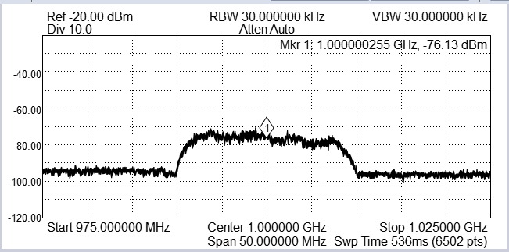
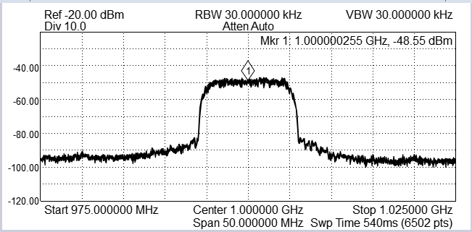
Signal Amplitude vs Compression Ratio
The spectrum analyzer snapshots below show representative examples of low and high amplitude signal captures of a DVB-S2x carrier.
cap-30k-07-difi-only-payload.bin
cap-251223-8psk-0.2-3fourths-10.0msps-fs25.000-difi-only-payload.bin
File_Name | Orig_size | Zstd | Gzip | GC 3 | GC 4 | Lz4 |  | Zstd | Gzip | GC 3 | GC 4 | Lz4
cap-30k-07-difi-only-payload.bin | 123351776 | 71610685 | 68810754 | 53165782 | 44983995 | 100382780 |  | 58.05 | 55.78 | 43.10 | 36.46 | 81.37
cap-251223-8psk-0.2-3fourths-10.0msps-fs25.000-difi-only-payload.bin | 205460192 | 179715790 | 179446577 | 155855409 | 149636657 | 205460403 |  | 87.46 | 87.33 | 75.85 | 72.82 | 100
At lower RF amplitudes, the effective ADC resolution decreases, causing the most significant bits (MSBs) of each sample to be largely zero. This produces a data stream that is more compressible.
Results indicate strong compressibility for spread-spectrum waveforms at higher ADC resolutions (e.g., 14-bit), where signals typically reside near the noise floor. Similar gains are observed for other waveform types when the effective ADC resolution is reduced.
The DIFI specification supports variable ADC resolutions using either tightly packed bit formats or padding into 16-bit words. Current results show that the evaluated compression approach achieves approximately 45% compression for padded formats and ~15% for tightly packed formats. Further investigation, characterization, and validation of these effects will be conducted in the next reporting period.
Notes:
The primary differentiator appears to be the RF carrier signal level at the digitizer ADC input. At lower RF amplitudes, the effective ADC resolution decreases, causing the most significant bits (MSBs) of each sample to be largely zero. This produces a data stream that is more compressible, as long runs of zeros can be efficiently removed by the compression algorithm.
Results indicate strong compressibility for spread-spectrum waveforms at higher ADC resolutions (e.g., 14-bit), where signals typically reside near the noise floor. Similar gains are observed for other waveform types when the effective ADC resolution is reduced.
The DIFI specification supports variable ADC resolutions using either tightly packed bit formats or padding into 16-bit words. Current results show that the evaluated compression approach achieves approximately 45% compression for padded formats and ~15% for tightly packed formats. Further investigation, characterization, and validation of these effects will be conducted in the next reporting period.

Slide 11

Results (Data Set 2)
 | Size ( Bytes ) |  |  |  |  |  |  | Ratio ( % )
File_Name | Orig_size | Zstd | Gzip | GC 3 | GC 4 | Lz4 |  | Zstd | Gzip | GC 3 | GC 4 | Lz4
cap-251223-8psk-0.2-3fourths-10.0msps-fs12.500-difi-only-payload.bin | 205328608 | 177941366 | 177646563 | 154057685 | 149762638 | 205328819 |  | 86.66 | 86.51 | 75.02 | 72.93 | 100
cap-251223-8psk-0.2-3fourths-10.0msps-fs15.625-difi-only-payload.bin | 205386176 | 185664005 | 185750237 | 165554865 | 160123836 | 205386387 |  | 90.39 | 90.43 | 80.6 | 77.96 | 100
cap-251223-8psk-0.2-3fourths-10.0msps-fs25.000-difi-only-payload.bin | 205460192 | 179715790 | 179446577 | 155855409 | 149636657 | 205460403 |  | 87.46 | 87.33 | 75.85 | 72.82 | 100
cap-251223-8psk-0.2-3fourths-10.0msps-fs31.250-difi-only-payload.bin | 205484864 | 186522936 | 186537715 | 166541178 | 159174050 | 205485075 |  | 90.77 | 90.77 | 81.04 | 77.46 | 100
cap-251223-qpsk-0.2-2thirds-2.0msps-fs02.273-difi-only-payload.bin | 204218368 | 174943601 | 174978935 | 150317550 | 146321167 | 204218579 |  | 85.66 | 85.68 | 73.6 | 71.64 | 100
cap-251223-qpsk-0.2-2thirds-2.0msps-fs02.500-difi-only-payload.bin | 204341728 | 180344473 | 180109166 | 157914855 | 152910671 | 204341939 |  | 88.25 | 88.14 | 77.27 | 74.83 | 100
cap-251223-qpsk-0.2-2thirds-2.0msps-fs03.125-difi-only-payload.bin | 204596672 | 177944040 | 177773330 | 154594034 | 149789530 | 204596883 |  | 86.97 | 86.88 | 75.56 | 73.21 | 100
cap-251223-qpsk-0.2-2thirds-2.0msps-fs05.000-difi-only-payload.bin | 204974976 | 182468311 | 182329589 | 160134965 | 153606936 | 204975187 |  | 89.01 | 88.95 | 78.12 | 74.93 | 100
cap-251223-qpsk-0.2-2thirds-2.0msps-fs06.250-difi-only-payload.bin | 205106560 | 179651888 | 179418966 | 155782614 | 148478335 | 205106771 |  | 87.58 | 87.47 | 75.95 | 72.39 | 100
cap-251223-qpsk-0.2-2thirds-2.0msps-fs12.500-difi-only-payload.bin | 205336832 | 179838348 | 179669692 | 155690019 | 143042736 | 205337043 |  | 87.58 | 87.49 | 75.82 | 69.66 | 100
cap-251223-qpsk-0.2-2thirds-2.0msps-fs25.000-difi-only-payload.bin | 205460192 | 179790338 | 179773307 | 155652074 | 137602961 | 205460403 |  | 87.5 | 87.49 | 75.75 | 66.97 | 100
Compression algorithms make a large performance impact. Proprietary algorithms outperform generic algorithms.
The latest study further reduced GC4 from 75% to 67%, 15-20% better than commercially available solutions.

Slide 12
Compute Time (using command time, including compute and disk read and write)
OS: Linux 6.8.0-88-generic #89-Ubuntu
CPU: Intel(R) Core(TM) i7-14700T, 20 cores, 2 threads/core, max MHz: 5200.0000, min MHz:800.0000
Test File: cap-251223-8psk-0.2-3fourths-10.0msps-fs12.500-difi-only-payload.bin (205328608 bytes)
 | Zstd |  |  | GC3 |  |  | GC4
 | Compressed: 177646563 bytes ( 86.52% ) |  |  | Compressed: 154057685 bytes ( 75.03% ) |  |  | Compressed: 149762638 bytes ( 72.94% )
 | Real | User | System | Real | User | System | Real | User | System
1 threads | 0m0.508s | 0m0.572s | 0m0.127s | 0m12.579s | 0m12.404s | 0m0.169s | 0m23.998s | 0m23.751s | 0m0.213s
4 threads | 0m0.183s | 0m0.576s | 0m0.152s | 0m3.949s | 0m12.447s | 0m0.200s | 0m9.387s | 0m27.489s | 0m0.373s
8 threads | 0m0.143s | 0m0.649s | 0m0.178s | 0m2.086s | 0m12.642s | 0m0.211s | 0m5.581s | 0m30.196s | 0m0.536s
20 threads | 0m0.144s | 0m0.760s | 0m0.229s | 0m2.092s | 0m12.723s | 0m0.208s | 0m6.106s | 0m30.130s | 0m1.008s
40 threads | 0m0.149s | 0m0.721s | 0m0.263s | 0m2.145s | 0m12.701s | 0m0.201s | 0m6.915s | 0m30.399s | 0m1.764s
Real | Wall-Clock Time - the actual elapsed time from the moment the command starts until it finishes. It’s the same as if you timed the command with a stopwatch.
User | User CPU Time - the time the CPU spends executing user-space code of the process, i.e., the actual instructions of the command or script, not the kernel, which measures CPU resources directly used by the process itself, excluding time spent in the kernel.
System | System CPU Time - the time the CPU spends executing kernel-space code on behalf of the process. This includes system calls, which measures overhead from interactions with the operating system (e.g., accessing files, network, or hardware).

Slide 13
Data Transport

Slide 14
Our Innovation
Optimize → Data Transport Protocol
TCP vs UDP
Reliable, Assured Delivery
Packet Loss Recovery via ACK & RESENT
Poor Performance, High Latency
Simple & Fast
No Assured Delivery @ Packet Losses
Not Deterministic, No QoS Performance
The best of both, for a better digital world.
Genesis Codes Data Transport
UDP Speed + Assured Performance => Assured UDP
Notes:
We focus on data transport protocols that control traffic flow. The two dominant options—TCP and UDP—come with trade-offs: TCP ensures reliability but at the cost of speed and performance, and UDP offers speed without delivery guarantees. Our solution combines the best of both. Using Genesis Forward Error Correction (FEC), we deliver high-performance data transport over even unreliable networks—while guaranteeing every packet’s delivery.
This is important for mission-critical applications like remote medical procedures and military surveillance, where image quality is critical.
Since real-world networks are imperfect, data errors and losses can occur during transmission. In high-volume audio/video streaming, people use UDP protocol, prioritize speed and often tolerate minor packet loss. However, even a loss rate above 0.1% can noticeably degrade image quality. In contrast, file transfers demand complete accuracy—where a single lost packet can corrupt the entire file—making TCP the preferred protocol.
TCP ensures reliable data transmission through packet loss recovery
Uses ACKnowledgments (ACKs) to confirm receipt of packets
Missing packets trigger retransmission (RESENT) of lost data
Continuous monitoring of ACKs helps maintain data integrity
Retransmission mechanisms adapt to network conditions to optimize throughput
Genesis innovative Error Correction Coding – can Recover Packet Losses, applying them on UDP, maintain UDP Efficiency + TCP-like Reliability => Genesis Assured UDP

Slide 15
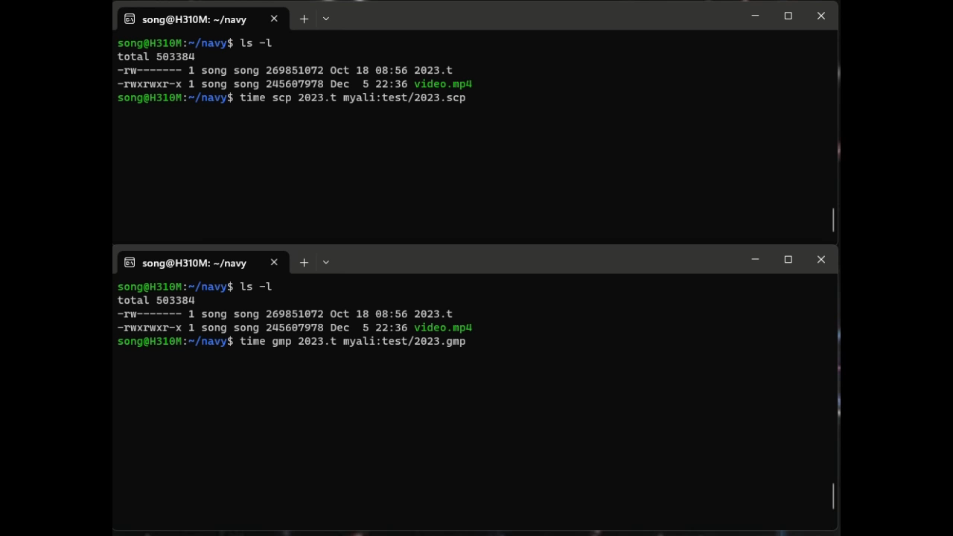

LIVE DEMO — SPEED
10X Throughput: See It In Action
Turbocharge Data Move
on the Internet
Transmit
large data files
over the Internet
between two computers
5000 miles away
Benchmark:
Secure Copy
SCP
(TCP)
Genesis Copy
GCP
(Audp)
15

Slide 16
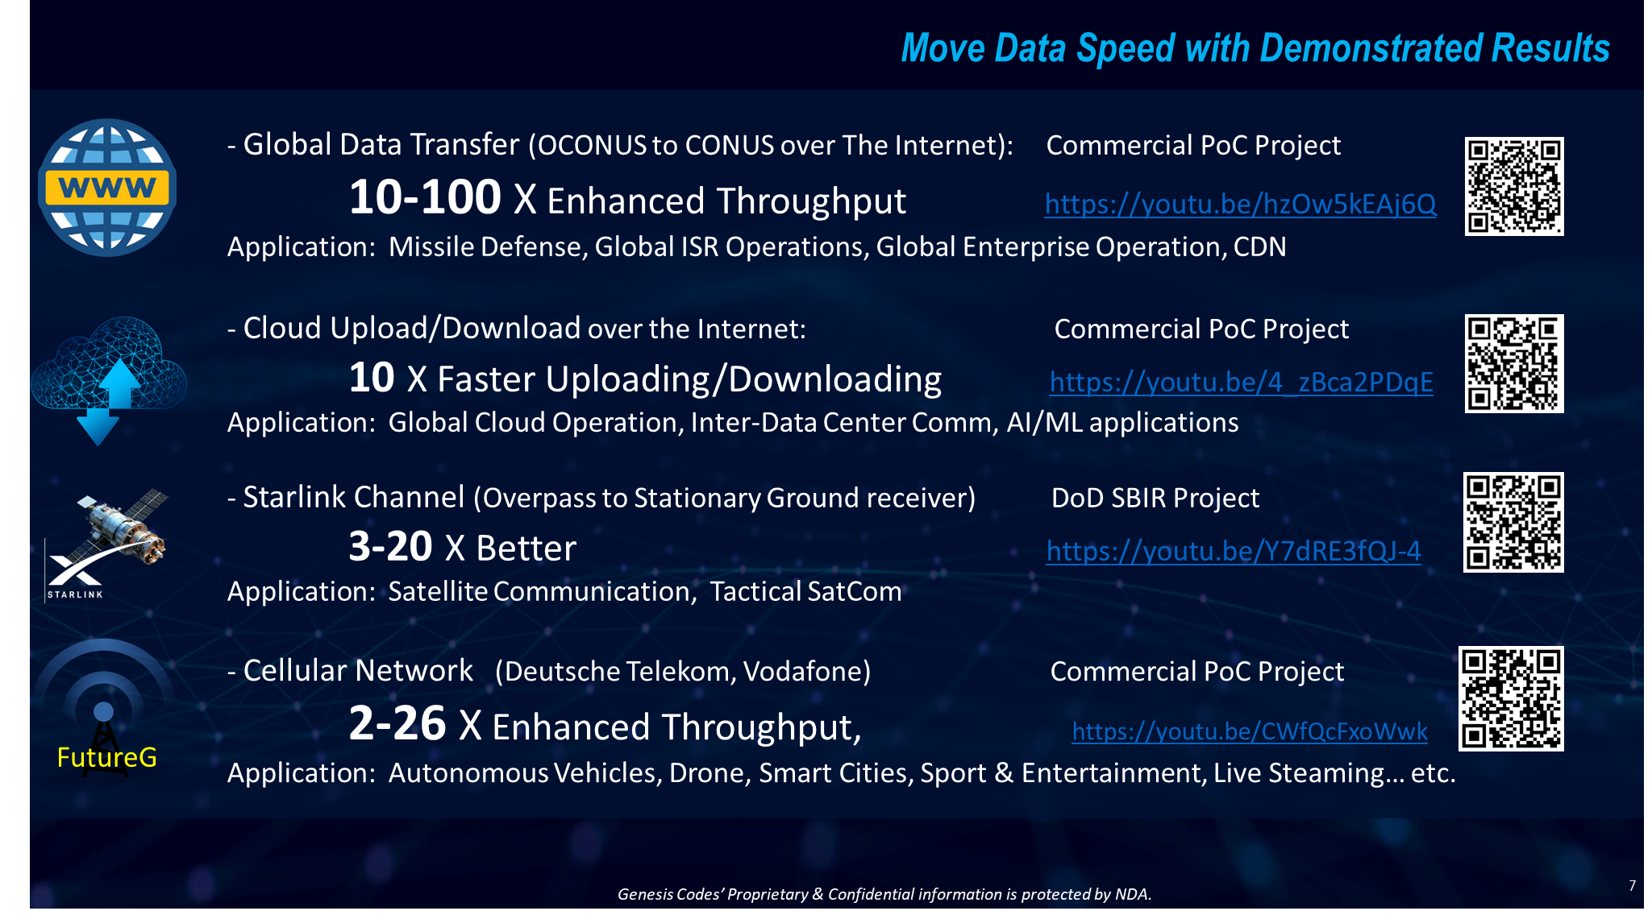

Slide 17
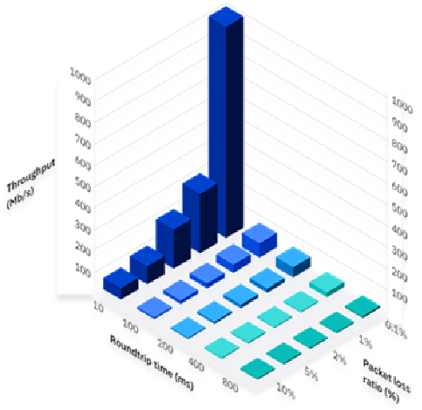
Why?
TCP: underperform over WAN
AUDP delivers
Consistent Peak Performance
Independent of network conditions
LAN: AUDP ~ TCP
WAN: AUDP > TCP
Long-hual: AUDP >> TCP
IBM Research
TCP uses Send and Ack/Resend to ensure reliable packet delivery. It responds adversely to long distance and dropped or corrupted packets, bringing the performance of TCP-based applications to a standstill, per IBM research.

Slide 18
Test Results
AUDP consistently outperforms TCP over WAN

Slide 19
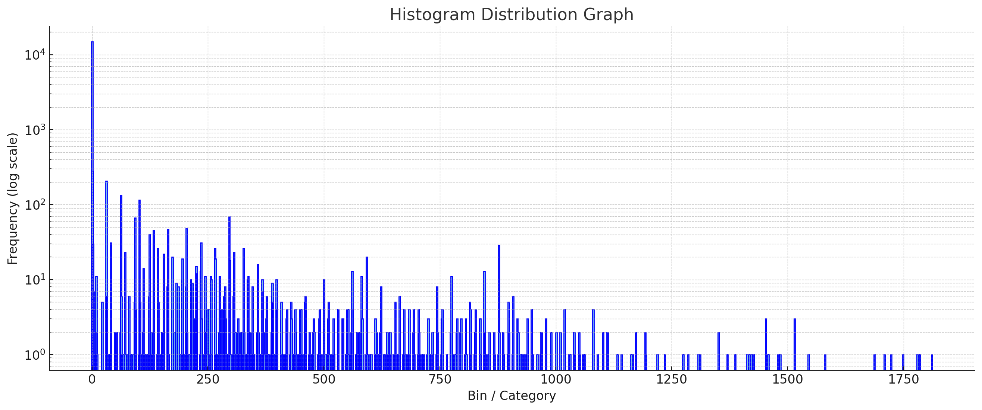
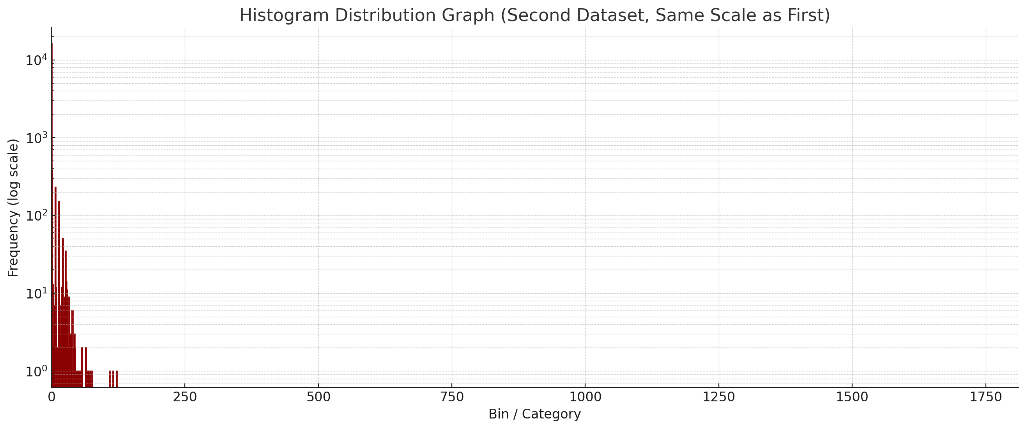
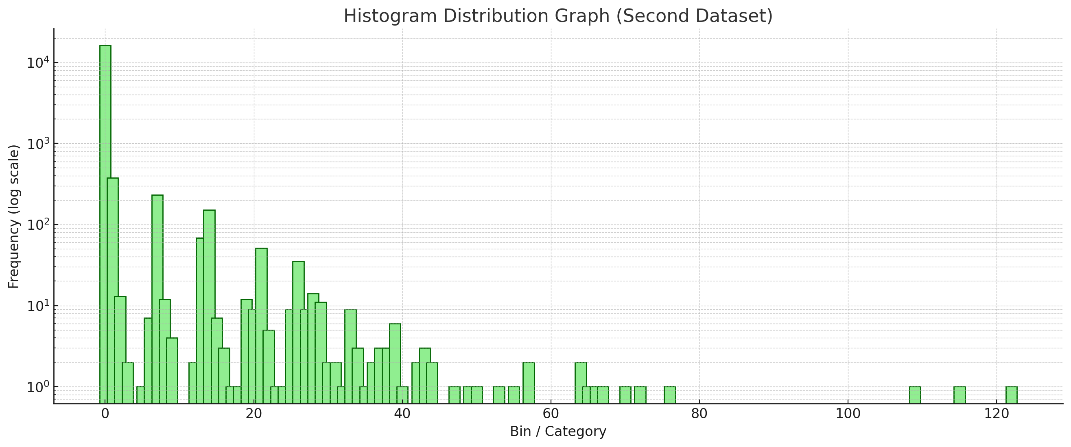
Move Data In Action
Reduce (P95, P99 & Tail) Latency & Jitter by over 90%
Each packet takes its own path—travel times vary across the WAN.
Latency & Tail Latency: Your data delivery is only as fast as the last packet that arrives!
Bottleneck to Mission Critical Applications:
AI/ML Parallel Processing, Data Fusion
Machine-to-Machine Communication
System on System Integration
Genesis Codes reduces WAN Transport latency & Jitter by up to 90%
Uncontrolled, wide distribution of packet arrival time, maximum delay at 1,811 packets =2.3 sec.
Coding controlled, narrow distribution of packet arrival time, maximum delay at 122 packets =0.19 sec.
Use Scenario: Long-Haul Internet (Asia-US)
Method: Proactive Latency Control @ 2% Extra Network Overhead
19
Genesis Codes’ Proprietary & Confidential information is protected by NDA.
Notes:
Beyond speed, we deliver a unique solution that minimizes both latency and jitter. Real-world experiments have demonstrated significant improvements.
we have already demonstrated the concept in a real-world experiment, over the wide-area network (WAN), By tuning our coding parameters. we significantly reshaped the packet travel time distribution: On top is the normal packet travel time distribution histogram. In the lower window, we set another parameter to proactively accelerate decoding without waiting late-arriving packet. Here, we slightly increase the network overhead from 36% to 38%, however, we successfully reduce tail latency from 2.3 seconds down to just 0.19 seconds, achieving an impressive 92% reduction. This breakthrough highlights the practical impact of our solution in delivering faster, more predictable data transport.

Slide 20

Foundation Technology
10X throughput, 10% Latency
With QoS-defined Performance
AI-powered, Modular Integrated, Software Defined
Channel
Coding
Data Fragmentation
Data Compression
Data Security
Data Transport
Genesis Data Coding Framework
Mathematics Foundation, Information Theory
Genesis Codes’ Proprietary & Confidential information is protected by NDA.
Notes:
Building on our Genesis Data Coding Framework, we integrate a range of technologies to develop an AI-powered, modular, software-defined solution. This innovative approach has demonstrated exceptional performance in meeting real-world data transportation needs.

Slide 21






Move Data 3.0: Data Coding Framework
A Software-Defined, Computational Network
Our Solution
backed by
……
1. Compression
3. Decompression
2. Fragmentation
3. Encryption
Encoding
1 Decryption
Decoding
2. Reassembly
Encoder
Decoder
Genesis Codes’ Proprietary & Confidential information is protected by NDA.
21
Notes:
Let’s explain the high level concept of our data coding framework: A data stream first passes through our encoding algorithm, which compresses the data and fragments it into many small pieces, as small as a single packet, while adding error-correction (repair) packets. This encoded data can then be transmitted across a mesh network using any available paths and multiple relay nodes. Some data may be lost during transmission, and certain relay nodes may become non-functional. However, thanks to the built-in data resilience, we can tolerate significant data loss without costly and delayed retransmission, which can further aggregate the network congestion.
Users can dynamically adjust a threshold value T in the algorithm, such that if the number of received data fragments is equal to or greater than T, we guarantee successful reconstruction of the original data. This coding framework opens up a range of possibilities: from enhancing data resilience and enabling error correction, to reducing overall data size, leveraging parallel processing. When applied over the UDP protocol to address packet loss, our solution has demonstrated remarkable results, achieving 10-100 times improved data transport throughput, 90% reduced latency, and 100% data delivery without retransmission.

Slide 22
Compute Time ( Data Coding excluding Compression)
Test Condition: Lab in Silicon Valley to AWS (east) via 1 gbps Internet line. 10 GB data file transfer.
GCP consumes 5-6X more computing resources @ edge
40% Throughput Improvement, No change in network infrastructure

Slide 23
Any IP network Single or Multi-Pass datalink Point-to-Point Good “Network Citizen” Data Transport Efficiency & Resiliency Better Results in Long Haul Network (large RTT, high Packet Loss)
Solution Applicability

Slide 24
Computational Data Transport
A software-defined transport overlay, easily installed at both ends
Delivers 2-10X throughput over WAN
Eliminates Jitter & tail latency over 90%
Improve DiFi bandwidth 30-60%
over any IP network — no hardware changes, no infrastructure overhaul.

Slide 25
NEXT STEPS
Let's Prove It On Your Network
1
2
3
Technical Deep Dive
Proof of Concept
Production Pilot
Walk through your latency-critical use case, network topology, and performance requirements.
Deploy on your infrastructure. Same network, same workload — measured side-by-side against your TCP baseline.
Scale deployment with SLA-backed latency and throughput guarantees. Software licensing or managed service.
Jing Song | song@genesis-codes.com | genesis-codes.com

Slide 26


Jing Song Managing Director Genesis Codes Inc. www.genesis-codes.com Silicon Valley, California, USA
Q & A
Contact: Email: song@genesis-codes.com
LinkedIn: https://www.linkedin.com/in/jingsong/
26

