Slide 1

Agentic AI for SatCom
Kathy O’Donnell
Alan Campbell
Principal AI/ML Solutions Architect
Amazon Web Services
VP, Digital Transformation
SES Space & Defense

Slide 2
What are AI Agents?
Autonomous software systems that leverage AI to reason, plan, and complete tasks on behalf of humans or systems
Notes:
At AWS, we define AI agents as are autonomous software systems that leverage AI to reason, plan, and complete tasks on behalf of humans or systems – like compiling research, paying bills, planning a trip or managing enterprise applications.
What makes agents powerful is their ability to think iteratively - to evaluate results, adjust their approach, and continue working toward a goal. They don't just answer questions; they solve problems through a process of exploration and refinement.

Slide 3
What’s the difference?
Complimentary technologies
Generative AI
Agentic AI
Primary purpose: Content generation
Dependency: Prompts and input data
Agency level: Lower (requires more human oversight)
Ability to execute workflows: None / low
Primary purpose: Goal achievement
Dependency: Prescribed tasks and tools
Agency level: Higher (often less human oversight)
Ability to execute workflows: Medium / high
Notes:
We have a mixed audience in this room. I’m not going to go into a drawn-out lesson on the differences between Gen AI and Agentic AI.
But what I will say is this. They are two complimentary technologies that sit somewhere along the same spectrum.
But whereas Generative AI is mostly used to generate content… Agentic AI is primarily used to help users achieve their goals.
I’ve been working with AI for over 10 years now and I think this is the most interesting form we’ve ever seen. Not just because of the technology aspect, although that is fascinating, but because of how it radically changes the psychology, and mental paradigms, of how humans interact with computers.

Slide 4
Understanding Agentic AI
Knowledge/memory from multiple data sources
Interaction with tools and environments
Levels of autonomy within workflows
Capacity to make decisions and choices
Power to reason, plan, reflect, and act on choices
Complex Goal
an intended “job” to be done,
or a “task” to accomplish
Like humans, AI Agents can be created and instructed with language to perform tasks with various levels of problem solving autonomy.
Notes:
When we talk about Agentic AI, or “AI Agents”, we’re talking about applications, or systems, that THROUGH LANGUAGE, can be created, and instructed to perform specific tasks with various levels of problem solving autonomy.

Slide 5
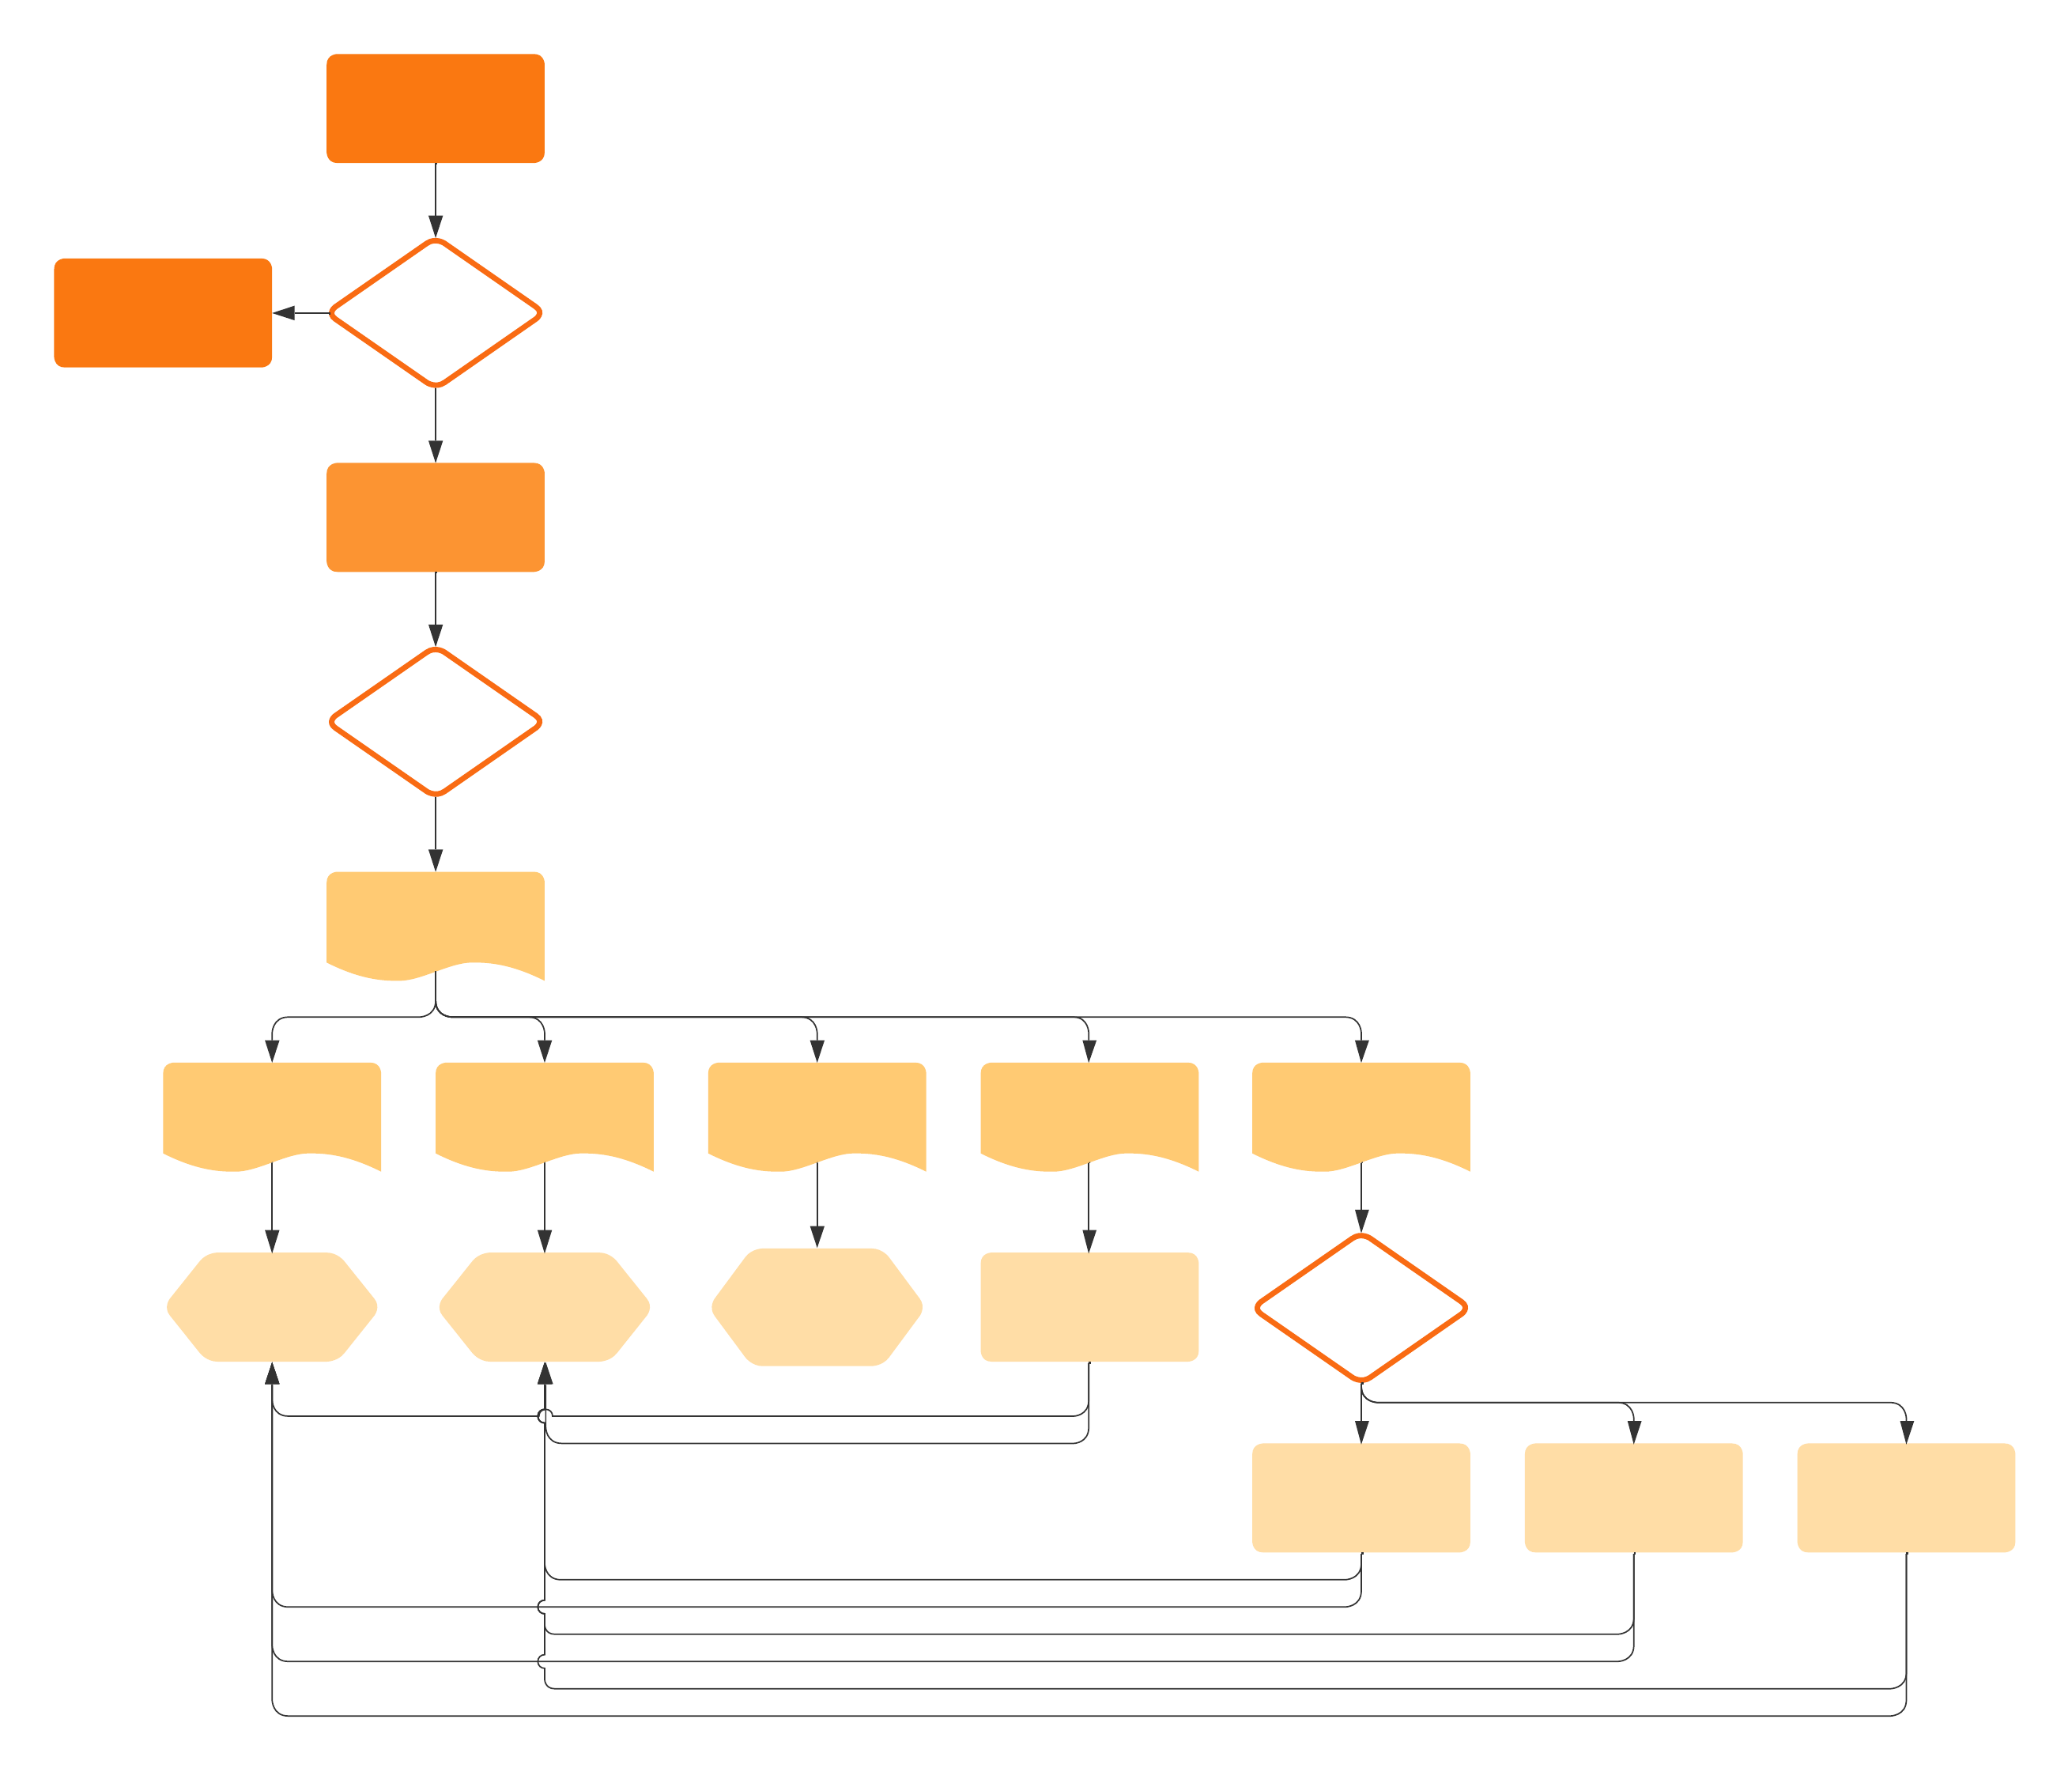
The Evolution of the Workflow
Task
Systems
Databases
Tools
Result

Slide 6

Technology advancements make
AI agents practical for Space Applications
Model reasoning capabilities
Scalability and cost-effectiveness
Secure data infrastructure
Development tools
Notes:
Agents have reached a critical tipping point in enterprise adoption for several reasons.
Foundation models are evolving with more advanced reasoning capabilities and a wider range of cost-effective options.
Organizations have developed robust infrastructure that allows them to securely integrate agentic systems with their proprietary data at scale, ensuring optimal performance, while also maintaining data integrity.
And the emergence of sophisticated development tools are streamlining the process of building and deploying agentic applications, making them more accessible to businesses of all sizes.

Slide 7
Your Space Partner
Delivering secure end-to-end global comms
across every mission, landscape, and orbit.
Leveraging AI to deliver differentiated SatCom assets

Slide 8
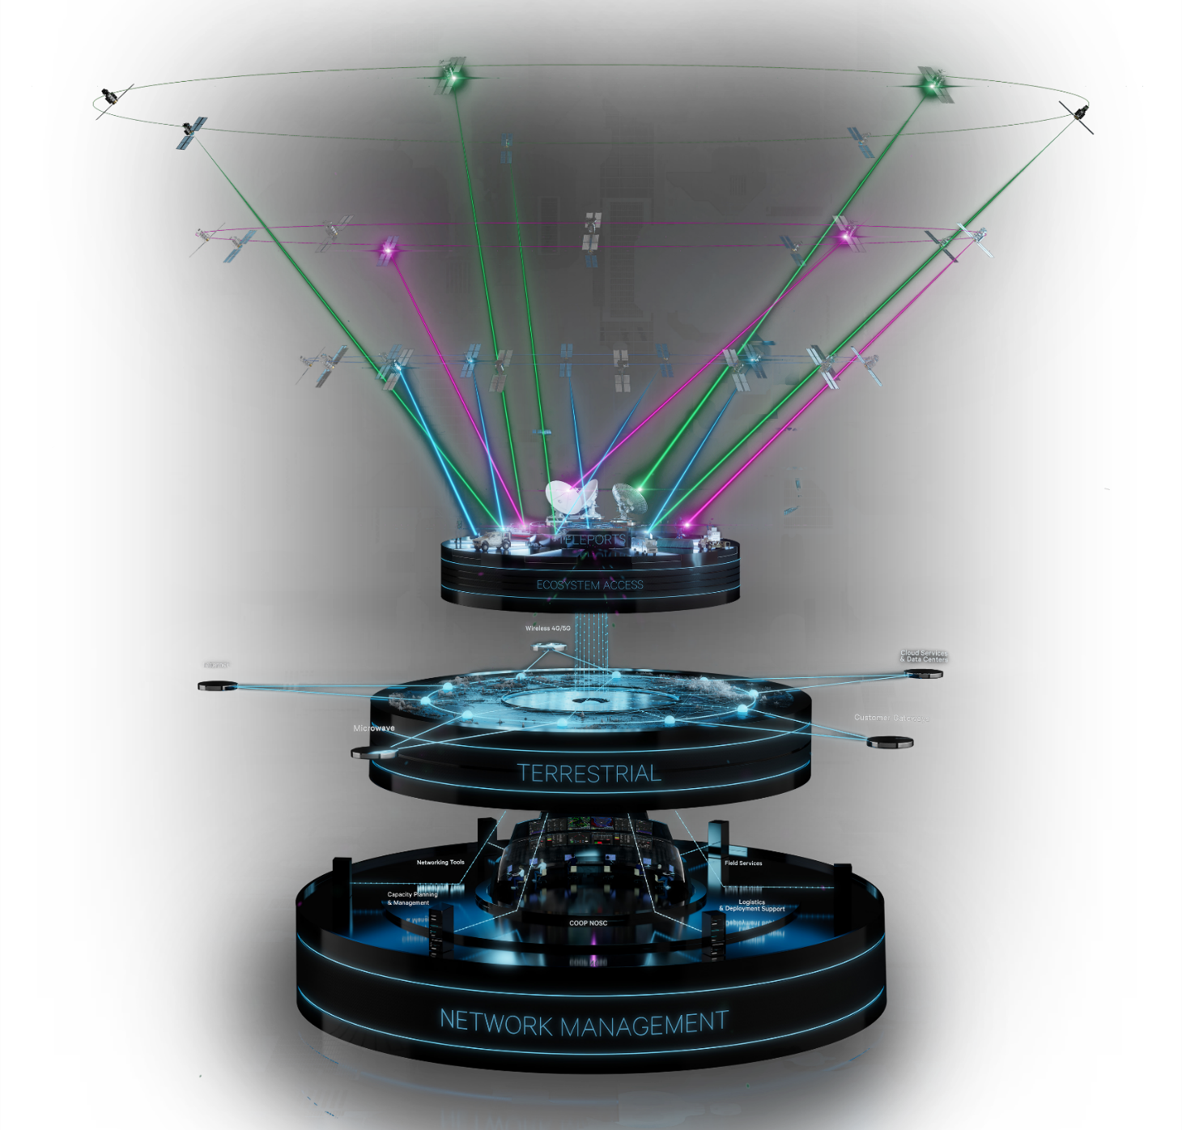
Resilient & Secure Global Communications
Opportunities to leverage AI to deliver the mission
AGNOSTIC INTEGRATION
End-to-end global comms meeting the most stringent requirements, enhanced through vendor agnostic integration.
Multi-band, multi-orbit, and multi-operator SATCOM integration
From legacy to state-of-the-art, all types of terminals are integrated to provide resilient and flexible access
Sovereign Space Solutions
Hosted Payloads/Sensor as a Service
Space Relay for Tactical ISR/Earth Sensing
Support for protected tactical waveforms and location obfuscation.
Secure and Highly Resilient
Global Terrestrial Network
Redundant and self-healing fiber-optic backbone connecting core nodes and customer networks to teleports, data-centers, cloud services, gateways, and the internet.
RMF-authorized for high availability and dedicated for U.S. government operations
Enterprise Management
& control (EM&C)
The 24x7x365 Global Network Operations and Security Center (NOSC) ensures customer networks operate at peak performance and meet all requirements of network confidentiality, integrity, and availability.
The ICT Portal is a web-based enterprise management capability providing a complete view into your network to improve network performance and operational decision making.
State-of-the-art Cyber & IT Services
Discreet Networks, Beamforming & Switching, Data Encryption, Information Assurance, Vulnerability Management, Certification & Authorizations, AI/ML, ITSM

Slide 9
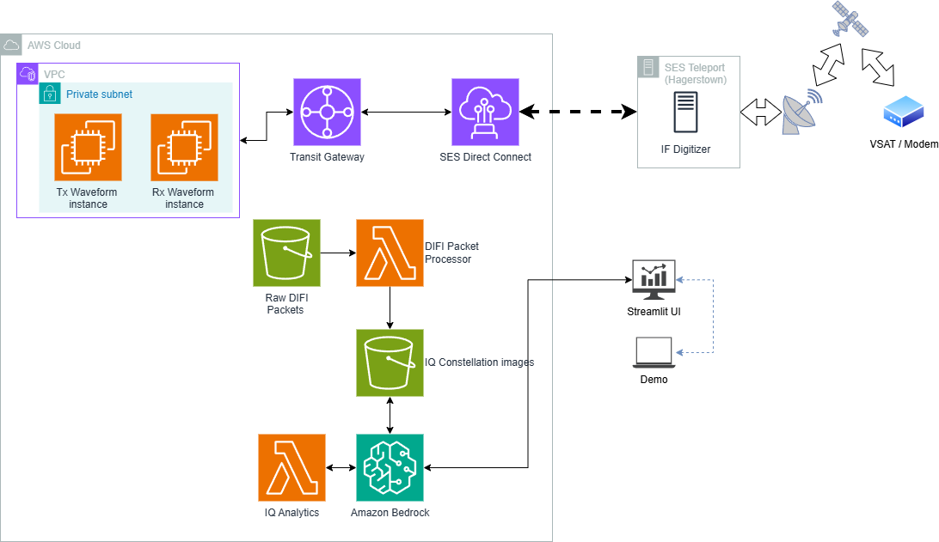




Unlocking AI transformation with Virtualized Satcom
Satellite Show demo – Agentic AI baseband analytics
Partnering with Gilat and AWS
WAVE-compliant, Cloud FPGA-accelerated modulation and demodulation
IP Baseband layer enables new AI capabilities e.g. interference mitigation, beamforming

Slide 10
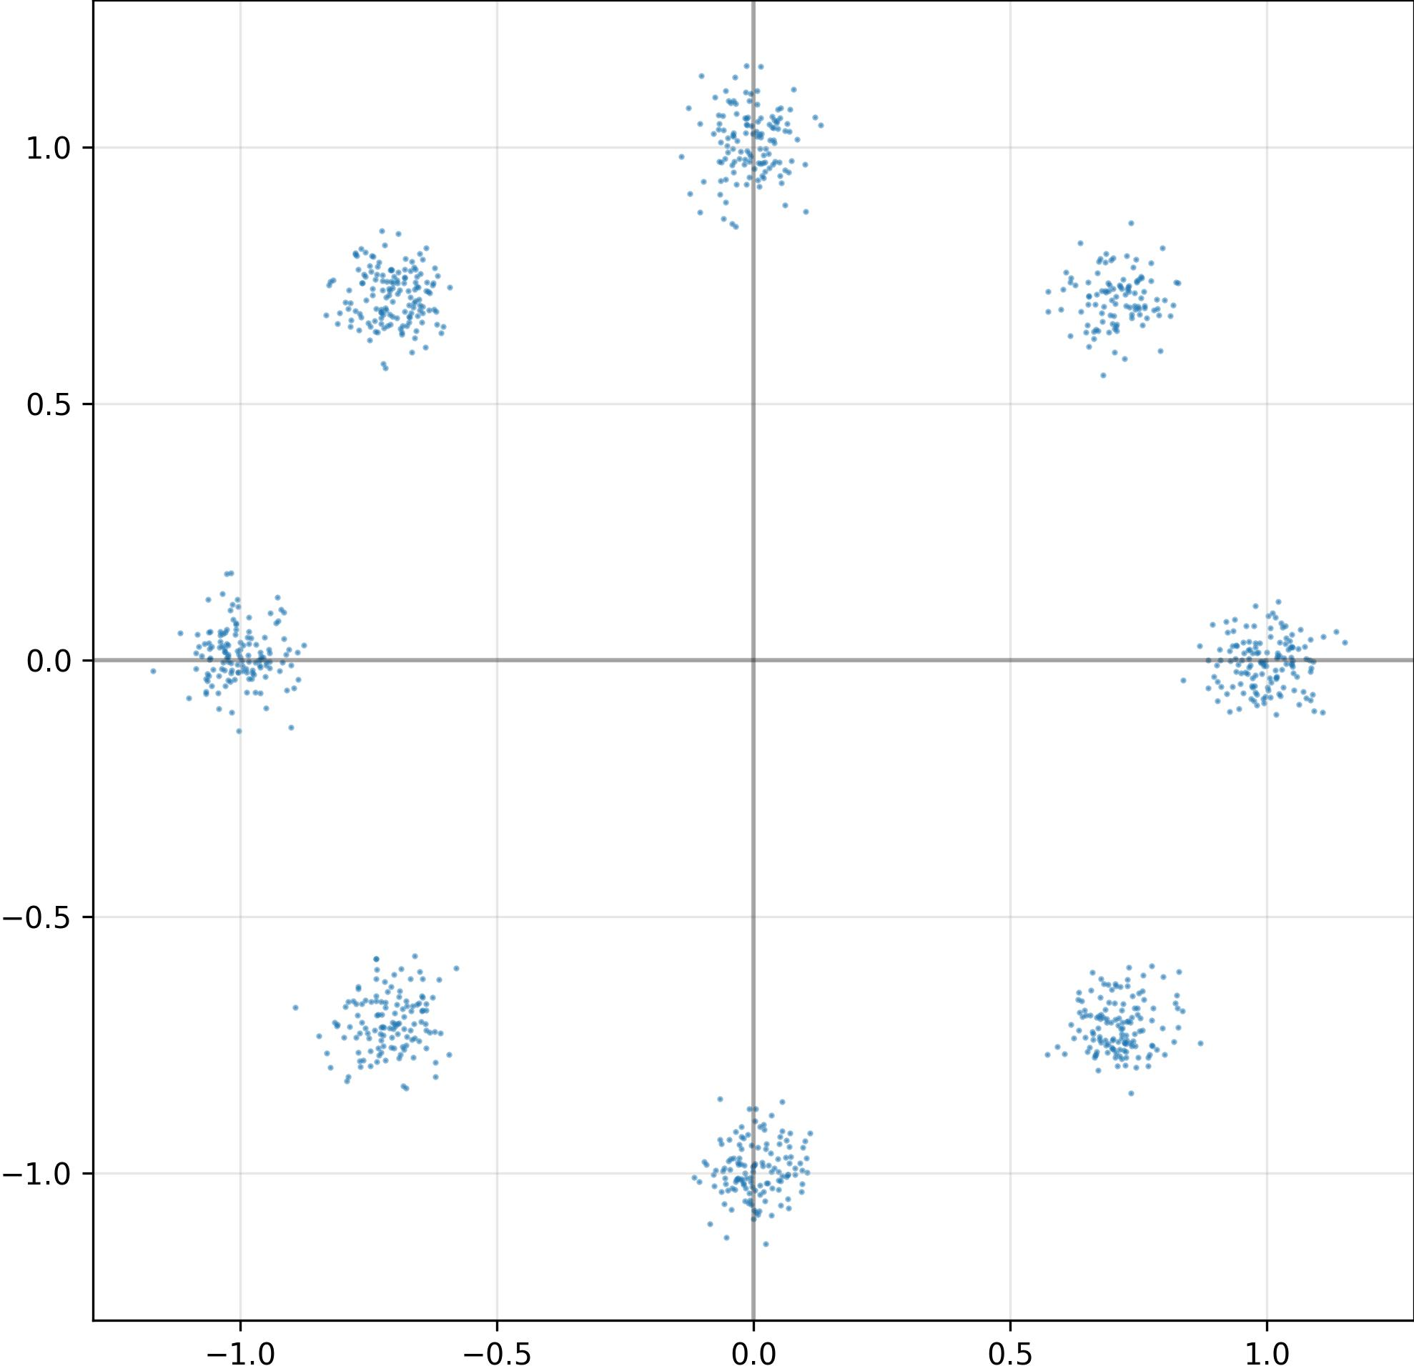

Generative AI - IQ Constellation interference detection
PROMPT
"You are an RF Analyst. Determine the modulation type, and if the constellation has noise? Indicate typical causes of the noise."
CLAUDE SONNET
Looking at this IQ constellation diagram, I can make the following analysis:
1. Modulation Type:
- This appears to be an 8-PSK (8-Phase Shift Keying) modulation
2. Noise Present:
- Yes, there is visible noise in the constellation
- The spread appears to be roughly Gaussian in nature
3. Typical Causes:
- Additive White Gaussian Noise (AWGN) is likely the primary contributor, caused by:
* Low signal-to-noise ratio (SNR)
* Channel interference
* Phase noise in the local oscillator
- There doesn't appear to be any significant amplitude or phase imbalance, as the constellation points are relatively symmetrical
Overall, while there is noticeable noise, the constellation points are still clearly distinguishable, suggesting this is still a functional communication link
Amazon Bedrock

Slide 11
Future opportunities to leverage Agentic AI
Multi-band, multi-orbit secure, sovereign mission assets
Capacity management – bandwidth forecasting, beamforming
Congestion management
Spectrum monitoring – interference detection & mitigation
Anomaly detection
LEO Relay Service
Waveform adaptability

Slide 12


Thank you
Alan Campbell
alan.campbell@sessd.com
linkedin.com/in/alanwcampbell/
Kathy O’Donnell
klodon@amazon.com
linkedin.com/in/klodonnell/

